Slide 1


TrustCheck
Proposed solution
Don't only ask “is this fake?”
Ask “should you act on this?”
Deepfake voices, face-swapped video calls and scam messages trick people into paying, sharing OTPs or clicking links. Detectors alone will always lag the next fake. TrustCheck checks the content AND its context, makes you verify with the real person, then turns the scam into evidence.
Detect
Decide
Fight back
Working prototype: a real-time 3D landing, the web console, a live-call guard and a phone page for the real person.
AI voice, face swap, AI image, scam text, bad links
Context vs the Trust Graph + what is being asked
Ask the real person, lock the payment, trap the scammer
PS 02: AI-Based Deepfake-Enabled Social Engineering Detection | Team Semicolons
Notes:
Open with the thesis. Detectors lose the arms race, process doesn't. The Arup case: a finance employee paid USD 25M after a deepfake video call with a fake CFO. TrustCheck answers: should you act on this? Three steps: detect, decide with context, verify and fight back. The screenshot on the right is our running prototype, which we demo live after the slides.

Slide 2
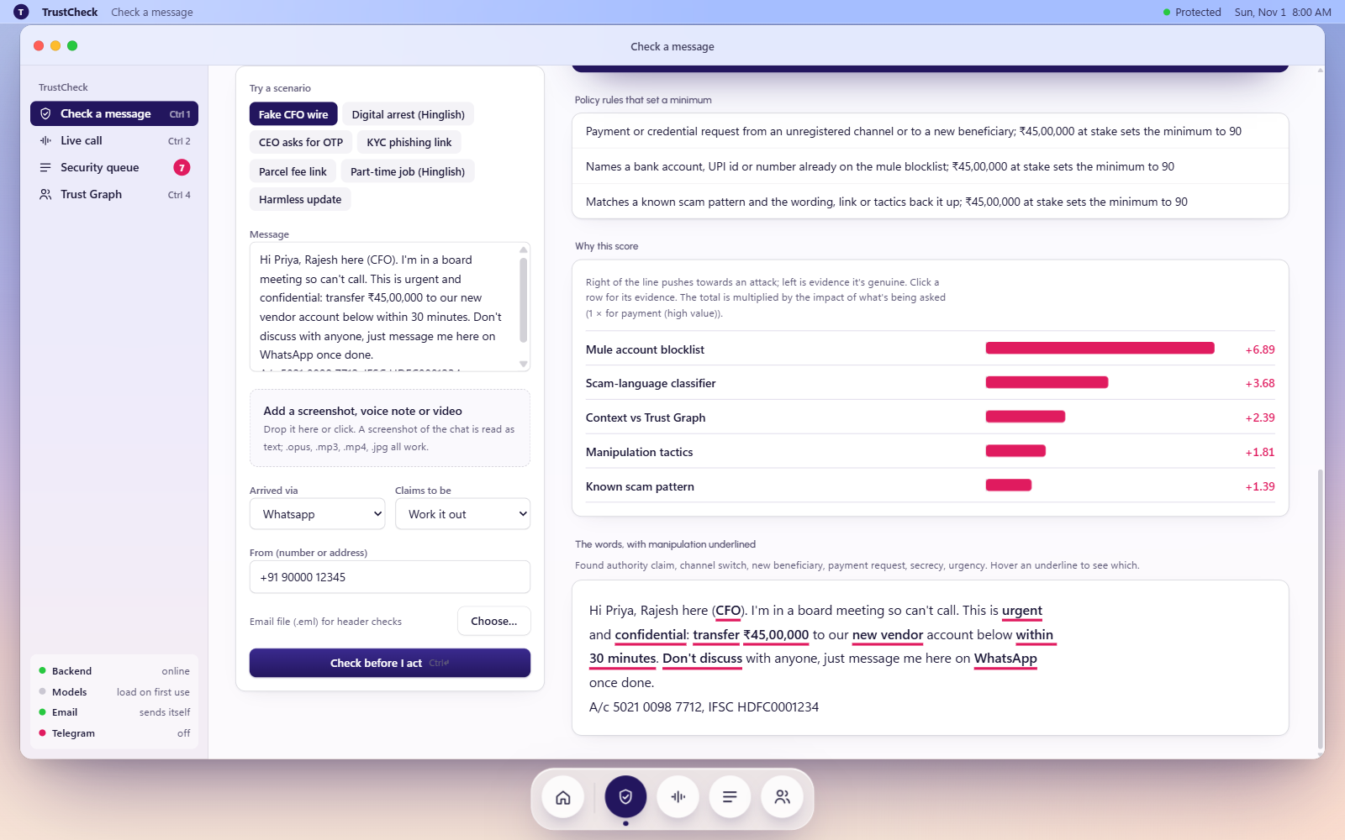
Technical approach
One pipeline for every input. Every detector explains itself; fusion weighs evidence by what is being asked.
1 Input
2 Detectors
3 Context
4 Fusion
5 Act
Message, chat screenshot (OCR), QR, voice note, video, image, live Meet/Zoom tab
Voice: pellav2 clone, ECAPA, Whisper
Video: GenD face swap
Image: UnivFD + C2PA
Text: semantic model, 24 scam types, link checks
Org Trust Graph: who uses which channel, hours, approval limit, registered numbers, face and voiceprint
Log-odds sum × impact of the ask, then policy floors (unregistered channel, mule account, bad link → never below HIGH)
Verdict + reasons, 30-min lock, real person alerted by email + Telegram, code word, Decoy Mode, CERT-In report
Risk = 100 × σ(b + Σ wᵢ · logit sᵢ) × Impact
Impact: 1.0 big payment / crypto, 0.9 install app, 0.8 OTP or password, 0.7 click link, 0.2 no action.
Same perfect deepfake: 9.8 for a birthday wish, 99.9 for a ₹45 lakh wire. Context beats pixels.
Explainable: each signal's push, every manipulation word underlined.
Notes:
Walk the pipeline left to right. Five stages. Detectors return a score and a reason each; missing ones are ignored, never penalised. Context from the Trust Graph. Fusion is log-odds, multiplied by the impact of what is asked, then hard policy floors so a perfect fake still lands HIGH when the request breaks policy. Stack: FastAPI, PyTorch on a 6 GB laptop GPU, React 19.

Slide 3
27 kinds of fraud, one check
3 deepfake media types + 24 scam types, plus phishing links, QR codes and known mule accounts on every check.
27
Digital arrest / fake police
Boss / CFO money ask
KYC / account block
Fake bank officer
Parcel / customs fee
Electricity disconnection
Fake e-challan / tax refund
Lottery / prize
fraud types detected, in English, Hindi and Hinglish
Task / part-time job
Investment / trading
Instant-loan app
Malicious APK install
AI voice clone
Remote access / tech support
'Sent by mistake' UPI
OTP account takeover
Sextortion
calls and voice notes
Face-swap video
Romance / gift parcel
Family emergency / new number
Drugs-in-parcel case
'Safe account' transfer
Meet / Zoom / WhatsApp
AI-made image
OTP / PIN / CVV ask
Inheritance / windfall
Pay-a-fee-to-receive
Personal data harvesting
fake IDs, proofs, posts
Notes:
How many frauds we catch: 27 types. Three deepfake media types: cloned voices, face-swapped video, AI-made images. Twenty-four scam types from the message engine, each with its own advice: digital arrest, boss or CFO money asks, KYC, parcel fees, job and investment scams, loan apps, APKs, sextortion and more. On top of that every check looks at links, QR codes and the mule blocklist.

Slide 4
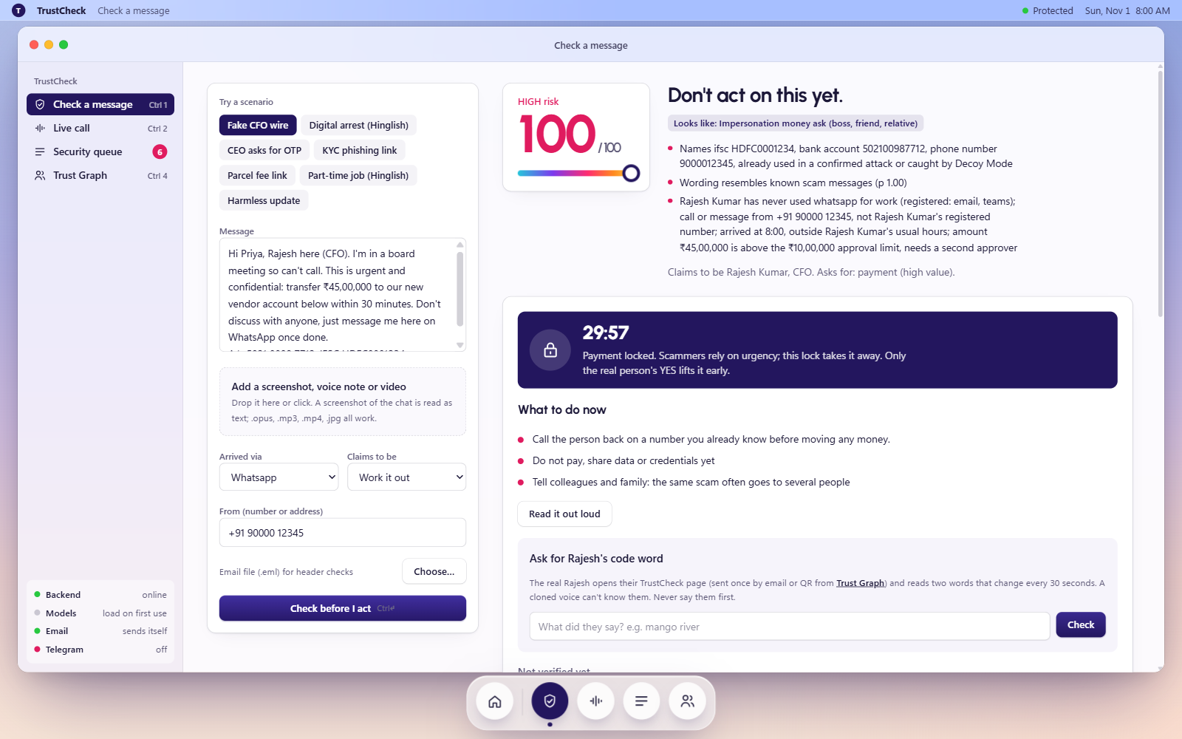
Feasibility: built, running, measured
Working prototype on one student laptop (RTX 4050, 6 GB). All numbers below were measured by us; limits stated.
120 / 120
97%
91%
0 / 60
AI voice clones caught
AI images caught
face-swap videos caught
real msgs flagged HIGH
incl. WhatsApp-compressed; 0.8% real voices flagged
after we retrained the head; 6% false alarms
3% real flagged (re-encoded: 88% / 35%)
73% of never-seen scams HIGH on first try
Why it is feasible today
Real verdict: fake CFO asks ₹45 lakh on WhatsApp → HIGH 100, payment locked 30 min.
6 AI models in 5.5 GB GPU; voice note ~2.5 s, video ~4.5 s
Live call: cloned voice HIGH ~12 s in, real speech LOW
Real person alerted on email + Telegram, QR as backup
Free, open models, offline; 44 edge cases pass
Honest limit: voiceprint alone accepted 100% of clones, so never trusted alone
Notes:
Feasibility is proven, not promised: everything runs on this laptop now. Read the four numbers and their honest limits. Voice: 120 F5-TTS clones of 40 speakers, all caught. Images: UnivFD head retrained, 11% to 97%. Video: GenD calibrated on 300 videos. Messages: 4 hand-written held-out sets, 58 of 80 scams HIGH at first sight, zero false HIGH. Point at the limitation: voiceprints are fooled by clones, which is exactly why our design asks the real person.

Slide 5
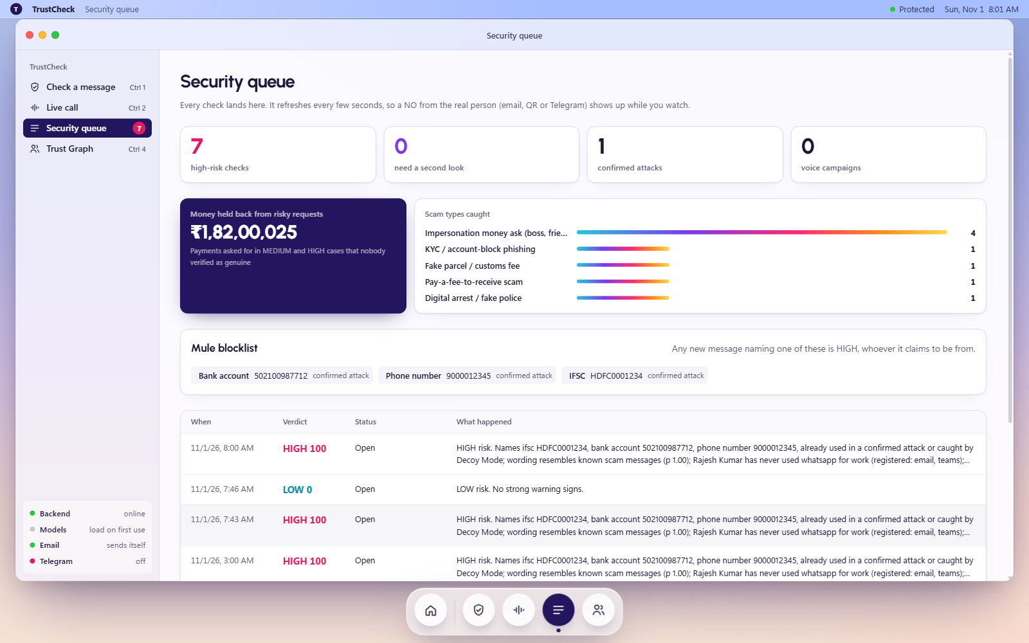
Impact and benefits
Stops the money before it moves, for companies and for ordinary people, in the languages India actually uses.
For employees and finance teams
Fake CEO / CFO asks for a wire or OTP: flagged, payment locked, real person asked on their phone.
For citizens
24 scam types incl. digital arrest, KYC, job, loan-app, sextortion; English, Hindi, Hinglish; 1930 shown.
For the security team
Live queue, money held back, voice campaigns linked, CERT-In 6-hour report in one click.
Privacy by design
Security queue (demo data): HIGH cases, confirmed attacks, rupees held back, scam types and the mule blocklist update live.
Uploads deleted after analysis, only embeddings kept, secrets never leave the server (DPDP).
Notes:
Three audiences: employees, citizens, security teams. The key benefit is time: the 30-minute lock removes the urgency every scam depends on. The dashboard shows money held back. Hindi and Hinglish because that is how these scams arrive in India. CERT-In needs incidents within 6 hours; we draft that report.

Slide 6
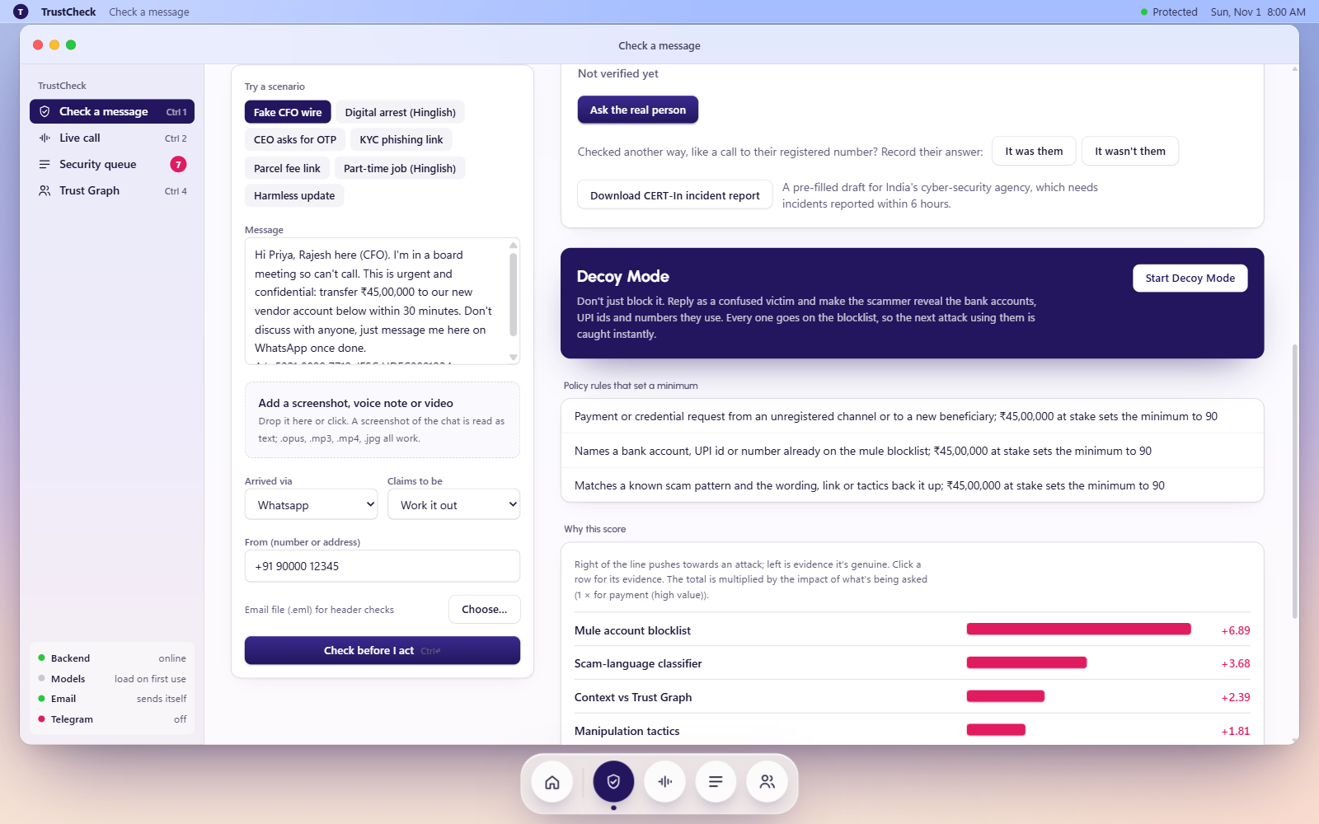
USP: every other tool defends. We fight back.
Five features no deepfake detector has, all built and tested in the prototype.
Decoy Mode
Mule blocklist
Replies as a confused victim (English or Hinglish) so the scammer reveals bank account, IFSC, UPI id and phone.
Every identifier caught goes on a blocklist; any later message naming it is HIGH, whoever it claims to be.
Human 2FA
Cooling-off lock
Code word: two words that change every 30 s on the real person's phone. A cloned voice can't know them.
HIGH payment requests are frozen 30 min; only the real person's YES releases them early.
Real person alerted: email + Telegram
On a HIGH case the real person instantly gets an email and a Telegram message with YES / NO. NO = confirmed attack, CERT-In draft.
Live call: every slice of the cloned voice red, six scam tricks heard.
Notes:
This is the slide to slow down on. Decoy Mode turns the scam into evidence: the scammer's own replies give us their mule accounts. Those go on the blocklist, so the next message using them is HIGH instantly. The code word is two-factor authentication for humans. The cooling-off lock takes away urgency. And the real person is alerted the moment a case goes HIGH: an email and a Telegram message with YES / NO buttons; NO marks a confirmed attack and drafts the CERT-In report. Then show it live in the prototype.

Slide 7
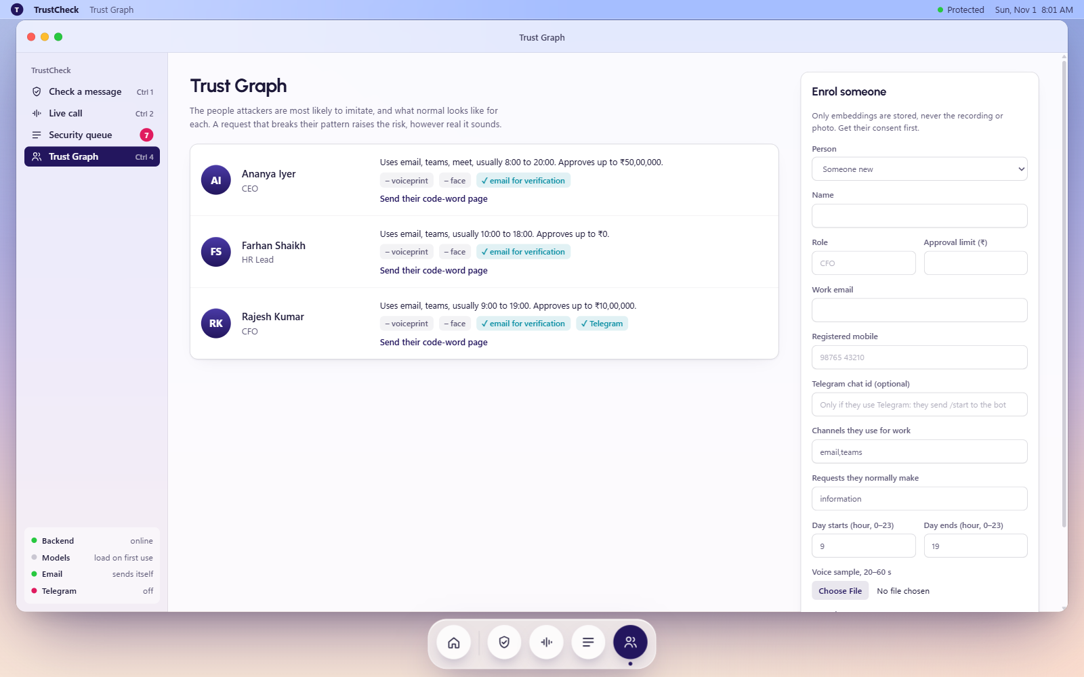
Future scope
What we build next, in order. Each one is already wired or scoped in the codebase.
LLM reasoning for brand-new scams
Claude API path is wired: it reads messages no rule has seen and explains why.
Stronger media models
Consented team clones and Deep-Live-Cam swaps for evaluation; second audio model, lip-sync.
Where people already are
Extension on Meet / Teams, WhatsApp Business and email plug-ins, mobile share-to-check.
Shared mule intelligence
Detectors will lose the arms race. Process won't.
Thank you. Live demo next.
Banks, UPI apps and CERT-In share the blocklist: one caught account protects everyone.
Notes:
Close with what comes next: LLM reasoning for scams no pattern covers, real consented deepfake evaluation, meeting the user inside Meet and WhatsApp, and a shared mule blocklist with banks and CERT-In. End on the thesis, then switch to the live prototype.

