Slide 1
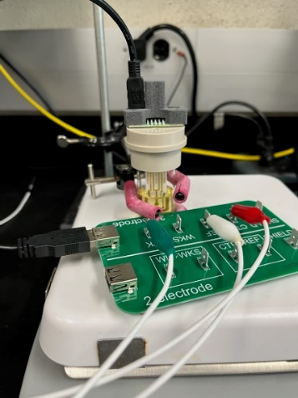
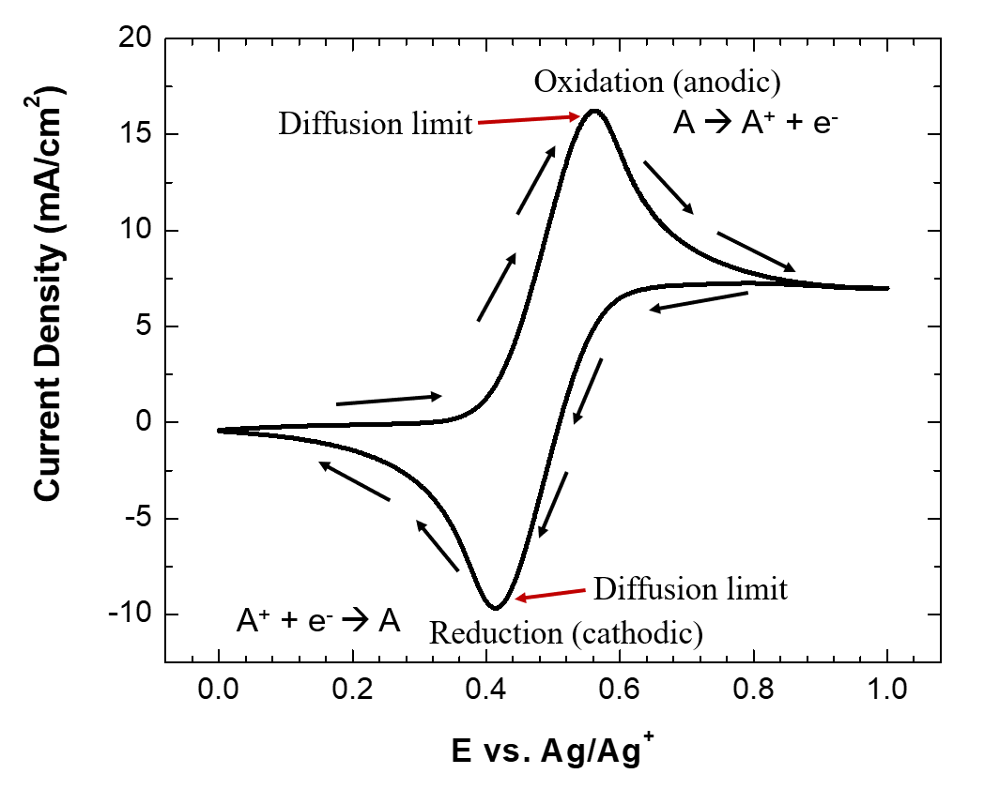
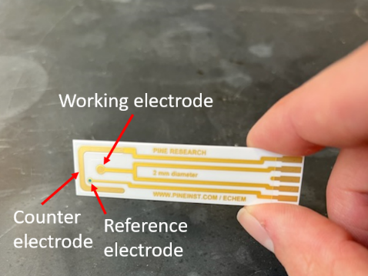
In the Mix experimental session

Slide 2
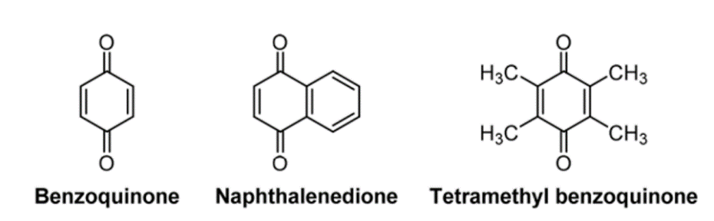
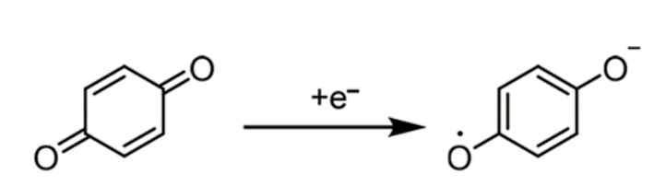
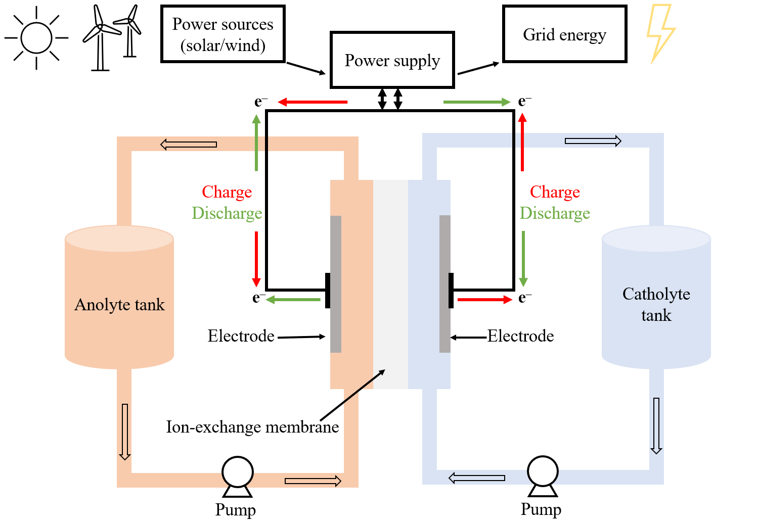
The three molecules we will be investigating
We will use cyclic voltammetry to determine the E_{1/2} value for each quinone derivative and connect chemical structure to redox potential.

Slide 3
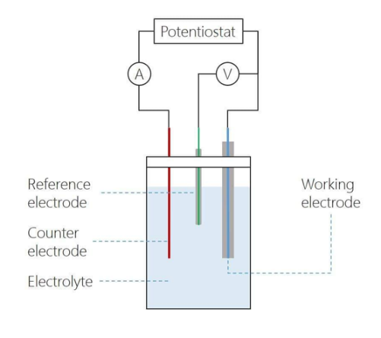
Analytical technique: cyclic voltammetry
Cyclic voltammetry is an electrochemical technique that measures current (A) as a function of an applied potential (V). It provides both qualitative and quantitative information on the redox processes of species.

Slide 4
CV Theory
∆G = -nFE
-
ELECTRODE
A → A⁺ + e⁻
E
HOMO of molecule A
Start E
A⁺ + e⁻ → A
+
3

Slide 5
CV Theory
∆G = -nFE
-
ELECTRODE
A → A⁺ + e⁻
Increase in current as A begins diffusing to electrode to undergo oxidation
E
HOMO of molecule A
Start E
A⁺ + e⁻ → A
+
3

Slide 6
CV Theory
∆G = -nFE
-
ELECTRODE
A → A⁺ + e⁻
Steady current increase as A diffuses to electrode and is oxidized
E
HOMO of molecule A
Start E
A⁺ + e⁻ → A
+
3

Slide 7
CV Theory
∆G = -nFE
-
Peak current
ELECTRODE
Peak current is reached as there is depletion of surface [A] and max mass transfer rate is reached. A begins to diffuse in from the bulk solution now.
A → A⁺ + e⁻
E
LUMO of molecule A⁺
Start E
A⁺ + e⁻ → A
+
3

Slide 8
CV Theory
∆G = -nFE
-
Peak current
ELECTRODE
A → A⁺ + e⁻
Decline in current as depletion of surface [A] sets in and the surface [A⁺] increases
E
LUMO of molecule A⁺
Start E
A⁺ + e⁻ → A
+
3

Slide 9
CV Theory
∆G = -nFE
-
Peak current
ELECTRODE
A → A⁺ + e⁻
E
LUMO of molecule A⁺
Start E
Surface becomes saturated with A⁺ and mass transport of A from the bulk reaches equilibrium
A⁺ + e⁻ → A
+
3

Slide 10
CV Theory
∆G = -nFE
-
Peak current
ELECTRODE
A → A⁺ + e⁻
E
LUMO of molecule A⁺
Start E
Switching potential, scanning in negative direction now
A⁺ + e⁻ → A
+
3

Slide 11
CV Theory
∆G = -nFE
-
Peak current
ELECTRODE
A → A⁺ + e⁻
E
LUMO of molecule A⁺
Start E
Increase in current as A⁺ begins diffusing to electrode to undergo reduction
A⁺ + e⁻ → A
+
3

Slide 12
CV Theory
∆G = -nFE
-
Peak current
ELECTRODE
A → A⁺ + e⁻
E
LUMO of molecule A⁺
Start E
Steady current increase as A⁺ diffuses to electrode and is reduced
A⁺ + e⁻ → A
+
3

Slide 13
CV Theory
∆G = -nFE
-
Peak current
ELECTRODE
A → A⁺ + e⁻
E
LUMO of molecule A⁺
Start E
Peak current is reached as there is depletion of surface [A⁺] and max mass transfer rate is reached. A⁺ begins to diffuse in from the bulk solution now.
A⁺ + e⁻ → A
Peak current
+
3

Slide 14
CV Theory
∆G = -nFE
-
Peak current
ELECTRODE
A → A⁺ + e⁻
E
LUMO of molecule A⁺
Start E
Decline in current as depletion of surface [A⁺] sets in and the surface [A] increases
A⁺ + e⁻ → A
Peak current
+
3

Slide 15
CV Theory
∆G = -nFE
-
Peak current
ELECTRODE
A → A⁺ + e⁻
E
LUMO of molecule A⁺
Start E
Surface becomes saturated with A and mass transport of A⁺ from the bulk reaches equilibrium
A⁺ + e⁻ → A
Peak current
+
3

Slide 16
CV Theory
∆G = -nFE
-
Peak current
ELECTRODE
A → A⁺ + e⁻
E
LUMO of molecule A⁺
Start E
Switching potential, back where we started
A⁺ + e⁻ → A
Peak current
Disclaimer: the energy of electrode and orbitals of molecules comes in the form of a band, so electrons move in the whole region of the orbital.
+
3

Slide 17
Important spots in the CV
Oxidation peak current & E
∆G = -nFE
∆G = ∆Gº + RTln(Q)
∆Gº = -nFEº
E_{1/2}
-nFE = -nFEº + RTln(Q) divide by -nF
Switching E
E = Eº - (RT/nF)ln(Q) Nernst equation
Start E
The E_{1/2} value is called the formal potential and is where the surface concentration of each species (A and A⁺) are equal. In the Nernst equation, this cancels out the second term, and E = Eº. This is what is reported experimentally for a redox couple.
Reduction peak current & E
4

Slide 18

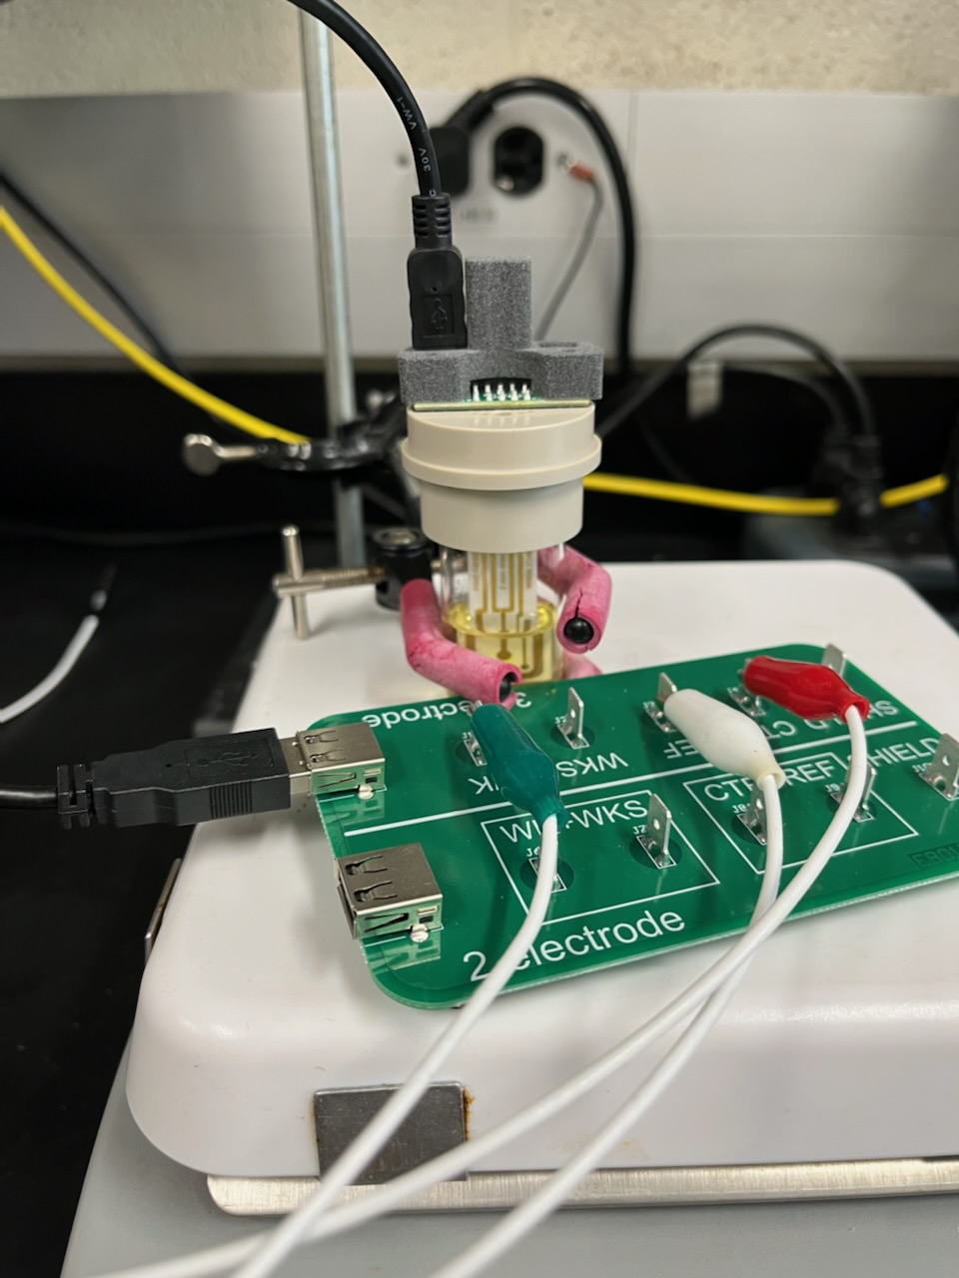
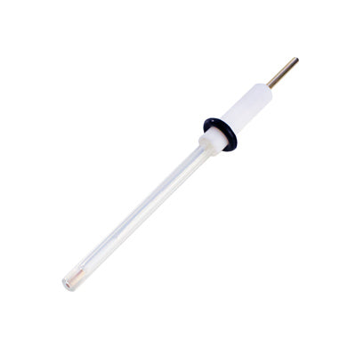
The screen-printed electrodes and setup we will use today
OR
An external Ag/Ag⁺ reference electrode for better results

