Slide 1
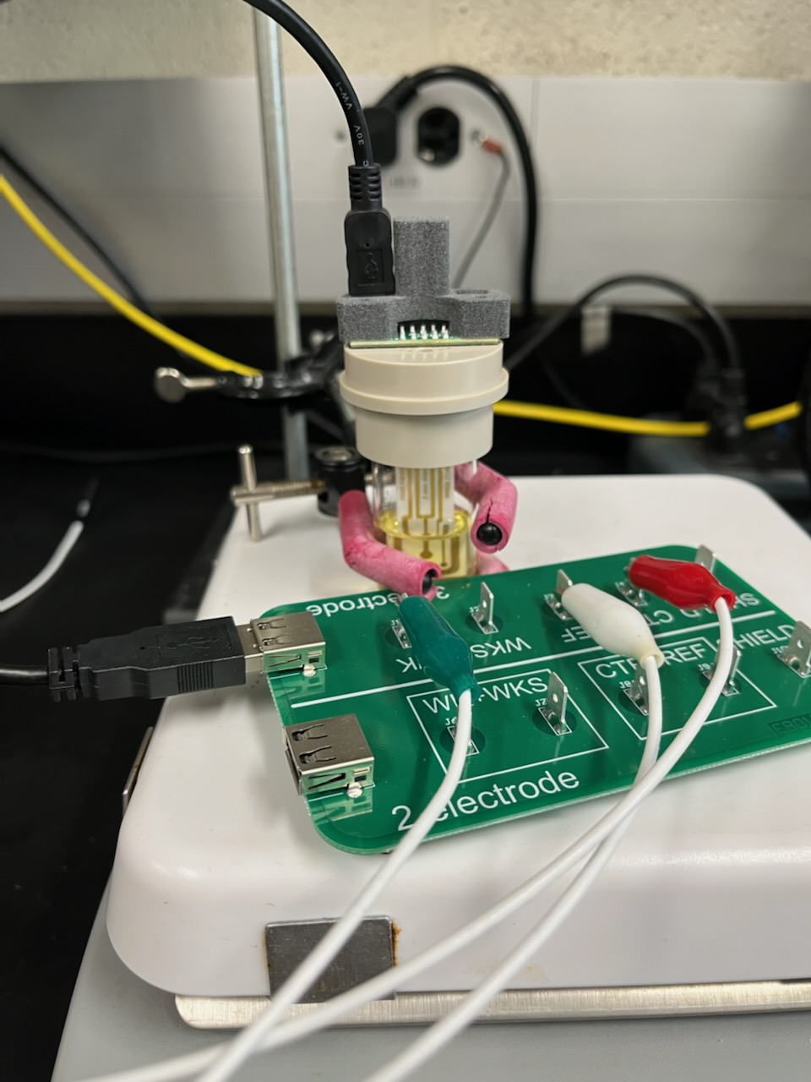
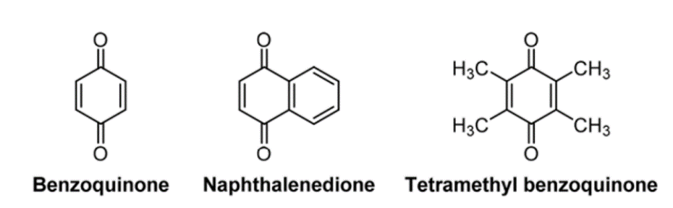
BQ
(100 mV/sec scan for each)
NQ
TQ
BQ
NQ
TQ

