Slide 1
FastUrduGuard
Integrated parallel & distributed computing with NLP for Urdu misinformation detection
Team: Sameer Asif (22I-0493) · Immad Shah (22I-0395)
Course: Phase-3 · Cluster 1 (PDC + NLP)
Repository: github.com/D3aThNdDeMiSe/FASTUrduGuard

Slide 2
Problem statement
Urdu is widely used yet under-served by English-centric moderation and detection tools.
False or misleading items spread quickly through text, memes, and Roman-Urdu social posts.
Manual fact-checking does not scale; automated pipelines must handle noisy text and low-resource settings.
Practical systems need fine-grained labels, explainability, and deployment-aware training — not lab-only accuracy.

Slide 3
Literature review — baseline (Islam et al., 2025)
Islam et al., "Unified LLMs for Misinformation Detection in Low-Resource Linguistic Settings," arXiv:2506.01587, 2025.
Introduces Urdu-LLD and strong binary {real, fake} results with six transformer encoders (e.g., mBERT, XLM-R).
Single-workstation, sequential training; limited discussion of Roman Urdu, multi-class labels, or explainability.
We adopt the same encoder families as a scientific control, but extend the problem setting and systems story.

Slide 4
Research objectives
Unify and clean multiple public Urdu corpora under one schema with careful deduplication.
Move beyond binary labels toward a four-way schema (Real, Fake, PartiallyFalse, Satire) with rule-based expansion.
Fine-tune six encoders and combine them with a validation-weighted ensemble for robustness.
Add explainability (attention + sentence-level LIME) and an inference-oriented evaluation path.
Exploit two consumer GPUs on separate networks using a Git-coordinated training and aggregation workflow.

Slide 5
Proposed solution — overview
Production-shaped pipeline: data fusion → multilingual preprocessing → distributed training manifests → metrics via Git.
Optional Federated-Averaging of small LoRA adapters where bandwidth is constrained.
Post-training: aggregator builds leaderboards/plots; benchmark and explanation scripts support demos.
Technical stack: PyTorch, Hugging Face Transformers/Trainer, PEFT-LoRA, scikit-learn metrics.

Slide 6
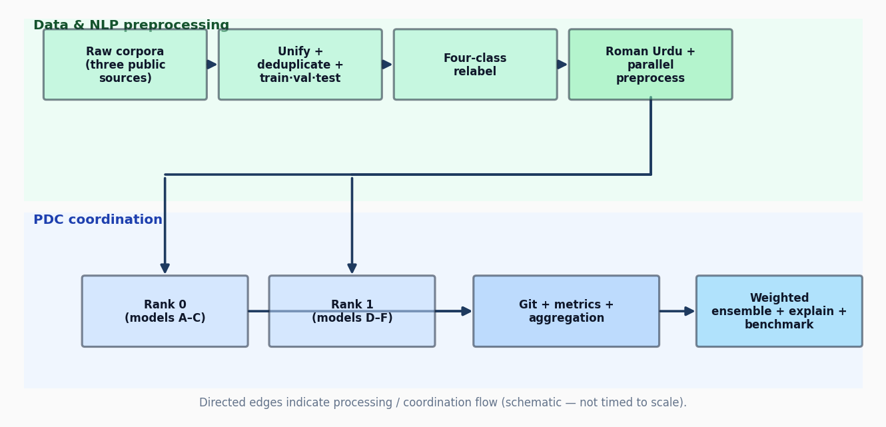
End-to-end workflow

Slide 7
Methodology — NLP
Unicode normalization (NFC), noise removal (URLs, HTML, elongated characters).
Roman-Urdu detection and lexicon-aided transliteration when Roman tokens dominate.
Stratified train / validation / test split on multi-class targets; multilingual tokenizers seq. length 256 (configurable).
Fine-tuning: AdamW, weight decay, warmup + linear decay; optional LoRA on larger encoders.

Slide 8
Methodology — PDC / coordination
Rank-specific model queues from coordinator/manifest.json (load-balanced by footprint).
Home / campus networks behind NAT: asynchronous Git pushes of lightweight metrics and artefacts.
GPU-serial scheduling per laptop (--placement_override gpu) avoids CPU contention from concurrent tokenization.
Aggregation job merges checkpoints/metrics locally for ensemble scoring and reproducible plots.

Slide 9
Challenges during implementation
Mixed-precision training: aligning Trainer AMP (fp16/bf16) with model dtypes to avoid scaler/clip failures.
Consumer GPU stack: limited or absent BitsAndBytes sm_120 support — fallback to BF16/FP16 + LoRA instead of NF4 everywhere.
Two-node parallelism without rendezvous TCP: GitOps choreography instead of classical NCCL collectives.
Class imbalance across four labels vs. headline-heavy corpora; weighted ensemble mitigates weak tail classes.

Slide 10
Comparison with the baseline approach
Labels: binary (Islam et al.) → four-way schema with explicit partial-fake and satire handling.
Data: single curated head-line set → unified multi-source corpus with hash-based cross-corpus deduplication.
Training: one machine sequential → two-rank manifest + Git-mediated coordination and optional FedAvg-of-LoRA.
Analysis: accuracy-focused reporting → ensemble, confusion analysis, explainability hooks, and inference benchmarks (to be finalized).

Slide 11
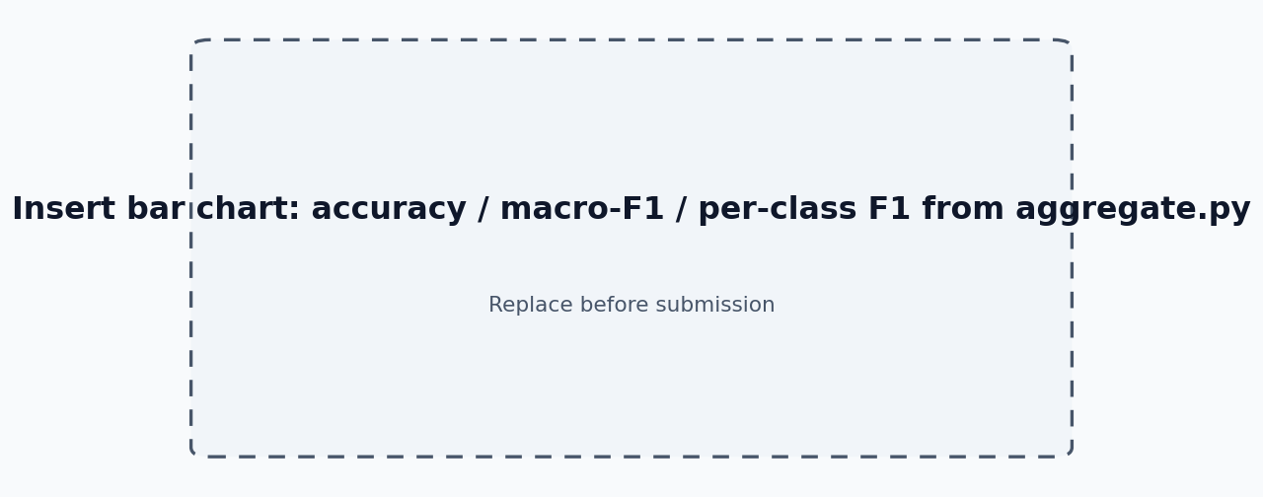
Results — model & ensemble performance (placeholder)

Slide 12
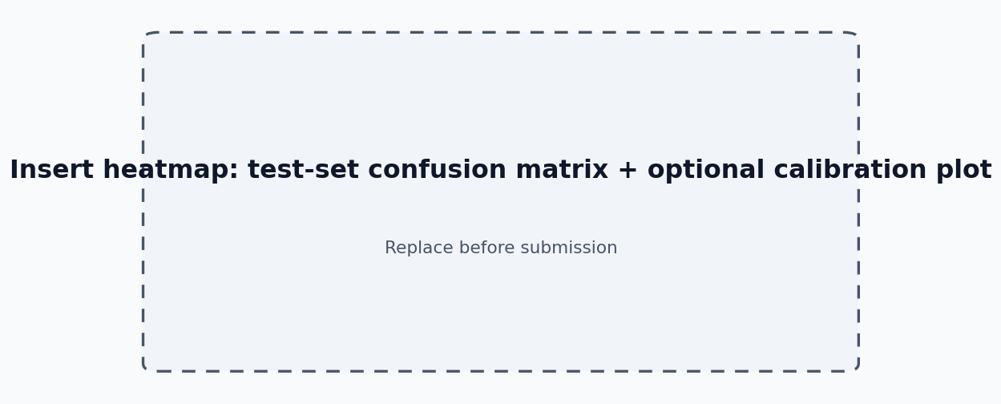
Results — confusion matrix & error analysis (placeholder)

Slide 13
Technical readiness & oral examination
Laptop with conda/venv mirroring repository requirements.txt; datasets available locally.
Trained checkpoints and parquet shards kept on-disk (large weights typically gitignored; metrics may be synced).
Prepared live paths: scripts/node_train.py, aggregate pipeline, benchmark and explain_demo entry points.
Thank you — questions welcome (Q&A guideline: approximately 5–7 minutes).

