Slide 1
PEECC
Implementation, Visualisation and Improvement
Pentatope-based Elliptic Curve Cryptography as the encryption core of an underwater-communication authentication protocol
Prasun Baranwal
Notes:
Overview: we implemented the PEECC cryptosystem of the base paper in C, visualised it, tested it, found a weakness and evaluated an improvement.

Slide 2
Problem and scope
M1-M3
M4-M6
M7-M9
M10-M12
UWS
SUB
B (buoy)
SAT
BS
Every message: E{ PU(receiver), ⟨ID ‖ Nonce ‖ Timestamp or data⟩ } = PEECC encryption
Scope of this work: the cryptographic core (PEECC of reference [18]) on the 2-D curve secp256r1
Not implemented: the 5-D curve of the UWC-N paper and the protocol layer (identities, nonces, timestamps, fallback)
Goals: implement, verify, visualise, assess security and performance, and propose an improvement
Notes:
The UWC-N protocol chains five entities; every message is encrypted with the receiver's public key using PEECC. We study that primitive.

Slide 3
PEECC algorithm (reference [18])
1 Key generation
2 Encryption
3 Decryption
d ∈ [1, N−1] (random)
Pub = d · B
S = x(x+1)(x+2)(x+3) / 24, x = B_x
K = S² + S + 41
C1 = K · B
C2 = P_m + K · Pub
P_m = C2 − d · C1
Why it works: d · C1 = d · K · B = K · Pub, so C2 − d · C1 = P_m + K·Pub − K·Pub = P_m
Notes:
Three procedures. The pentatope number S and Euler's polynomial give the key K from the generator's x-coordinate.

Slide 4
Implementation and validation
PEECC: keygen · encrypt · decrypt
13 / 13
self-tests pass (curve, keys, S and K values, 1000 round trips)
Koblitz encoding · pentatope S · Euler K
secp256r1
Point group: add · double · negate · double-and-add
GMP 6.3.0, 283 lines of C, no compiler warnings
Field F_p: add · sub · mul · inverse
2B matches the published curve value
Independent Python re-computation agrees
GMP big integers · OS random source
Notes:
Single C file on GMP. Layers from field arithmetic up to the PEECC functions. 13 self-tests pass, including the published 2B value of secp256r1.

Slide 5
Worked example: “hello world”
Plaintext
Koblitz point P_m
Encrypt
Ciphertext
Decrypt
11 bytes
68 65 6c 6c 6f 20 77 6f 72 6c 64
x = 0x168656c6c…6c6401
(message bytes are visible inside x)
S: 1015 bit
K: 2029 bit
C1 = K·B, C2 = P_m + K·Pub
C1.x = 681dc236…c19f4f
1024 bit = 128 bytes
P_m = C2 − d·C1
“hello world” MATCH
Private key d (250 bit) and C2 change in every run; P_m, S, K and C1 do not
C1 = 681dc236…c19f4f was identical in both recorded runs, with different keys
Notes:
Values are from one run of peecc.exe; an independent Python implementation reproduced S, K, Pub, C1, C2 and the decryption.

Slide 6
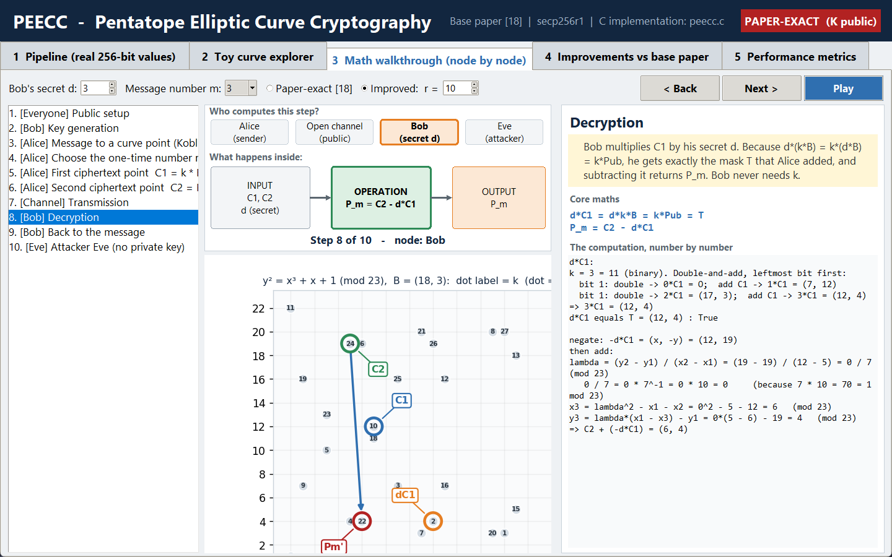
Visualisation tool
Pipeline: real 256-bit values, animated
Toy curve: every point visible
Math walkthrough: each node, every number
Improvements and metrics: live measurements
Screenshot: decryption step of the math walkthrough
Notes:
Python GUI with five tabs. The math walkthrough shows every number of the computation node by node.

Slide 7
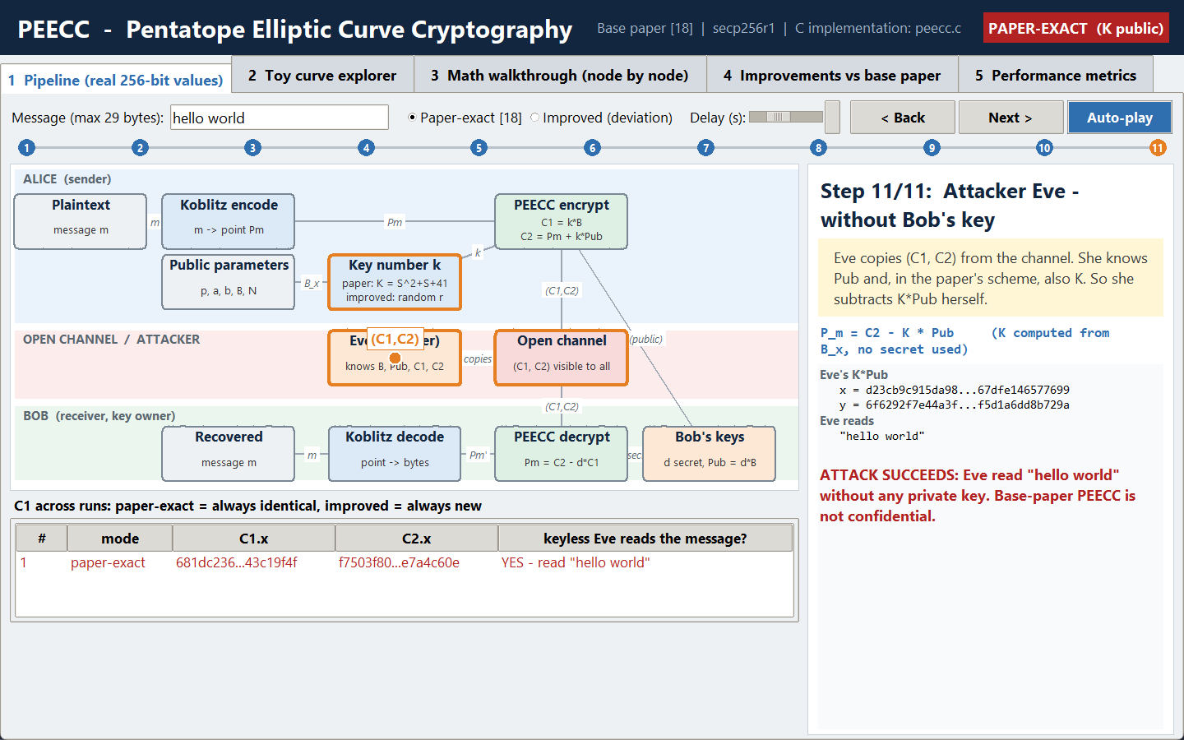
Finding: the key K is public
K is derived only from the public generator B
Any observer computes P_m = C2 − K · Pub without the private key
C1 = K · B is the same for every message
Encryption is deterministic
Screenshot: Eve recovers “hello world” without d
Notes:
K depends only on B, which everybody knows, so anyone can subtract K*Pub. Shown numerically and in the GUI.

Slide 8
Improvement: one-time random r
Base paper [18]
Improved (deviation from [18])
k = K = S² + S + 41
k = r, random in [1, N−1]
computed from public B
fresh secret for every message
C1 constant, ciphertext repeatable
C1 and C2 differ every time
Eve: C2 − K·Pub = P_m
Eve: C2 − K·Pub ≠ P_m
Decryption is unchanged: d·C1 = d·r·B = r·Pub
Also added: check that C1, C2 lie on the curve before use
Notes:
r replaces K in the same two formulas. Bob decrypts exactly as before because d*(r*B) = r*Pub; r is never sent.

Slide 9
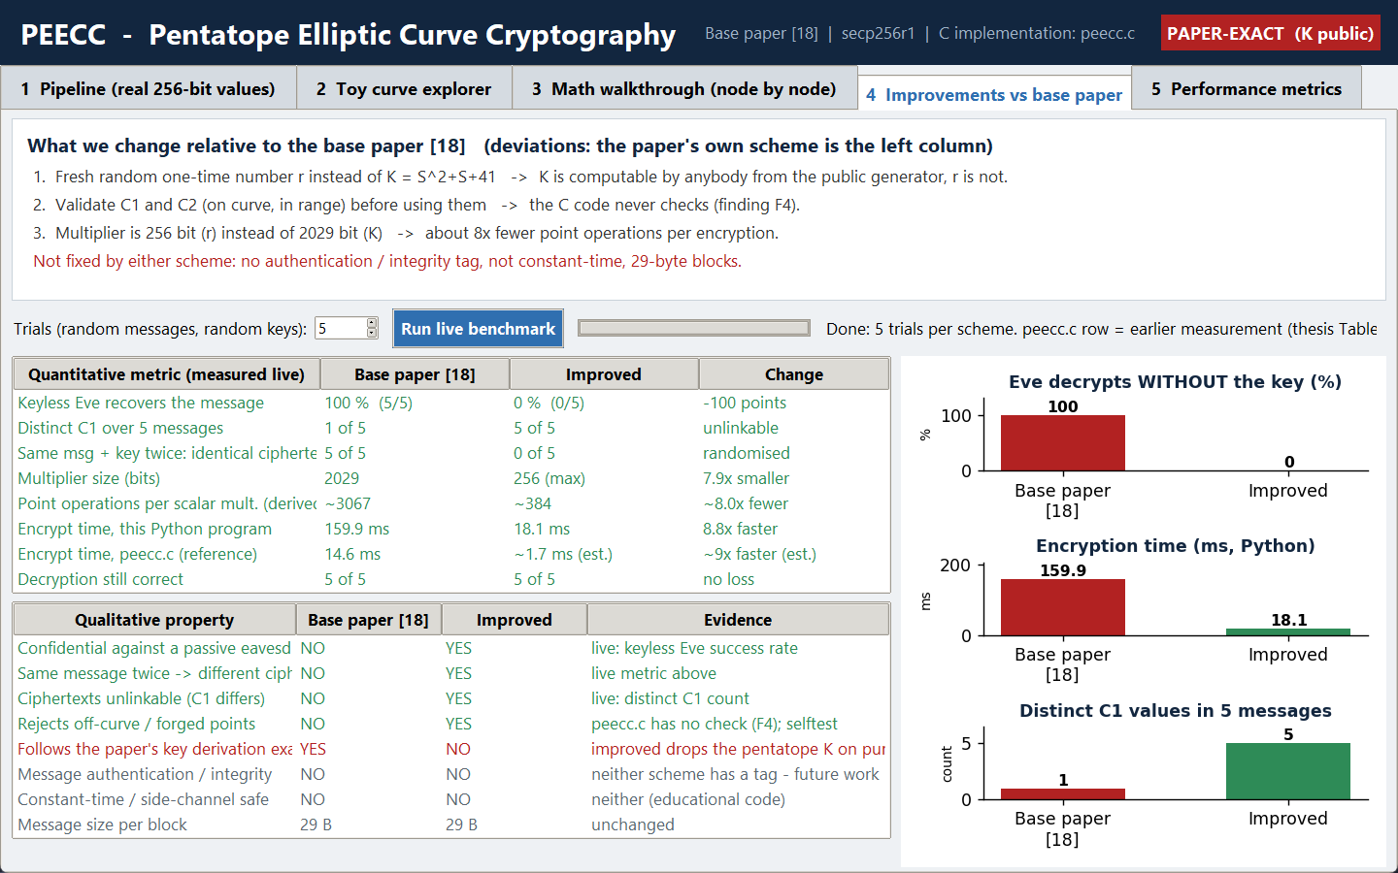
Results: base paper vs improved
100% → 0%
keyless eavesdropper recovers the message (5/5 → 0/5)
1 → 5
distinct C1 values in 5 messages
≈ 8× fewer
point operations per multiplication: ~3067 → ~384 (2029-bit K vs 256-bit r)
C implementation: encryption 14.6 ms measured; ≈ 1.7 ms expected with a 256-bit multiplier
Notes:
Live benchmark in the GUI, 5 random messages and keys per scheme. Encryption times in C are from the earlier peecc.c measurement; 1.7 ms is an estimate of two 256-bit multiplications.

Slide 10
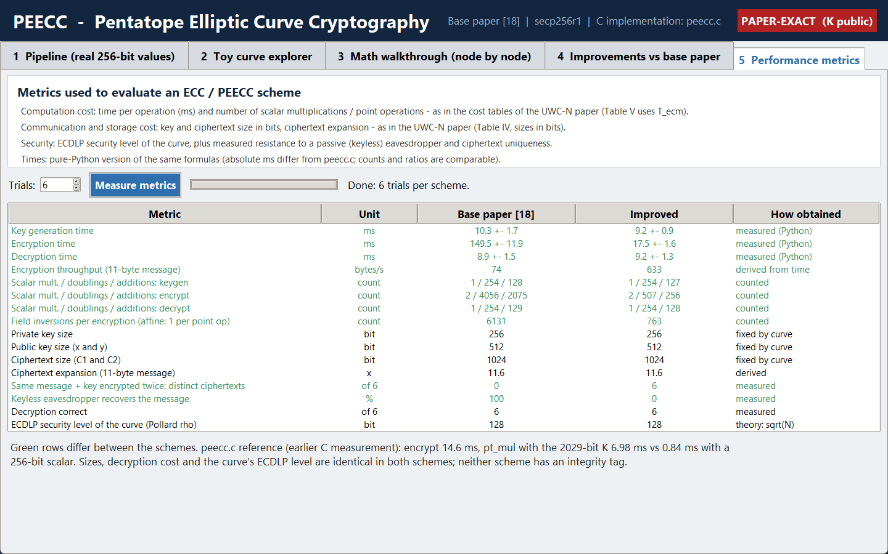
Performance metrics and conclusion
PEECC implemented and verified: 13/13 tests
Paper-exact scheme is not confidential: K is public
Random r restores confidentiality and cuts encryption work about 8×
Key and ciphertext sizes (256 / 512 / 1024 bit) and decryption cost unchanged
Not addressed: integrity tag, constant-time code, 29-byte block limit, protocol layer.
Notes:
Metrics: operation time, scalar multiplications and point operations, key and ciphertext sizes, uniqueness and eavesdropper success. Sizes and decryption cost are identical in both schemes.

