Slide 1
Session-1
Introduction to Machine Learning

Slide 2
What is Machine Learning?

Slide 3

Humans can learn from past experience and make decision of its own
3

Slide 4
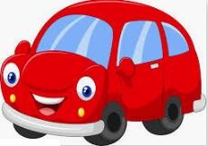
What is this object?
4

Slide 5
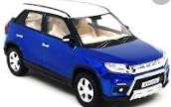

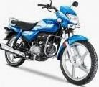
What is this object?
CAR
CAR
It is a CAR
BIKE
BIKE
5

Slide 6

Let us ask the same question to him
What is this object?
6

Slide 7


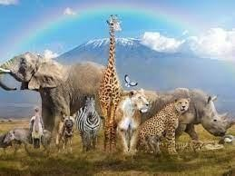
Let us ask the same question to him
?
What is this object?
7

Slide 8

Let us make him learn
show him
8

Slide 9
Let us make him learn
CAR
show him
CAR
BIKE
BIKE
9

Slide 10
Let us ask the same question now
What is this object?
CAR
CAR
BIKE BIKE
Past experience
10

Slide 11

Let us ask the same question now
CAR
What is this object?
CAR
CAR
BIKE BIKE

Slide 12

What about a Machine ?
Machines follow instructions
[ It can not take decision of its own]

Slide 13
What about a Machine ?
We can ask a machine
To perform an arithmetic operations such as
Addition
Multiplication
Division
Machines follow instructions

Slide 14
What about a Machine ?
Comparison
Print
Plotting a chart
Machines follow instructions

Slide 15
What is Machine Learning?
Machine learning is a subfield of artificial intelligence, which is broadly defined as the capability of a machine to imitate intelligent human behavior

Slide 16

Applications?
[ to identify this object.]

Slide 17
Applications?
Price in 2025?
[predict the price in future]

Slide 18
What is Machine Learning?
I made met him yesterday
[ Natural Language comprehension, resulting in correct grammar ]

Slide 19

Applications?
Ayush?
[ Recognize Faces ]

Slide 20
Applications?
What do we do?
Just like, what we did to human, we need to provide experience
to the machine.

Slide 21
What is Machine Learning?
[This what we call as Data or Training dataset
We first need to provide training dataset to the machine]
+
Dataset

Slide 22

What is Machine Learning?
+
+
[ Then, devise algorithms and execute programs on the data
With respect to the underlying target tasks ]
Dataset

Slide 23

What is Machine Learning?
+
+
+
[ Then, using the programs, Identify
required rules ]
Dataset

Slide 24

What is Machine Learning?
+
+
+
[extract required patterns ]
Dataset

Slide 25

What is Machine Learning?
+
+
+
Dataset
[ Identify relations ]

Slide 26
+
What is Machine Learning?
+
+
=
[ So that machine can derive inferences
from the data ]
Dataset

Slide 27


In summary, what is machine learning?
Given a machine learning problem
Identify and create the appropriate dataset
Perform computation to learn
Required rules, pattern and relations
Output the decision

Slide 28
Machine Learning Paradigms
Supervised
Unsupervised Learning
Reinforcement learning
[ We as human being solve various types of problem in our day-to-day life, <pause> Various decisions need to be taken.
Depending on the nature of the problem, machine learning tasks can be broadly divided in ]

Slide 29
What is Supervised Learning?

Slide 30
What is Supervised Learning?
CAR
+
CAR
₌ Training Dataset
BIKE
BIKE
Samples
Labels
[In supervised learning, we need some thing called a Labelled Training Dataset ]

Slide 31
What is Supervised Learning?
CAR
+
CAR
₌ Training Dataset
BIKE
BIKE
𝑓( , )=
Samples
Labels
[ Given a labelled dataset, the task is to devise a function which takes the dataset, and a new sample, and
produces an output value.]
31

Slide 32

What is Supervised Learning?
CAR
+
CAR
₌ Training Dataset
BIKE
BIKE
𝑓( , )=
Samples
Labels
[ Given a labelled dataset, the task is to devise a function which takes the dataset, and a new sample, and
produces an output value.]
32

Slide 33
What is Supervised Learning?
CAR
+
CAR
₌ Training Dataset
BIKE
BIKE
𝑓( , )= CAR
Samples
Labels
[ Given a labelled dataset, the task is to devise a function which takes the dataset, and a new sample, and
produces an output value.]
33

Slide 34
What is Supervised Learning?
CAR
+
CAR
₌ Training Dataset
BIKE
Classification
𝑓( , )= Car
BIKE
Samples
Labels
[ If the possible output values of the function are predefined and discrete/categorical, it is called
Classification]
33

Slide 35
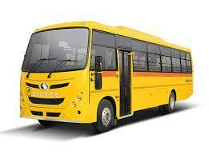
What is Supervised Learning?
CAR
+
CAR
₌ Training Dataset
BIKE
Classification
𝑓( , )= CAR
BIKE
Samples
Labels
[ Predefined classes means, it will produce output only from the labels defined in the dataset. For example,
even if we input a bus, it will produce either CAR or BIKE ]

Slide 36
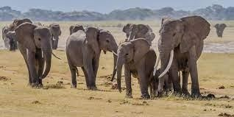
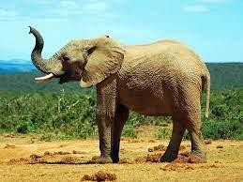
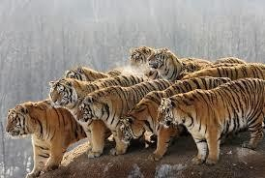
Classifier
Elephant
Tiger
Elephant
Classifier
Identify the Animal ?
Dataset

Slide 37
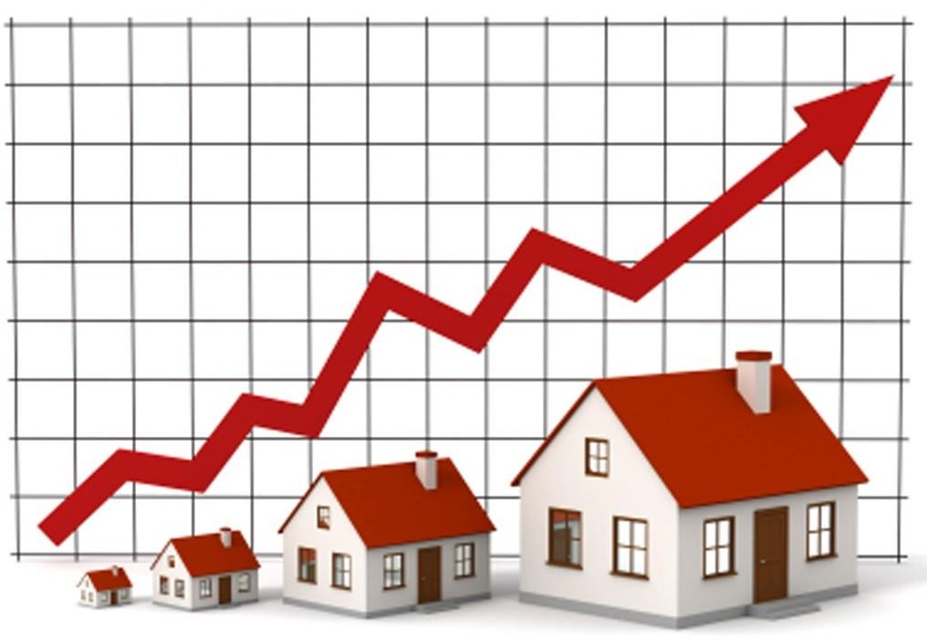
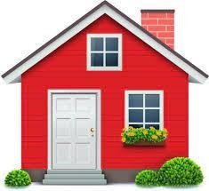
Regression
Regression
𝑓( , )=$20000.50
Dataset
[ If the possible output values of the function are continuous real values, then it is called Regression

Slide 38
What is Unsupervised Learning?

Slide 39
What is Unsupervised Learning?
CAR
CAR
BIKE BIKE
Dataset
[ In the unsupervised learning, we do not need to know
the labels or Ground truth values ]

Slide 40
What is Unsupervised Learning?
Clustering
Dataset
[ The task is to identify the patterns like group the similar objects together ]
39

Slide 41

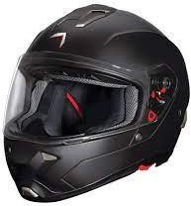
What is Unsupervised Learning?
Dataset
Association Rules Mining

Slide 42
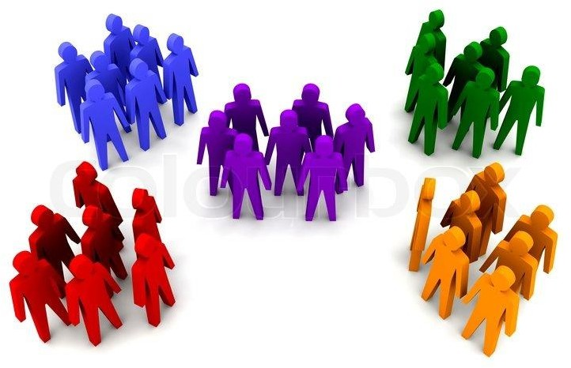
More Example on Unsupervised Learning
Dataset

Slide 43
More Example on Unsupervised Learning
Dataset

Slide 44


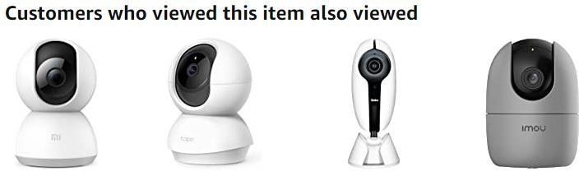
More Example on Unsupervised Learning

Slide 45
What is Reinforcement Learning?

Slide 46


What is Reinforcement Learning?

Slide 47

What is Reinforcement Learning?

Slide 48


What is Reinforcement Learning?

Slide 49
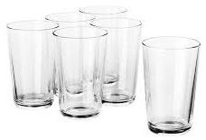





Another Example
Agent
Task
Environment

Slide 50

Reinforcement Learning
Punishment

Slide 51

Reinforcement Learning
Reward

Slide 52
Reinforcement Learning
Reward
Baby Learns from the Trials and Errors
Reinforcement Learning

Slide 53
Summary
What is Machine Learning?
Supervised Learning
Unsupervised Learning
Reinforcement Learning

