Slide 1

Data Input Control Tutorial
Umer Mohammed
Data Input Control – Date: 24/07/2023

Slide 2
Program Information
Program was developed to help input and format data
Reduces Human Error
Increases Data Input speed as formatting is done automatically.
Allows for universal understanding of required data
Scalable
Built on C# Visual studio 2022 .net Framework

Slide 3
Installation Process Availability
Built for Windows only
Available on GitHub here
Require Visual Studio 2022
Uses C#
Created on .NET 6.0 Framework
Note: when launching on visual studio, could require a certificate to be signed, go to project properties and either create new certificate or sign existing one. Password is test123

Slide 4
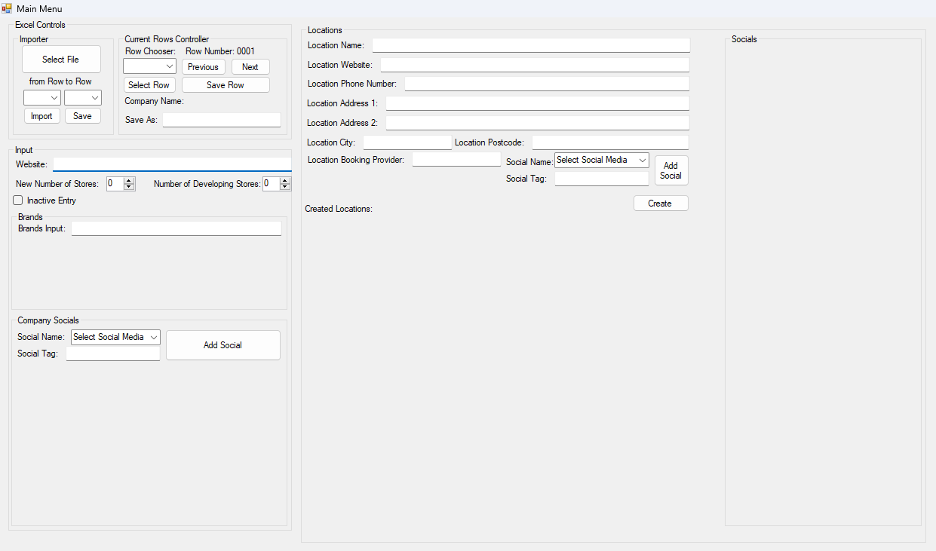
Program Layout
The program is laid out in order of what data would most likely be found first.
Overview:
You import the excel file, choose the rows you want then insert it into the program.
You then add data as you wish, using the buttons next and previous to scroll between the data, and then save the data as either the file you imported or a new data file.

Slide 5
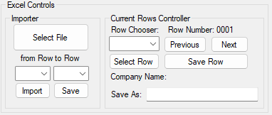
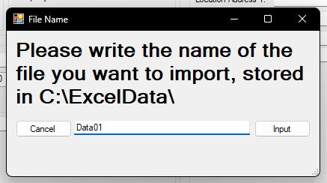
Import Data File
Ensure the file you want to edit is an xlsx file and is stored on the local C drive in a folder called ExcelData.
Click on the Select File button, a popup will appear.
Put in the name of the file you want to import. (See Image 2 for reference)
Upon a successful import, you should get a confirmation popup saying “Successfully got the rows for the file, choose what rows you want to insert”, Click “Okay”

Slide 6
Import Data File
Ensure the file you want to edit is an xlsx file and is stored on the local C drive in a folder called ExcelData.
Click on the Select File button, a popup will appear.
Put in the name of the file you want to import. (See Image 2 for reference)
Upon a successful import, you should get a confirmation popup saying “Successfully got the rows for the file, choose what rows you want to insert”, Click “Okay”

Slide 7
Import Data File
Now, you should choose from what row to what row of the excel sheet you want to import.
Use the dropdowns located above the Import and Save buttons.
Once selected, click on the import button, the code will then import the data, you should receive a confirmation message saying, “Successfully inserted data”.

Slide 8
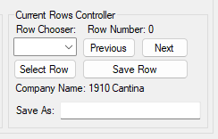
Rows Controller
The rows controller allows you to do multiple things
Previous: Allows you to go back one row from the current one you are editing. (Saves the data when pressed)
Next: Allows you to go forward one row from the current one you are editing. (Saves the data when pressed)
Select Row: Works with the dropdown above the button, choose the specific numbered row you want to edit and then click select row, which will then take you directly to that row.
Save Row: Save row saves the current row you’re editing, mainly used if you don’t want to lose location data by accident.
Save As: Simply put the name of the file you want to save the data as in here in order to save the data in a specific slot, otherwise it will overwrite the imported data file.
Note there is no "undo", but you can re-edit rows if you make a mistake. This is one reason for having a backup file you can use if you overwrite something.

Slide 9
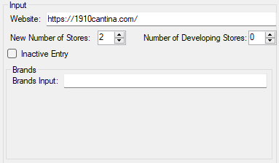
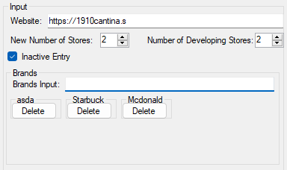
Input
Website: Is the website used by the company. The program would automatically format the website, copy and pasted from Web Browser and checks the format
New Number of Stores: The number of stores for this company, as indicated from online
Number of Developing Stores: The number of stores being developed by the company.
Inactive Entry: Tick here if the data row is invalid, Example could be the company went bankrupt.
Brands: the brand franchises the company operates, for example McDonalds, or Starbucks. Write the name of the brand, and then press enter for it to be processed, you can add as many as you want, as you add they appear below the input, you can always delete a brand using the delete button that pops up below it.

Slide 10
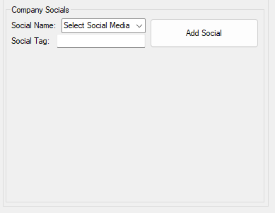
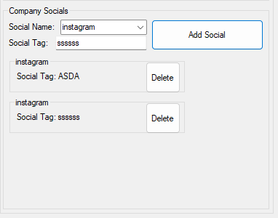
Company Socials
Social Name: The name of the social media the company use, we have a dropdown system to ensure no human error with spelling mistake for social media companies.
Social Tag: The tag for the social media account, Do not include “@” when you enter the tag.
The company socials are stored in a list, so if there are two entries for Facebook, enter them separately, however in the data file it will appear as, for example Facebook[“Test50”,”Test 20”], this is to allow multiple company accounts and reduce repeating social company names throughout the dataset.
Duplicate Socials are automatically deleted.

Slide 11
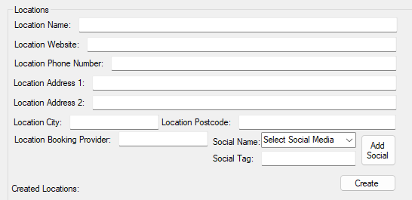
Locations
Location Name: The name of the location, not the company name.
Location Website: The specific locations website, Must be an independent website (eg https://www.bluebearinn.com/), not a page of a company website, (eg not www.asda.com/Loughborough).
Location Phone Number: The phone number of the location in any of a range of foramts, such as +44 (0) 20 21232142 or (0) 20 21232142 or 020 21232142 or 02021232142, the code will automatically format and split the number into area code, and number, removing everything we don’t need, then storing it in the location as Location_Number[“020”, “232142”]
Location Address 1, 2: The street number of the building goes into address 1, and then area or county goes into address 2.
Location City: The city where the location is based.
Location Postcode: The postcode for the location, will always get rid of special characters and autoformat the postcode for the ending 3 characters to split off.
Location Booking Provider: The booking provider for the location, such as DesignMyNight, or ResDiary.

Slide 12
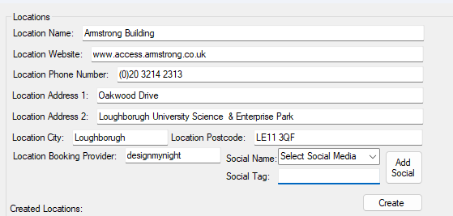
Location Example
Here is an example of how location should be filled out

Slide 13
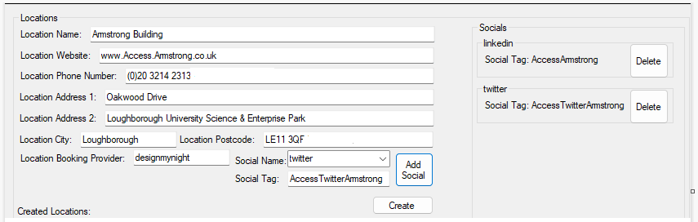
Location Socials
Location Socials work similarly to company socials, in that they are stored the same and have the same delete function and design, however these are different as they are specific to each location, and are stored as such.

Slide 14
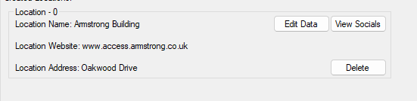
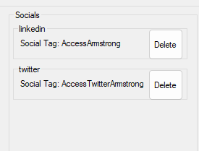
Created Location
How the created location should appear
Edit Data: Used to edit the data, should open up a control panel allowing you to edit the data. This will clear all fields currently in the location, so make sure its empty before editing another location
View Socials: See image 2, will allow you to display the socials for this location
Delete: Will delete the location data. Warning, cannot be undone.

Slide 15
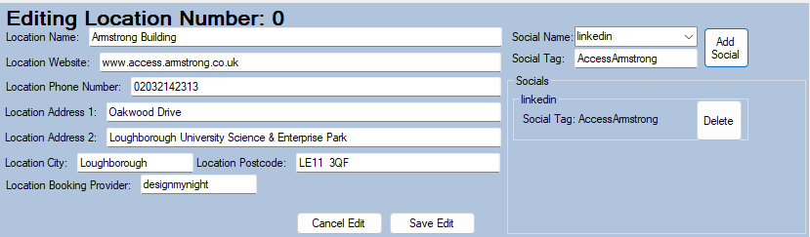
Editing Location
The same principles as with creating the location, however this is just editing. All the same rules apply.

Slide 16
Brush Up
The program has tool tips for each input, giving you information and warnings if you ever get confused.
There is a lot of auto validation, and formatting, so its always best to check what the tooltip recommends.
(This is my very first tutorial, I’d like feedback on how to improve it.)

