Slide 1

The problem
Finding the door and it’s button

Slide 2
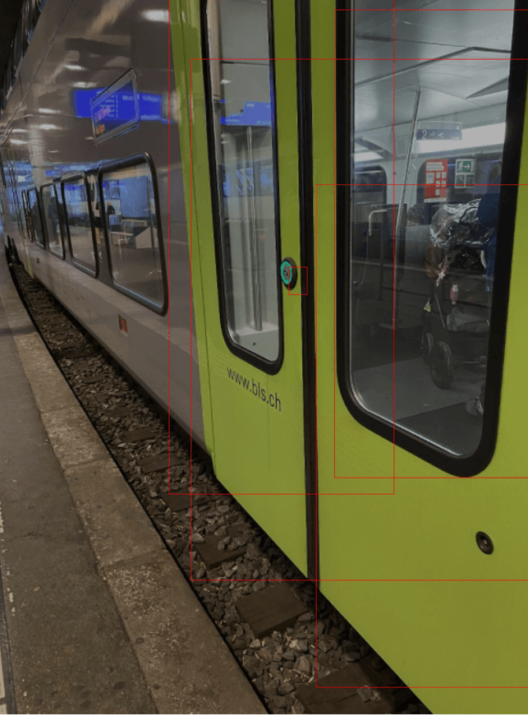
A solution : the SBB Inclusive App
Building a train door button detector

Slide 3
But what about…
Crowd gets in the way
First / second class
User eXperience
Hands are full
Need to point the phone in the direction of an object she/he can’t see

Slide 4
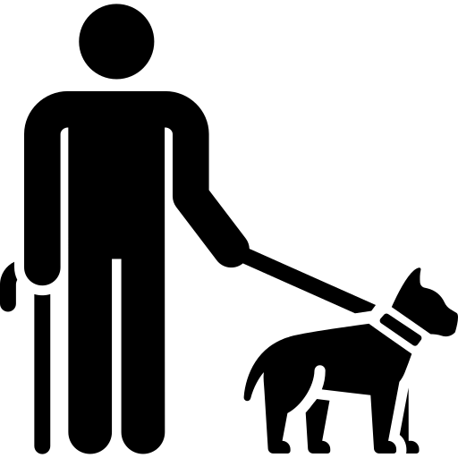


Two hands isn’t enough. What about a third one ?

Slide 5
Our solution (a supprimer)
With a few known thing we can get a precis position
Camera position and orientation
Use of Computer Vision to get the exact position of the train on the platform
Locate the user thanks to Bluetooth beacons on the platform (modern technology allows to get extremely accurate positioning and orientation => triangulation and trilateration )
Guide the user to the nearest door corresponding to his/her ticket using vocal commands thanks to Speech Synthesis
(Optional) Everything relies on the perfect positioning of the train on the platform. To back up our Computer Vision algorithm, it is possible to install a Bluetooth beacon at one edge of the train and it would be triangulated the same way the user is (thanks to beacons on the platform)

Slide 6
Model the solution not the problem
All same type train are the same -> doors can be precisely found by knowing the train type and the start of the train
With a few known thing we can get the position of the train
Camera position and it’s orientation
Computer Vision -> exact position of the train on the platform
Bluetooth beacon transmit their position, user localise himself with it

Slide 7
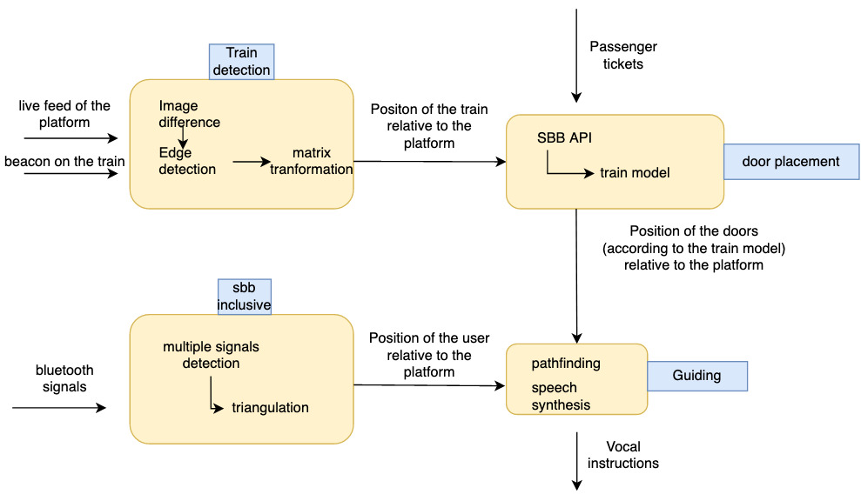

Slide 8

Advantages of our solution
Modular ( assigned cars and seats, train change )
Easier for visually impaired people
Tiny needs (no ML -> low processing power needed, no cloud)
privacy friendly: SBB doesn’t know the position of the user
Exact train position can tackle other problems

Slide 9
Proof of concept : Train detection

