Slide 1

Loading Screen

Slide 2
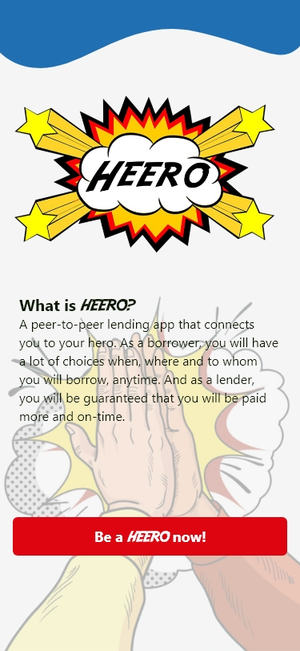

Slide 3
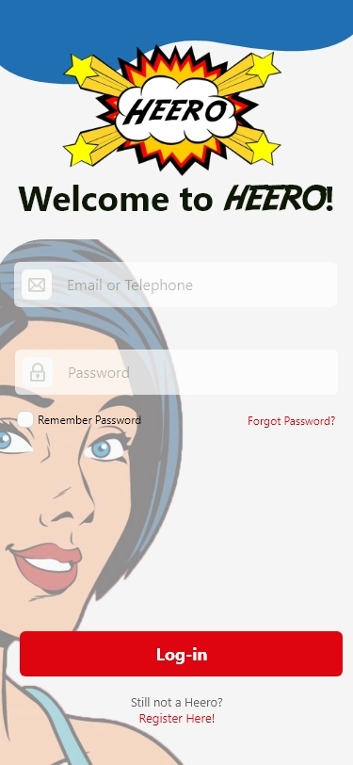
Log-in
Registration
- Need valid ID
Can connect social media accounts to have a friend lists
Ask for a personal PIN

Slide 4
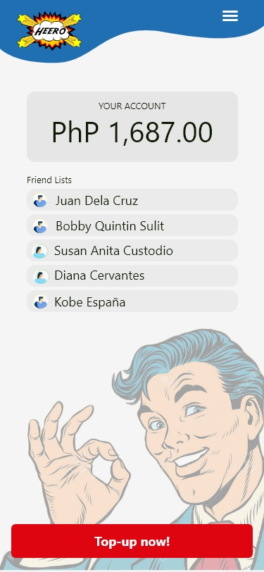
Home Page

Slide 5
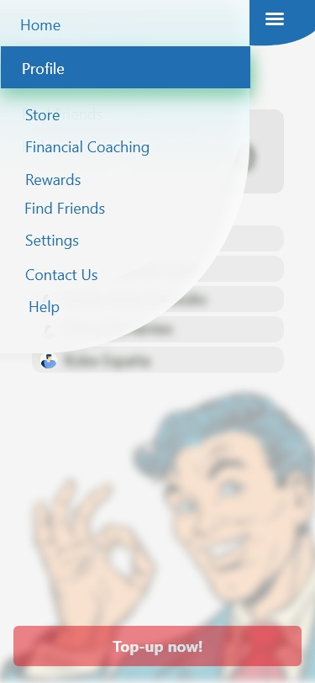

Slide 6
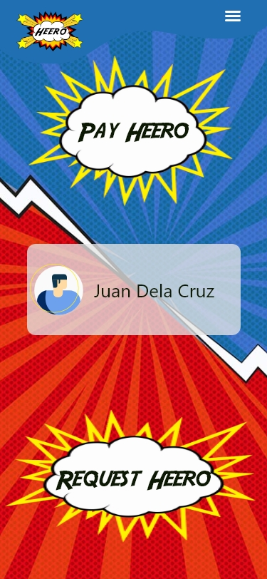
Request/Pay Heero (when a name in home page is clicked)

Slide 7
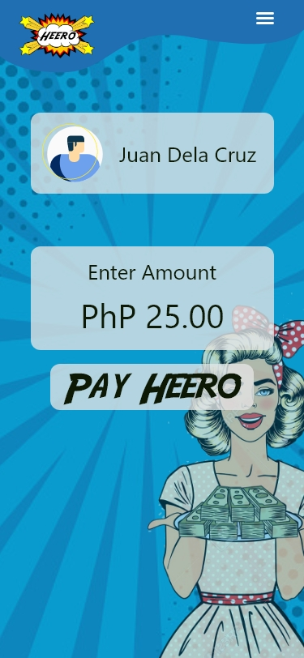

Slide 8
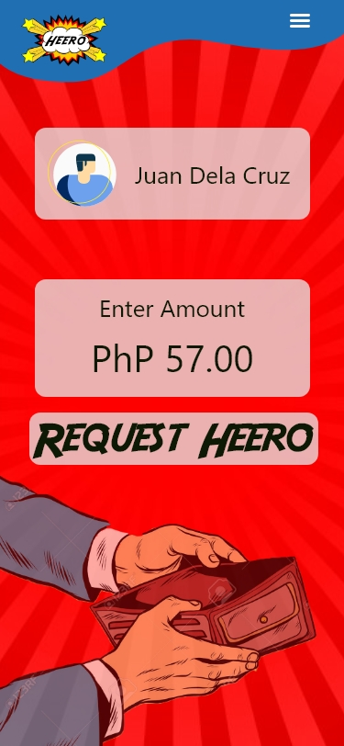

Slide 9
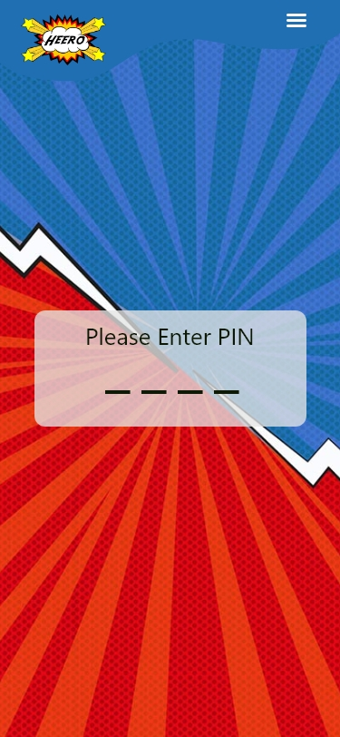
For security

