Slide 1

SUBSTITUTION CIPHER
COE 121.2 MINI PROJECT
BALIGUAT, DENNIS IVAN
CHAVES, KERT
BSCPE II

Slide 2


SUBSTITUTION CIPHER
What is a
Substitution ciphers encrypt the plaintext by swapping each letter or symbol in the plaintext by a different symbol as directed by the key.
The key is your ‘new alphabet’.

Slide 3

The

Slide 4
Unified Modeling Language
class SubstitutionCipher
public SubstitutionCipher
public void setKey
public String encrypt
public String decrypt
private String transform

Slide 5
Package used:
import javax.swing.JOptionPane;
Field Variables
static final int MAX = 26;
protected char[] encoder;
protected char[] decoder;

Slide 6

The flow

Slide 7
Setting the key AND CREATING AN OBJECT
1
String KeyString = ”FJORDBANKGLYPHSVEXTCWMQUIZ";
SubstitutionCipher subCipher = new SubstitutionCipher();
subCipher.setKey(KeyString);
Key = FJORDBANKGLYPHSVEXTCWMQUIZ
(User-defined)

Slide 8
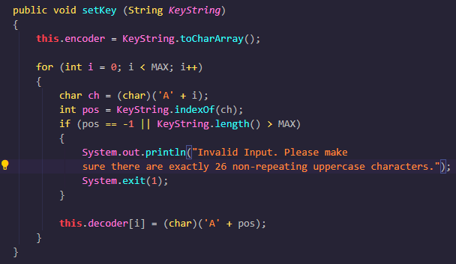
GENERATING THE KEY
2
Turns key into char array
Generates the alphabet
Reassigns the alphabet based on the new alphabet (key).
Checks if key has exactly 26 non-repeating uppercase letters
encoder
F | J | O | R | D | B | A | N | K | G | L | Y | P | H | S | V | E | X | T | C | W | M | Q | U | I | Z
0 | 1 | 2 | 3 | 4 | 5 | 6 | 7 | 8 | 9 | 10 | 11 | 12 | 13 | 14 | 15 | 16 | 17 | 18 | 19 | 20 | 21 | 22 | 23 | 24 | 25
A | B | C | D | E | F | G | H | I | J | K | L | M | N | O | P | Q | R | S | T | U | V | W | X | Y | Z
0 | 1 | 2 | 3 | 4 | 5 | 6 | 7 | 8 | 9 | 10 | 11 | 12 | 13 | 14 | 15 | 16 | 17 | 18 | 19 | 20 | 21 | 22 | 23 | 24 | 25
decoder
G | F | T | E | Q | A | J | N | Y | B | I | K | V | H | C | M | W | D | O | S | X | P | U | R | L | Z
0 | 1 | 2 | 3 | 4 | 5 | 6 | 7 | 8 | 9 | 10 | 11 | 12 | 13 | 14 | 15 | 16 | 17 | 18 | 19 | 20 | 21 | 22 | 23 | 24 | 25

Slide 9
BASICALLY
ORIGINAL ALPHABET
0 | 1 | 2 | 3 | 4 | 5 | 6 | 7 | 8 | 9 | 10 | 11 | 12 | 13 | 14 | 15 | 16 | 17 | 18 | 19 | 20 | 21 | 22 | 23 | 24 | 25
A | B | C | D | E | F | G | H | I | J | K | L | M | N | O | P | Q | R | S | T | U | V | W | X | Y | Z
F | J | O | R | D | B | A | N | K | G | L | Y | P | H | S | V | E | X | T | C | W | M | Q | U | I | Z
0 | 1 | 2 | 3 | 4 | 5 | 6 | 7 | 8 | 9 | 10 | 11 | 12 | 13 | 14 | 15 | 16 | 17 | 18 | 19 | 20 | 21 | 22 | 23 | 24 | 25
NEW ALPHABET

Slide 10
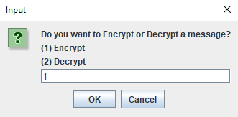
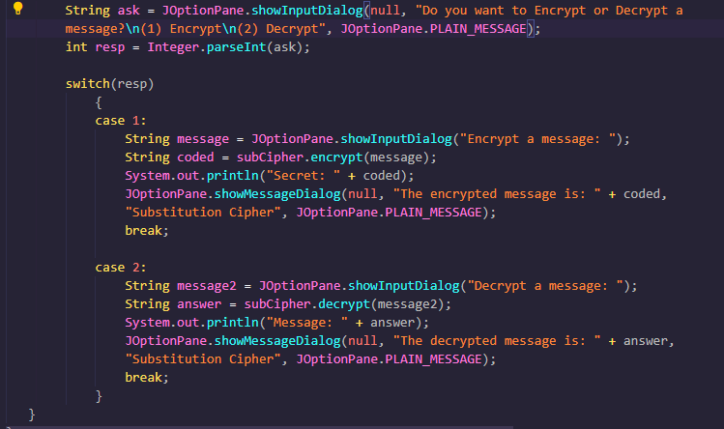
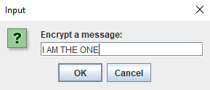
Encrypting a message
3

Slide 11
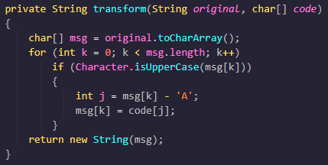
ENCRYPTION
4
I AM THE ONE
I AM THE ONE
NOTE: Since, lowercase letters are already filtered, if Character is not an uppercase (a space), then it is added to msg.
encoder
F | J | O | R | D | B | A | N | K | G | L | Y | P | H | S | V | E | X | T | C | W | M | Q | U | I | Z

Slide 12
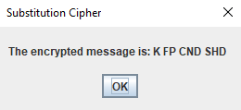
Behind the scenes
int j = msg[k] - 'A';
VALUE
VALUE
INT J
Iamtheone
8
0
12
19
7
4
14
13
4
---------
aaaaaaaaa
000000000
=========
8
0
12
19
7
4
14
13
4
kfpcndshd
msg[k] = code[j];
(k = from 0)
F | J | O | R | D | B | A | N | K | G | L | Y | P | H | S | V | E | X | T | C | W | M | Q | U | I | Z
0 | 1 | 2 | 3 | 4 | 5 | 6 | 7 | 8 | 9 | 10 | 11 | 12 | 13 | 14 | 15 | 16 | 17 | 18 | 19 | 20 | 21 | 22 | 23 | 24 | 25
A | B | C | D | E | F | G | H | I | J | K | L | M | N | O | P | Q | R | S | T | U | V | W | X | Y | Z

Slide 13

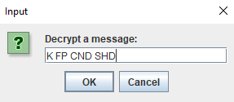
DECRYPTING a message
5

Slide 14
DECRYPTION
6
K FP CND SHD
K FP CND SHD
decoder
G | F | T | E | Q | A | J | N | Y | B | I | K | V | H | C | M | W | D | O | S | X | P | U | R | L | Z

Slide 15
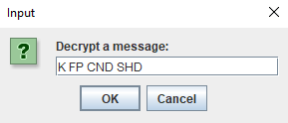
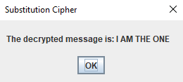
Behind the scenes
int j = msg[k] - 'A';
VALUE
VALUE
INT J
kfpcndshd
10
5
15
2
13
3
18
7
3
---------
aaaaaaaaa
000000000
=========
10
5
15
2
13
3
18
7
3
Iamtheone
msg[k] = code[j];
(k = from 0)
G | F | T | E | Q | A | J | N | Y | B | I | K | V | H | C | M | W | D | O | S | X | P | U | R | L | Z
0 | 1 | 2 | 3 | 4 | 5 | 6 | 7 | 8 | 9 | 10 | 11 | 12 | 13 | 14 | 15 | 16 | 17 | 18 | 19 | 20 | 21 | 22 | 23 | 24 | 25
A | B | C | D | E | F | G | H | I | J | K | L | M | N | O | P | Q | R | S | T | U | V | W | X | Y | Z

Slide 16
disadvantages
The Substitution Cipher can be easily deciphered by hand with the use of frequency analysis.
In the English language, the most commonly used letters are e, t, a, o, i, n.
single-letter words include I, a
common two-letter words include an, I’m, in
common three-letter words include the, and
Hence K FP CND SHD
I
AM
THE
E
A
I’M
AND
IN

Slide 17
THANKS FOR LISTENING!

