Slide 1
Zero-Knowledge Proofs Security
Proof Without Disclosure

Slide 2
What are Zero-Knowledge Proofs?
Way of proving a known piece of information without disclosure.
Can be interactive or non-interactive between computational parties.
A Zero-Knowledge Proof have a 1 to 1 relationship with statements.
Card Example…. Red/Black, Suit, Value. Can be verified independently non-interactive.
Color Blind Object Differentiation…. Two identical balls of different colors.
Statements must be represented in NP or P exclusively.
Various types: Constraint proofs, Range proofs, Bulletproofs (combining both…..)

Slide 3
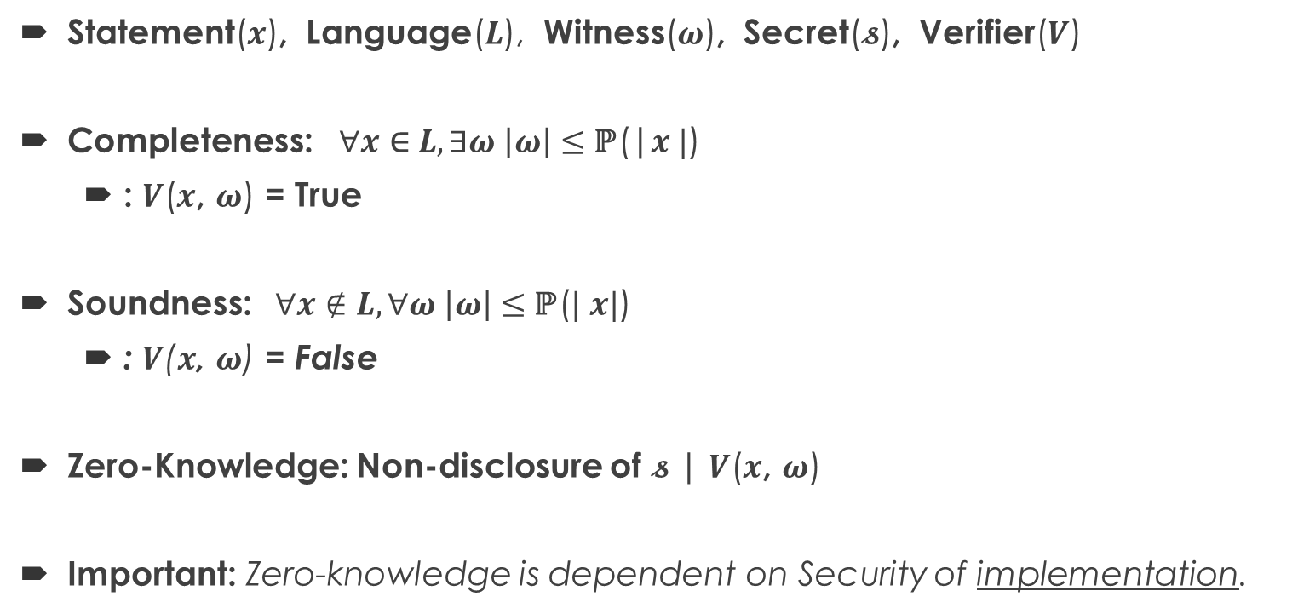
The 3 Mandatory Properties Of Zero-Knowledge Proofs
Statement($x$), Language($L$), Witness($ω$), Secret($𝓼$), Verifier($V$)
Completeness: $∀x \text{∈} L, ∃ω \left|ω\right|≤$ℙ(|$x |$)
: $V$($x$, $ω$) = True
Soundness: $∀x∉L,∀ω \left|ω\right|≤$ℙ($| x|$)
: $V$($x$, $ω$) = False
Zero-Knowledge: Non-disclosure of $𝓼$ | $V$($x$, $ω$)
Important: Zero-knowledge is dependent on Security of implementation.

Slide 4
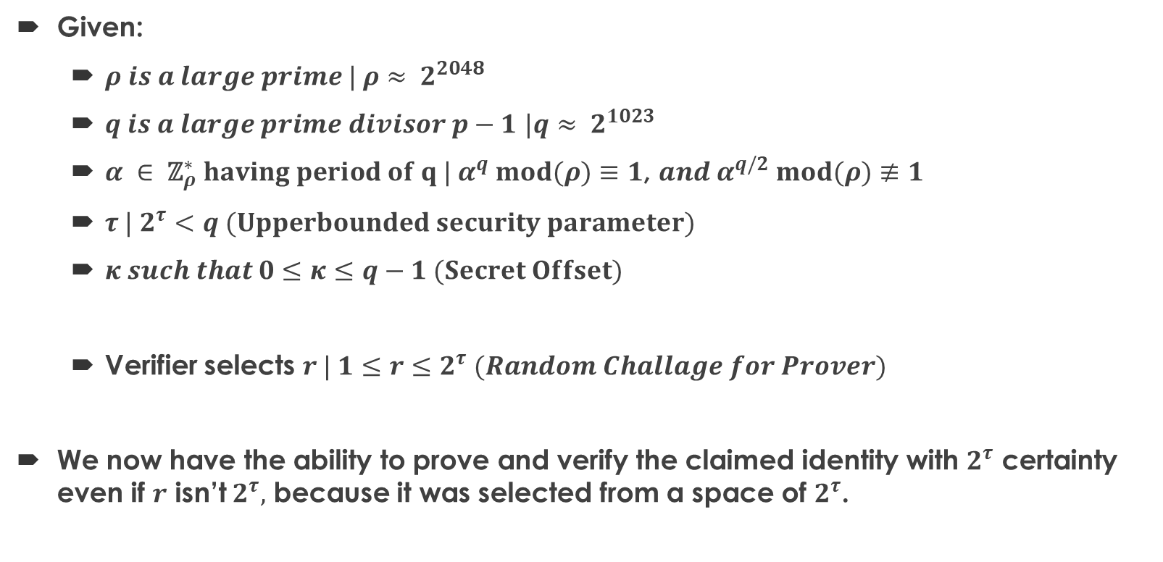
Schnorr Identification Scheme Setup
Given:
$ρ is a large prime | ρ$ $≈ 2^{2048}$
$q is a large prime divisor p−1$ $|q≈ 2^{1023}$
$α ∈ {\text{ℤ}}_{ρ}^{∗} having period of q | α^{q} mod(ρ)≡1$, $and α^{q/2} mod(ρ)≢1$
$τ {| 2}^{τ}<q (Upperbounded security parameter)$
$κ such that 0≤κ≤q−1 (Secret Offset)$
Verifier selects $r | 1≤r≤2^{τ} (Random Challage for Prover)$
We now have the ability to prove and verify the claimed identity with $2^{τ}$ certainty even if $r$ isn’t $2^{τ},$ because it was selected from a space of $2^{τ}$.

Slide 5
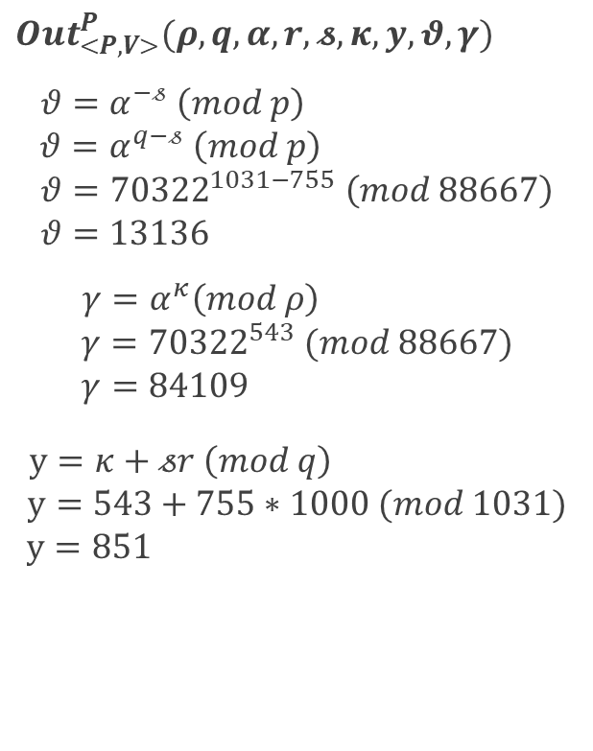
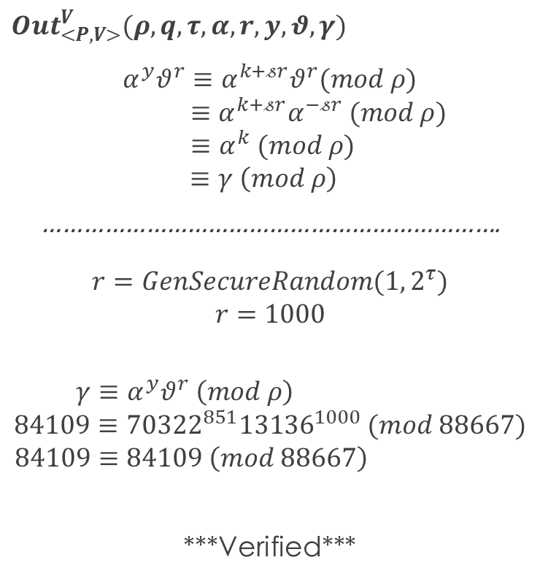


Schnorr Identification Scheme Transcripts
Variables:
$$θ=Public Key$$
$$γ=Commitment$$
$$y=Challenge Response$$
$$κ=Random Offset$$
$$𝓼=Secret$$
$$r=Random Challenge$$
$${Out}_{<Ρ,V>}^{P}(ρ, q,α,r,𝓼, κ, y,θ,γ)$$
$$θ=α^{−𝓈} \left(mod p\right)$$
$$θ=α^{q−𝓈} \left(mod p\right)$$
$$θ={70322}^{1031−755} \left(mod 88667\right)$$
$$θ=13136$$
$$γ=α^{κ}\left(mod ρ\right)$$
$$γ={70322}^{543} (mod 88667)$$
$$γ=84109$$
$$y=κ+𝓈r \left(mod q\right)$$
$$y=543+755∗1000 (mod 1031)$$
$$y=851$$
$$\underset{⇒}{θ}$$
$$\underset{⇒}{γ}$$
$$\underset{⇐}{r}$$
$$\underset{⇒}{y}$$
$${Out}_{<Ρ,V>}^{V}(ρ, q,τ,α,r, y, θ,γ)$$
$$α^{y}θ^{r}≡α^{k+𝓈r}θ^{r}(mod ρ)$$
$$≡α^{k+𝓈r}α^{−𝓈r} (mod ρ)$$
$$≡α^{k} (mod ρ)$$
$$≡γ \left(mod ρ\right)$$
………………………………………………………….
$$r=GenSecureRandom(1, 2^{τ})$$
$$r=1000$$
$$γ≡α^{y}θ^{r} \left(mod ρ\right)$$
$$84109≡{70322}^{851}{13136}^{1000} (mod 88667)$$
$$84109≡84109 \left(mod 88667\right)$$
***Verified***

Slide 6
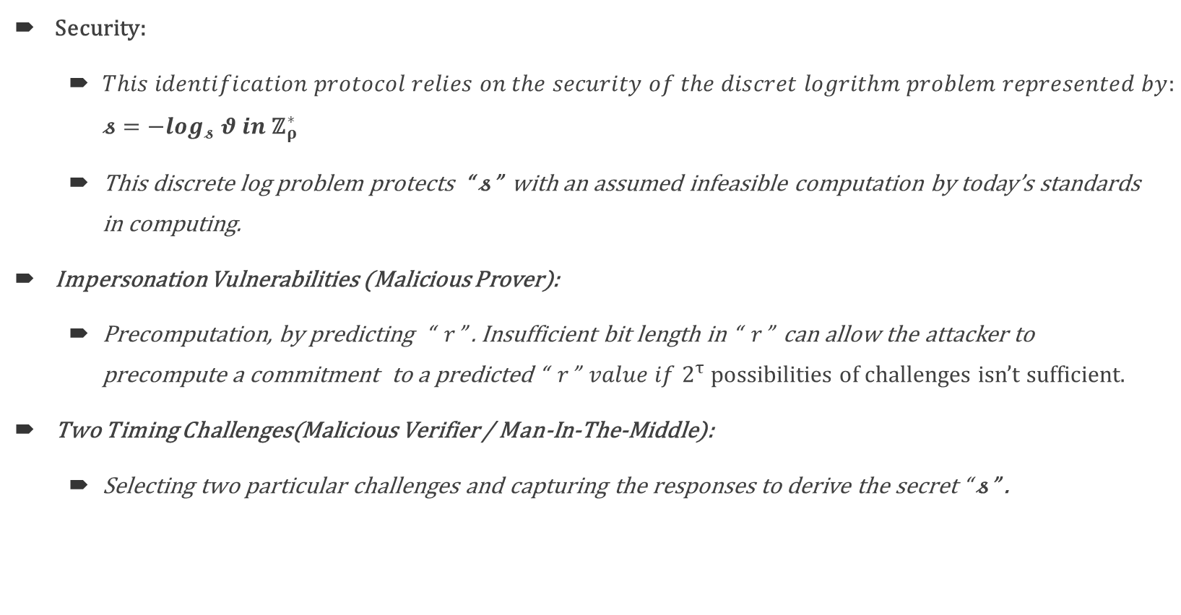
Security Of Schnorr’s Identification Scheme
Security:
$This identification protocol relies on the security of the discret logrithm problem represented by:$ $𝓼=−\log_{𝓼} θ in {\text{ℤ}}_{ρ}^{∗}$
This discrete log problem protects “$𝓼$” with an assumed infeasible computation by today’s standards in computing.
Impersonation Vulnerabilities (Malicious Prover):
Precomputation, by predicting “ $r$” . Insufficient bit length in “ $r$” can allow the attacker to precompute a commitment to a predicted “ $r$” $value if 2^{τ}$ possibilities of challenges isn’t sufficient.
Two Timing Challenges(Malicious Verifier / Man-In-The-Middle):
Selecting two particular challenges and capturing the responses to derive the secret “$𝓼$” .

Slide 7
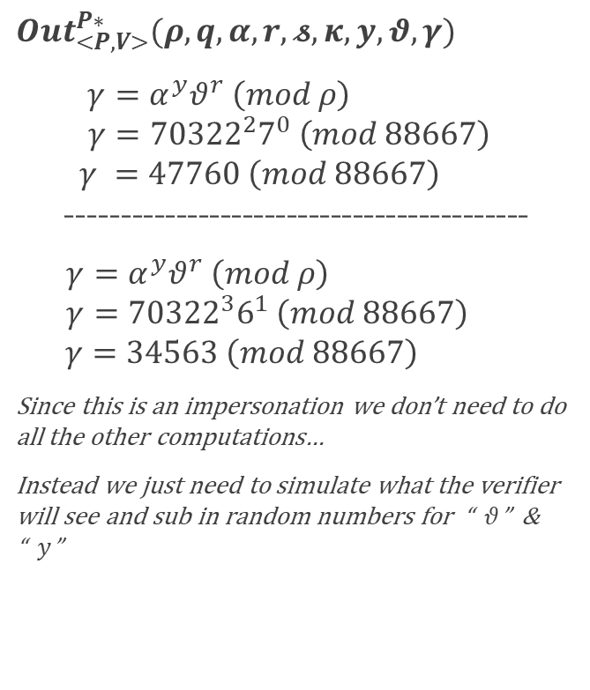
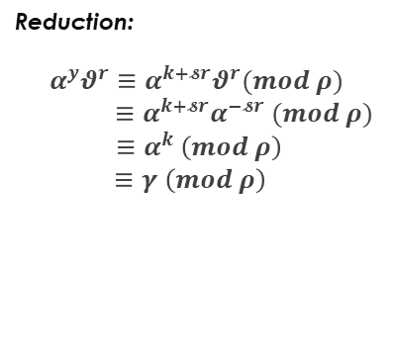
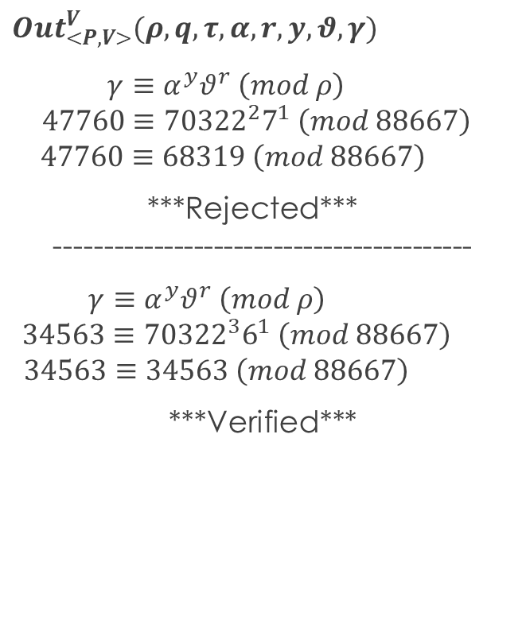
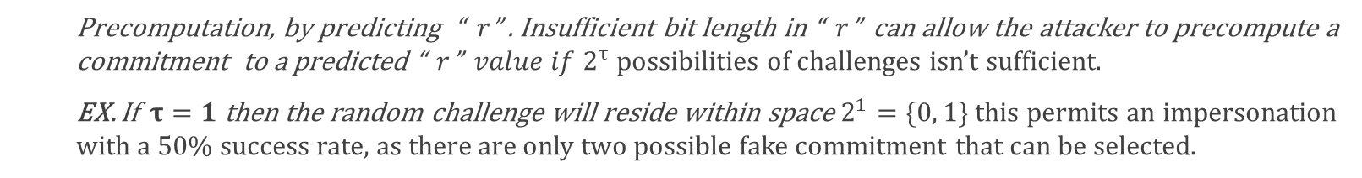
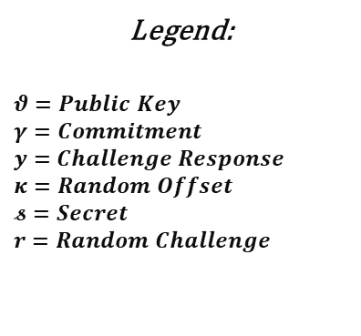

Impersonation Vulnerabilities (Malicious Prover):
Legend:
$$θ=Public Key$$
$$γ=Commitment$$
$$y=Challenge Response$$
$$κ=Random Offset$$
$$𝓼=Secret$$
$$r=Random Challenge$$
Malicious Prover Security Parameter Pre-calculation:
Precomputation, by predicting “ $r$” . Insufficient bit length in “ $r$” can allow the attacker to precompute a commitment to a predicted “ $r$” $value if 2^{τ}$ possibilities of challenges isn’t sufficient.
EX. If $τ=1$ then the random challenge will reside within space $2^{1}=\{0, 1\}$ this permits an impersonation with a 50% success rate, as there are only two possible fake commitment that can be selected.
$${Out}_{<Ρ,V>}^{P∗}(ρ, q,α,r,𝓼, κ, y,θ,γ)$$
$$γ=α^{y}θ^{r} \left(mod ρ\right)$$
$$γ={70322}^{2}7^{0} \left(mod 88667\right)$$
$$γ =47760 \left(mod 88667\right)$$
------------------------------------------
$γ=α^{y}θ^{r} \left(mod ρ\right)$
$$γ={70322}^{3}6^{1} \left(mod 88667\right)$$
$$γ=34563 \left(mod 88667\right)$$
Since this is an impersonation we don’t need to do all the other computations…
Instead we just need to simulate what the verifier will see and sub in random numbers for “$θ$” & “$y$”
$${Out}_{<Ρ,V>}^{V}(ρ, q,τ,α,r, y, θ,γ)$$
$$γ≡α^{y}θ^{r} \left(mod ρ\right)$$
$$47760≡{70322}^{2}7^{1} \left(mod 88667\right)$$
$$47760≡68319 \left(mod 88667\right)$$
***Rejected***
------------------------------------------
$γ≡α^{y}θ^{r} \left(mod ρ\right)$
$$34563≡{70322}^{3}6^{1} \left(mod 88667\right)$$
$$34563≡34563 \left(mod 88667\right)$$
***Verified***
Reduction:
$$α^{y}θ^{r}≡α^{k+𝓼r}θ^{r}(mod ρ)$$
$$≡α^{k+𝓼r}α^{−𝓼r} (mod ρ)$$
$$≡α^{k} \left(mod ρ\right)$$
$$≡γ \left(mod ρ\right)$$
$$\underset{⇒}{θ}$$
$$\underset{⇒}{γ}$$
$$\underset{⇐}{r}$$
$$\underset{⇒}{y}$$

Slide 8

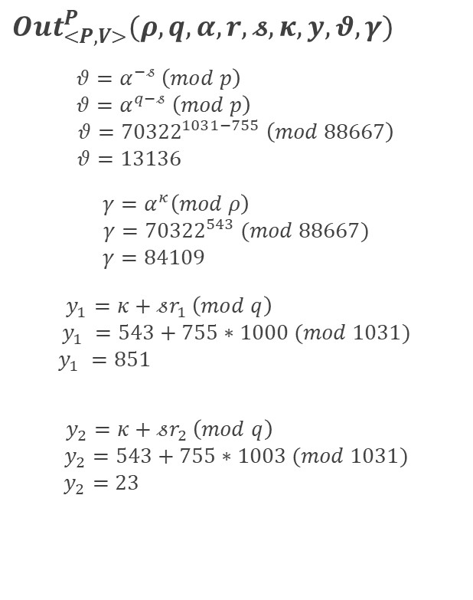
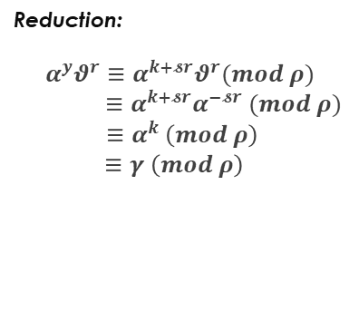
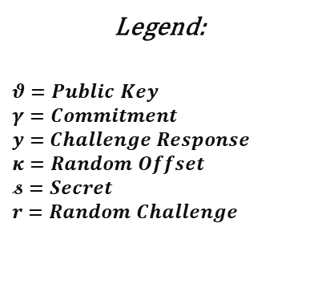
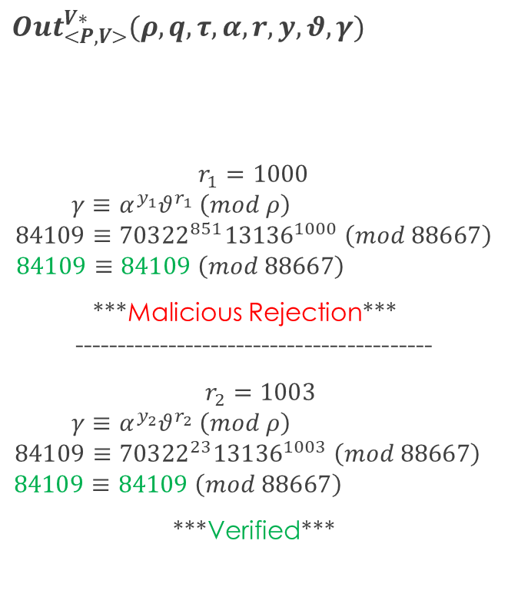
Two Timing Challenges (Malicious Verifier / Man-In-The-Middle):
Legend:
$$θ=Public Key$$
$$γ=Commitment$$
$$y=Challenge Response$$
$$κ=Random Offset$$
$$𝓼=Secret$$
$$r=Random Challenge$$
$${Out}_{<Ρ,V>}^{P}(ρ, q,α,r,𝓼, κ, y,θ,γ)$$
$$θ=α^{−𝓈} \left(mod p\right)$$
$$θ=α^{q−𝓈} \left(mod p\right)$$
$$θ={70322}^{1031−755} \left(mod 88667\right)$$
$$θ=13136$$
$$γ=α^{κ}\left(mod ρ\right)$$
$$γ={70322}^{543} (mod 88667)$$
$$γ=84109$$
$$y_{1}=κ+𝓈r_{1} \left(mod q\right)$$
$$y_{1} =543+755∗1000 (mod 1031)$$
$$y_{1} =851$$
$$y_{2}=κ+𝓈r_{2} \left(mod q\right)$$
$$y_{2}=543+755∗1003 (mod 1031)$$
$$y_{2}=23$$
$${Out}_{<Ρ,V>}^{V∗}(ρ, q,τ,α,r, y, θ,γ)$$
$$r_{1}=1000$$
$$γ≡α^{y_{1}}θ^{r_{1}} \left(mod ρ\right)$$
$$84109≡{70322}^{851}{13136}^{1000} \left(mod 88667\right)$$
$$84109≡84109 \left(mod 88667\right)$$
***Malicious Rejection***
------------------------------------------
$r_{2}=1003$
$$γ≡α^{y_{2}}θ^{r_{2}} \left(mod ρ\right)$$
$$84109≡{70322}^{23}{13136}^{1003} \left(mod 88667\right)$$
$$84109≡84109 \left(mod 88667\right)$$
***Verified***
Reduction:
$$α^{y}θ^{r}≡α^{k+𝓼r}θ^{r}(mod ρ)$$
$$≡α^{k+𝓼r}α^{−𝓼r} (mod ρ)$$
$$≡α^{k} \left(mod ρ\right)$$
$$≡γ \left(mod ρ\right)$$
$$\underset{⇒}{θ}$$
$$\underset{⇒}{γ}$$
$$\underset{⇐}{r_{1}}$$
$$\underset{⇒}{y_{1}}$$
$$\underset{⇐}{r_{2}}$$
$$\underset{⇒}{y_{2}}$$

Slide 9
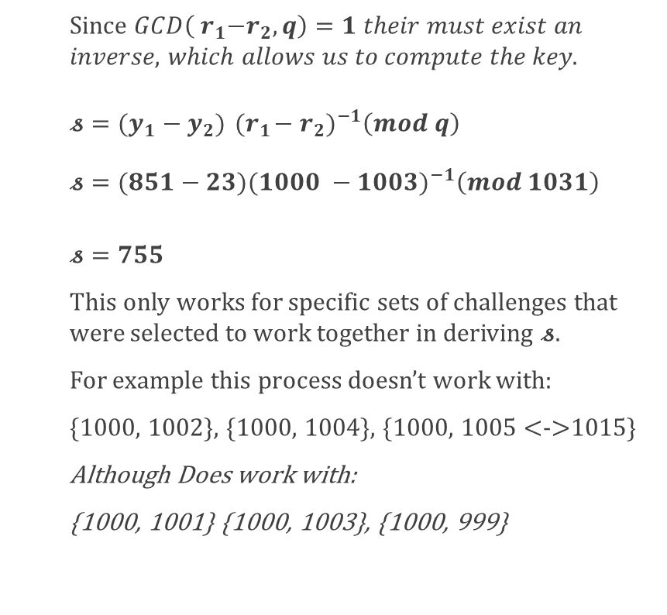
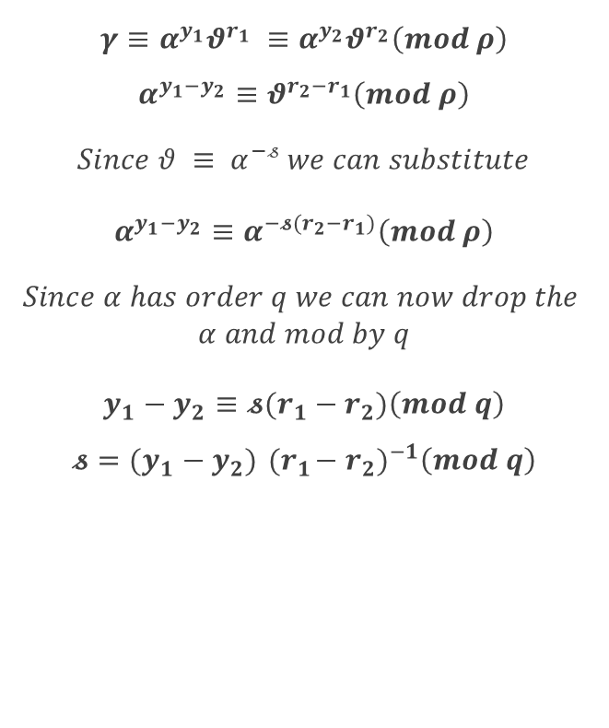
Two Timing Challenges (Malicious Verifier / Man-In-The-Middle):
Legend:
$$θ=Public Key$$
$$γ=Commitment$$
$$y=Challenge Response$$
$$κ=Random Offset$$
$$𝓼=Secret$$
$$r=Random Challenge$$
Since $GCD\left({ r}_{1}−r_{2},q\right)=1$ 𝑡ℎ𝑒𝑖𝑟 𝑚𝑢𝑠𝑡 𝑒𝑥𝑖𝑠𝑡 𝑎𝑛 𝑖𝑛𝑣𝑒𝑟𝑠𝑒, 𝑤ℎ𝑖𝑐ℎ 𝑎𝑙𝑙𝑜𝑤𝑠 𝑢𝑠 𝑡𝑜 𝑐𝑜𝑚𝑝𝑢𝑡𝑒 𝑡ℎ𝑒 𝑘𝑒𝑦.
$𝓼={(y_{1}−y_{2}){ (r}_{1}−r_{2})}^{−1}\left(mod q\right)$
$$𝓼={(851−23)(1000 −1003)}^{−1}\left(mod 1031\right)$$
$𝓼=755$
This only works for specific sets of challenges that were selected to work together in deriving $𝓼$.
For example this process doesn’t work with:
{1000, 1002}, {1000, 1004}, {1000, 1005 <->1015}
Although Does work with:
{1000, 1001} {1000, 1003}, {1000, 999}
$$γ≡α^{y_{1}}θ^{r_{1}} ≡α^{y_{2}}θ^{r_{2}}\left(mod ρ\right)$$
$$α^{y_{1}−y_{2}}≡θ^{{r_{2}−r}_{1}}\left(mod ρ\right)$$
$$Since θ ≡ α^{−𝓈} we can substitute$$
$$α^{y_{1}−y_{2}}≡α^{−{{𝓼(r}_{2}−r}_{1})}\left(mod ρ\right)$$
$$Since α has order q we can now drop the$$
$$α and mod by q$$
$$y_{1}−y_{2}≡{𝓼(r}_{1}−r_{2})\left(mod q\right)$$
$$𝓼={(y_{1}−y_{2}){ (r}_{1}−r_{2})}^{−1}\left(mod q\right)$$
Reduction:
$$α^{y}θ^{r}≡α^{k+𝓼r}θ^{r}(mod ρ)$$
$$≡α^{k+𝓼r}α^{−𝓼r} (mod ρ)$$
$$≡α^{k} \left(mod ρ\right)$$
$$≡γ \left(mod ρ\right)$$

Slide 10
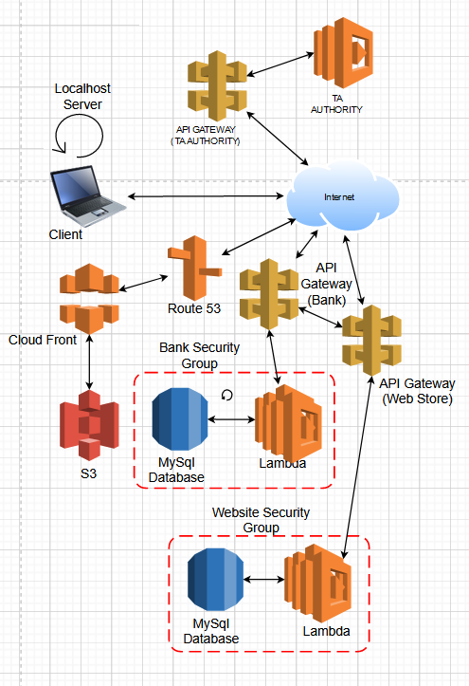
Network Topology

Slide 11
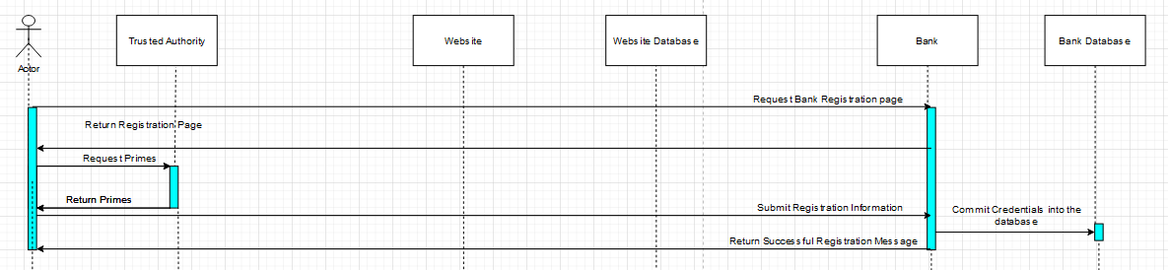
Bank Registration Process

Slide 12
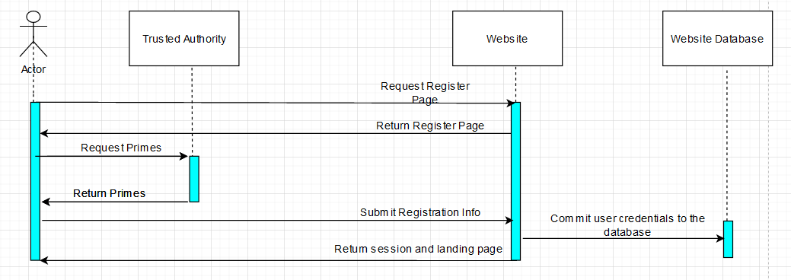
Website Registration Process

Slide 13
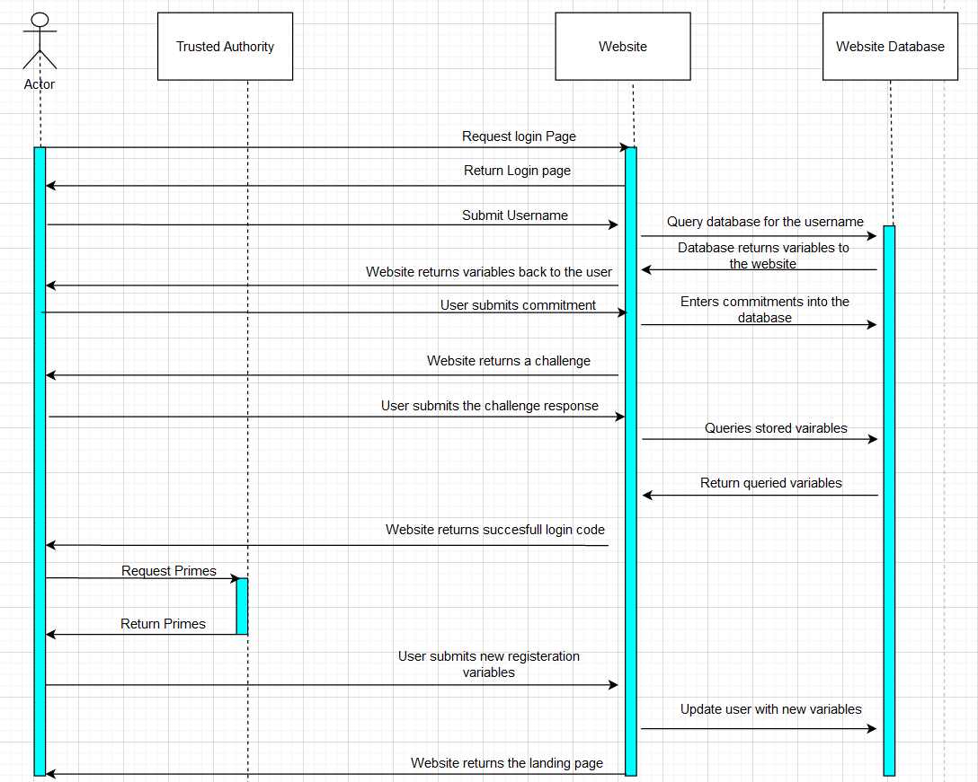
User Login Process

Slide 14
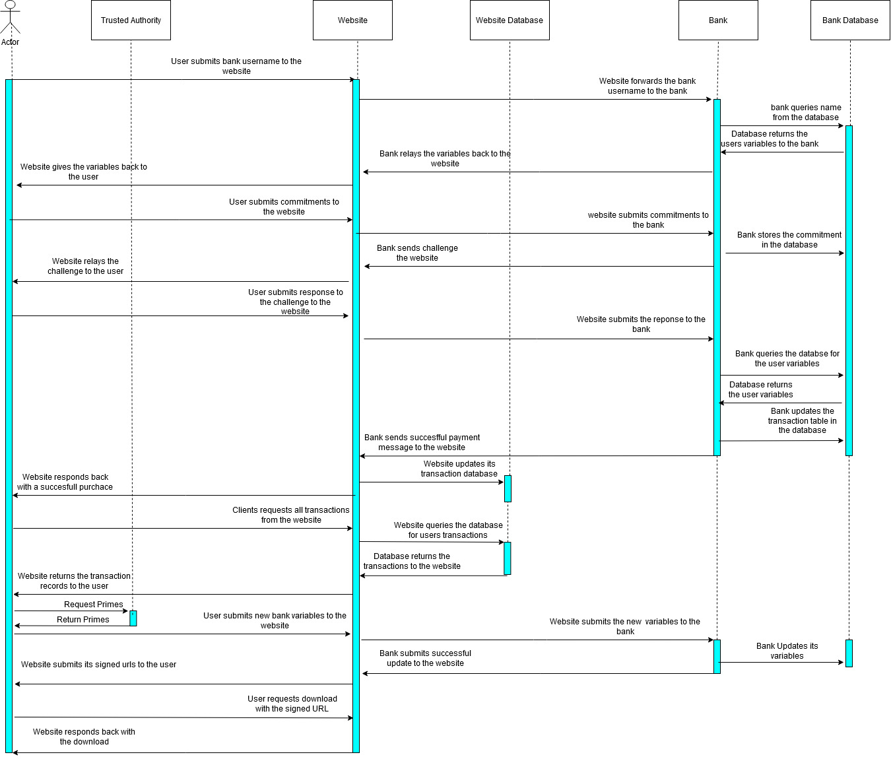
Product Purchase Process

