Slide 1
Front End Engineering-I Project
Team Details: Devansh Aggarwal(2210990258)
Devansh Bhagania(2210990259)
Devang Saini(2210990257)
Devansh Mittal(2210990260)
Faculty Coordinator: Dr. Monika Sethi
:
Chitkara University Institute of Engineering and Technology, Chitkara University, Punjab

Slide 2
Table of Contents
Introduction
Problem Statement
Technical Details
Key Features
Project Highlights
Conclusion
References/Links used

Slide 3
Introduction
The project to be made is a survey form.A survey is the process of collecting, analysing and interpreting data from many individuals. It aims to determine insights about a group of people. A survey goes much deeper than a questionnaire and often involves more than one form of data collection.

Slide 4
Problem Statement
Survey solutions are used to perform market research and gain insights into people's choices, opinions, and experiences. Surveys are used in a number of situations, ranging from listening to the voice of customer, measuring employee satisfaction or launching a new product. They collect relevant data to give insights on to make the product or the marketplace better.

Slide 5
Technical Details
This survey form was made by using HTML & CSS language. It was coded by using the VS Code IDE.

Slide 6
Key Features
The survey form will first ask for a few personal details such as name, age etc. It will then ask various questions ranging from the ease of use, key highlights, the game experience, overall experience, as well as a dedicated text box for feedback on to make the experience even more better and easier for the users.

Slide 7
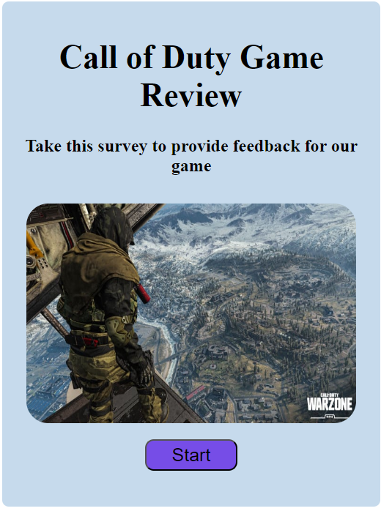
Project Highlights
Front Page

Slide 8
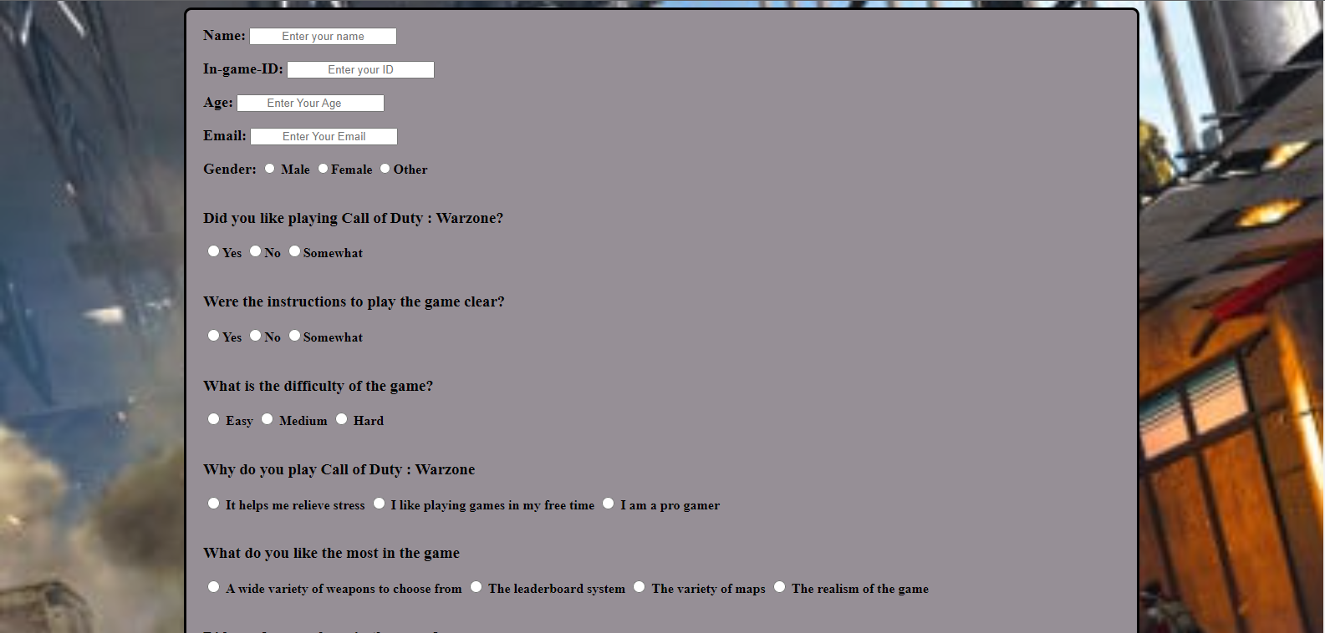
Project Highlights
Survey Form

Slide 9
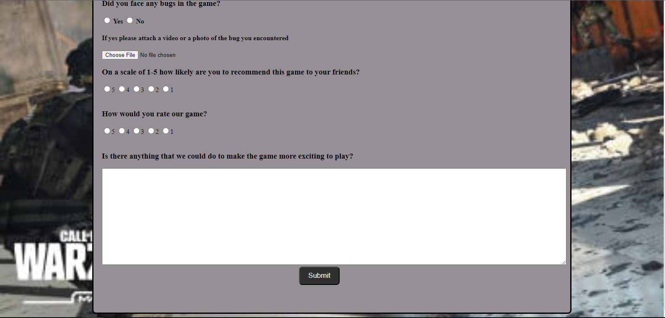
Project Highlights
Survey Form

Slide 10

Project Highlights
Thank You Page!

Slide 11
Bonus Feature
There is a page to welcome you before the start of the survey. It gives description about what the survey is about and why you should fill it out.

Slide 12
Conclusion
Before the start of the survey you are welcomed by an introduction page. It then proceeds to collect the user's information provided to it and asks various questions for the survey to complete and finally proceeds to a thank you page.
Our team's takeaway from this project is that it necessary to have proper survey forms for any company to succeed.

Slide 13
References/Links used
W3Schools

