Slide 1
Vaadin
A small introduction

Slide 2

About Vaadin

Slide 3
What is Vaadin?
Developed since 2002
Open Source Java Web Framework
Lots of pre-existing customizable components
Everything inside the web project is done with pure Java
A lot of Backend stuff is done for you. (You can do everything with Java) :)

Slide 4
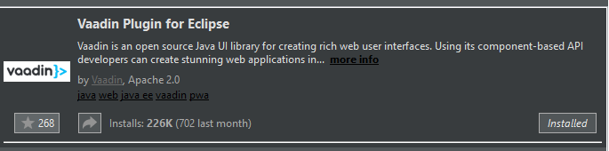
Where to get?
Download a project template from Vaadin webpage.
https://vaadin.com/start
There are also some demo projects.
Eclipse has Vaadin Plugin → Adds „native“ support

Slide 5
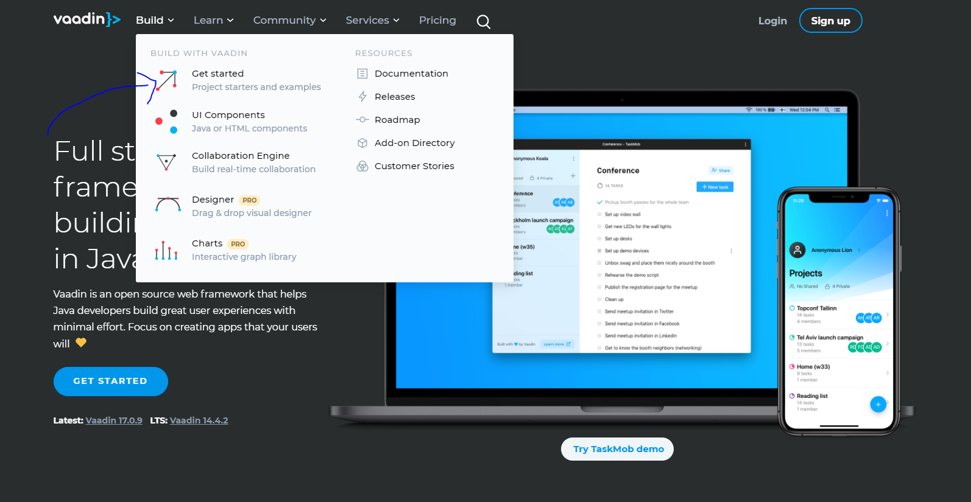

Slide 6
Developing Vaadin Applications

Slide 7
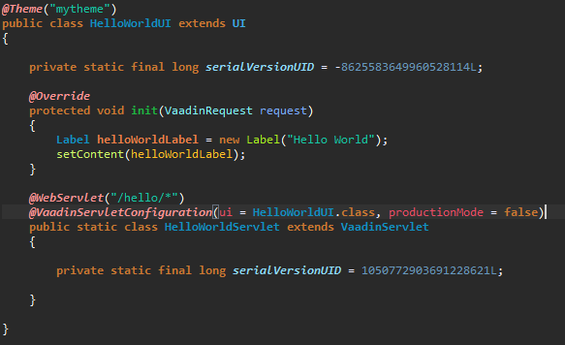
Building a simple project

Slide 8
Building UI‘s
You build with pre-defined components
Vaadin provides a lot of free-to-use components
→ Not only provide the visual side but also Backend help
Lots of addon components (and premium components…)
Everything is possible. :)

Slide 9
Custom Components
You can also create your own custom components
(Vaadin provides support for that)
Just extend from „CustomComponent“ and then you can use that object as a component.

Slide 10
Complete Examples

Slide 11
Further information
Vaadin also has a tool for drag-and-drop UI-building.
(Vaadin-Designer)
More examples can be found here:
https://vaadin.com/start

Slide 12
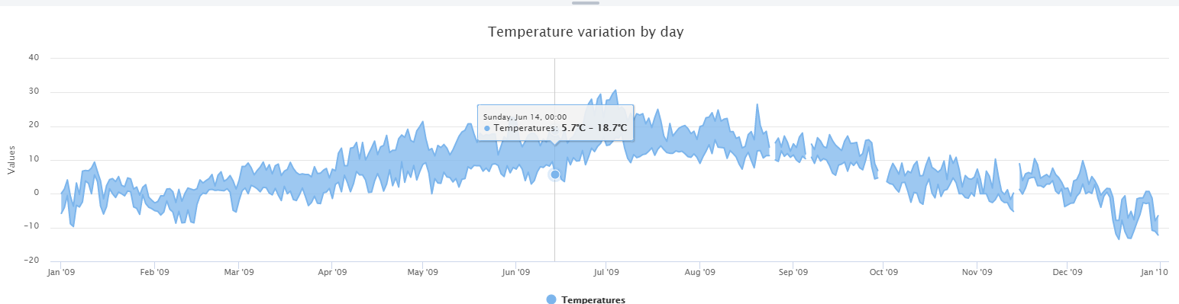
About Pro-Components

Slide 13
Thank you for listening

Slide 14
Sources
https://vaadin.com
More information about components.
https://vaadin.com/components
Git Repo: https://github.com/D45Hub/Vaadin-Example

