Slide 1

7Chan
Group 7
a Forum
One stream with posts,
Friend system and Friend messages.

Slide 2
Use cases
Register/login
Post
Comment
Friend
Message
Edit profile
Search

Slide 3
Code structure
Xhtml files
Backing beans
Control beans
Entity classes
Database

Slide 4
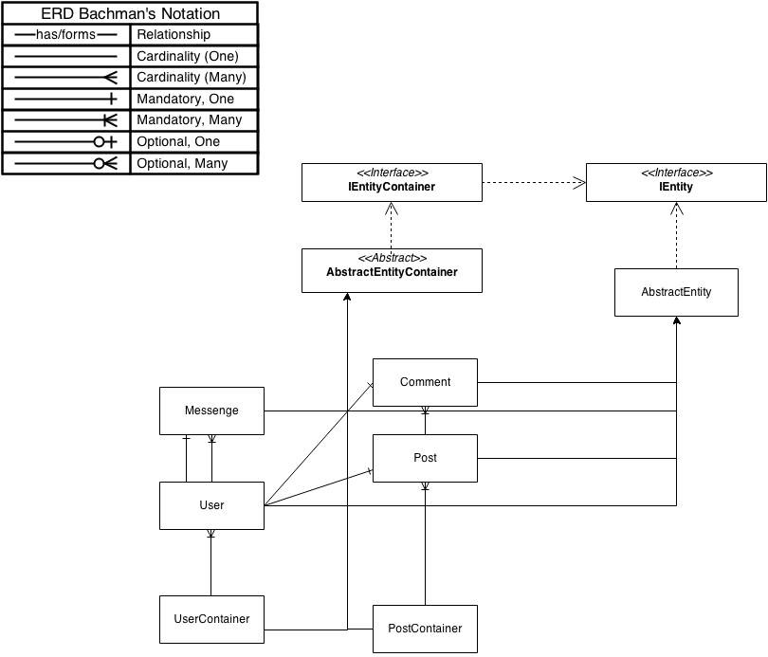
OO model

