Slide 1
7chan

Slide 2
Use cases
Register/login
Post
Comment
Friend
Message
Edit profile
Search

Slide 3
Code structure
Xhtml files
Backing beans
Control beans
Entity classes
Database

Slide 4
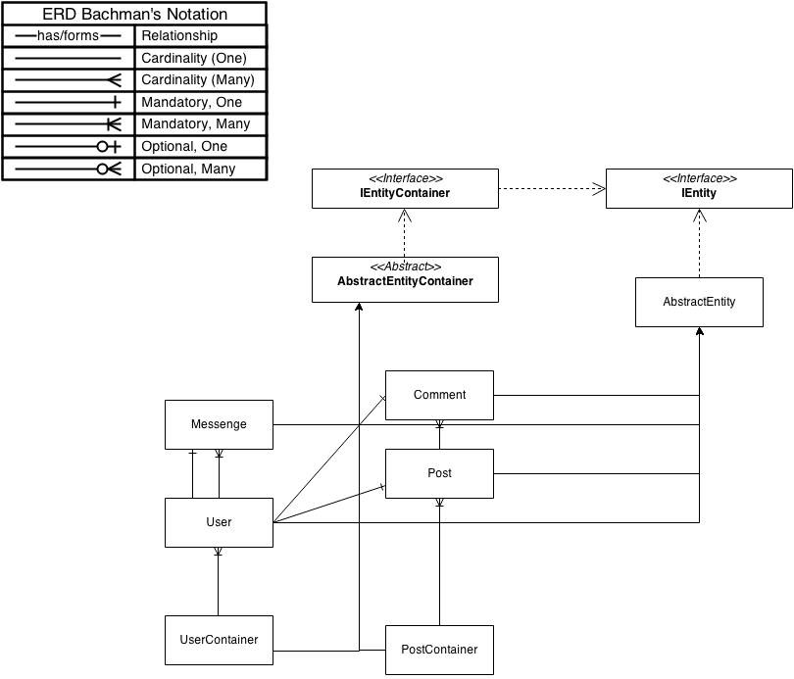
OO model

