Slide 1
Jill Watson: Virtual Teaching Assistant
Presenter: Sandeep Kakar
Team: Karan Taneja, Pratyusha Maiti, Sanjeev Rao, Pranav Guruprasad, Rob Lindgren, Elaine Cortez, Gina Nguyen, Alekhya Nandula, Aiden Zhao, Sandeep Kakar, Ashok Goel

Slide 2
Jill Watson: Virtual Teaching Assistant
GOAL: Enhance teaching presence in online classrooms
SOLUTION: Use AI assistants to answer learners’ questions​
Answers students' questions on demand
Engages students in extended conversations about educational materials

Slide 3


LLM-powered Conversational Question-Answering
Jill Watson will...
Student asks a question
Find relevant
conversation history
Find relevant
content from courseware
From Memory
From Knowledge Base
Student gets a response
Perform safety and consistency checks
Prompt LLM for QA
ChatGPT

Slide 4


Jill in Action: Combine Multiple Data Sources
Would rotating an image or finding symmetry in an image be considered conceptual?
Intro Cog Sci Georgia Tech
Rotating an image or finding symmetry in an image can involve both imagistic and conceptual representations, depending on how they are approached.
When rotating an image, if you are mentally visualizing the image and physically rotating it in your mind, then it involves imagistic representations. You are using mental imagery to simulate the rotation of the image. This process relies on the sensory-based representation of the image and the manipulation of spatial relationships.
On the other hand, if you are approaching the task of rotating an image or finding symmetry from a more abstract and conceptual perspective, it involves conceptual representations. This means that you are relying on your understanding of spatial relationships, geometric principles, and abstract concepts related to rotation and symmetry. You may not necessarily rely on vivid mental imagery, but rather on your conceptual knowledge and reasoning abilities…
Sourced from the course textbook
Sourced from explanations in the video transcripts
Jill Watson

Slide 5
Jill vs. ChatGPT: Hallucination Mitigation
In questions with two or more unrelated concepts – Jill identifies the gap, ChatGPT often hallucinates.
How does Thagard explain the concept of 'free will' within the frameworks he discusses in his book "MIND: Introduction to Cognitive Science"?
Jill Watson
ChatGPT
Thagard does not explicitly discuss the concept of "free will" within the frameworks he discusses in his book "MIND: Introduction to Cognitive Science." The book primarily focuses on explaining various aspects of intelligent behavior and the different approaches to modeling the mind. Thagard's emphasis is on understanding the nature of the mind and the cognitive processes that underlie intelligent behavior, rather than delving into philosophical concepts such as free will.
In his book "MIND: Introduction to Cognitive Science," Paul Thagard addresses the concept of free will within the context of cognitive science, exploring how cognitive processes give rise to our sense of agency and decision-making. Thagard's approach to free will in "MIND" is consistent with his broader views on consciousness and cognition, emphasizing the role of neural mechanisms and computational processes in shaping human behavior. While "MIND" covers a wide range of topics in cognitive science, including perception, language, and reasoning, Thagard's discussion of free will typically focuses on the following key points:
[...]

Slide 6

Findings from Performance Comparison with OpenAI Assistants
Method | Pass | Failures: Retrieval | IDK response to toxic prompt
JW-GPT | 78.7% | 43.2% | 98%
OpenAI-Assistant | 30.7% | 68.3% | 68%
Better accuracy
Less likely to retrieve incorrect information
More likely to avoid toxic requests

Slide 7
Deployments and Experiments
Institution | Fall 2023: Course | Configured Courseware
Georgia Tech | Knowledge-Base AI (KBAI) | Syllabus, E-book
Wiregrass College (TCSG) | English: Composition and Rhetoric | Syllabus, Instructor handouts, Textbook, Writing Guide
Conducted A/B experiments
OMSCS KBAI at GT (section A has access to Jill, section B doesn’t)
English: Composition and Rhetoric at Wiregrass College (sections 1 & 2 had access to Jill, section 3 did not)
Institution | Spring 2024: Course | Configured Courseware
Georgia Tech | Knowledge-Base AI (KBAI) | Syllabus, E-book
Georgia Tech | Introduction to Cognitive Science | Syllabus, Textbook, Video Transcripts
Wiregrass College (TCSG) | English: Composition and Rhetoric | Syllabus, Instructor handouts, Textbook, Writing Guide
Columbus College (TCSG) | Leadership | Course syllabus, schedule, textbook
edX | Computing in Python I, II, III, IV | Textbook
COI survey tool used to measure impact on Teaching Presence, Social Presence & Cognitive Presence.

Slide 8
Findings from A/B Experiment in OMSCS KBAI - Fall 2023
Dimension | Student’s t-test |  | Mann-Whitney U Test |  | Effect Size
 | Test statistic | p-value | Test statistic | p-value | Cohen’s d | CLES
Cognitive Presence | 1.2984 | 0.0974 | 20887.5 | 0.2039 | 0.1098 | 0.5241
Social Presence | 1.8883 | 0.0299 | 21324 | 0.1145 | 0.1619 | 0.5351
Teaching Presence: Facilitation and Direct Instruction | 0.2597 | 0.3976 | 19999.5 | 0.4749 | 0.0240 | 0.5018
Teaching Presence: Design and Organization | 2.0549 | 0.0203 | 21975 | 0.0378 | 0.1776 | 0.5514
Statistically significant improvement in:
Design and Organization component of Teaching Presence
Course topics, calendar, communication
Social Presence
Anthropomorphizing agent

Slide 9
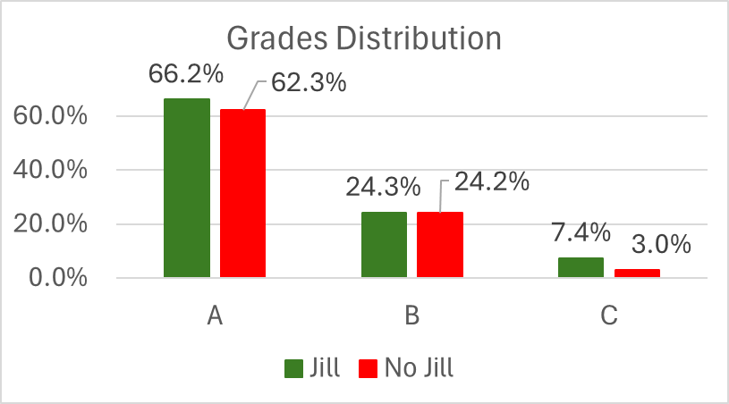
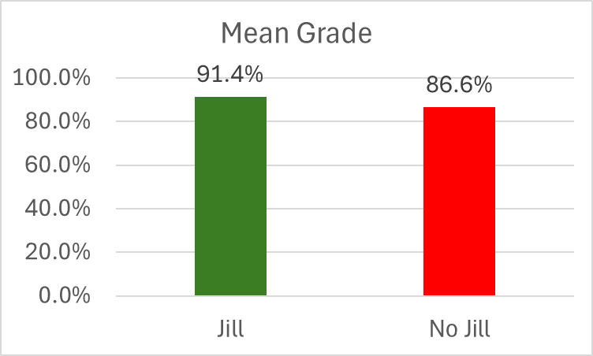
Learning Impact (Preliminary Results)
Results from A/B experiments – Section w/ Jill and section w/o Jill
p = 0.007

Slide 10
Self-efficacy
Q: How confident are you in your performance in the course so far?
Q: How confident are you that you will succeed in the remainder of the course?
“Control”: Used Jill < 5 times “Treatment”: Used Jill >= 5 times
Treatment” Mean: 2.692
Control” Mean: 3.875
T-test stat: -4.028, p=0.0002
Mann-Whitney U Test stat=76.0, p=0.017
Treatment Mean: 2.92
Control Mean: 3.95
T-test stat: -3.51; p=0.001
Mann-Whitney U Test stat=80.0, p=0.025
Lower confidence Higher usage

Slide 11


Future Work
Scalability - Instructor-deployable Jill Watson
Textbook and video-embedded Jill Watson
Responsive/adaptive web interface (ex-LTI and mobile deployments)
Industry partnerships -

