Slide 1
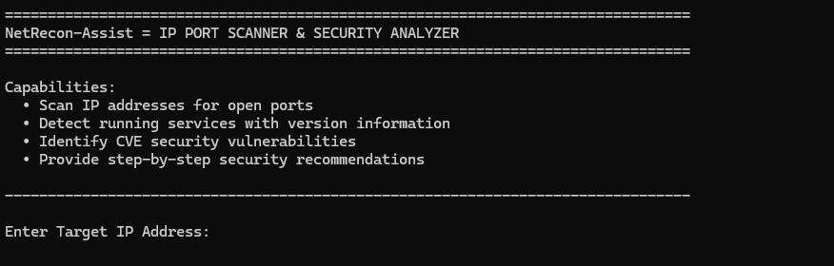
NetRecon-Assist
Next-Gen IP Port Scanner & Security Analyzer for Beginners
D4rkScyth3

Slide 2
Project Introduction & Philosophy
Net
Recon
-Assist
Networking concepts
Scanning network entry points
Guiding users for learning
An educational security tool that helps beginners understand networking easily by turning raw scan data into clear and practical security advice.

Slide 3
Core Capabilities
1
2
Versatile Scanning
Intelligent Service Detection
Full ports scan ,Common ports scan, or Specific port scan
Banner grabbing helps to know which service is running on a port.
3
4
Risk Categorization
Unnecessary Port Identification
Automatically labels ports as CRITICAL, HIGH, or LOW risk.
Identify open ports where no service is detected.

Slide 4
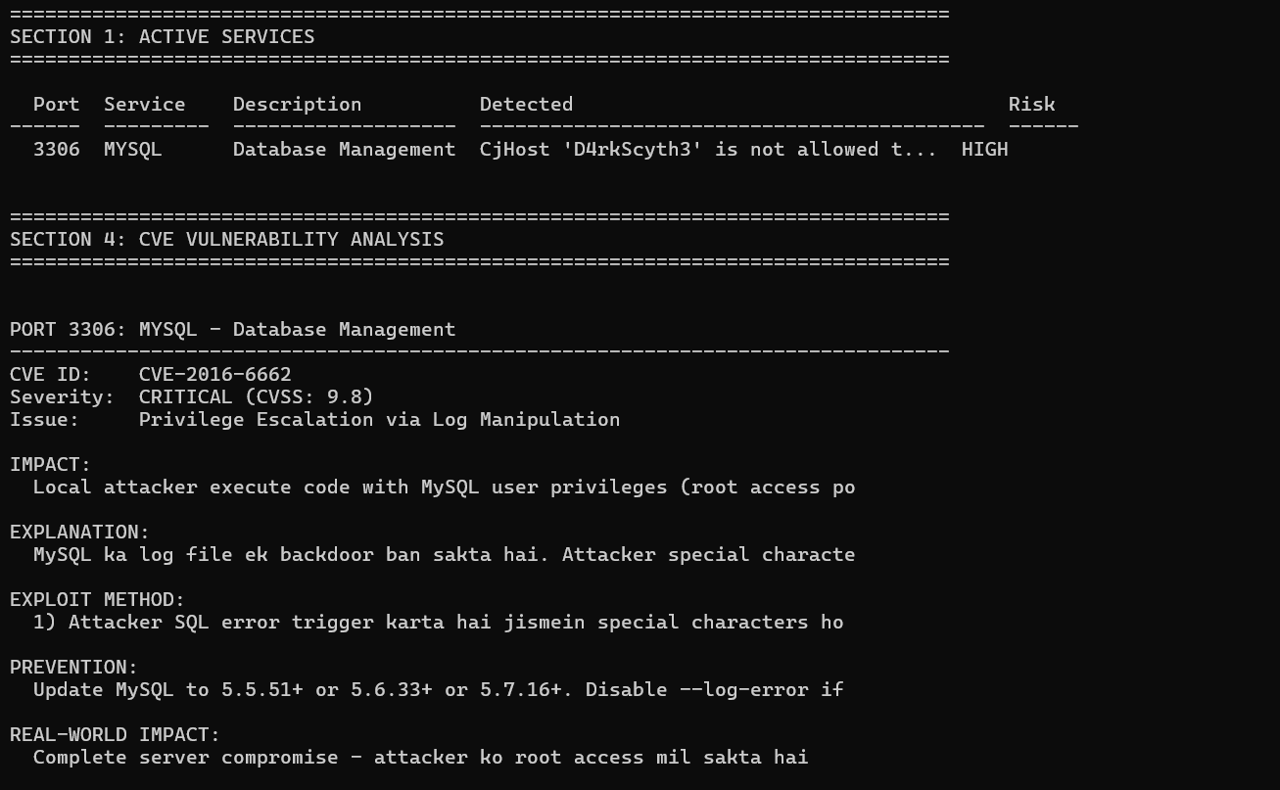
Why It's Built for Beginners
Simplified Concepts
It explains technical concepts in simple language.
Educational Descriptions
Its helps beginners learn while scanning ports.
Plain Text Logic
It shows results in an easy-to-read format.
Local Learning Environment
It allows safe practice on your own system. (127.0.0.1)

Slide 5
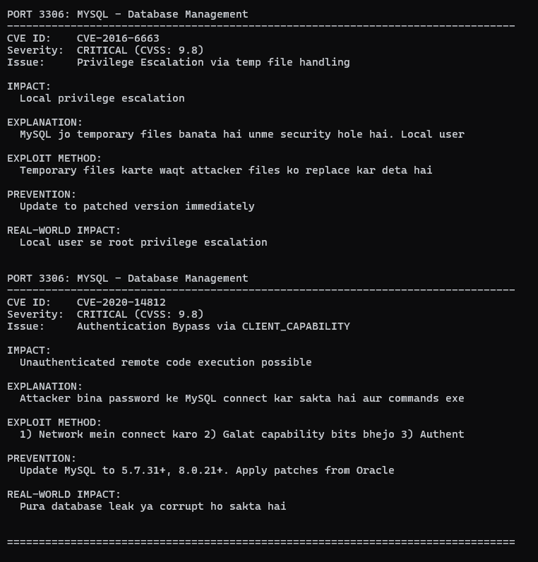




Deep Vulnerability (CVE) Analysis
CVE Database Integration
Helps find known vulnerabilities from a CVE local database.
Exploit Visualization
Explains how attackers exploit security weakness.
Severity Scoring
Shows how serious each vulnerability is using severity scores.
Matching with past attacks
Provide real examples of past cyber attacks.

Slide 6
Actionable Security Recommendations
01
02
Step-by-Step fixes
Linux/Unix Support
Gives clear steps and commands to fix security problems/ not just find them.
Shows simple systemctl commands to stop or disable unsafe services.
03
04
Windows Support
Alternative Suggestions
Explains how to fix issues using windows tools like Services and Control Panel.
Suggests safer options, such as using SFTP instead of FTP.

Slide 7
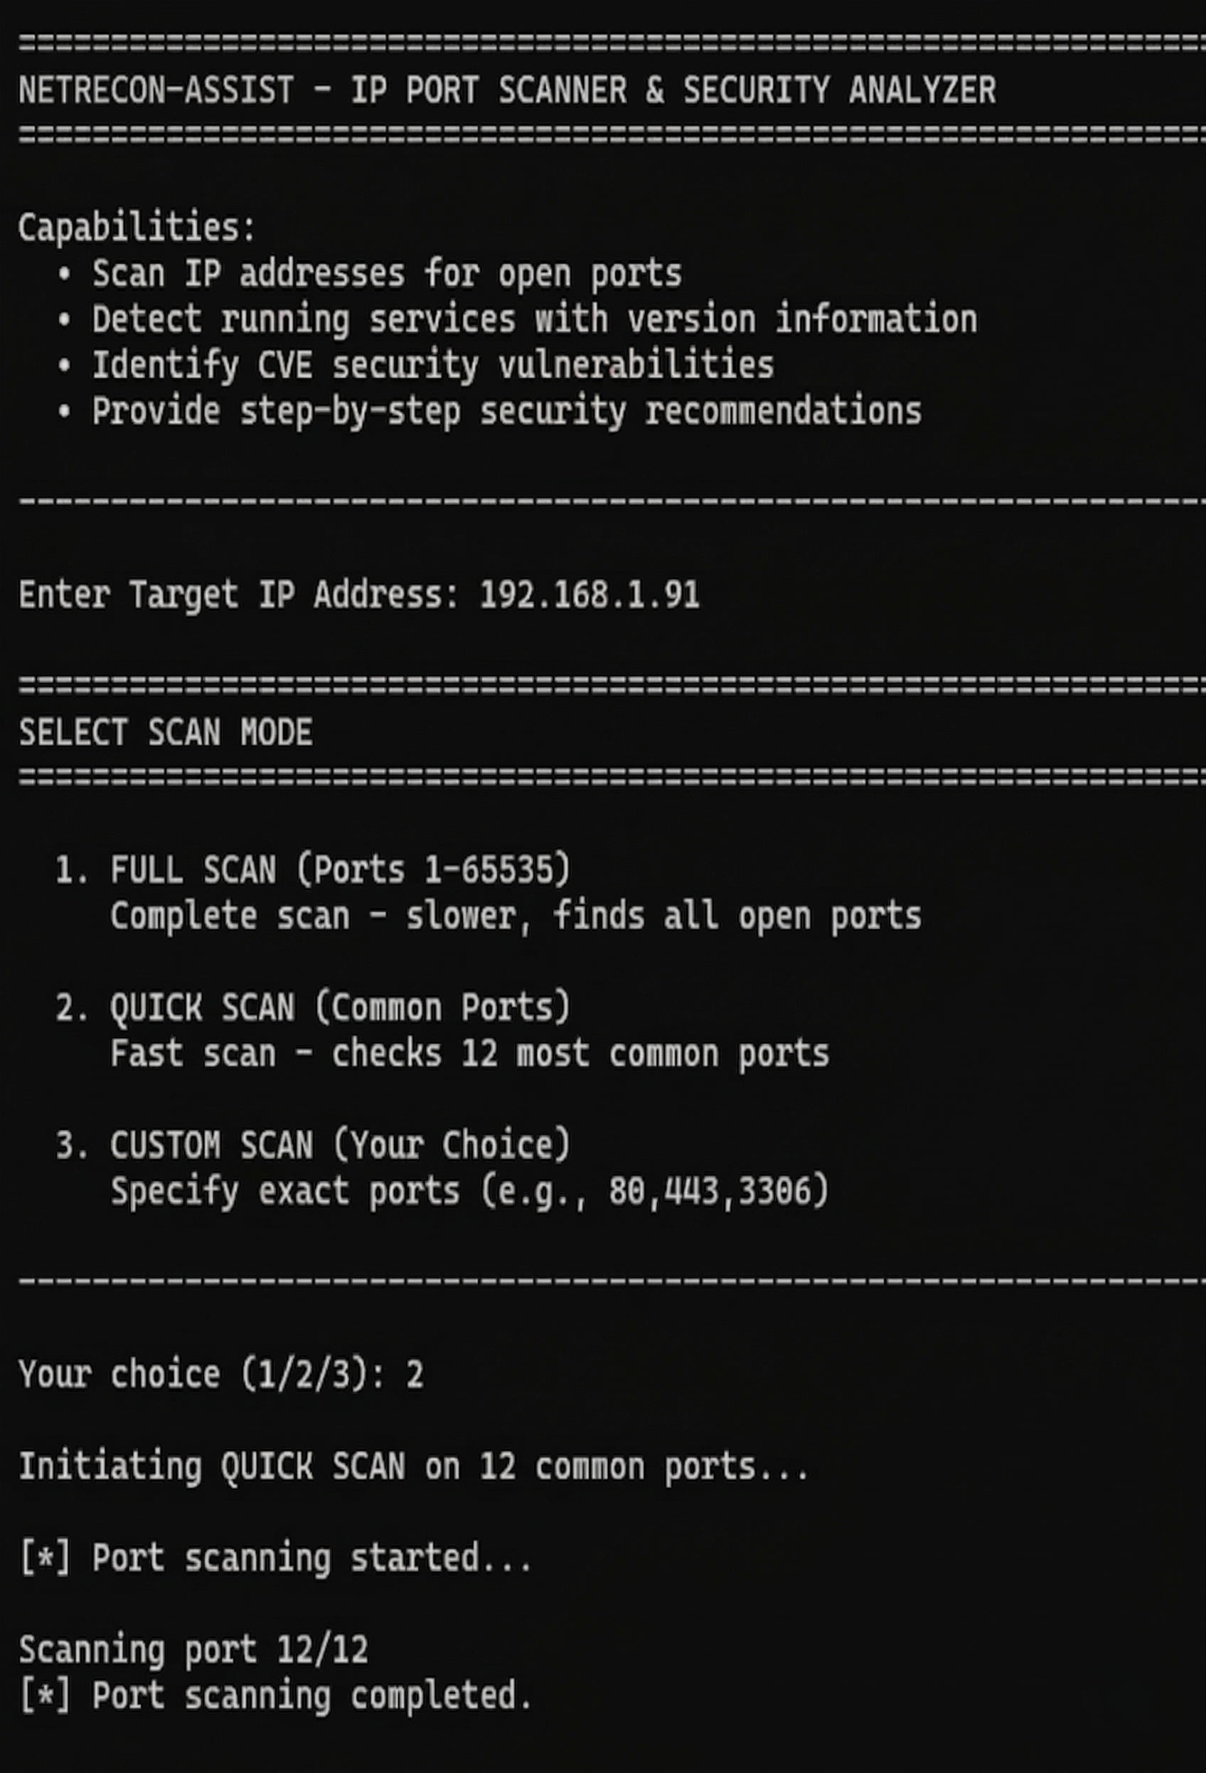
The Security Principle
Attack Surface Reduction
Proactive Defense
Close unused ports before attackers find them.
"Fewer open ports = Fewer chances for attack"
Stepping Stone
Helps beginners move from basic knowledge to advance tools.

Slide 8

learning Makes Security Strong
NetRecon-Assist helps beginners understand networking and security in an easy and practice way.

