Slide 1
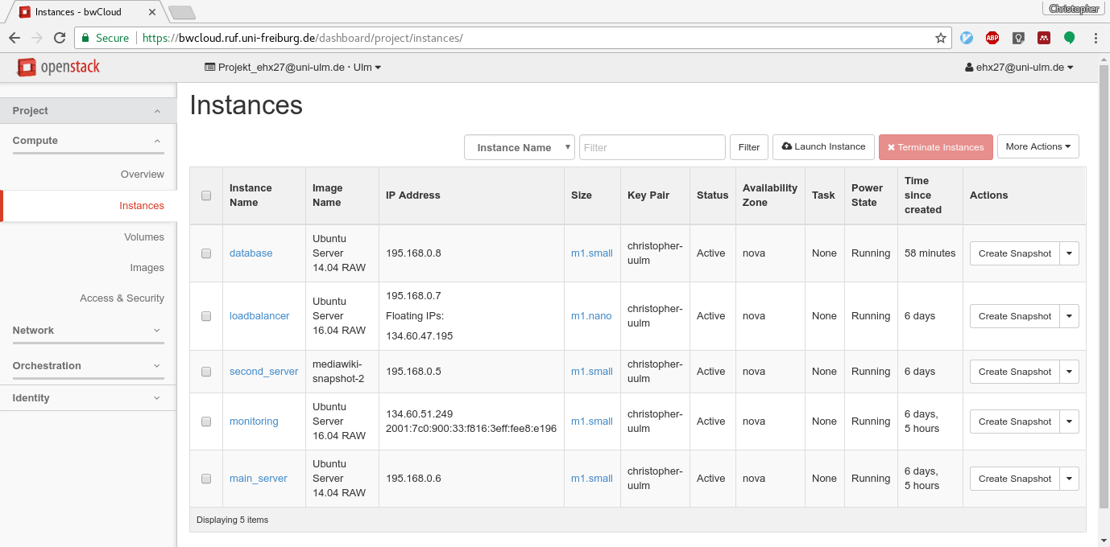
Exercise 3: Solution
You should have five VMs now

Slide 2
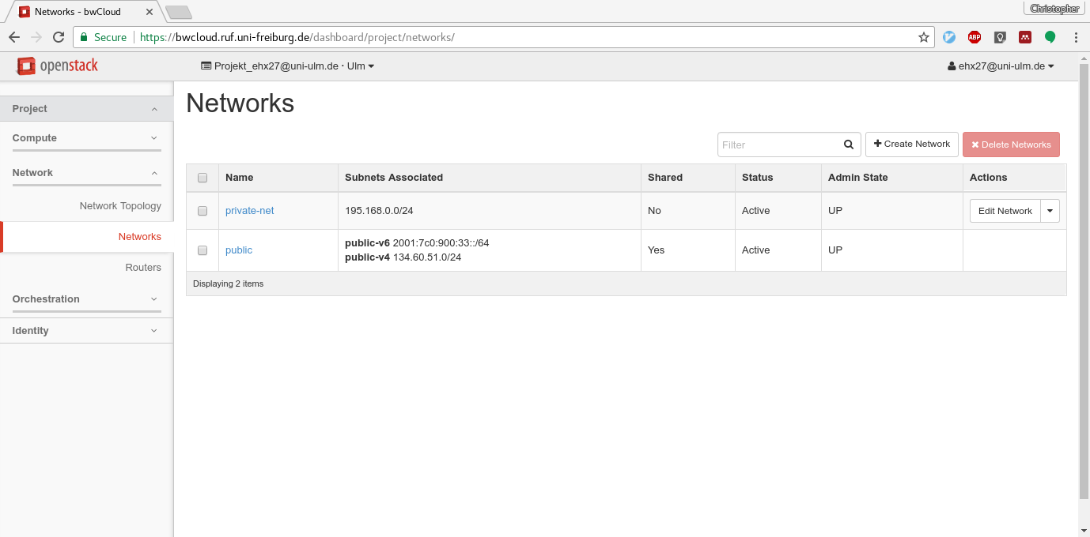
Exercise 3: Solution
You should have a private network

Slide 3
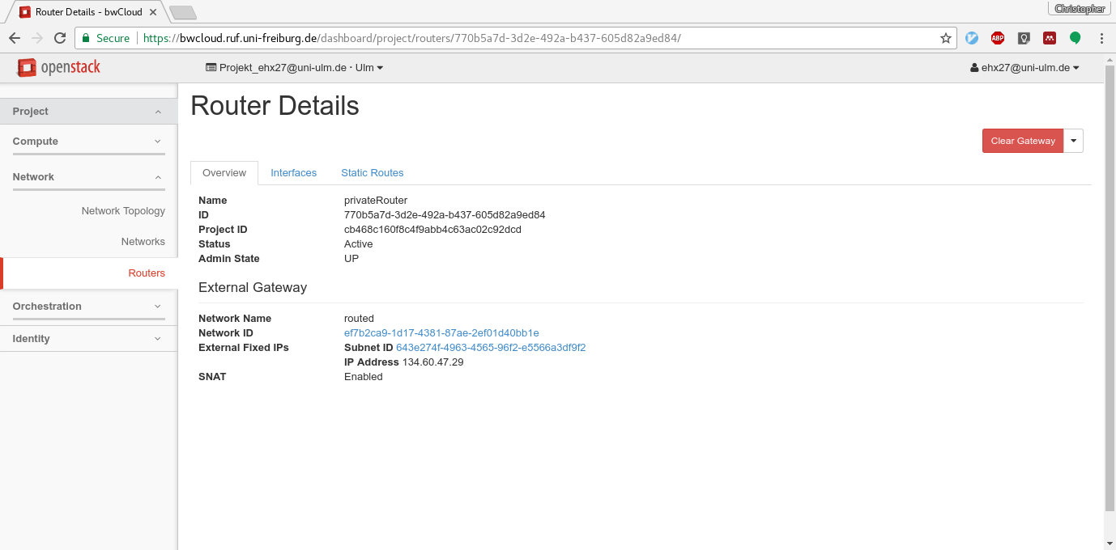
Exercise 3: Solution
… and a router

Slide 4
Stressing mediawiki
Vertical Scaling:
Horizoncal Scaling:
Separate database VM
Separate loadbalancer VM
Two mediawiki instances with 2vCPUs
2 vCPUs | 1 concurrent | 8 R/s
 | 10 concurrent | 30 R/2
4 vCPUs | 1 concurrent | 8 R/s
 | 10 concurrent | 60 R/2
2 vCPUs | 1 concurrent | 6 R/s
 | 10 concurrent | 53 R/2

Slide 5
Questions:

