Slide 1

1 0 1 1 0
0 0 0 1 1
1 1 0 1 0
0 0 1 0 0
Companion #2
Seminars and Exercises
Daniel Baur, Christopher Hauser Institut für Organisation und Management von Informationssystemen
Sommersemester 2017
Cross-Organizational Distributed
Systems and Clouds
Notes:
<number>

Slide 2
What has happened since last time?
You created accounts in bwcloud
You walked through the first excercise
=> You have a mediawiki running
You answered questions in moodle
Any Problems with your mediawiki installation?

Slide 3
Hands-on Open Stack
What are Virtual Machines?
software-based emulation of a computer
„an efficient and isolated duplicate of a real machine“
a platform that supports the execution of a whole operating system
In our context:
a computer that can be
configured (assembled)
managed and controlled over the Internet
The “Cloud” we used is
A management platform
Instant availability of (virtual) hardware resources
Yielding scalability for elastic applications

Slide 4
Hands-on Open Stack
key creation
don’t forget to save it
create security group
launch instance
select your key

Slide 5
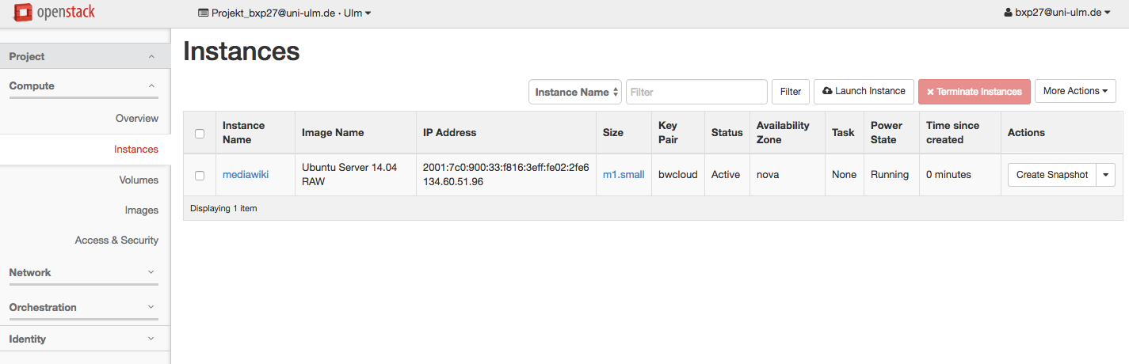
Hands-on Open Stack
Launch instance (IV):

Slide 6
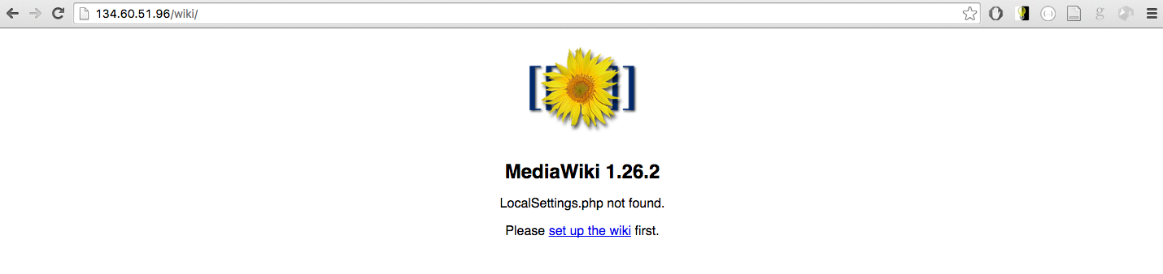
Hands-on Open Stack
Install wiki application (web installer I)

Slide 7
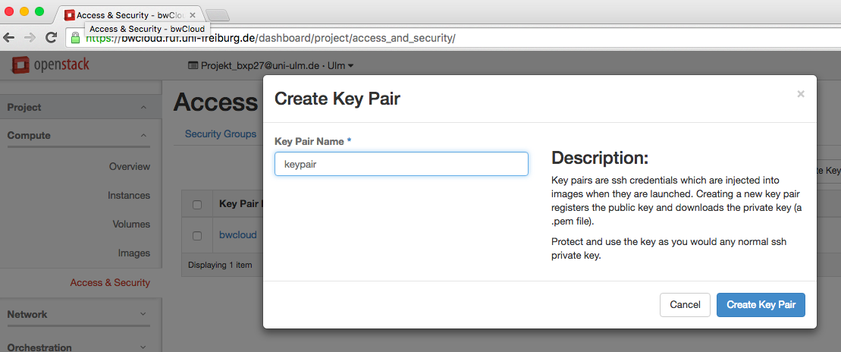
Hands-on Open Stack
Create a keypair:

Slide 8
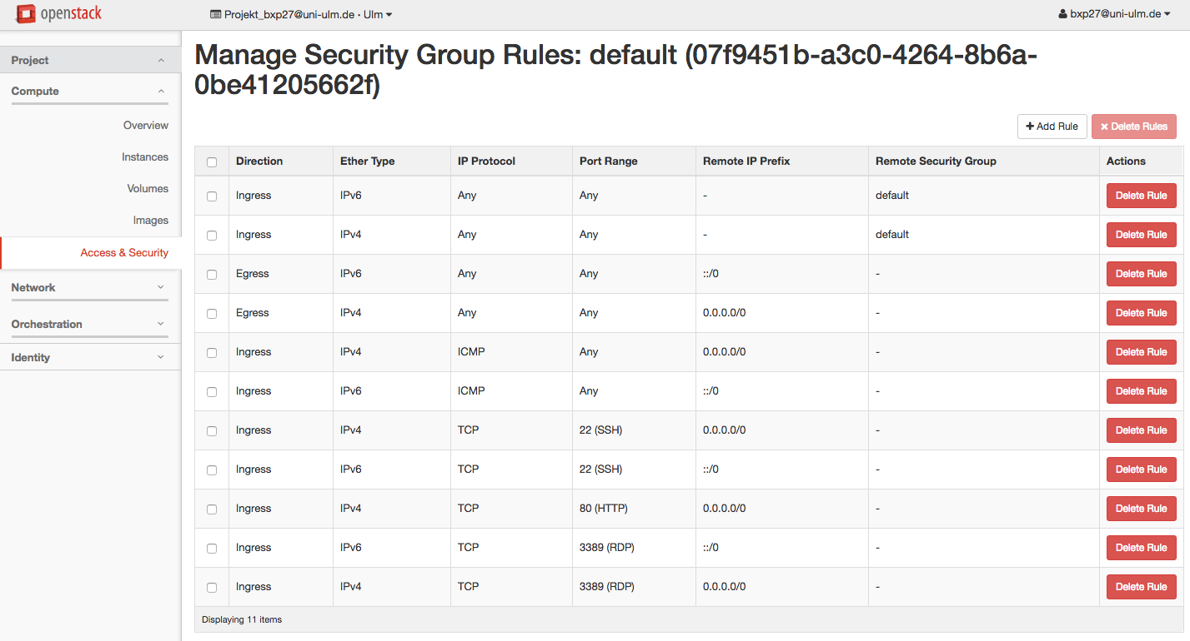
Hands-on Open Stack
Create a security group:

Slide 9
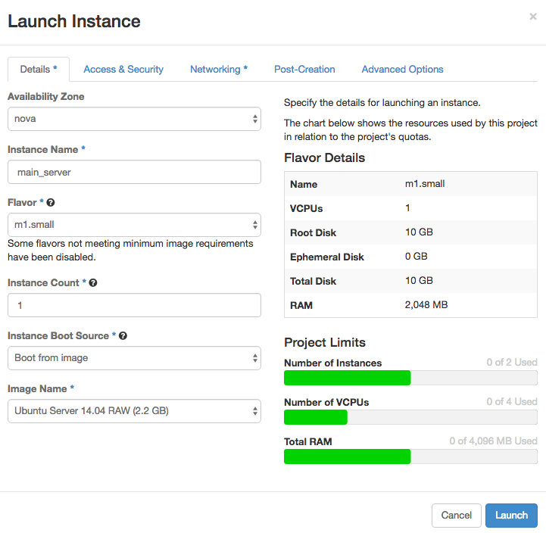
Hands-on Open Stack
Launch instance (I):

Slide 10
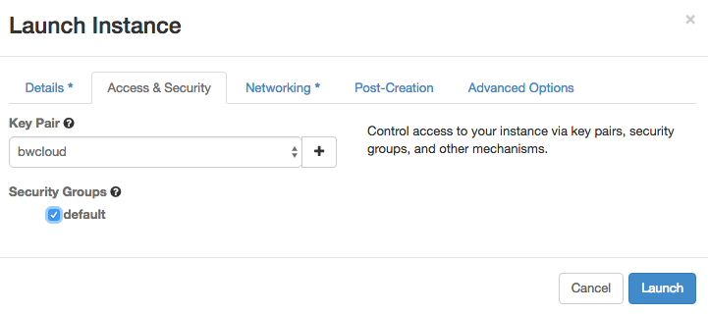
Hands-on Open Stack
Launch instance (II):

Slide 11
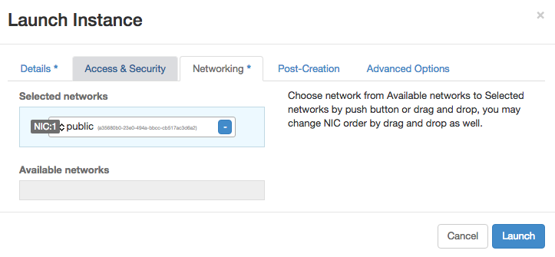
Hands-on Open Stack
Launch instance (III):

Slide 12
Hands-on Open Stack
Access Virtual Machine
IP address is something like 134.60.51.96
To connect to the virtual machine, we require a secure shell connection
ssh-cli (Unix)
Putty (Windows)

Slide 13
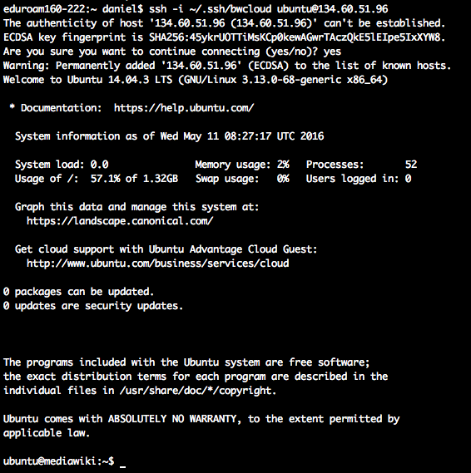
Hands-on Open Stack
SSH Access (Unix)

Slide 14
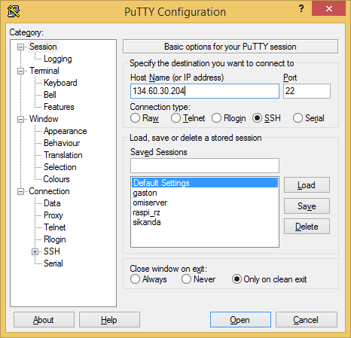
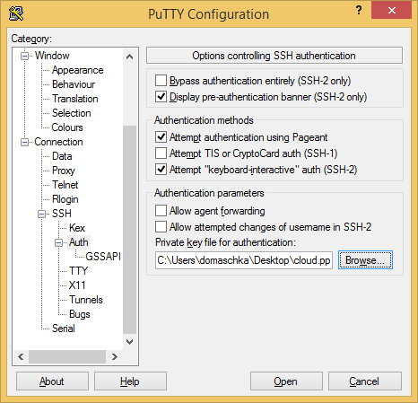
Hands-on Open Stack
SSH Access (Windows)

Slide 15
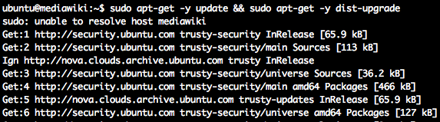
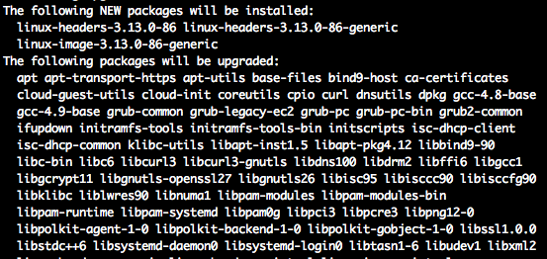
Hands-on Open Stack
Install wiki application (Prepare apt Packages)

Slide 16
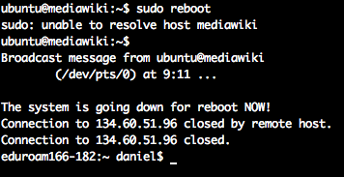
Hands-on Open Stack
Install wiki application (reboot)

Slide 17
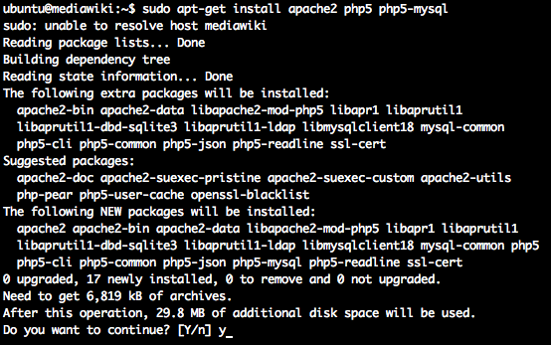
Hands-on Open Stack
Install wiki application (dependencies)

Slide 18
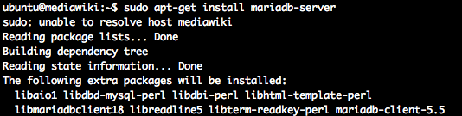
Hands-on Open Stack
Install wiki application (dependencies)

Slide 19
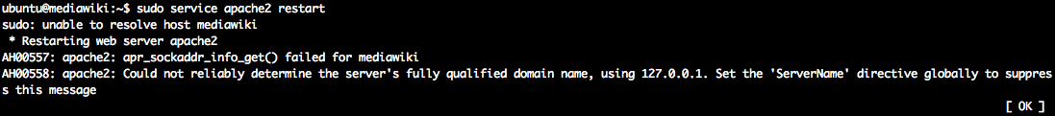
Hands-on Open Stack
Install wiki application (restart apache)

Slide 20
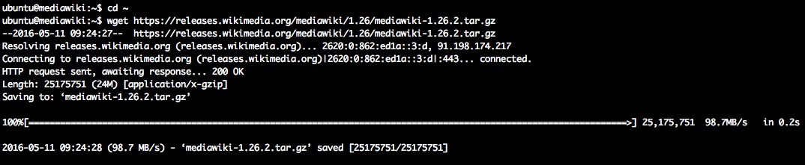
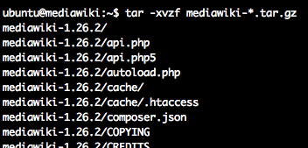
Hands-on Open Stack
Install wiki application (download & extract)

Slide 21
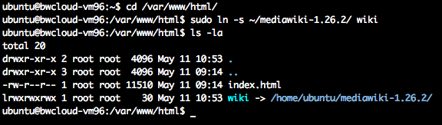
Hands-on Open Stack
Install wiki application (symbolic link)

Slide 22
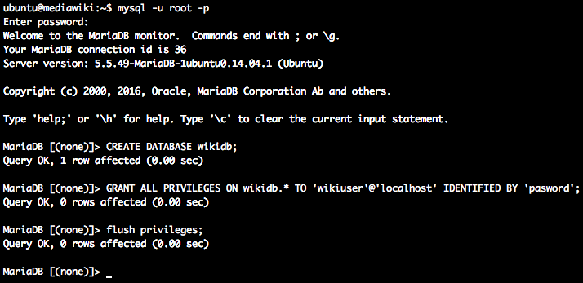
Hands-on Open Stack
Install wiki application (database)

Slide 23
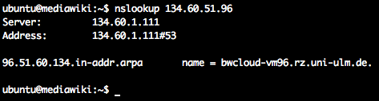
Hands-on Open Stack
Install wiki application (find out dns/hostname)

Slide 24
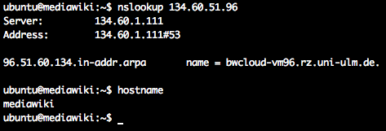
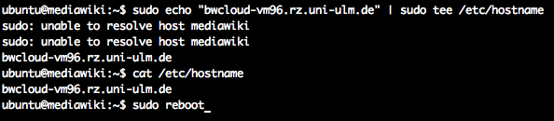
Hands-on Open Stack
Install wiki application (fix apache)

Slide 25
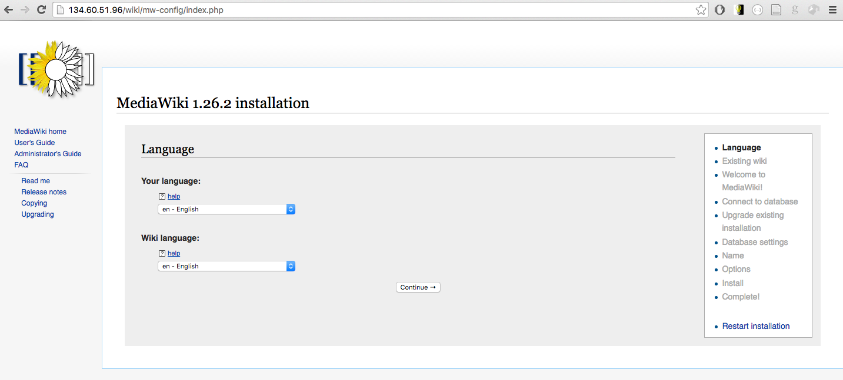
Hands-on Open Stack
Install wiki application (web installer II)

Slide 26
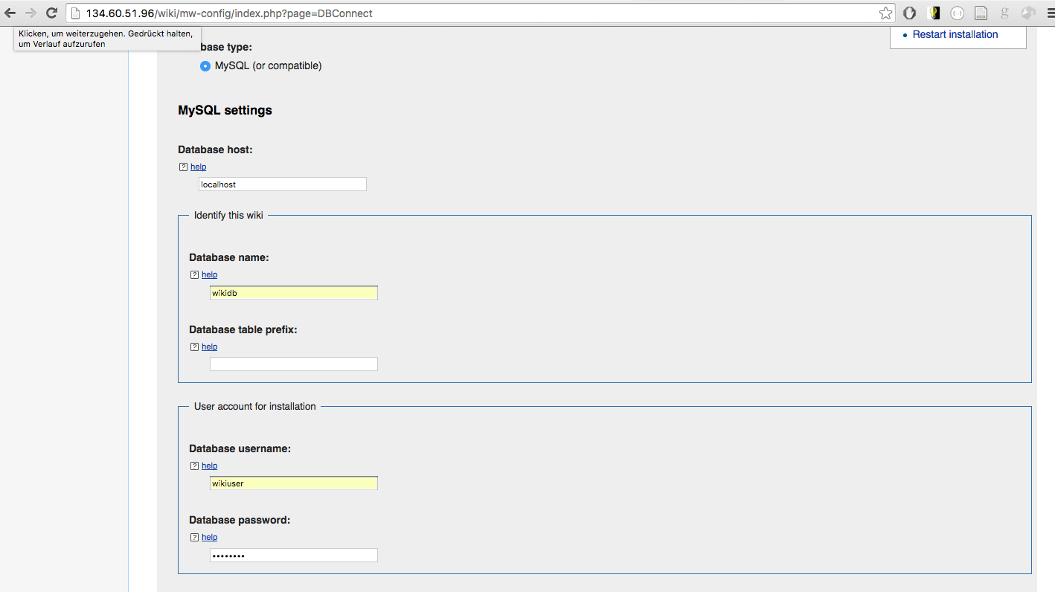
Hands-on Open Stack
Install wiki application (web installer III)

Slide 27
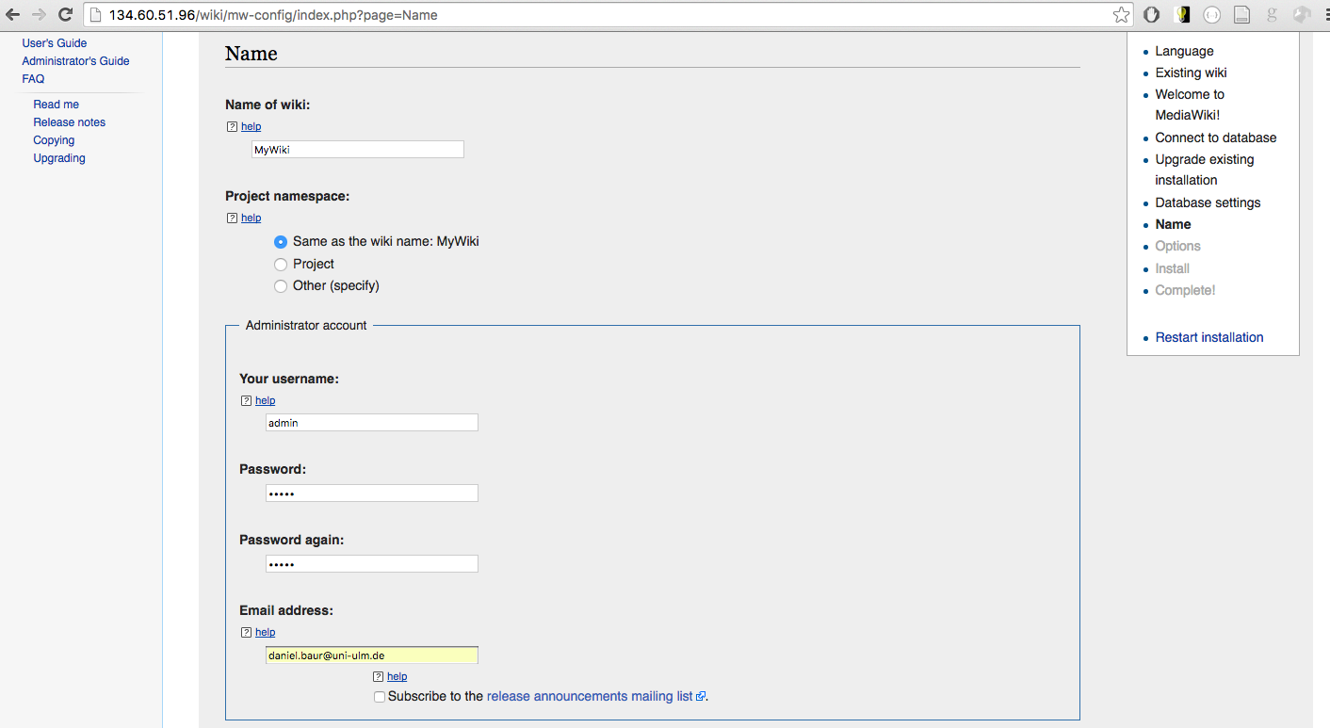
Hands-on Open Stack
Install wiki application (web installer IV)

Slide 28
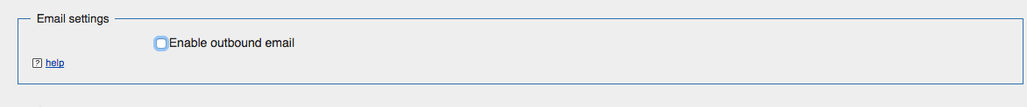
Hands-on Open Stack
Install wiki application (web installer V)

Slide 29
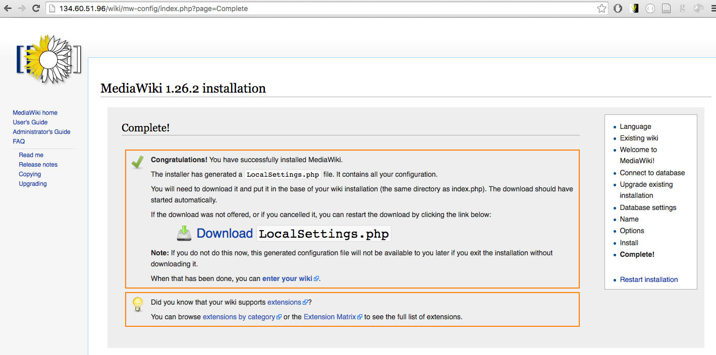
Hands-on Open Stack
Install wiki application (web installer VI)

Slide 30

Hands-on Open Stack
Install wiki application (LocalSettings.php)

Slide 31
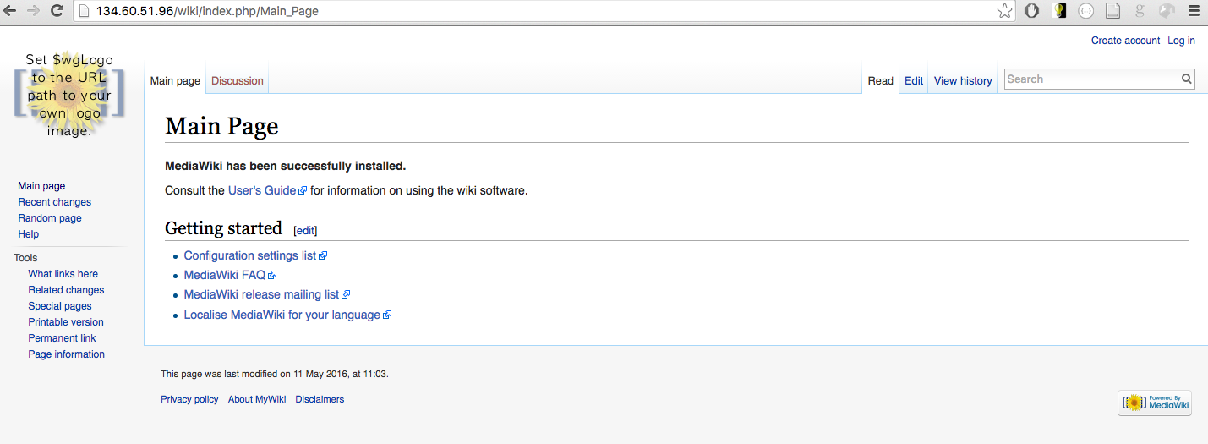
Hands-on Open Stack
Wiki installed

Slide 32
Architectural Result
Virtual Machine
mariaDB
Apache2 + php
port: 80
port: 3306
http://<public ip>:80
127.0.0.1

Slide 33
Hands-on Open Stack
Apache2 + MariaDB binding
Good:
connection via 127.0.0.1 is quick
Traffic does not leave the host
Bad:
There is only one 127.0.0.1 => Scalability
Apache2 and mariaDB have to run on the same node
DB and Web server have different resource demand (CPU vs Memory/Disk)
Better
Move database to different host
Connect apache2 to it

Slide 34
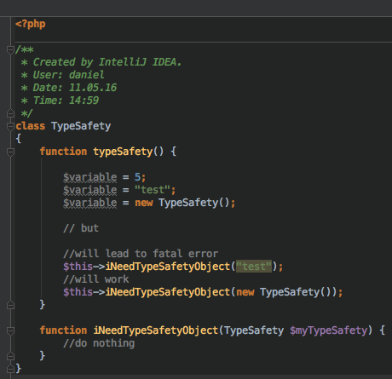
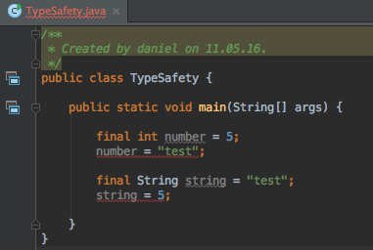
(Bonus) PHP vs Java
Type Safety:
Java: Type Safe
PHP: Type Hinting

Slide 35
(Bonus) PHP vs Java
Source: http://althing.cs.dartmouth.edu/local/www.acm.uiuc.edu/sigmil/RevEng/ch02.html

Slide 36
(Bonus) PHP vs Java
Source: http://jpauli.github.io/2015/03/05/opcache.html

Slide 37
Any problems we have here?
Virtual Machine
mariaDB
Apache2 + php
port: 80
port: 3306
http://<public ip>:80
127.0.0.1
Scaling: add more resources when needed
resources could be a virtual machine

Slide 38
Reminder: IaaS Cloud Computing
Reasons for Infrastructure as a Service:
Instant access to resources
Usage based accounting
Cloud applications should use the „elasticity“
Scale up and down according to its needs

