Slide 1
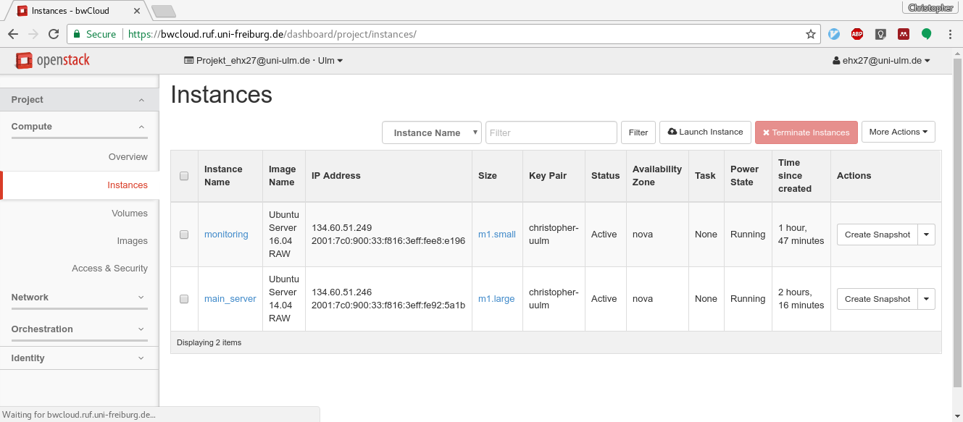
Hands-on II: Monitoring and Stressing
You should have two VMs now

Slide 2
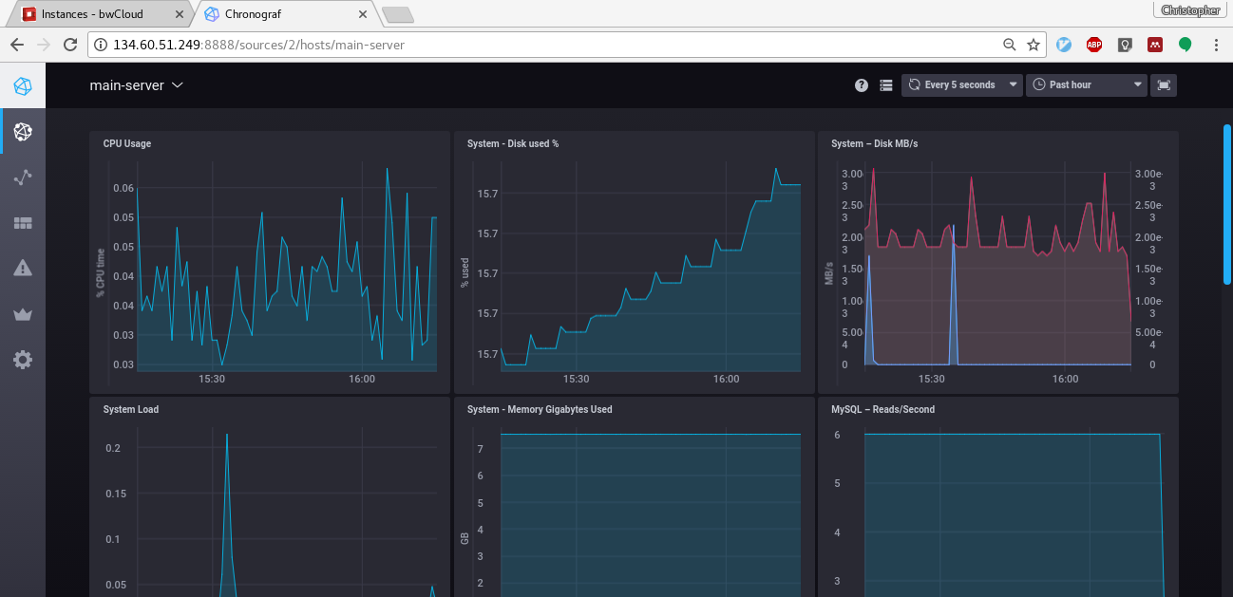
Hands-on II: Monitoring and Stressing
The Chronograf Dashboard has monitoring data of main_server

Slide 3
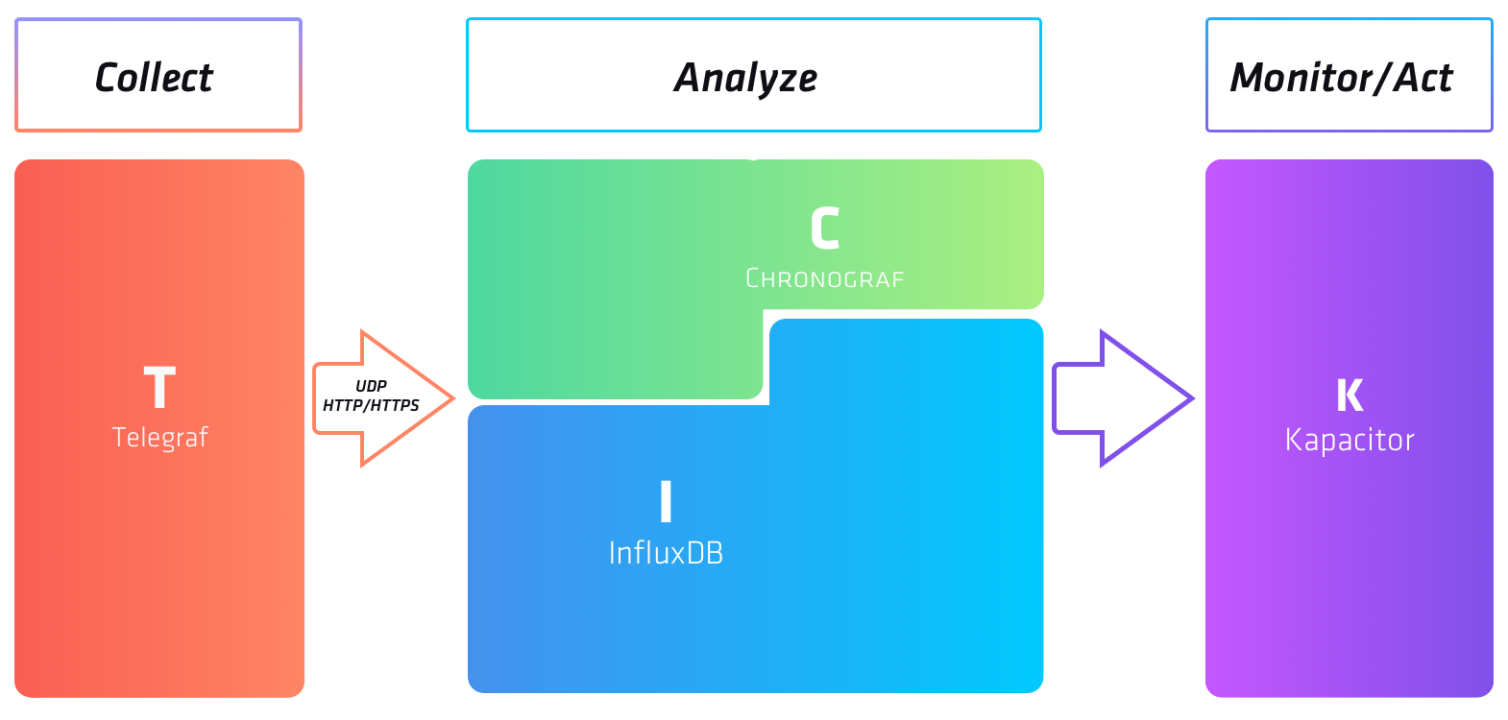
Hands-on II: Monitoring and Stressing
Min. TICK stack
Min. TICK stack
Web dashboard
Monitoring agent / data collector
Data processor and alerting
Time-series database, monitoring data store

Slide 4
Hands-on II: Monitoring and Stressing
By default, InfluxDB uses the following network ports:
TCP port 8086 is used for client-server communication over InfluxDB’s HTTP API
TCP port 8088 is used for the RPC service for backup and restore
ubuntu@monitoring:~$ sudo netstat -tulpen
sudo: unable to resolve host monitoring
Active Internet connections (only servers)
Proto Recv-Q Send-Q Local Address Foreign Address State User Inode PID/Program name
tcp 0 0 0.0.0.0:22 0.0.0.0:* LISTEN 0 13017 1043/sshd
tcp6 0 0 :::8086 :::* LISTEN 999 18068 2411/influxd
tcp6 0 0 :::22 :::* LISTEN 0 13025 1043/sshd
tcp6 0 0 :::8888 :::* LISTEN 998 18308 2505/chronograf
tcp6 0 0 :::8088 :::* LISTEN 999 18066 2411/influxd
udp 0 0 0.0.0.0:68 0.0.0.0:* 0 13398 880/dhclient

Slide 5
Stressing the Wiki – Part 1
Concurrency Level: 1
Time taken for tests: 618.219 seconds
Complete requests: 5000
Failed requests: 4958
(Connect: 0, Receive: 0, Length: 4958, Exceptions: 0)
Non-2xx responses: 5000
Total transferred: 58650042 bytes
HTML transferred: 56685042 bytes
Requests per second: 8.09 [#/sec] (mean)
Time per request: 123.644 [ms] (mean)
Time per request: 123.644 [ms] (mean, across all concurrent requests)
Transfer rate: 92.65 [Kbytes/sec] received
Connection Times (ms)
min mean[+/-sd] median max
Connect: 0 0 0.8 0 12
Processing: 101 123 21.5 121 1124
Waiting: 55 71 14.2 68 813
Total: 101 124 21.5 121 1124
Percentage of the requests served within a certain time (ms)
50% 121
66% 125
75% 127
80% 129
90% 135
95% 142
98% 152
99% 162
100% 1124 (longest request)
Concurrency Level: 10
Time taken for tests: 165.952 seconds
Complete requests: 5000
Failed requests: 4
(Connect: 0, Receive: 0, Length: 4, Exceptions: 0)
Non-2xx responses: 5000
Total transferred: 58654996 bytes
HTML transferred: 56689996 bytes
Requests per second: 30.13 [#/sec] (mean)
Time per request: 331.903 [ms] (mean)
Time per request: 33.190 [ms] (mean, across all concurrent requests)
Transfer rate: 345.16 [Kbytes/sec] received
Connection Times (ms)
min mean[+/-sd] median max
Connect: 0 0 0.5 0 11
Processing: 89 332 57.8 333 501
Waiting: 76 284 50.9 285 442
Total: 90 332 57.8 333 501
Percentage of the requests served within a certain time (ms)
50% 333
66% 357
75% 372
80% 380
90% 406
95% 425
98% 447
99% 459
100% 501 (longest request)

Slide 6
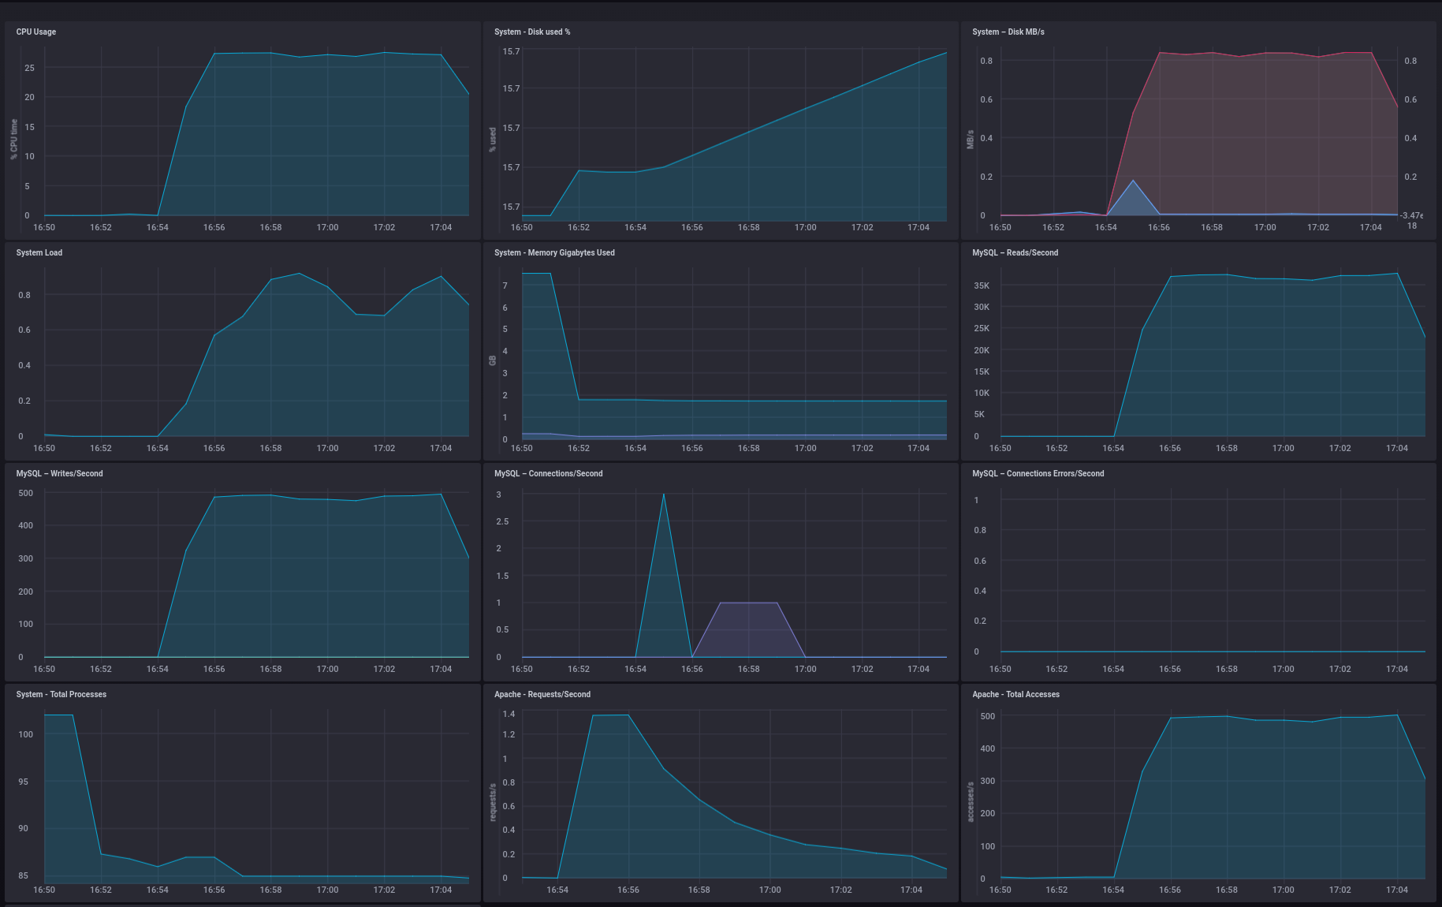
No concurrency
Stressing the Wiki – Part 1

Slide 7
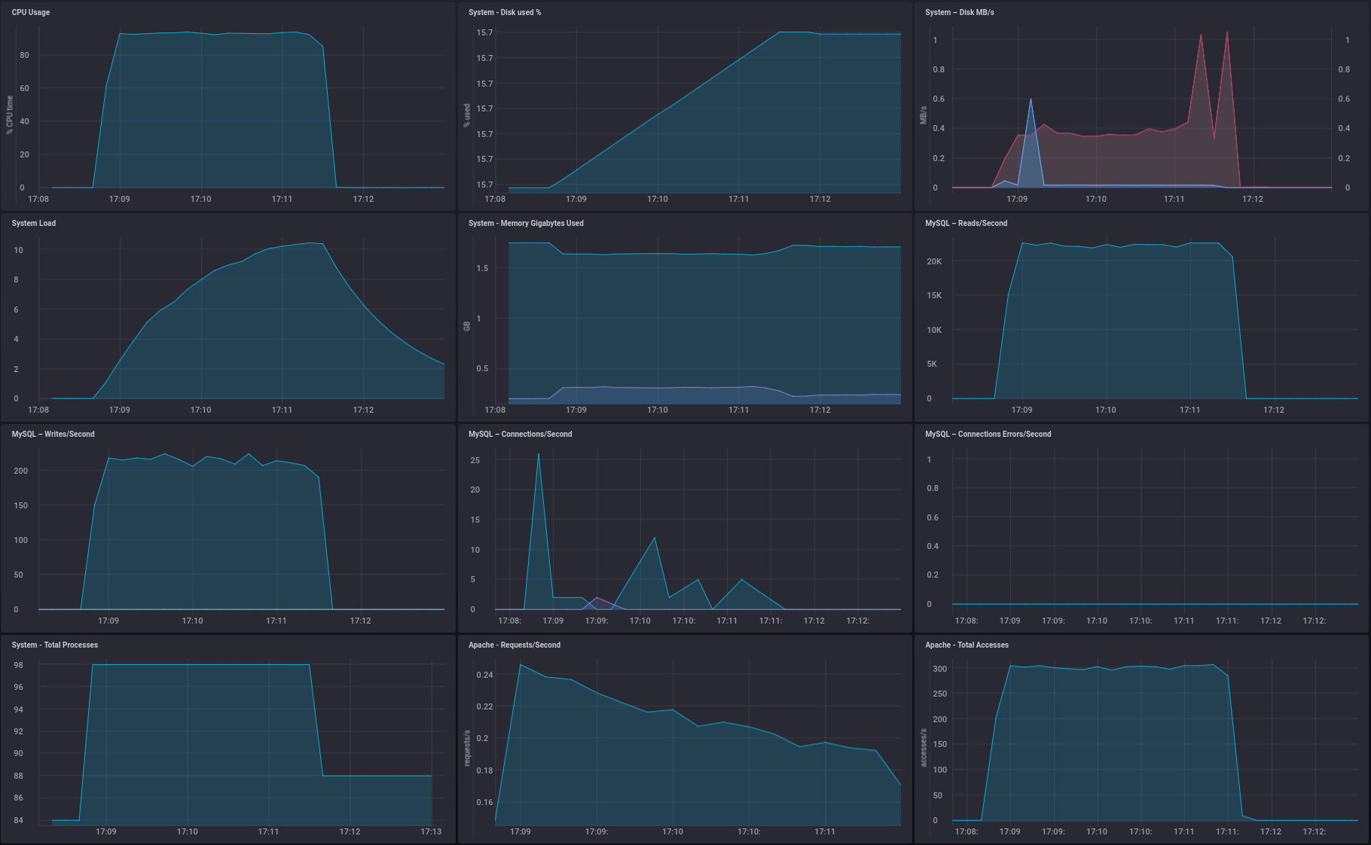
10x concurrency
Stressing the Wiki – Part 1

Slide 8
Vertical Scaling!
=> enlarge the machine you have by adding more resources.
m1.small
2GB Ram
2 vCores CPU
10GB Disk
m1.large
8GB Ram
4 vCores CPU
10GB Disk

Slide 9
Stressing the Wiki – Part 2
Concurrency Level: 1
Time taken for tests: 604.299 seconds
Complete requests: 5000
Failed requests: 4904
(Connect: 0, Receive: 0, Length: 4904, Exceptions: 0)
Non-2xx responses: 5000
Total transferred: 58650096 bytes
HTML transferred: 56685096 bytes
Requests per second: 8.27 [#/sec] (mean)
Time per request: 120.860 [ms] (mean)
Time per request: 120.860 [ms] (mean, across all concurrent requests)
Transfer rate: 94.78 [Kbytes/sec] received
Connection Times (ms)
min mean[+/-sd] median max
Connect: 0 0 0.1 0 2
Processing: 101 121 20.6 117 915
Waiting: 53 69 19.6 65 801
Total: 101 121 20.6 117 916
Percentage of the requests served within a certain time (ms)
50% 117
66% 121
75% 124
80% 126
90% 132
95% 140
98% 159
99% 177
100% 916 (longest request)
Concurrency Level: 10
Time taken for tests: 79.773 seconds
Complete requests: 5000
Failed requests: 1324
(Connect: 0, Receive: 0, Length: 1324, Exceptions: 0)
Non-2xx responses: 5000
Total transferred: 58653676 bytes
HTML transferred: 56688676 bytes
Requests per second: 62.68 [#/sec] (mean)
Time per request: 159.547 [ms] (mean)
Time per request: 15.955 [ms] (mean, across all concurrent requests)
Transfer rate: 718.02 [Kbytes/sec] received
Connection Times (ms)
min mean[+/-sd] median max
Connect: 0 0 0.1 0 2
Processing: 61 159 36.8 156 313
Waiting: 53 134 28.8 132 272
Total: 61 159 36.8 156 314
Percentage of the requests served within a certain time (ms)
50% 156
66% 171
75% 182
80% 190
90% 209
95% 225
98% 243
99% 258
100% 314 (longest request)

Slide 10
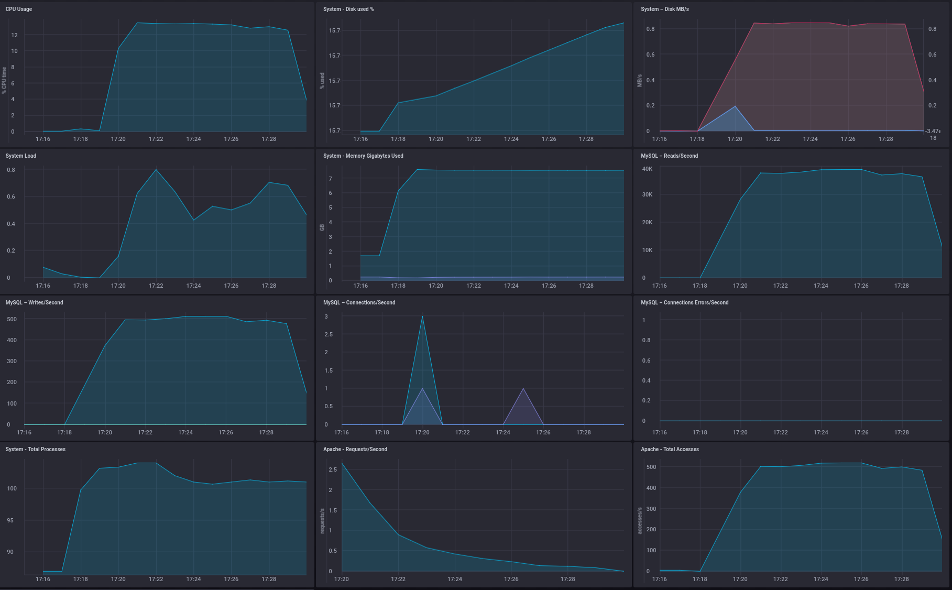
No concurrency
Stressing the Wiki – Part 1

Slide 11
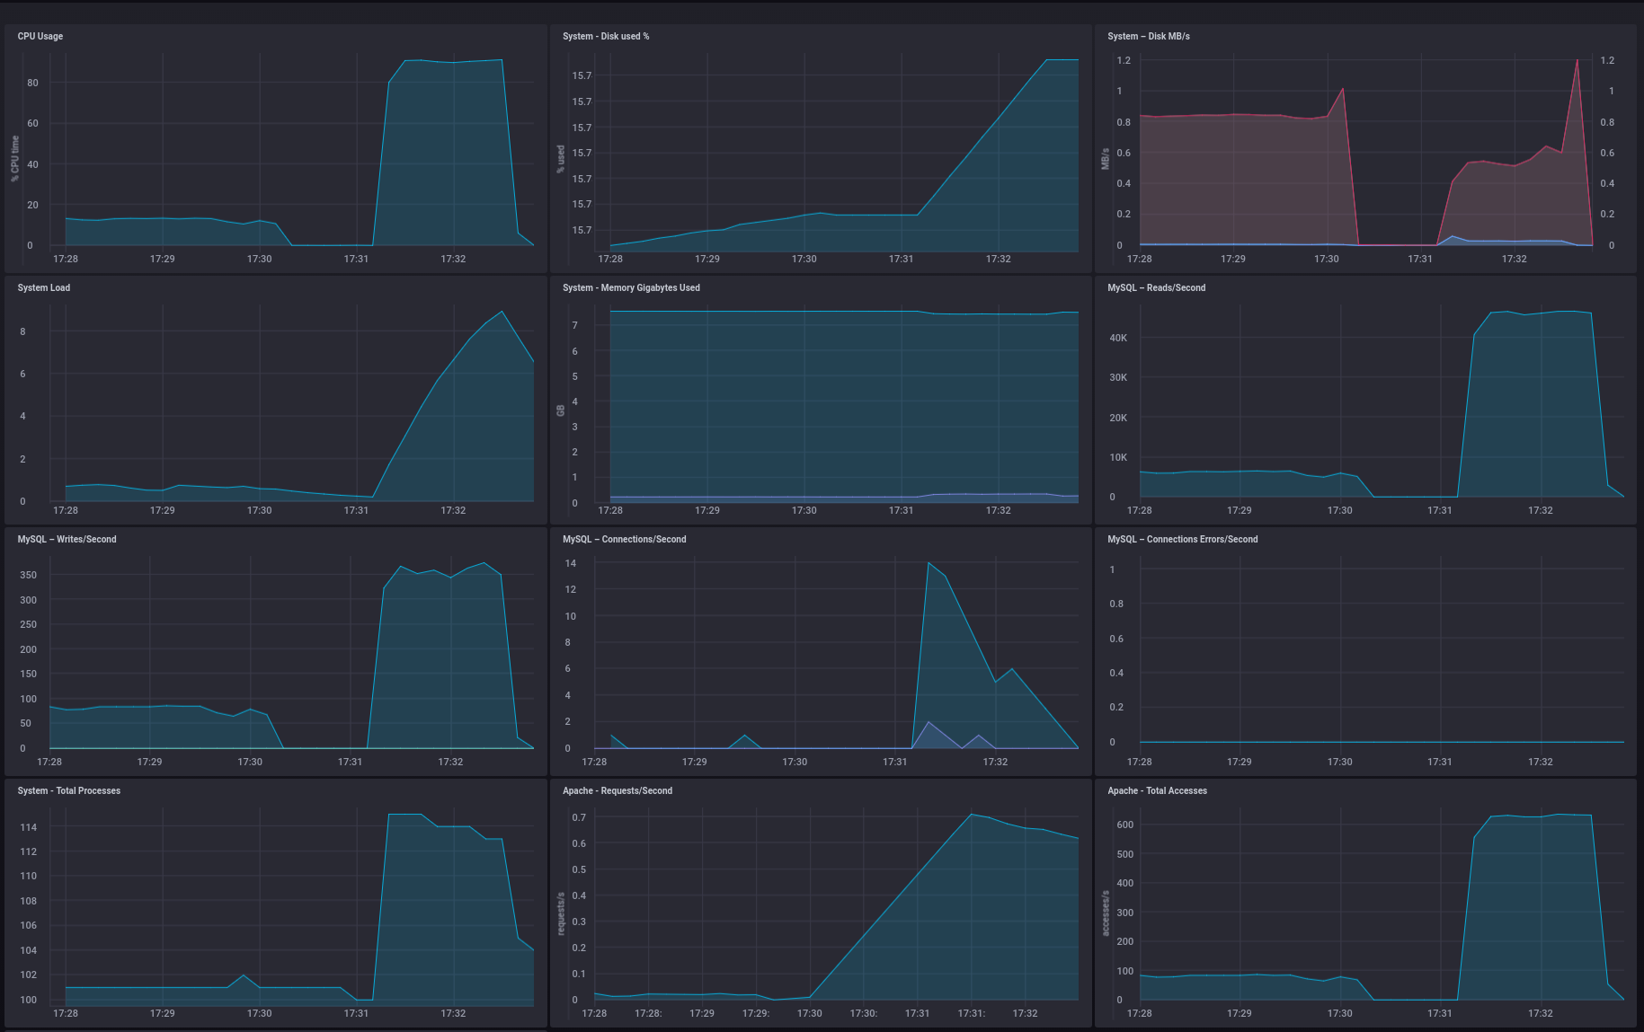
10x concurrency
Stressing the Wiki – Part 1

Slide 12
Vertical Scaling ?
Application is CPU bound
For concurrent requests more vCPUs are improving a lot!
Virtual scaling is limited to the larges available flavor. => unlimited scalability is not vertical.
2 vCPUs | 1 concurrent | 8 R/s
 | 10 concurrent | 30 R/2
4 vCPUs | 1 concurrent | 8 R/s
 | 10 concurrent | 60 R/2

Slide 13
(Bonus) Improve performance
Caching of PHP compilation (instead of recompiling)
Caching of application data (instead of requerying)
Caching of HTML files (instead of reparsing)
Optimize PHP Thread handling
Database Optimisations

