Slide 1
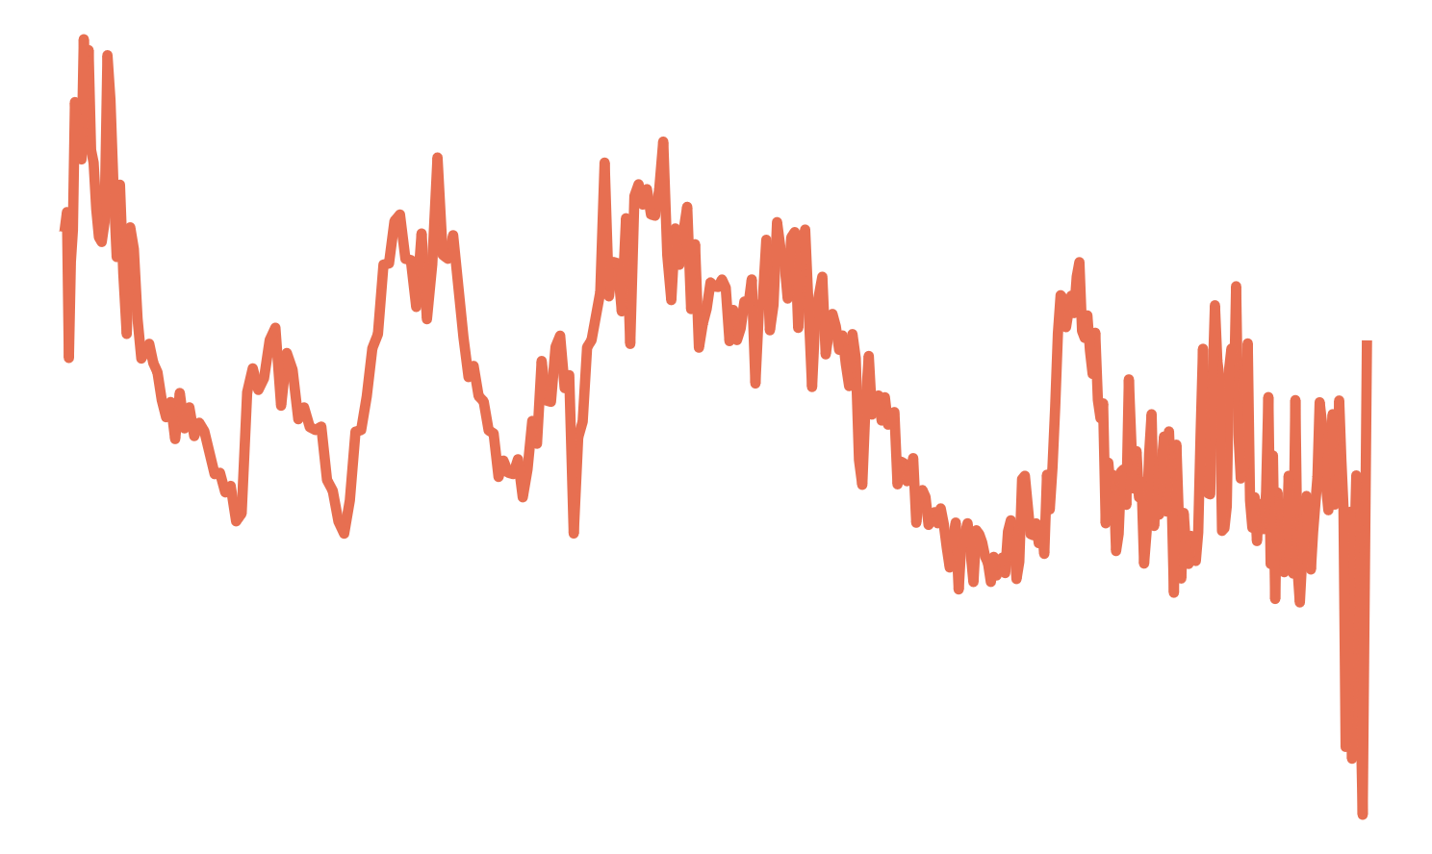


Input Spectrum
X
Encoder
$f_{θ}\left(X\right)=Z$
Latent
Space
Spots
Fac’s
CO₂
Z
Endmembers
$g_{θ′}\left(Z\right)=X′$
Decoder
Reconstructed Spectrum
-
-
Decontaminated Spectrum

Slide 2
Input Spectrum
X
Encoder
$f_{θ}\left(X\right)=Z$
Latent
Space
Spots
Fac’s
CO₂
Z
Endmembers
$g_{θ′}\left(Z\right)=X′$
Decoder
Reconstructed Spectrum
-
-
Decontaminated Spectrum

Slide 3


Input Spectrum
X
Encoder
$f_{θ}\left(X\right)=Z$
Latent
Space
Z
Decoder
$g_{θ′}\left(Z\right)=X′$
Reconstructed Spectrum

Slide 4
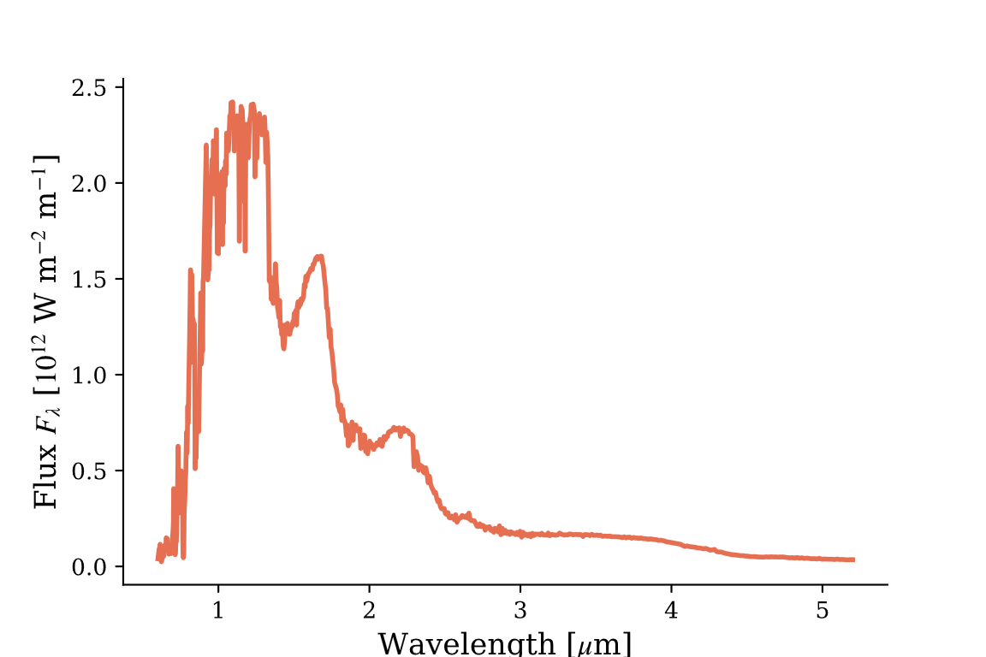
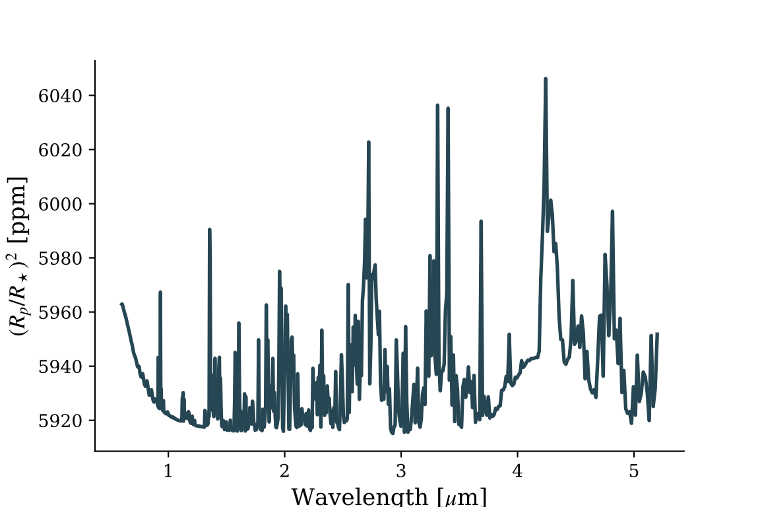
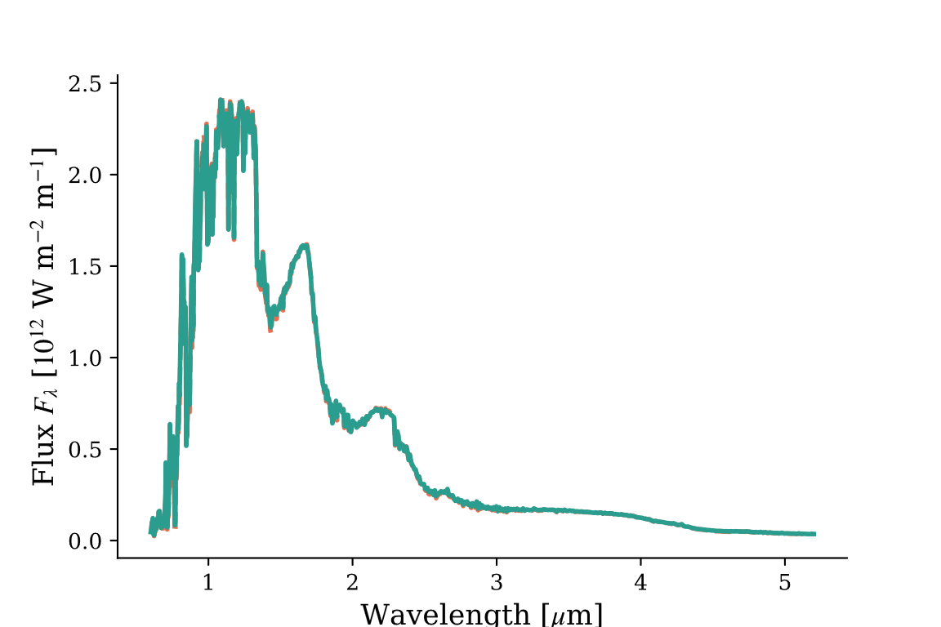
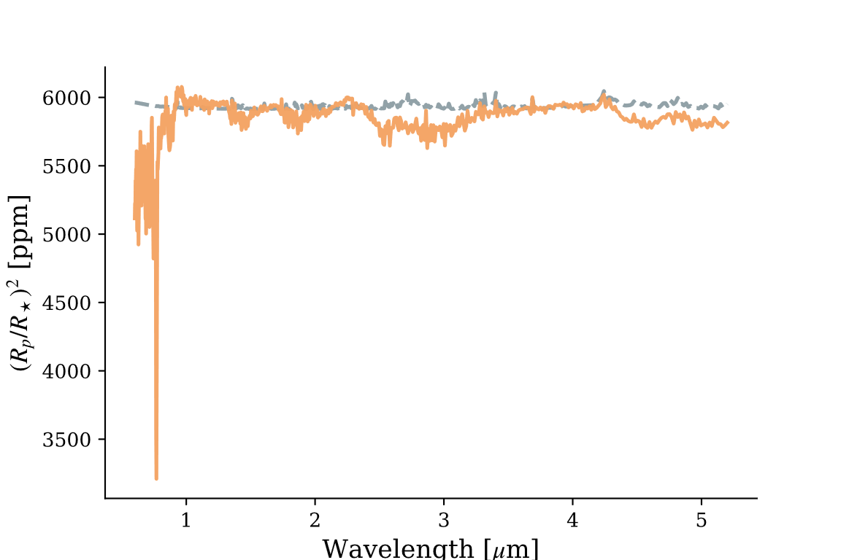
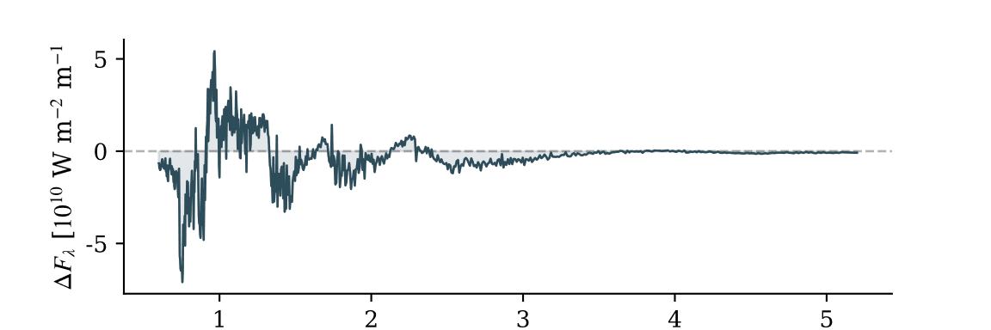
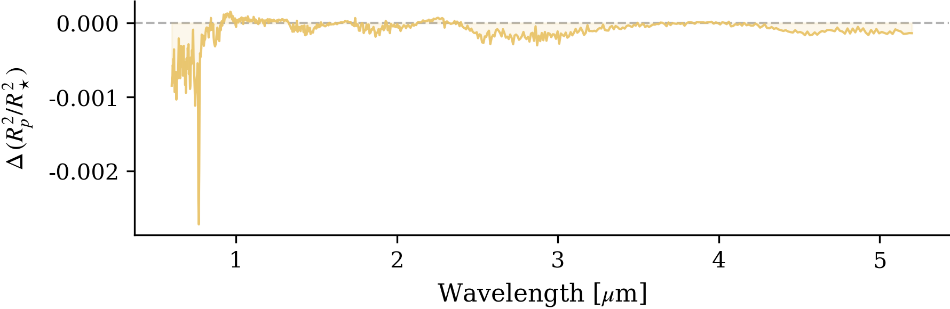
Photosphere
Photosphere +Transit
Stellar Spectrum
Transmission Spectrum
Disk
Disk +Transit
Stellar Spectrum
Transit
Residuals

