Slide 1
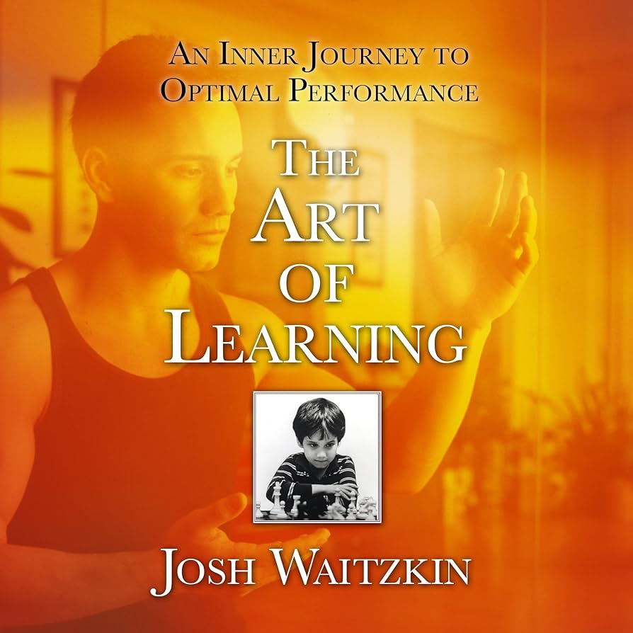
It is rarely a mysterious technique that drives us to the top, but rather a profound mastery of what may well be a basic skill set.
Josh Waitzkin, The Art of Learning: A Journey in the Pursuit of Excellence

Slide 2



Data Visualization
How many pattern violations do you see?

Slide 3
Data Visualization
Four Steps
Purpose
Content
Structure
Formatting

Slide 4

Step 1: Purpose
Which tool is better?

Slide 5

Step 2: Content
Americans Are Increasingly Using
Drive-Thru’s For Their Meals
# of McDondalds
in USA
Time ->

Slide 6
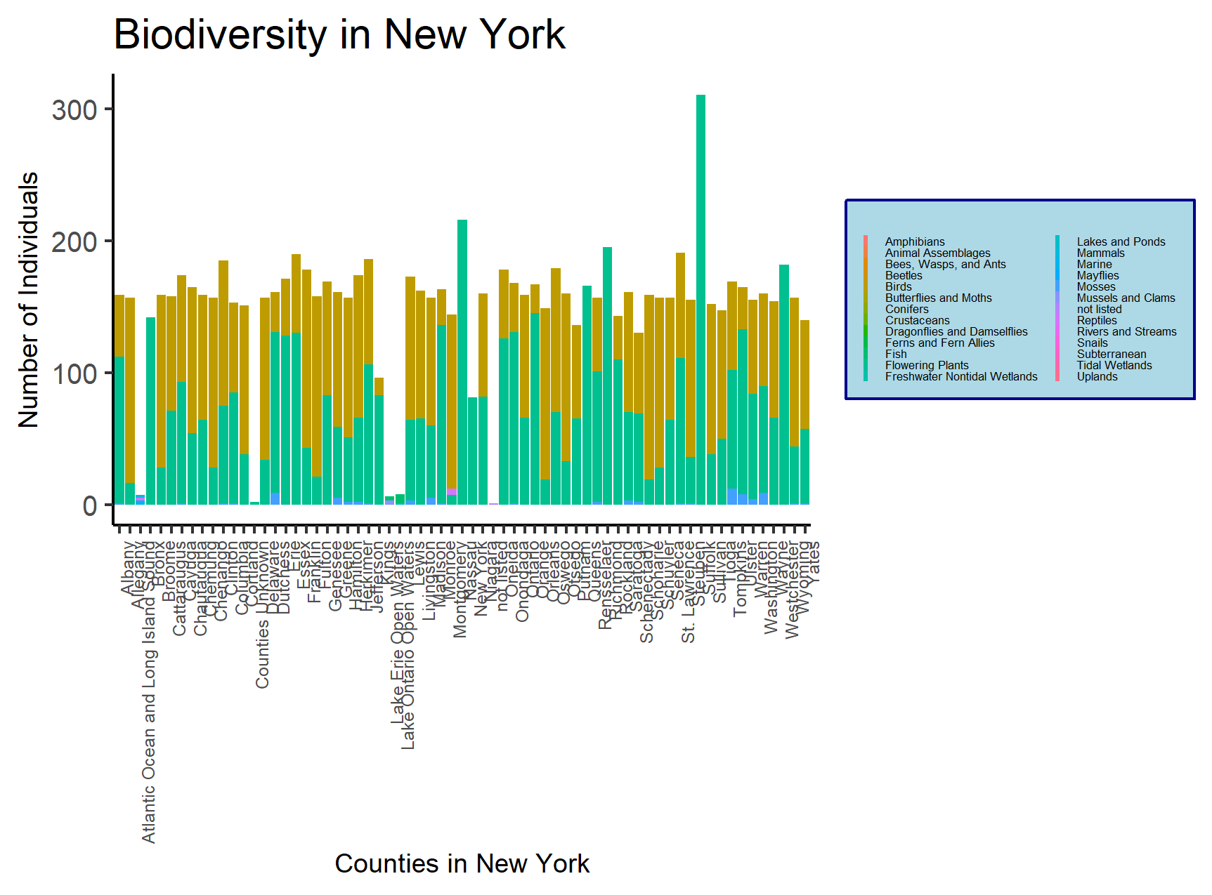
Step 3: Structure

Slide 7
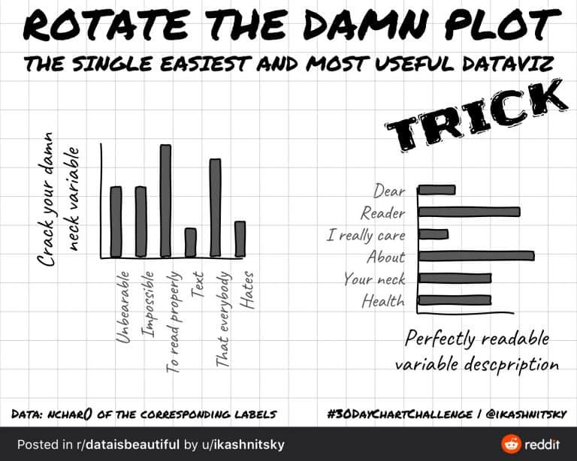
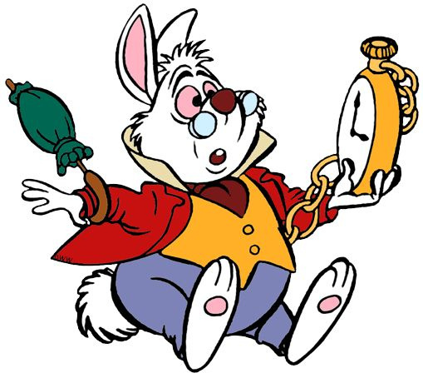
Step 4: Formatting

Slide 8

Code Walkthroughs
in reverse order

