Slide 1



Data Visualization
How many pattern violations do you see?

Slide 2
The Four Stages of Visualization
A Framework for Creating Effective Data Visualizations

Slide 3

It is rarely a mysterious technique that drives us to the top, but rather a profound mastery of what may well be a basic skill set.
Josh Waitzkin, The Art of Learning: A Journey in the Pursuit of Excellence

Slide 4
The Four Stages of Visualization

Slide 5

Step 1: Purpose
Which tool is better?

Slide 6

Step 2: Content
Americans Are Increasingly Using
Drive-Thru’s For Their Meals
# of McDondalds
in USA
Time ->

Slide 7
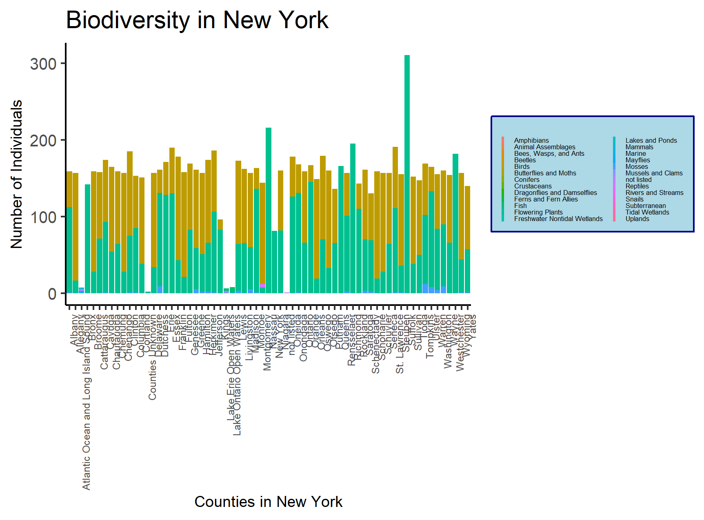
Step 3: Structure

Slide 8
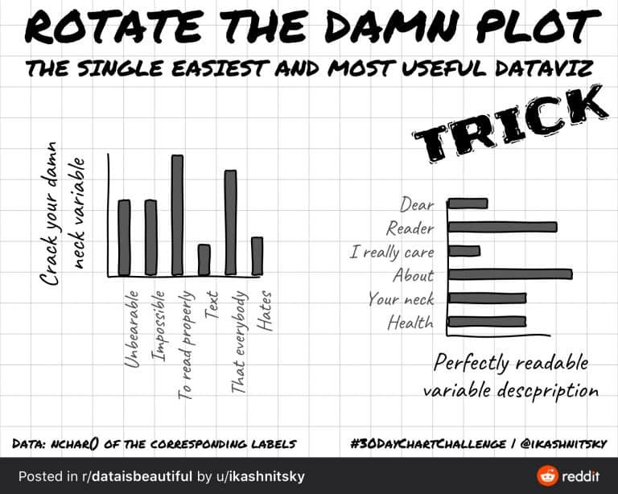

Step 4: Formatting

Slide 9
Overview
The four main stages of visualization:
Declaration of Purpose
Curation of Content
Structuring of Visual Mappings
Formatting for Your Audience

Slide 10
Stage 1: Declaration of Purpose

Slide 11
“Would you tell me, please, which way I ought to go from here?” “That depends a good deal on where you want to get to.” — Lewis Carroll, Alice in Wonderland

Slide 12
Key Points:
Clear intention: What message do you want to convey?
Bold titles: Use titles that state your recommendation
Visual hierarchy: Use color to guide attention

Slide 13
Example: Clear Purpose in Visualization

Slide 14
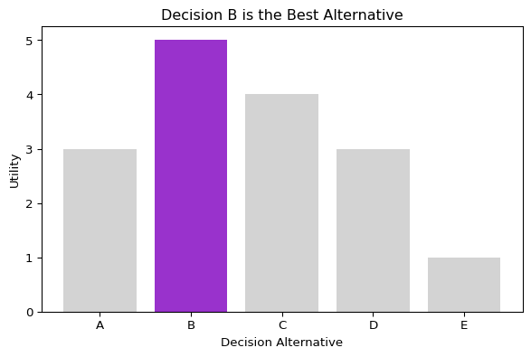
import matplotlib.pyplot as plt import pandas as pd # Decision alternatives and satisfaction values decisionArray = ["A","B","C","D","E"] satisfactionArray = [3,5,4,3,1] # Highlight the best decision bestUtility = max(satisfactionArray) colorArray = ["darkorchid" if utilityVal == bestUtility else "lightgrey" for utilityVal in satisfactionArray] # Create the visualization fig, ax = plt.subplots(figsize=[6,4], layout="constrained") ax.bar(x=decisionArray, height=satisfactionArray, color=colorArray) ax.set_xlabel("Decision Alternative") ax.set_ylabel("Utility") ax.set_title("Decision B is the Best Alternative") plt.show()

Slide 15
Notice: The title boldly states the recommendation, color draws attention to the best choice.

Slide 16
Stage 2: Curation of Content

Slide 17
“If all you have is a hammer, everything looks like a nail.” — Abraham Maslow

Slide 18
Key Points:
Don’t limit yourself to given data
Create or acquire all data you need
Use list comprehension and data manipulation
# Example: Create color array for highlighting colorArray = ["darkorchid" if utilityVal == bestUtility else "lightgrey" for utilityVal in satisfactionArray]
Key insight: This data didn’t exist - it had to be created to fulfill the visualization purpose!

Slide 19
import matplotlib.pyplot as plt import pandas as pd # Decision alternatives and satisfaction values decisionArray = ["A","B","C","D","E"] satisfactionArray = [3,5,4,3,1] # Highlight the best decision bestUtility = max(satisfactionArray) colorArray = ["darkorchid" if utilityVal == bestUtility else "lightgrey" for utilityVal in satisfactionArray] # Create the visualization fig, ax = plt.subplots(figsize=[6,4], layout="constrained") ax.bar(x=decisionArray, height=satisfactionArray, color=colorArray) ax.set_xlabel("Decision Alternative") ax.set_ylabel("Utility") ax.set_title("Decision B is the Best Alternative") plt.show()

Slide 20
Stage 3: Structuring of Visual Mappings

Slide 21
The Grammar of Graphics
Three key components:
Geometry (point, line, interval/bar)
Aesthetics (position, color, size, shape)
Facets (multiple similar graphics)

Slide 22
Geometry and Aesthetics

Slide 23
Visual Encoding Guide
Aesthetic | Handles Ordinal | Max Cardinality | Best For
x/y position | ✓ | Infinite | Most important data
color (discrete) | ✗ | < 12 | Categorical data
color (continuous) | ✓ | depends | Numerical data
size | ✓ | < 12 | Large differences
marker | ✗ | < 12 | Categorical data

Slide 24
Good vs. Poor Aesthetic Choices

Slide 25
Effective: Bar Chart with Color Highlighting
# Good choice: Bar chart with color highlighting fig, ax = plt.subplots(figsize=[6,4], layout="constrained") ax.bar(x=decisionArray, height=satisfactionArray, color=colorArray) ax.set_xlabel("Decision Alternative") ax.set_ylabel("Utility") ax.set_title("Decision B is the Best Alternative") plt.show()
Mappings: - Decision → horizontal position
Utility → vertical position - Max utility → color

Slide 26
Less Effective: Scatter Plot Alternative

Slide 27
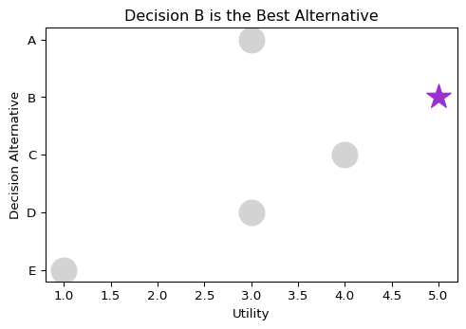
# Less compelling choice: Scatter plot shapeArray = ["*" if utilityVal == bestUtility else "o" for utilityVal in satisfactionArray] fig, ax = plt.subplots(figsize=[5,3.5], layout="constrained") # Plot each point separately due to marker limitation for satis, dec, col, shape in zip(satisfactionArray, decisionArray, colorArray, shapeArray): ax.scatter(x=satis, y=dec, color=col, marker=shape, s=400) ax.set_xlabel("Utility") ax.set_ylabel("Decision Alternative") ax.set_title("Decision B is the Best Alternative") ax.invert_yaxis() plt.show()

Slide 28
Facets: Multiple Similar Graphics

Slide 29
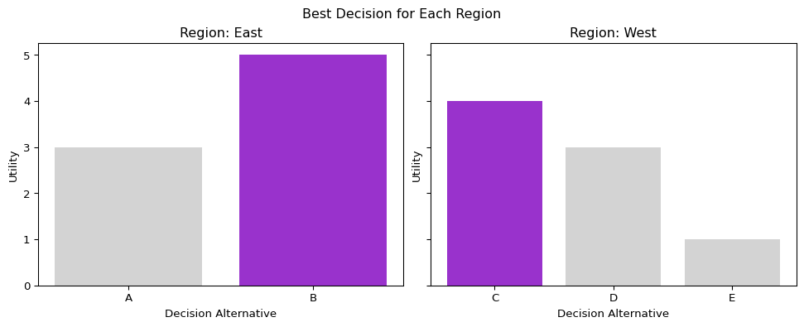
Creating Faceted Visualizations
# Create regional data for faceting regionArray = ["East","East","West","West","West"] plotDF = pd.DataFrame({"decision": decisionArray, "satisfaction": satisfactionArray, "region": regionArray}) # Group by region groupedRegionDF = plotDF.groupby("region") # Create facets fig, axs = plt.subplots(ncols=len(groupedRegionDF), figsize=[10,4], layout="constrained", sharey=True) # Create each facet for idx, (region, groupDF) in enumerate(groupedRegionDF): bestUtility = max(groupDF.satisfaction) colorArray = ["darkorchid" if utilityVal == bestUtility else "lightgrey" for utilityVal in groupDF.satisfaction] axs[idx].bar(x=groupDF.decision, height=groupDF.satisfaction, color=colorArray) axs[idx].set_xlabel("Decision Alternative") axs[idx].set_ylabel("Utility") axs[idx].set_title(f"Region: {region}") fig.suptitle("Best Decision for Each Region") plt.show()
Key: Each facet uses the same geometry and aesthetic mappings, only the data changes.

Slide 30
Stage 4: Formatting for Your Audience

Slide 31
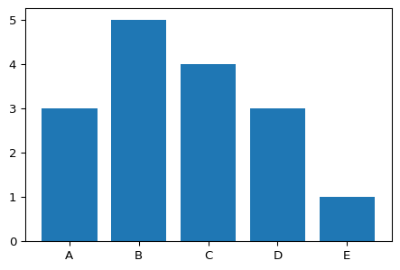
From Rough to Polished
Minimal Formatting (Exploration Only)
# Rough plot - good enough for you, not for audience fig, ax = plt.subplots(figsize=[4.5,3], layout="constrained") ax.bar(decisionArray, satisfactionArray) plt.show()
This is fine for exploration, but not for sharing!

Slide 32
Adding Titles and Labels

Slide 33
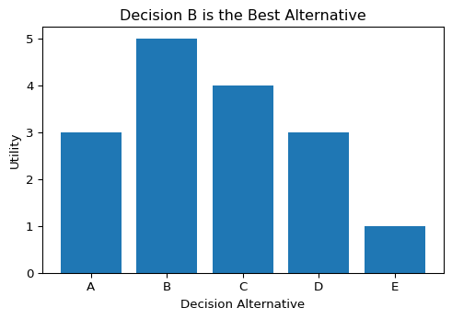
Clear Communication
Key principle: Title should convey your message, not just describe the plot.
# Add clear titles and labels fig, ax = plt.subplots(figsize=[5,3.5], layout="constrained") ax.bar(decisionArray, satisfactionArray) ax.set_title("Decision B is the Best Alternative") # Message, not description ax.set_xlabel("Decision Alternative") # Human readable ax.set_ylabel("Utility") # Clear units plt.show()

Slide 34
Color Coding with Legends

Slide 35
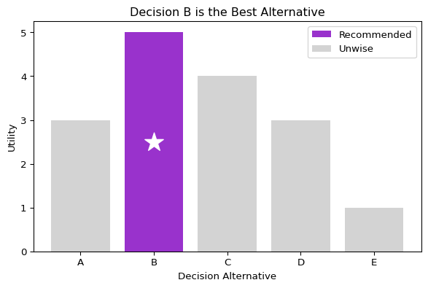
Professional Legend Creation
# Create plot with automatic legend fig, ax = plt.subplots(figsize=[6,4], layout="constrained") ax.set_title("Decision B is the Best Alternative") ax.set_xlabel("Decision Alternative") ax.set_ylabel("Utility") # Plot with labels for legend bestUtility = max(satisfactionArray) for decision, satisfaction in zip(decisionArray, satisfactionArray): if satisfaction == bestUtility: reco = ax.bar(decision, satisfaction, color="darkorchid", label="Recommended") ax.scatter(decision, satisfaction/2, color="white", marker="*", s=400) else: unwise = ax.bar(decision, satisfaction, color="lightgrey", label="Unwise") ax.legend(handles=[reco, unwise]) plt.show()
Technique: Use label argument and handles for clean legend creation.

Slide 36
Annotations: Direct Communication

Slide 37
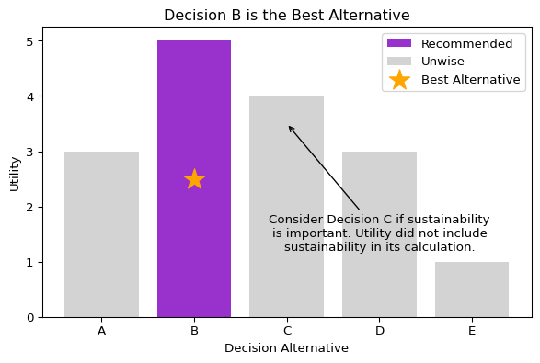
Adding Context and Caveats
# Create plot with annotation fig, ax = plt.subplots(figsize=[6,4], layout="constrained") ax.set_title("Decision B is the Best Alternative") ax.set_xlabel("Decision Alternative") ax.set_ylabel("Utility") # Plot bars with legend bestUtility = max(satisfactionArray) for decision, satisfaction in zip(decisionArray, satisfactionArray): if satisfaction == bestUtility: reco = ax.bar(decision, satisfaction, color="darkorchid", label="Recommended") best = ax.scatter(decision, satisfaction/2, color="orange", marker="*", s=300, label="Best Alternative") else: unwise = ax.bar(decision, satisfaction, color="lightgrey", label="Unwise") ax.legend(handles=[reco, unwise, best]) # Add annotation for important caveat ax.annotate(text="Consider Decision C if sustainability\nis important. Utility did not include\nsustainability in its calculation.", xy=("C", 3.5), xytext=("D", 1.2), horizontalalignment='center', arrowprops=dict({"arrowstyle": "->"})) plt.show()
Use annotations to: - Highlight important points - Add context or caveats - Guide audience attention

Slide 38
Key Takeaways

Slide 39
The Four Stages Framework
Purpose: Start with a clear message
Content: Get/create all data you need
Mapping: Choose geometry and aesthetics wisely
Formatting: Polish for your audience

Slide 40
Remember:
Position is the most powerful aesthetic
Color works best for categorical data (< 12 categories)
Always use clear titles and labels
Don’t skip the formatting stage for shared work

Slide 41
Questions to Consider

Slide 42
For Your Next Visualization:
What is your main message?
What data do you need to support it?
Which geometry best represents your data?
How can you use aesthetics to guide attention?
What formatting will make it audience-ready?

Slide 43
Resources

Slide 44
Further Learning
Grammar of Graphics: Wilkinson (2006), Wickham (2009)
Python for Data Analysis: Wes McKinney
Matplotlib Documentation: https://matplotlib.org/stable/

