Slide 1
Security in Azure
Securing Data
Davide Spano

Slide 2
Overview
Secure storage and delivery of secrets and operational data
Encryption of data
Authorization
Bad Practices
OWASP

Slide 3
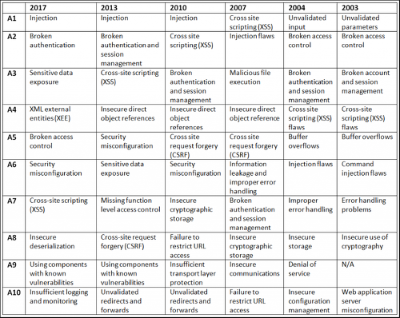
Threats

Slide 4
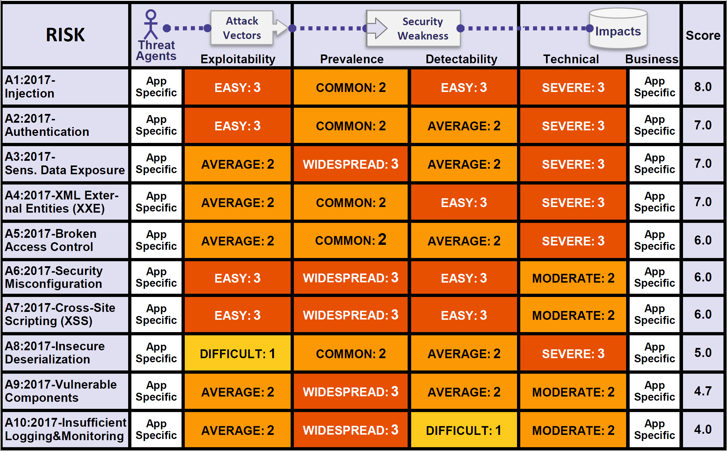
OWASP Table

Slide 5
Information in a business
Businesses need to manage a large variety of (sensitive) information
The nature of the information is heterogeneous
The information might or might not be direct property of the business
The responsibility for the handling of the info might be delegated to the business
Some info is operational and is used as key to access larger repositories of data
Handling of the information may be regulated by policies and law
Some information may be classified as secret

Slide 6
Secrets

Slide 7
Secrets
It must be kept safe somewhere
It cannot (even accidentally) be shared with anyone who should not know
It can be forgotten, lost, stolen or corrupted in which case becomes worthless and/or can cause loss of assets
Just the suspicion of loss or of accidental leak makes it worthless and a liability
More than one secret and life gets very complicated!

Slide 8
Where to store a secret?
Where to store a server side encryption key?
This is a good question posed on Stack Exchange Information Security.
Use an external Hardware Security Module.
Tie the encryption key to your hardware i.e. TPM chips .
Tie the encryption key to your admin login
Type in the encryption key when you start up, store it in memory.
Store the key on a different server.

Slide 9
The Problems with Secrets
It must be kept safe somewhere
It cannot be shared with anyone who should not know
It can be forgotten or lost
If stolen it becomes worthless
Just the suspicion of loss or of a leak makes it worthless
More than one secret and life gets very complicated!

Slide 10
What is Azure Key Vault
A storage service used to store cryptographic keys and secrets and keep this information secure. The service offers a software abstraction to solve the following problems.
Secret and Keys management such as access control.
Certificate management including provision and deployment i.e. (SSL/TLS) certificates used within Azure internally connected artifacts.
Store secrets and Keys on HSMs

Slide 11
Resource Types in Azure Key Vault
Secrets
Keys
Certificates
Secrets
Binary sequences with no semantic i.e. passwords, connection strings, bank details, thumbprints, hashes, etc. Any sensitive information that must be protected and access controlled. Any piece of information that may be versioned and needs to be centrally managed and protected.

Slide 12
Resource Types in Azure Key Vault
Secrets
Keys
Certificates
Cryptographic Keys
Existing RSA or EC Keys. These can either be imported into Azure Key Vault or be directly generated and stored by it. A cryptographic key is a string of bits used by a cryptographic algorithm to transform plain text into cipher text or vice versa. Their format is an agreed industry standard.

Slide 13
Resource Types in Azure Key Vault
Secrets
Keys
Certificates
Certificates
Data files which that digitally bind a cryptographic key(s) to an organization and prove ownership. The majority of certificates are Public Key Certificates (PKC) which holds information about the key(s) and their owner(s). The PKC is digitally signed by the Authority that has verified the certificate’s content. The most common format for PKC is X.509.

Slide 14
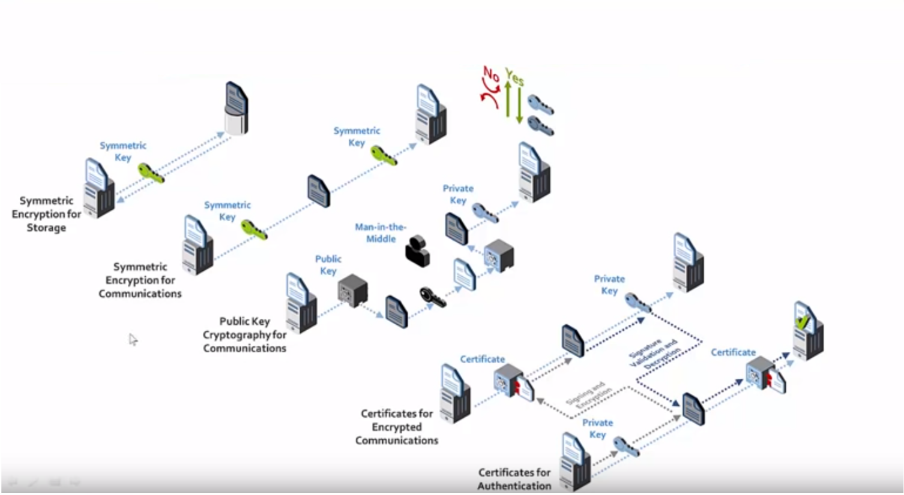
Symmetric and Asymmetric Encryption

Slide 15
What is Certificate
A certificate contains a public key and additional information such as issuer, what the certificate is supposed to be used for, and other types of metadata. It is signed by a certificate authority (CA) using CA's private key. This allows the recipient of the certificate to verify the authenticity of the certificate itself.

Slide 16
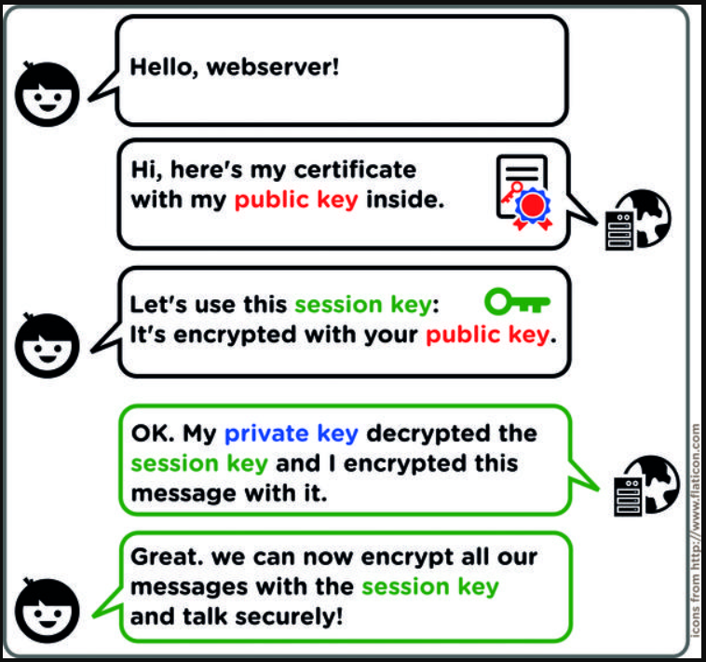
How a Certificate is Used

Slide 17
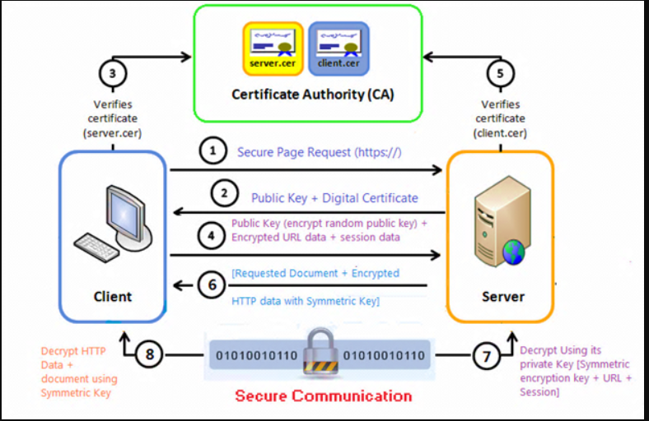
How a Certificate is Used

Slide 18
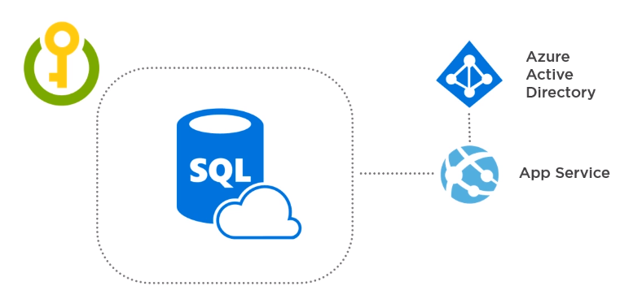
The Key Vault Approach

Slide 19
The Azure Key Vault Approach
Based on registering apps with Azure AD
Exchange of client ID and shared secret or certificate based
The secrets still fly over the public/private infrastructure and might need TSL if it is not private only and secure connection.
It is useful for scenarios of interconnected systems on private networks which may be not all part of Azure infrastructure (hybrid)
It is necessary in all cases in which a secret is required to connect two pieces of software but any of the two cannot use Azure AD as authentication service i.e. Azure Cache for Redis

Slide 20
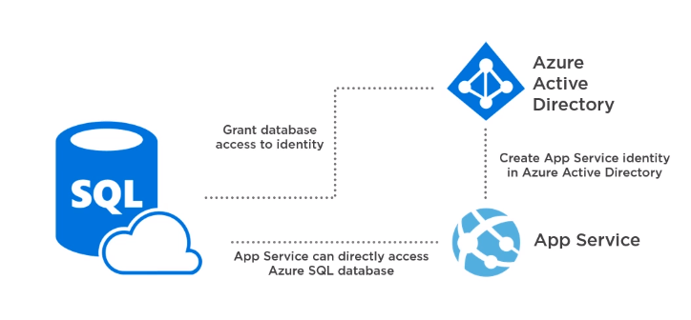
The Managed Service Identity Approach

Slide 21
The Managed Service Identity Approach
Based on registering apps and Services with Azure AD
No need for client ID, shared secret, certificates or configuration files
Authentication and Authorization happen within Azure infrastructure
Lower complexity compared with the Azure Key Vault approach
Ever expanding number of Azure services support this model

Slide 22
Summary on Secrets
Some business information can be qualified as Secrets
Secrets are generally some form of cryptographic key
Secrets must be stored and accessed securely
Secrets must not be accidentally or intentionally leaked
Secrets should be versioned and rotated
Secrets should not be accidentally lost or deleted
Azure Key Vault provides a solution to all these requirements
Managed Service Identity (MSI)

Slide 23
Encryption

Slide 24
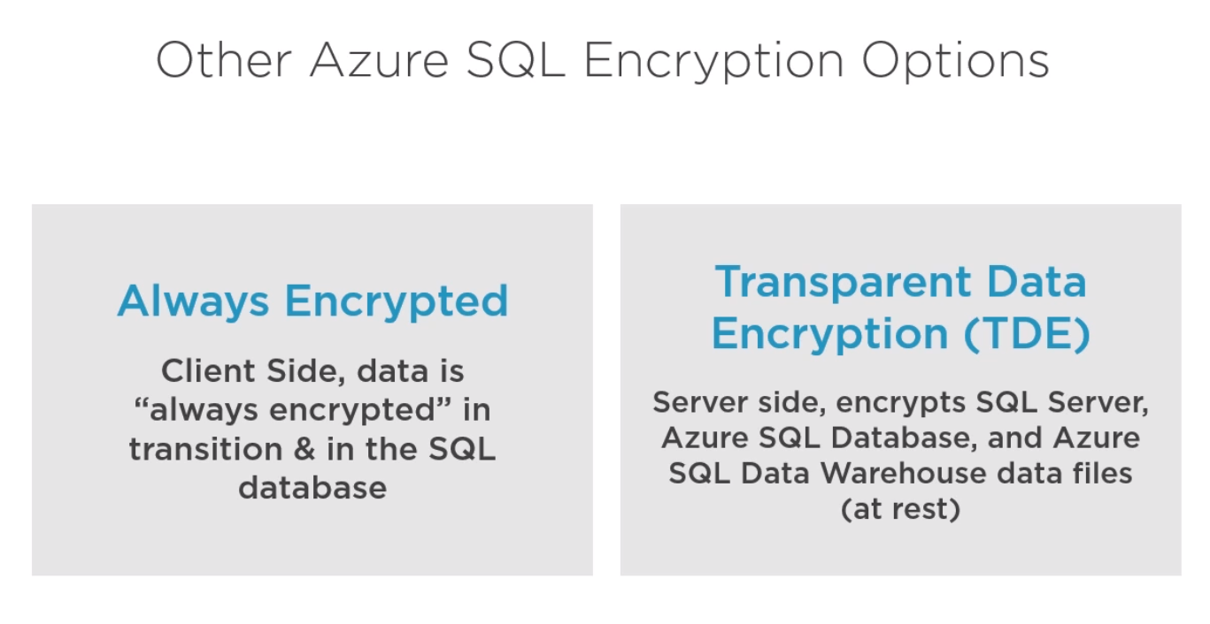

Slide 25
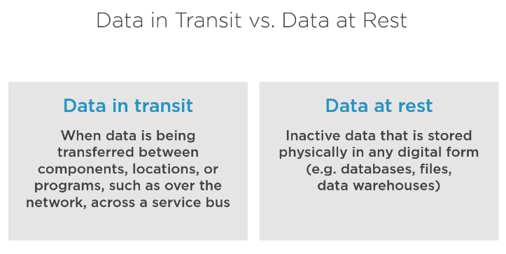

Slide 26
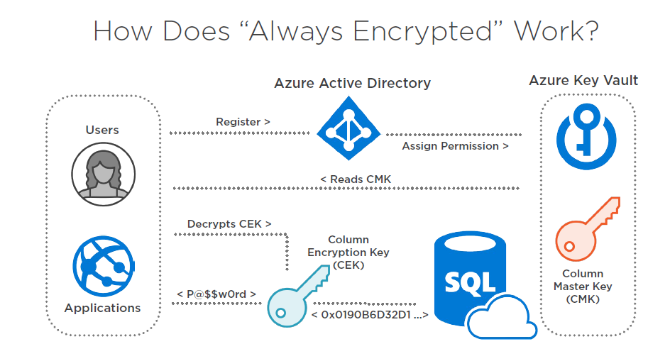

Slide 27
Azure Storage Service Encryption (SSE)
SSE automatically encrypts your data when persisting it to the cloud.
SSE help to meet organizational security and compliance commitments.
Data in Azure Storage is encrypted and decrypted transparently using 256-bit AES..
SSE is enabled by default and cannot be disabled for any storage account
SEE encrypts blobs, disks, files, queues, tables and Azure Managed Disks and any metadata pertaining to these artifacts.
SSE does not cause performance loss and it’s free
Works with Managed and Customer keys thus can be rotated, audited, etc. in which case the customer key is stored in Key Vault and accessed via MSI.

Slide 28
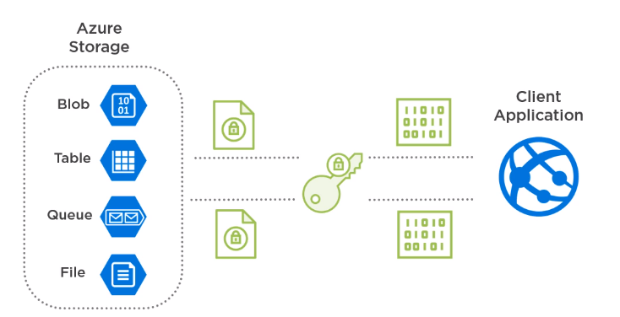
How does SSE work?

Slide 29
Summary on Encryption
Azure Always Encrypted Client Technology based on CMK &CEK
Azure Transparent Data Encryption (TDE) as server-side default encryption for data at rest. It encrypts the whole server or the database files with either a custom or managed key.

Slide 31
Functionality description
Description of the new function
Cases where the function is useful
Business limitations
For example:
Additional cost management on purchase order. By this functionality AX can track all additional cost on purchase order such as:
packing cost
Transportation
Insurance
Etc.

Slide 32
Functionality description
Business Limitations
Example: If the additional cost has to be invoiced to a third party vendor, the functionality doesn't apply

Slide 33
AX modules involved and setup
Main forms and parameters involved, in order to setup the functionality

Slide 34
Demo
Demo steps

Slide 35
Q&A

