Slide 1
Security in Azure
Securing Data
Davide Spano

Slide 2
Introduction
The business case for security
Businesses need to manage a variety of (sensitive) information
Firms are required to handle security concern adequately to stay in business
Handling of the information may be regulated by policies and law
Firms are opened to security threats due to the valuable information they hold
Responsibility for the handling of the info might be delegated to the business
Information might or might not be direct property of the business
Information can be heterogeneous
Some info is operational and is used as key to access larger repositories of data
Some information may be classified as secret and should be handled accordingly
Misuse or mishandling of information can lead to loss
Intrusion in secure area of the business or exploitation of data can lead to loss

Slide 3
Overview
Open Web Application Security Project (OWASP)
Secure Secrets
Encryption
Authorization
Bad Practices

Slide 4
OWASP
Open Web Application Security Project

Slide 5
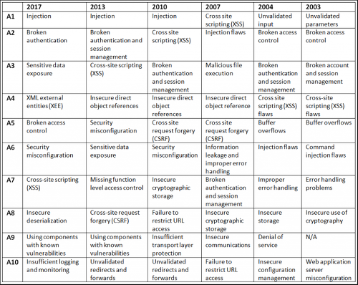
Threats

Slide 6
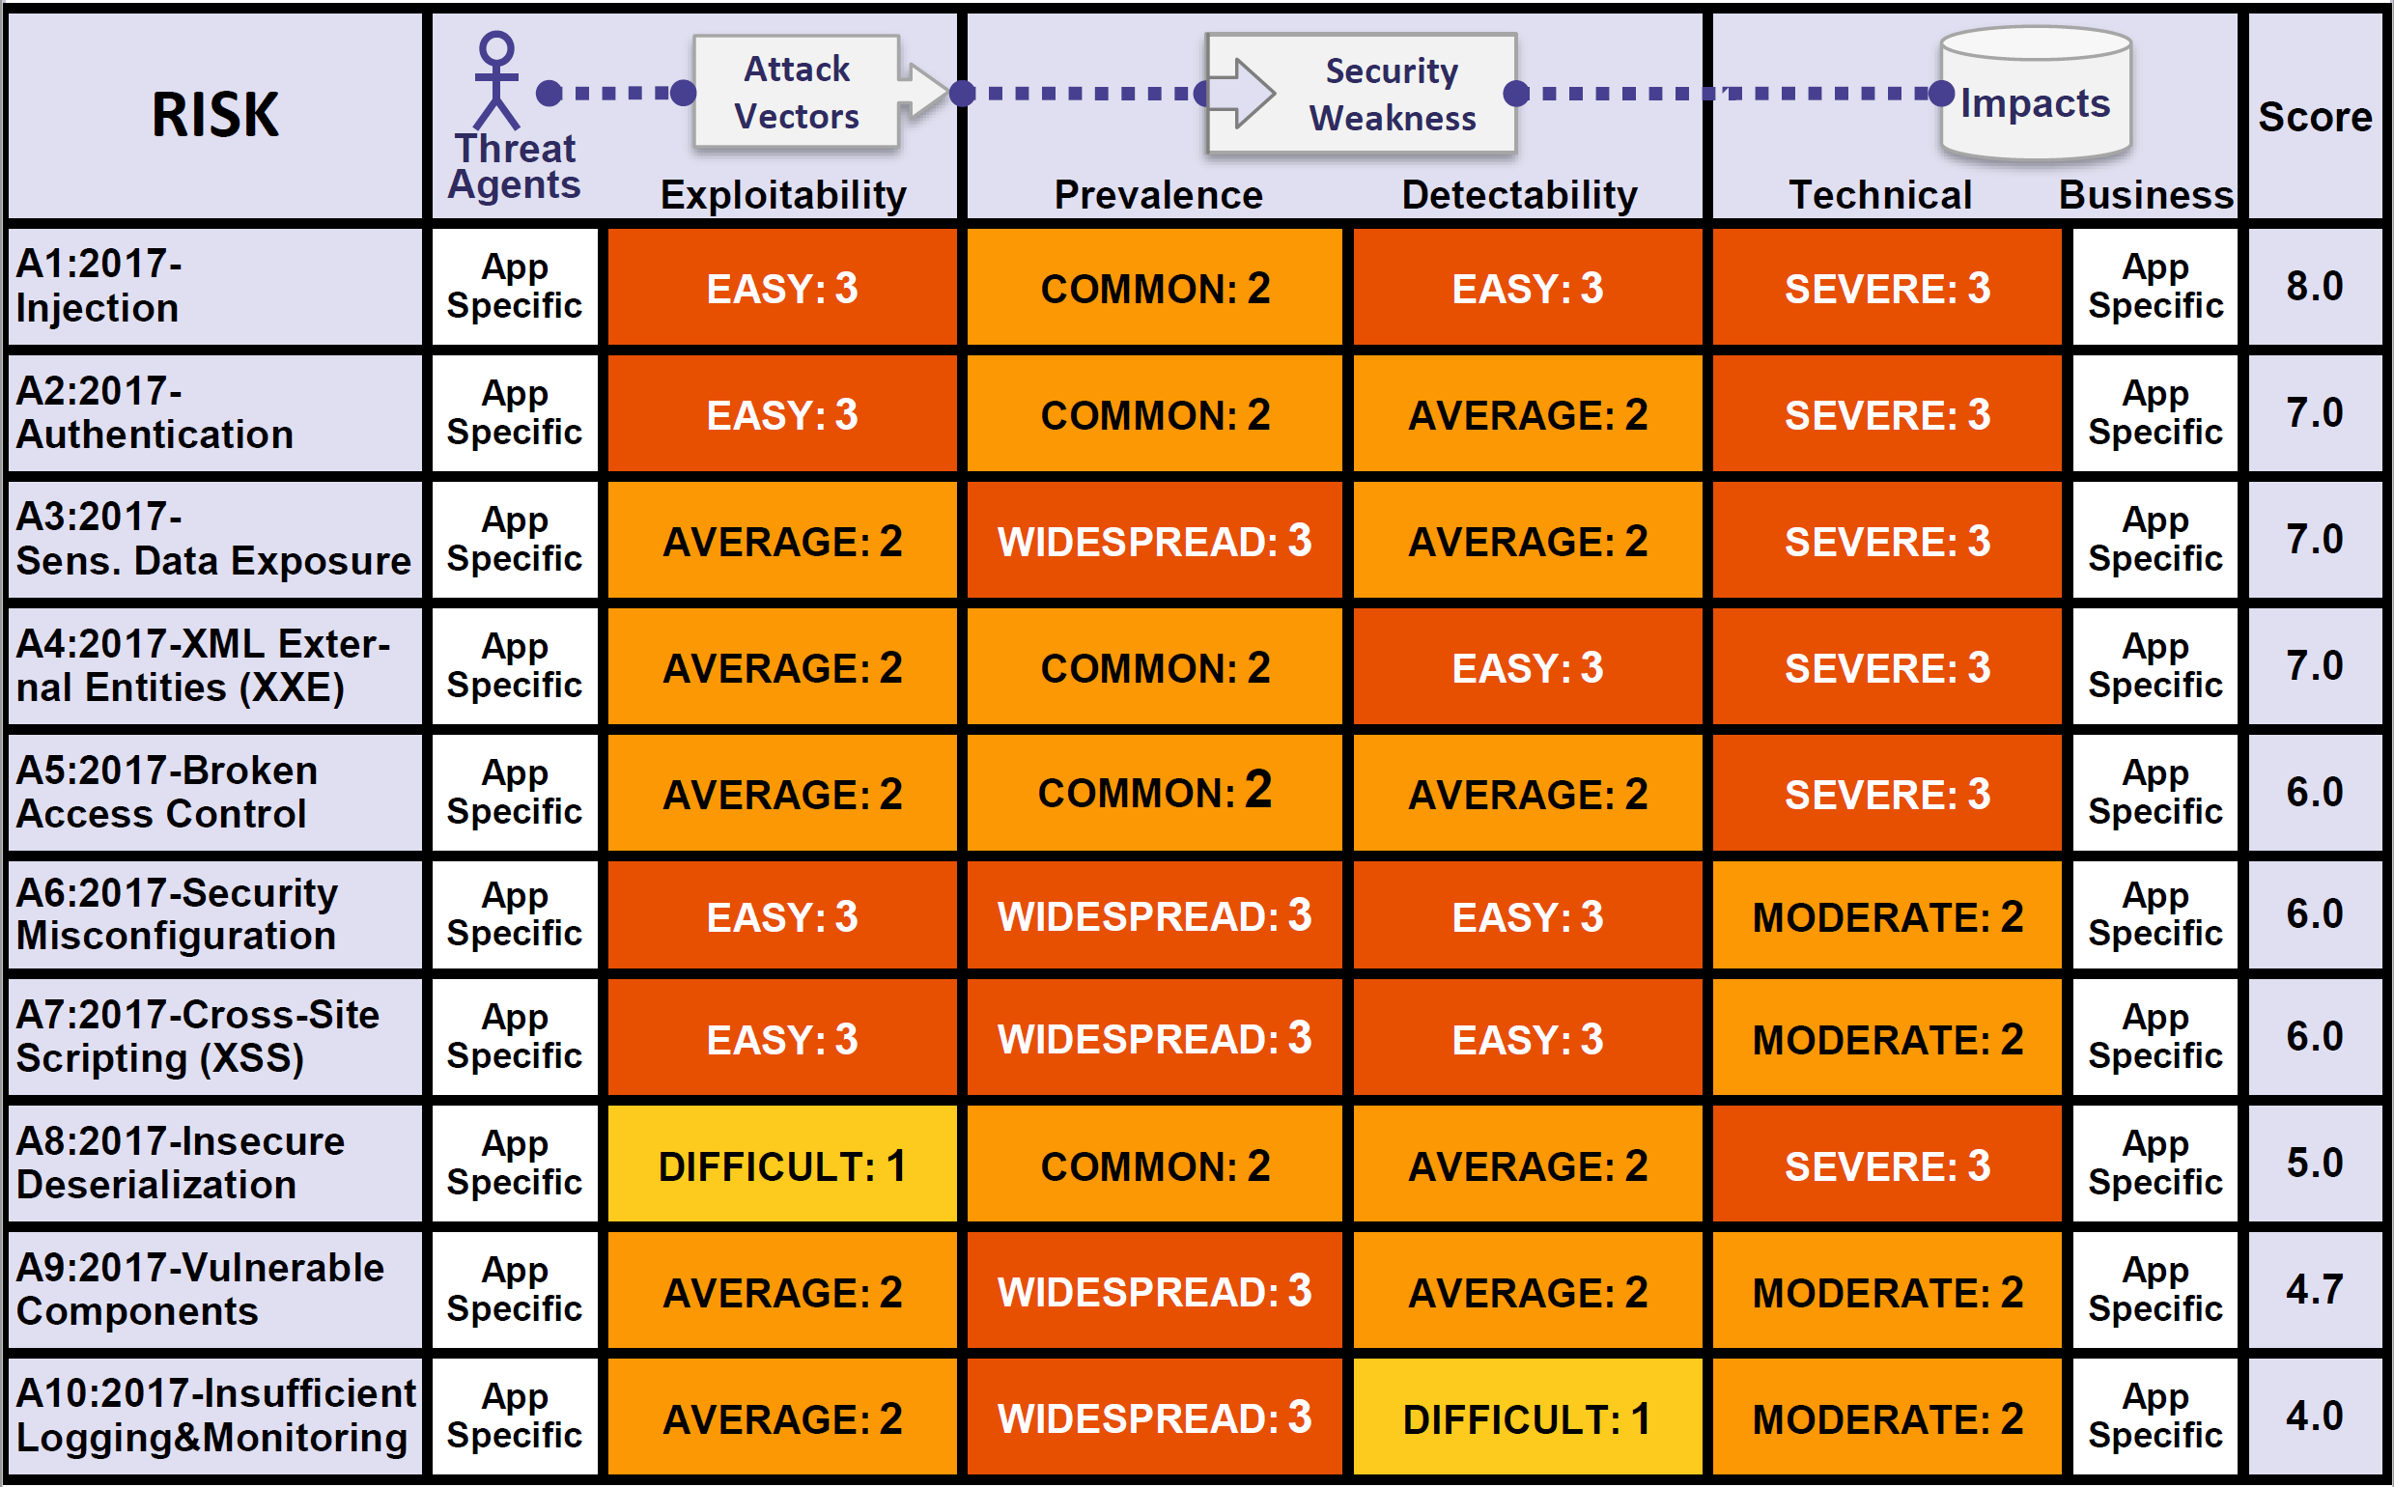
OWASP Table

Slide 7
Summary on OWASP
Open Web Application Security Project
An online community that produces freely-available articles, methodologies, documentation, tools, and technologies in the field of web application security.
A frame of reference to keep up-to-date with security threats.

Slide 8
Secrets

Slide 9
Secrets
It must be kept safe somewhere
It cannot (even accidentally) be shared with anyone who should not know
It can be forgotten, lost, stolen or corrupted in which case becomes worthless and/or can cause loss of assets
Just the suspicion of loss or of accidental leak makes it worthless and a liability
More than one secret and life gets very complicated!

Slide 10
Where to store a secret?
Where to store a server side encryption key?
This is a good question posed on Stack Exchange Information Security.
Use an external Hardware Security Module.
Tie the encryption key to your hardware i.e. TPM chips .
Tie the encryption key to your admin login
Type in the encryption key when you start up, store it in memory.
Store the key on a different server.

Slide 11
The Problems with Secrets
It must be kept safe somewhere
It cannot be shared with anyone who should not know
It can be forgotten or lost
If stolen it becomes worthless
Just the suspicion of loss or of a leak makes it worthless
More than one secret and life gets very complicated!

Slide 12
What is Azure Key Vault
A storage service used to store cryptographic keys and secrets and keep this information secure. The service offers a software abstraction to solve the following problems.
Secret and Keys management such as access control.
Certificate management including provision and deployment i.e. (SSL/TLS) certificates used within Azure internally connected artifacts.
Store secrets and Keys on HSMs

Slide 13
Resource Types in Azure Key Vault
Secrets
Keys
Certificates
Secrets
Binary sequences with no semantic i.e. passwords, connection strings, bank details, thumbprints, hashes, etc. Any sensitive information that must be protected and access controlled. Any piece of information that may be versioned and needs to be centrally managed and protected.

Slide 14
Resource Types in Azure Key Vault
Secrets
Keys
Certificates
Cryptographic Keys
Existing RSA or EC Keys. These can either be imported into Azure Key Vault or be directly generated and stored by it. A cryptographic key is a string of bits used by a cryptographic algorithm to transform plain text into cipher text or vice versa. Their format is an agreed industry standard.

Slide 15
Resource Types in Azure Key Vault
Secrets
Keys
Certificates
Certificates
Data files which that digitally bind a cryptographic key(s) to an organization and prove ownership. The majority of certificates are Public Key Certificates (PKC) which holds information about the key(s) and their owner(s). The PKC is digitally signed by the Authority that has verified the certificate’s content. The most common format for PKC is X.509.

Slide 16
What is Certificate
A certificate contains a public key and additional information such as issuer, what the certificate is supposed to be used for, and other types of metadata. It is signed by a certificate authority (CA) using CA's private key. This allows the recipient of the certificate to verify the authenticity of the certificate itself.

Slide 17
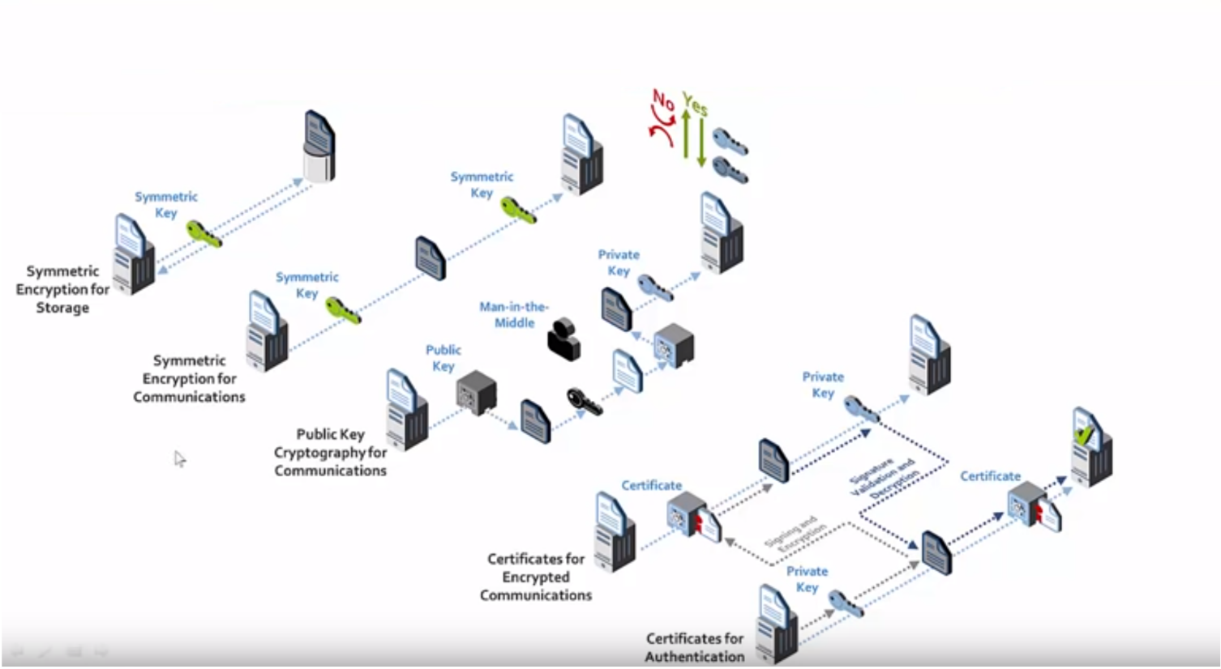
Symmetric and Asymmetric Encryption

Slide 18
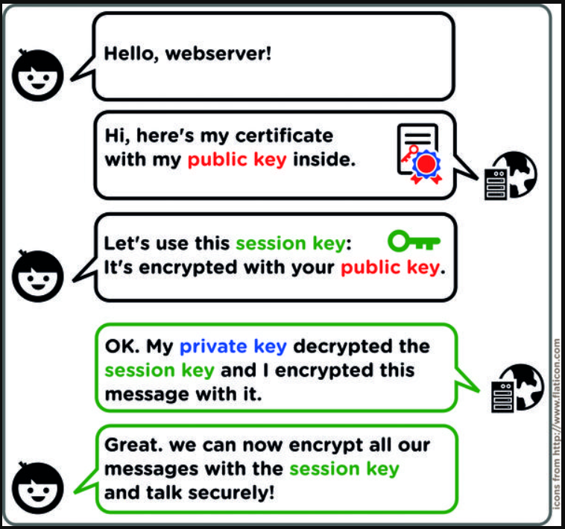
How a Certificate is Used

Slide 19
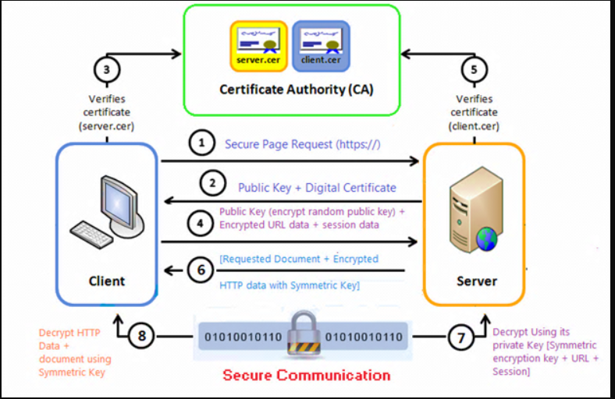
How a Certificate is Used

Slide 20
The Azure Key Vault Approach
Based on registering apps with Azure AD
Exchange of client ID and shared secret or certificate based
The secrets still fly over the public/private infrastructure and might need TSL if it is not private only and secure connection.
It is useful for scenarios of interconnected systems on private networks which may be not all part of Azure infrastructure (hybrid)
It is necessary in all cases in which a secret is required to connect two pieces of software but any of the two cannot use Azure AD as authentication service i.e. Azure Cache for Redis

Slide 21
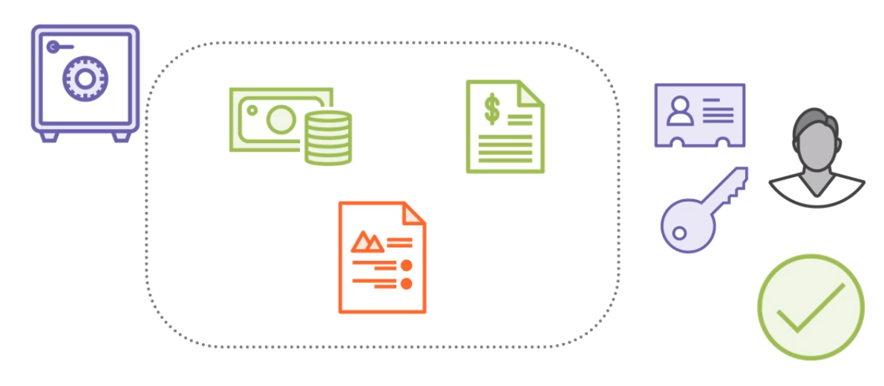
The Bank Vault Analogy

Slide 22
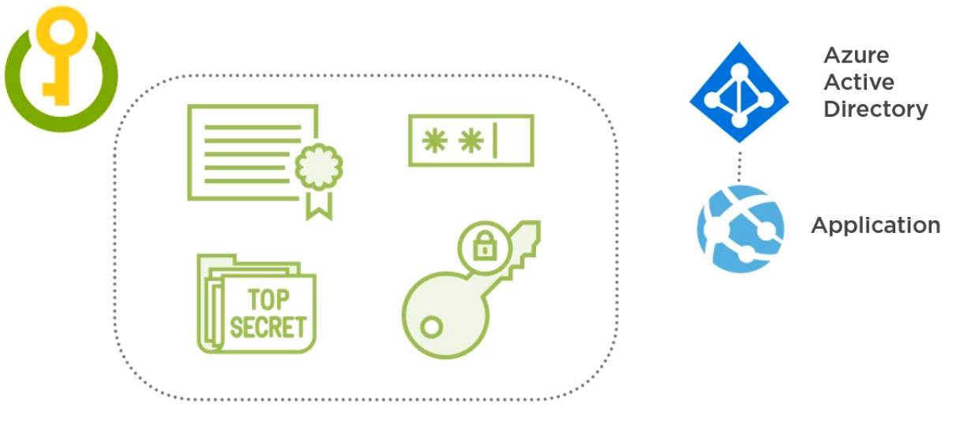
The Key Vault Approach

Slide 23
The Managed Service Identity Approach
Based on registering apps and Services with Azure AD
No need for client ID, shared secret, certificates or configuration files
Authentication and Authorization happen within Azure infrastructure
Lower complexity compared with the Azure Key Vault approach
Ever expanding number of Azure services support this model
Fined grained control over authorization via role-based access control (RBAC)

Slide 24
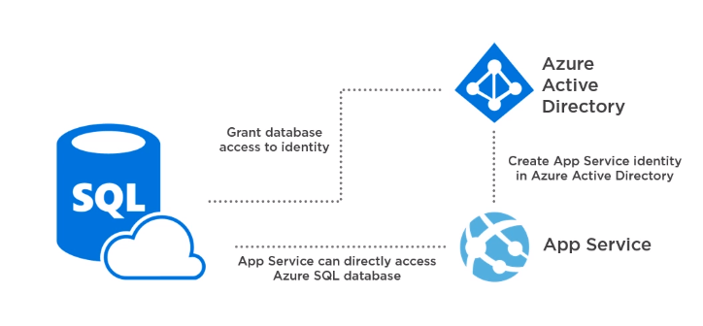
The Managed Service Identity Approach

Slide 25
Summary on Secrets
Some business information can be qualified as Secrets
Secrets are generally some form of cryptographic key
Secrets must be stored and accessed securely
Secrets must not be accidentally or intentionally leaked
Secrets should be versioned and rotated
Secrets should not be accidentally lost or deleted
Secrets must be exchanged securely
Azure Key Vault provides a solution to all these requirements
Managed Service Identity (MSI) is a better solution when applicable

Slide 26
Encryption

Slide 27
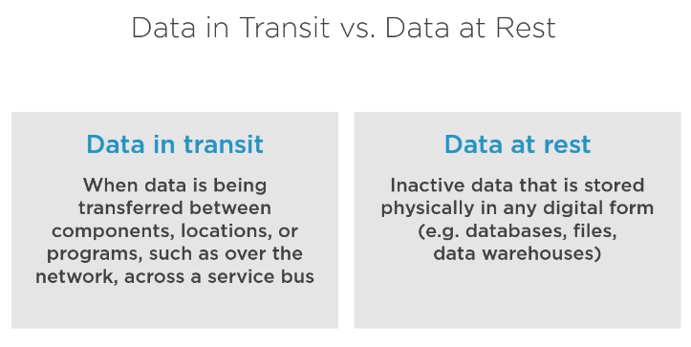

Slide 28
Azure Storage Service Encryption (SSE)
Encryption of data at rest for PaaS
Transparently encrypts your data when persisting it to the cloud.
Helps to meet organizational security and compliance commitments.
Data in Azure Storage is encrypted and decrypted transparently using 256-bit Advanced Encryption Standard (AES)
It is enabled by default and cannot be disabled for any storage account
It encrypts blobs, disks, files, queues, tables and Azure Managed Disks and any metadata pertaining to these artifacts.
It does not cause performance loss and it’s free
Works with Managed and Customer keys thus can be rotated, audited, etc. in which case the customer key is stored in Key Vault and accessed via Managed Service Identity (MSI).
It does not cover SQL Server

Slide 29
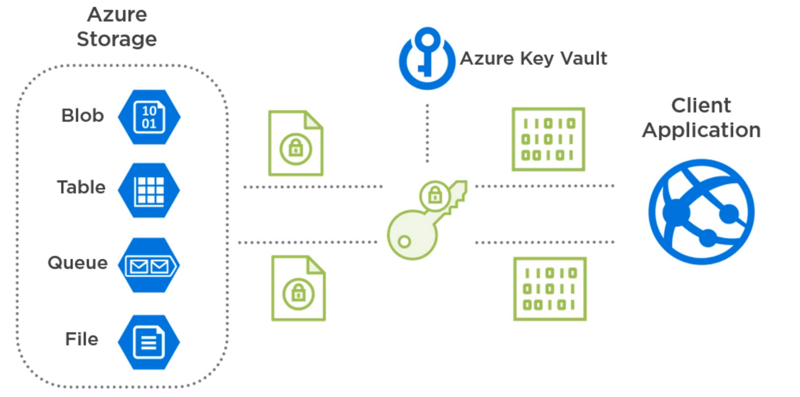
How does SSE work?

Slide 30
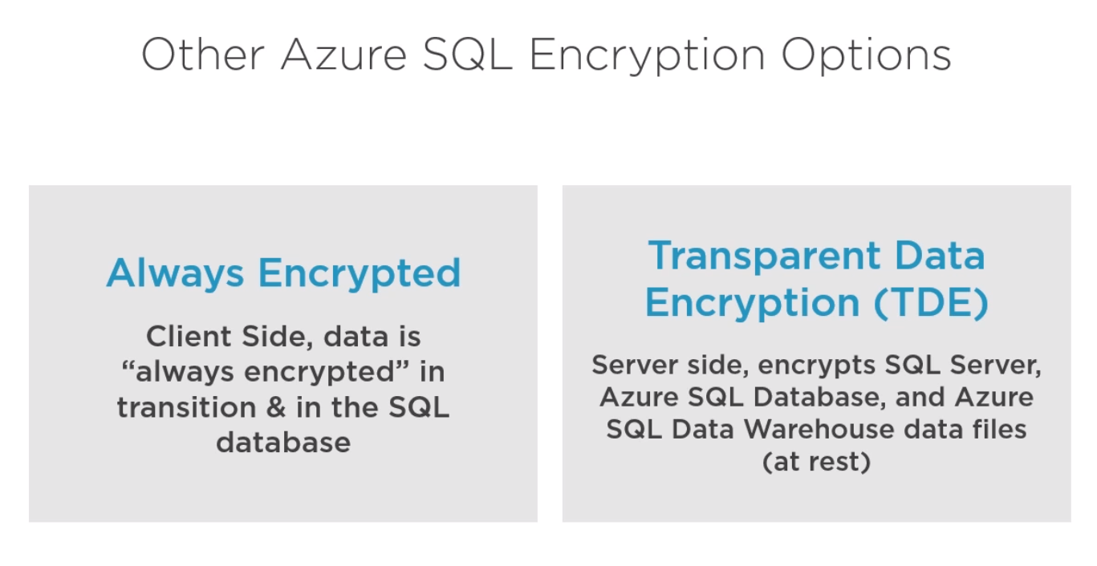

Slide 31
Azure SQL Server Always-Encrypted technology
Encryption technology for Azure SQL Server
Info can be saved in Azure SQL Server Database in plain format
Some information is sensitive and should not be stored in plain format in a database i.e. SSN, financials, personal data, passwords, DOBs, salaries, etc.
Protect the sensitive information i.e. DBAs need not know
Encryption of sensitive columns of a database
It’s a client-side technology that is the data is encrypted in transit and decrypted/encrypted on the client site

Slide 32
How does Always-Encrypted work?
There are two keys involved the CEK and the CMK
These keys can be created using SSMS
The CMK is stored on Azure Key Vault
The CMK is used to encrypt and decrypt the CEK on the client side
The CEK is stored in the database as encrypted key
Clients read data from the database together with the encrypted CEK but need the CMK to decrypt encrypted columns
Any registered Azure AD identity with proper claims to read the CMK is able to decrypt the CEK and decrypt/encrypt data for protected columns

Slide 33
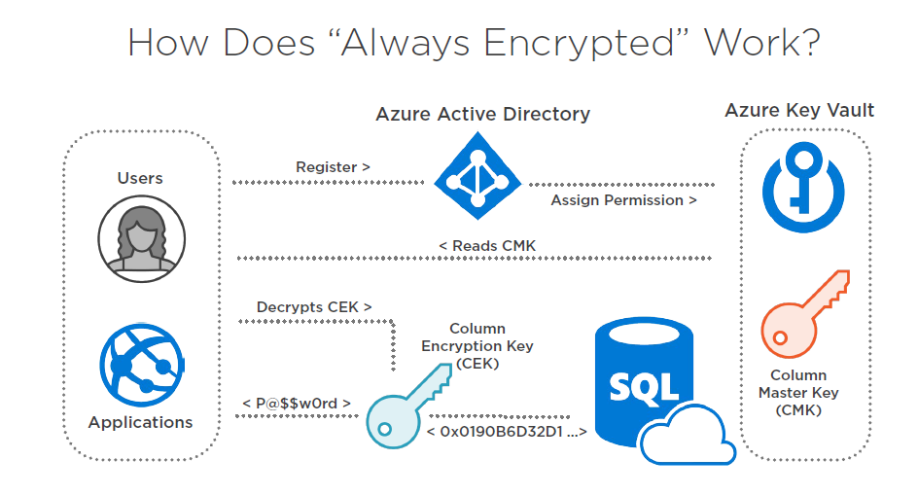

Slide 34
Always-Encrypted bonus
It offers two modes of columns encryption deterministic vs randomized
Randomized offers higher security but it prevents some typical SQL operations such as joins, indexes, etc.
Deterministic is less secure but it makes it possible to employ the usual SQL constructs i.e. joins, indexes, etc.

Slide 36
Azure SQL Server Transparent Data Encryption (TDE)
Encryption technology for Azure SQL Server (at rest)
It encrypts the database files
Azure SQL databases, Azure SQL Data Warehouse and data files
It is on by default on any Azure SQL Server database
It is similar in concept to Storage Service Encryption (SSE) that is the analogous technology available on Azure storage accounts
Can use managed or customer encryption keys as for SSE
Can be enabled at Server or database level

Slide 37
Azure Disk Encryption for IaaS (ADE)
Protection feature against data theft
To encrypt OS and Data disks of Linux & Windows VMs
These disks are hosted on Azure Blob Storage (Page Blobs)
On Windows BitLocker is used while on Linux dm-crypt
Part of the defense in depth strategy to security
Not enabled by default
A custom encryption key is used and can be stored in Key Vault

Slide 38
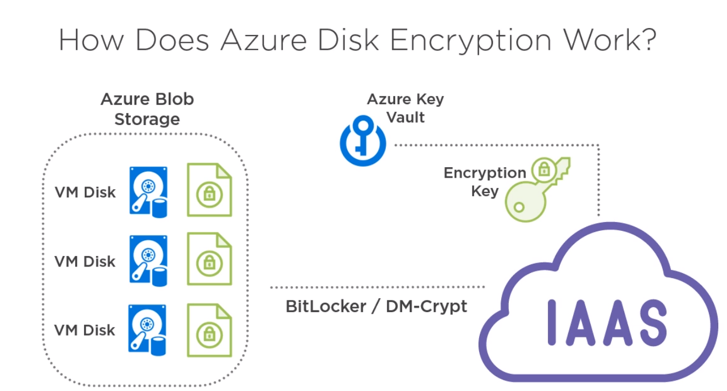

Slide 39
Summary on Encryption
Storage Accounts are transparently encrypted at rest via SSE
For Azure SQL Server Azure Transparent Data Encryption (TDE) as server-side default encryption for data at rest. It encrypts the whole server or the database files with either a custom or managed key.
For Azure SQL Server Always-Encrypted Client Technology based on CMK &CEK

Slide 40
BE OUR NEXT INSPIRATION MAKER!

Slide 41
Demo
Demo steps

Slide 42
Q&A

