Slide 1

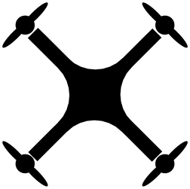
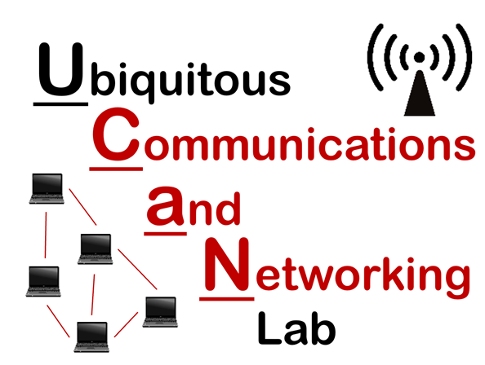
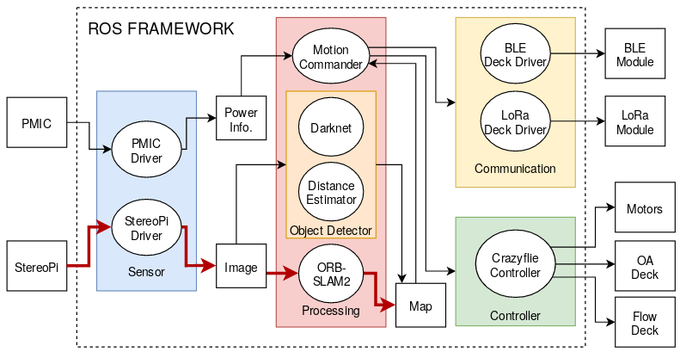
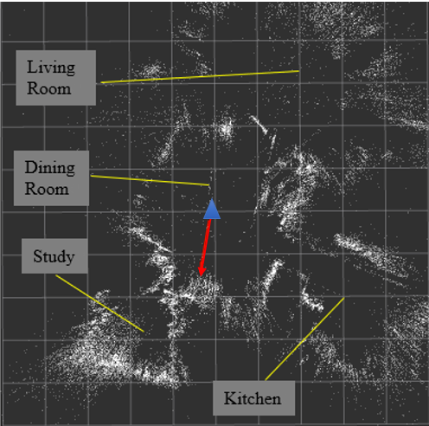
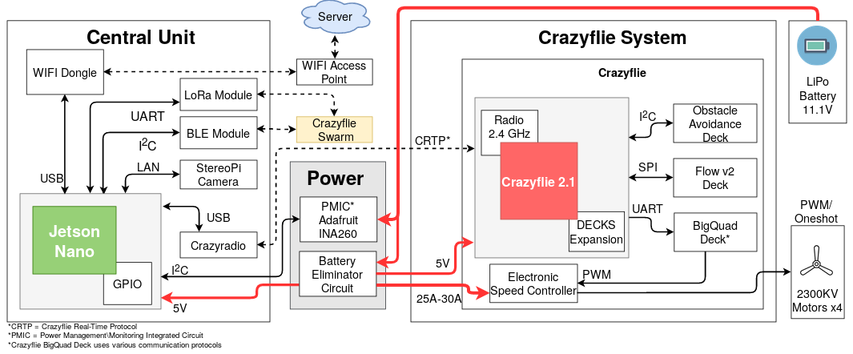
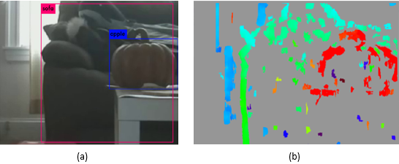
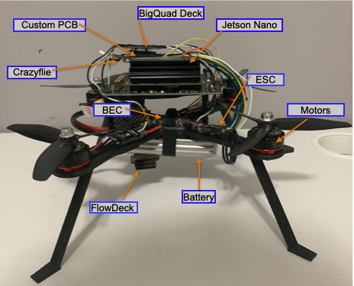
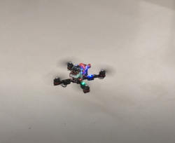

Unmanned Aerial Vehicle (UAV) based Visual SLAM Platform
Carlos J Orta, Deqiang Xu, and Lucas Lomba
Advisor: Dr. Honggang Zhang, Associate Professor, UMass Boston
Overview
Drone and Flight Tests
Our drone is shown in figure 3 with Crazyflie FlowDeck, BigQuad Deck and Crazyflie 2.1 for flight control, and Jetson Nano on top for computing tasks. The StereoPi camera is not shown here and it should be placed in the front top of the drone. With our developed drone, we successfully conducted several flight tests and achieved stability during the flight, as shown in Figure 4.
The goal of this project is to build a UAV-based system with a Nvidia Jetson Nano [1] performing tasks on Visual Simultaneous Localization And Mapping (SLAM), and Object Detection.
All the hardware resources in the system are managed by the Robotic Operating System (ROS) installed on the Jetson Nano, including the Crazyflie 2.1 [2] flight controller, the stereo camera for real-time video streaming, the power monitoring integrated circuit (PMIC) for battery level monitoring, the Bluetooth Low Energy (BLE) module and LoRa module for communication between drones. All software have been organized in the form of individual ROS packages and communicate effectively using ROS messages through the ROS internal communication protocol.
Our system features a high degree of hardware/software modularity/flexibility and system extensibility, and it is suitable for conducting further visual-related UAV experiments and research.
SLAM Result
Figure 5 shows the generated sparse map of a typical house consisting of a living room, a dining room, a study and a kitchen. Dots are the landmarks extracted for tracking and scene recognition from key frames.
White Dots: history landmarks
Blue Triangle: current pose of the camera in the space
Figure 2-The Software design
Software Design
ORB-SLAM2 package, Object detector, Image-preprocessor
BLE Node, LoRa Node, StereoPi Node, PMIC Node, Crazyflie Controller
Basic Surroundings Mapping Workflow
Drone moving in an indoor space
The StereoPi taking videos in 10 FPS and streaming to the Jetson Nano
Separating the frame into left/right frame, publishing visual information generated from camera calibration and rectification in ROS
Using ORB-SLAM2 [3] system for tracking and mapping
Store the resulting map
Figure 5-SLAM Result
Design
Object Detection Result and Disparity Image
Figure 6 (a) shows the result of object detection in our system with a pre-trained model. Each detected object is bounded in a rectangle box with a predicted class.
Figure 6 (b) shows the generated disparity image when rectifying images. The depth of the pixels is color-coded. A deeper color represents a smaller distance while a lighter color means a larger distance from the camera.
Result
Figure 1-The Hardware design of our system
Hardware Design
Drone frame, brushless motors, propellers, Lipo battery
Crazyflie 2.1, BigQuad Deck, Flow Deck, Object Avoidance(OA) Deck, Electronic Speed Control(ESC), Battery Eliminator Circuit(BEC)
Jetson Nano, StereoPi, Adafruit INA260 (PMIC), BLE Deck, LoRa Module
.
Figure 6 - (a) object detection result; (b) disparity map
We have implemented, tested, and proven the feasibility of most aspects of our proposed design, including the development of a large quadrotor, the programming of drivers for flight control and drone communication, and the integration of all ROS packages for performing visual SLAM and object detection.
Figure 3- The Big Drone
Figure 4- Drone on the flight test
[1] “Jetson Nano Developer Kit.” NVIDIA Developer, 6 Mar. 2019, https://developer.nvidia.com/embedded/jetson-nano-developer-kit.
[2] Home | Bitcraze. https://www.bitcraze.io/. Accessed 4 May 2020.
[3] Mur-Artal, Raul, and Juan D. Tardos. “ORB-SLAM2: An Open-Source SLAM System for Monocular, Stereo, and RGB-D Cameras.” IEEE Transactions on Robotics, vol. 33, no. 5, Oct. 2017, pp. 1255–62. DOI.org (Crossref), doi:10.1109/TRO.2017.2705103.

