Slide 1


Title: GHOST ID: Touchless Gesture System using Wi-Fi Signals Subtitle: “Control your world without touching anything” Team Name: Agile Avengers

Slide 2
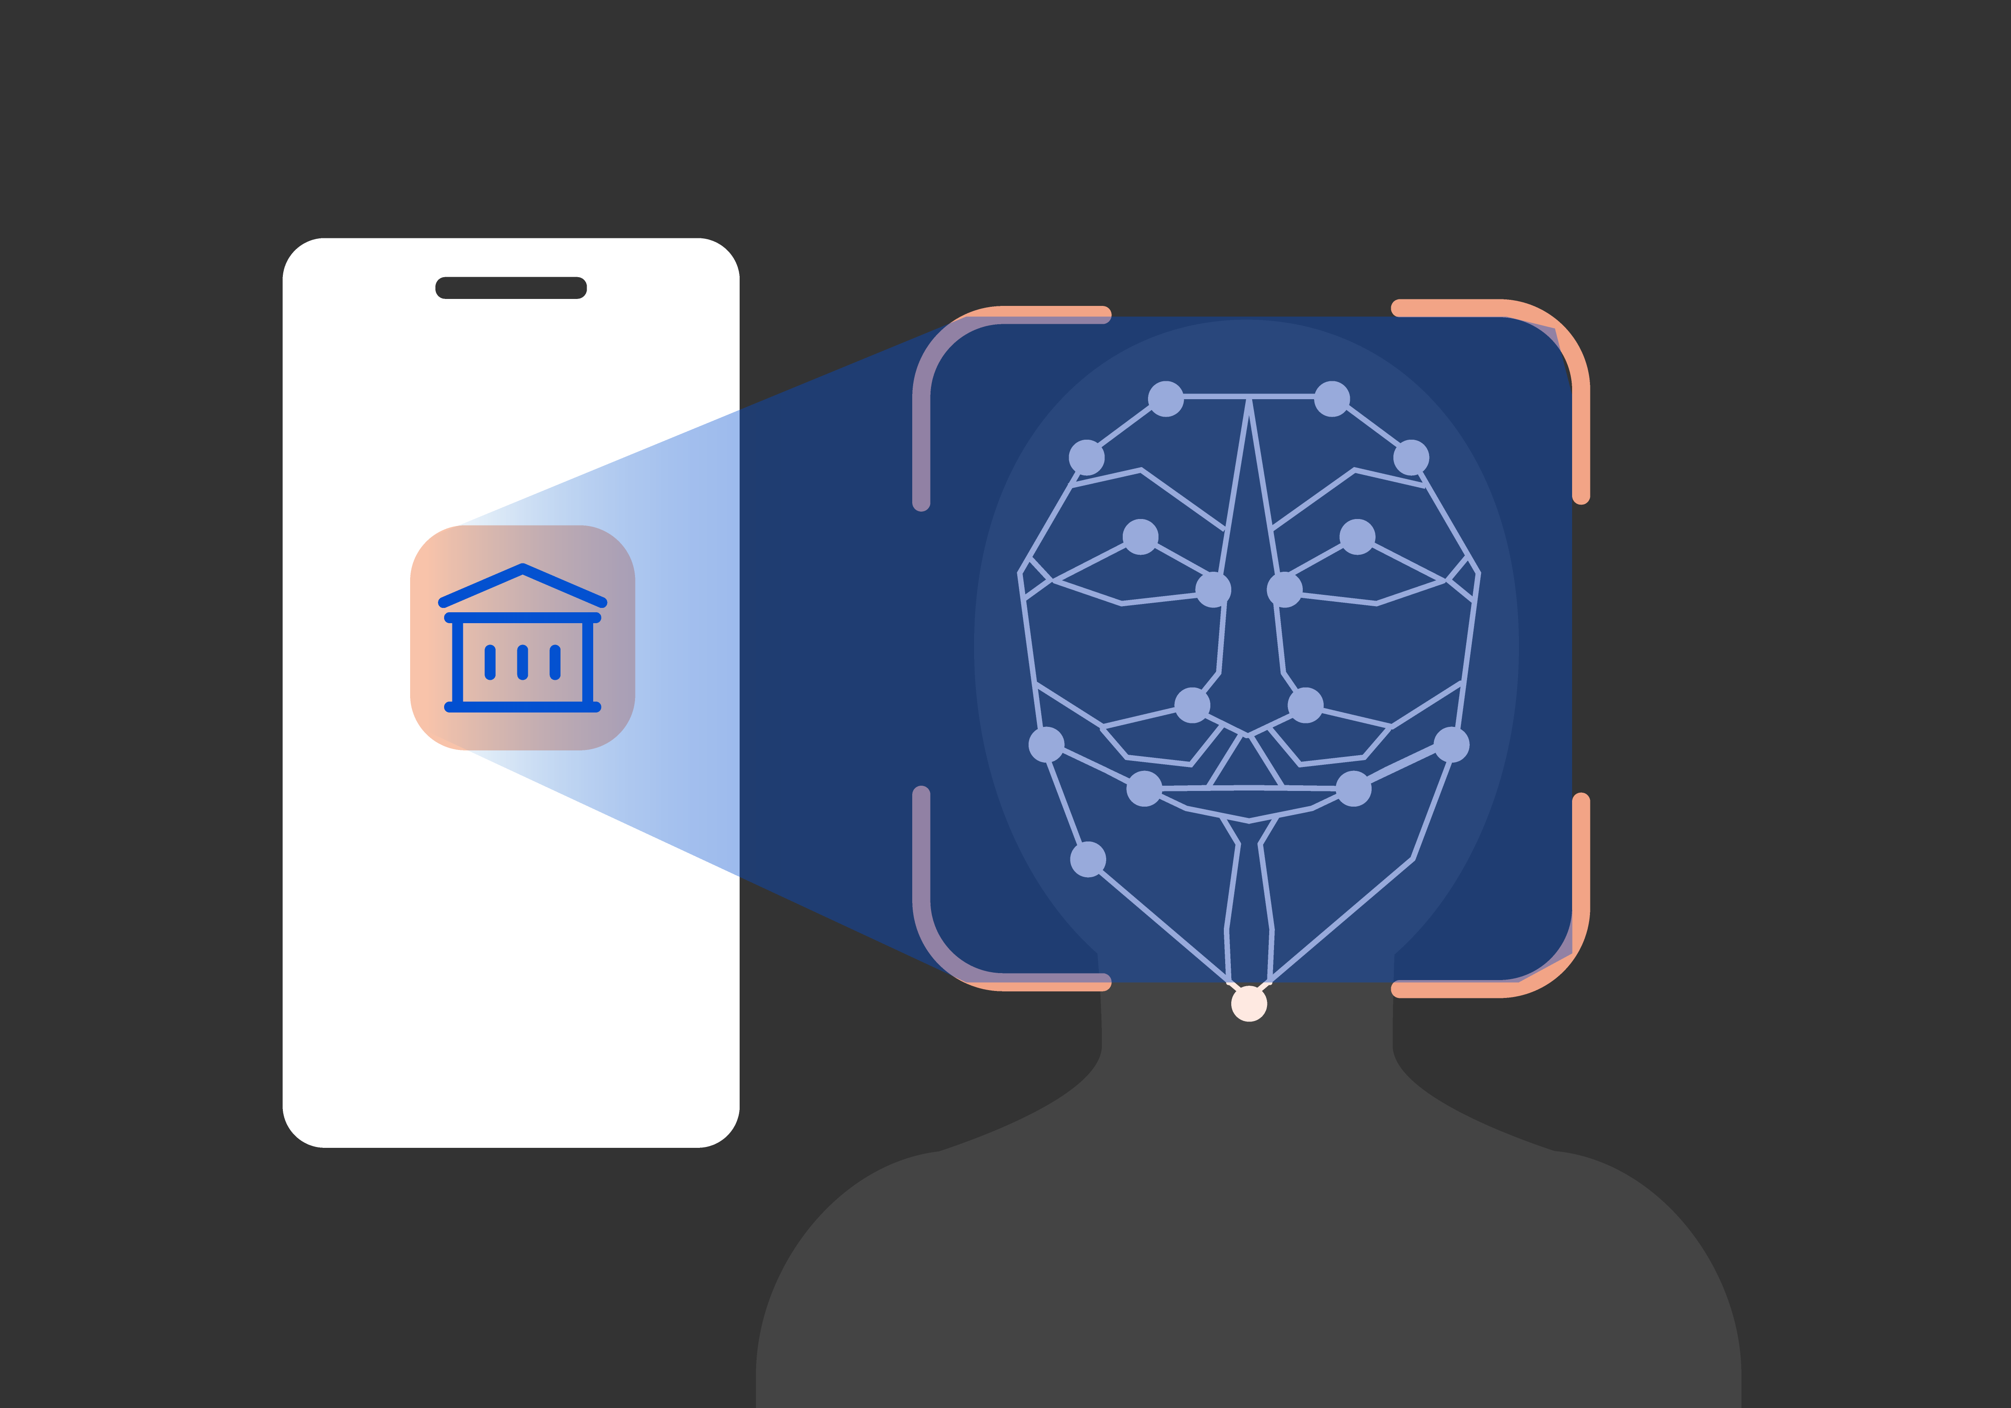
Problem Statement
Content:
Traditional authentication methods have serious limitations:
Passwords can be stolen or forgotten
Face recognition raises privacy concerns
Fingerprint systems require physical contact
These systems are either:
Insecure
Intrusive
Inconvenient
Need: A secure, contactless, and privacy-preserving authentication system (e.g. GAIT Pattern)

Slide 3





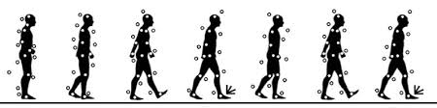
Proposed Solution
Uses Wi-Fi signals to identify users
No camera, no password
Works by analyzing signal distortion (CSI)
How It Works
Wi-Fi → Distortion → CSI → AI Model → Identity Match → Login
Features
Contactless authentication
Privacy-friendly
Harder to spoof than camera systems
Seamless user experience

Slide 4
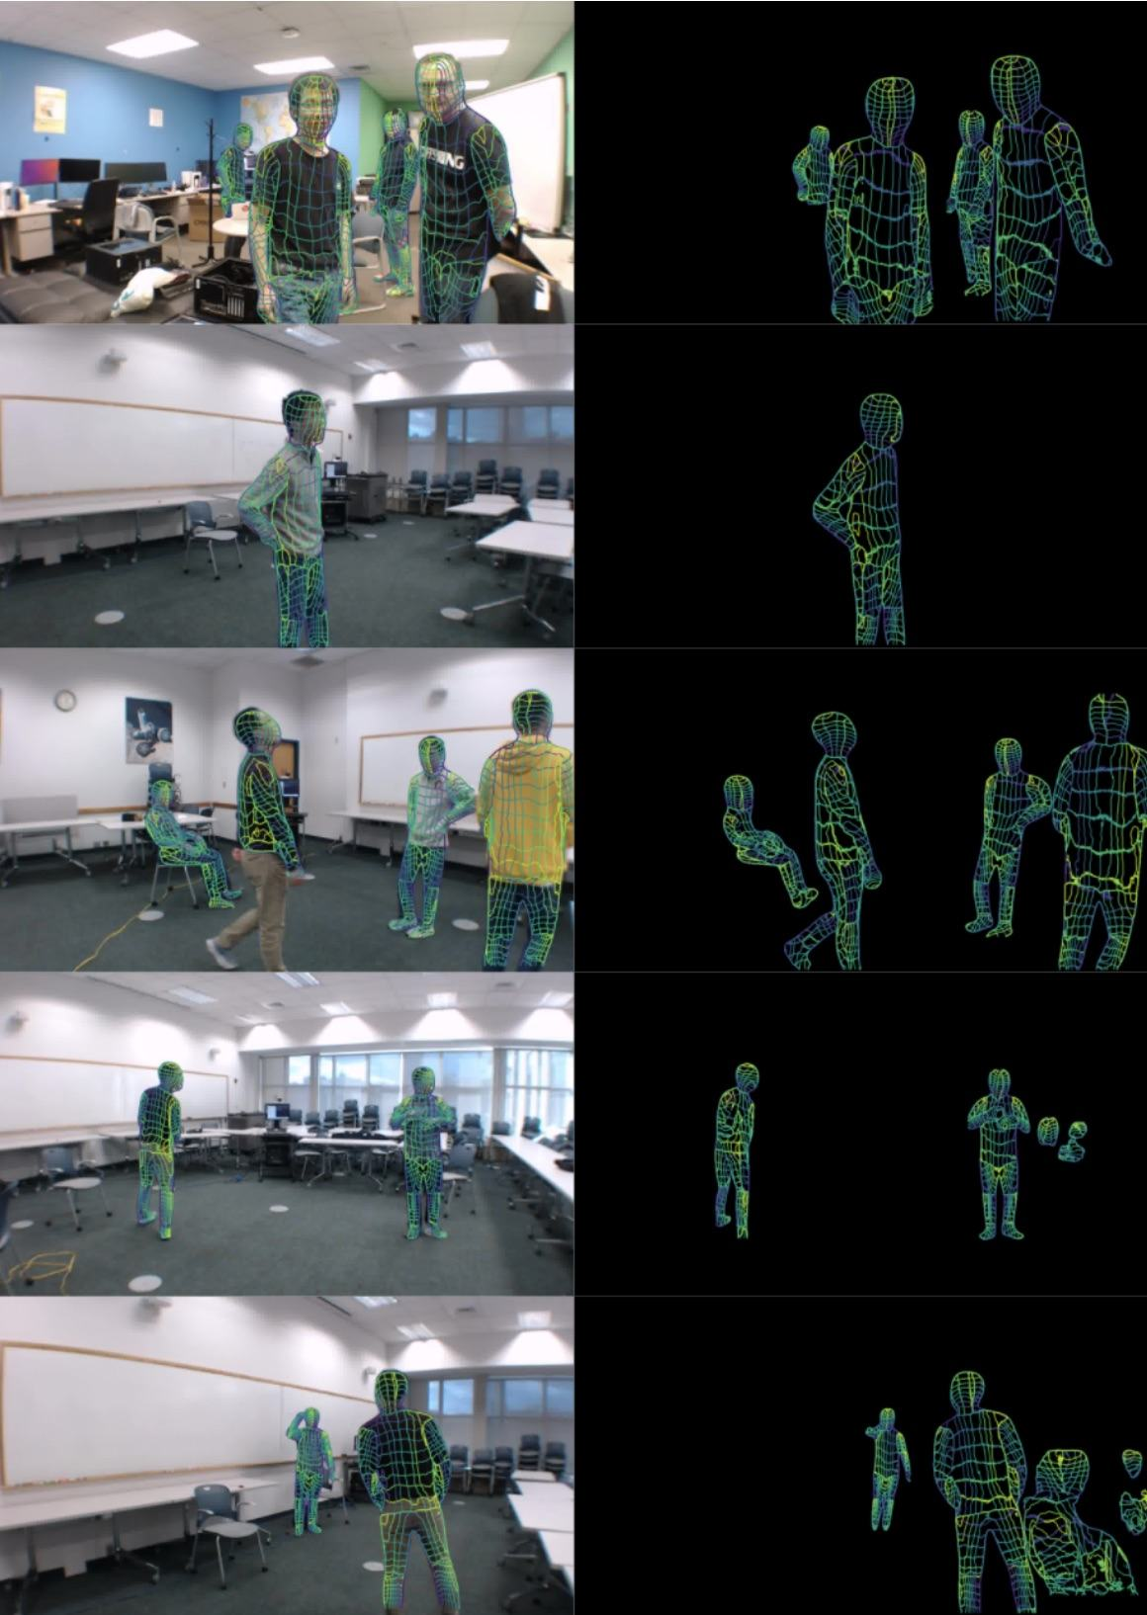
Tech Stack
Content:
Programming Language: Python
Deep Learning Framework: PyTorch
Models Used: Transformer / LSTM
Dataset: NTU-Fi (Wi-Fi CSI Data)
Frontend: Streamlit
Libraries: NumPy, Pandas, Matplotlib

Slide 5
Thank You
__________________________________________

