Slide 1
Cloud-based IoT and Big Data platforms assignment
Sipos Levente - D985ET

Slide 2
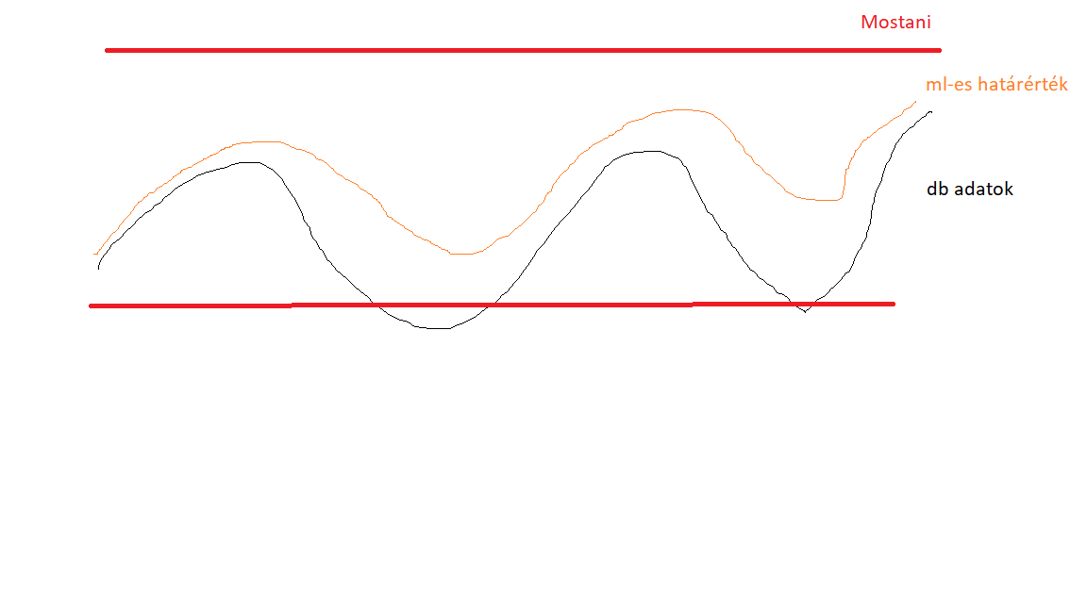
Topic basics
Forecast data from historical data.
Data monitoring.Data (MySQL) -> Interface (Springboot) -> Processing (Prometheus) -> Display/Alert (Alertmanager)
We need a solution against "alert fatigue" and reacting to late alerts.
Machine Learning algorithms (Facebook Prophet, Arima).

Slide 3
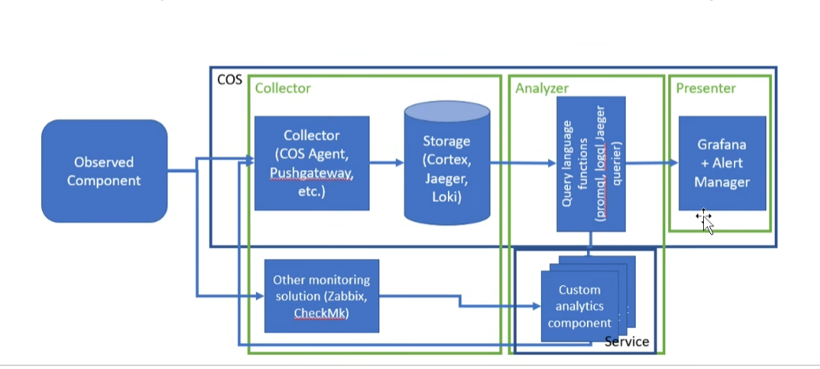
Components
Springboot and Prometheus.
Springboot: Java framework, API (DB<--->Prometheus)
Prometheus: data collector, (promql).

Slide 4
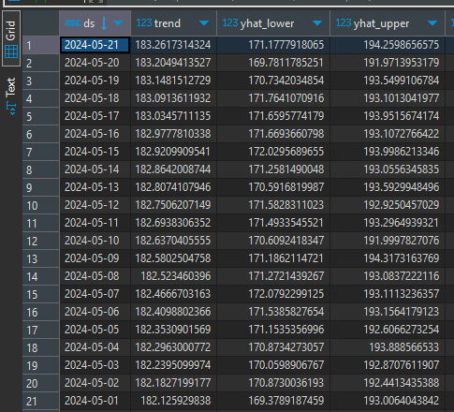
Database
It is currently on localhost.
There is an average table (aapl1) and from this data we can predict the next „n” days.
Yhat_lower, yhat_upper are the thresholds.

Slide 5
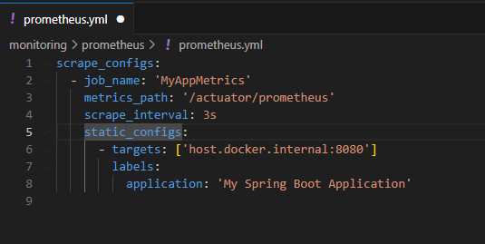
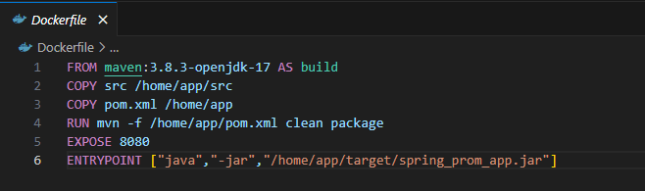
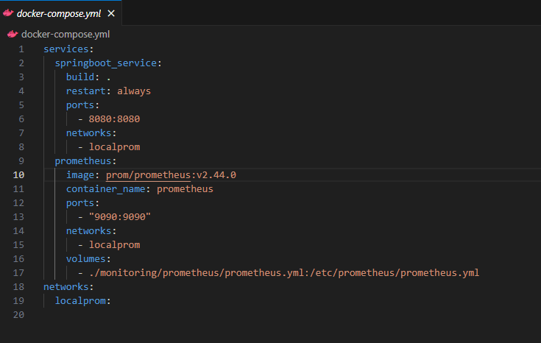
Dockerization
Dockerfile -> Performs initialization.
For Java.Docker-compose -> Advertise ports and connect Prometheus to Java.
Prometheus.yml -> Port, web url, scrape_interval (3 sec)

