Slide 1

Project Title - Optimizing Retail Stock Levels Through AI-Powered Demand Prediction
Submitted in partial fulfillment of the requirements for the award of the degree of
Master of Science (Data Science) MSc (DS)
By
Student Name: Mohit Yadav
Enrollment No: 024MSD110076
Under the guidance of
Guide/Mentor Name: Vikas Kumar Atray

Slide 2
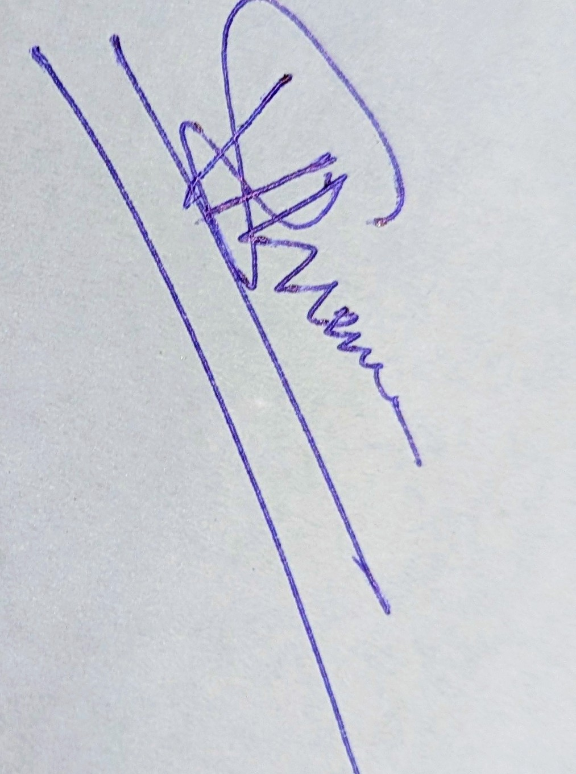
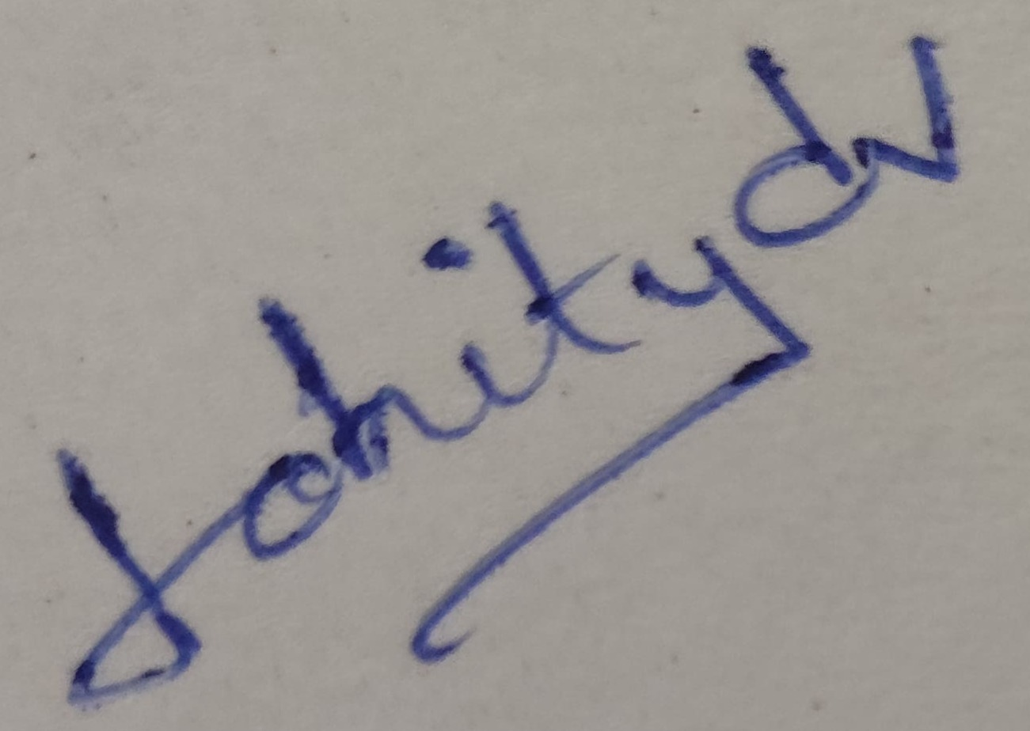
Certificate
BONAFIDE CERTIFICATE
Certified that this project report titled “Optimizing Retail Stock Levels Through AI-Powered Demand Prediction” is the bona fide work of Mohit Yadav, Reg. No.: 024MSD110076, who carried out this project work under my supervision.
Guide Signature
Student Signature
Date: 10/05/2026 Date: 01-05-2026
Place: Chandigarh Place: Chandigarh

Slide 3
Declaration
I, Mohit Yadav, hereby solemnly declare that the project report titled “Optimizing Retail Stock Levels Through AI-Powered Demand Prediction” submitted in partial fulfillment of the requirements for the award of the degree of Master of Science (Data Science)
I further declare that:
This project has been carried out by me during the academic year 2024-2026 under the supervision of Vikas Kumar Atray
The work has not been submitted previously to any other university, institution, or examination body for the award of any degree, diploma, or certification.
All sources of information used in this report have been duly acknowledged and referenced in accordance with academic ethics and plagiarism norms.
The data presented in this report is authentic to the best of my knowledge and has not been fabricated or manipulated.
I understand that if any part of this declaration is found to be false, my project may be rejected and disciplinary action may be taken as per institutional rules.
Place: Chandigarh Date: 18/05/2026
Student Signature:
Student Name: Mohit Yadav Enrollment No: 024MSD110076

Slide 4
Acknowledgement
I would like to thank Vikas Kumar Atray for his regular guidance, feedback and support for the project. He assisted in shaping both the technical and academic aspects of the project.
I would also like to thank the teaching faculty of the department for creating an academic space, technical environment and idea space to carry out this project. Their courses in data science, statistics, machine learning and system development provided the necessary foundation for the project.
Thank you to the university for granting me the opportunity to develop a project that is relevant for a business and implementing data science. I also wish to thank my family and friends for their encouragement, support and patience during the period of this project.

Slide 5
Abstract / Executive Summary
Project forecasts short-term retail demand for store 1
Scope: BEVERAGES, DAIRY and GROCERY I product families
Models compared: seasonal naive, moving average, regression lags, ARIMA and Prophet
Best operational model: lag-based linear regression by RMSE
Forecast output is converted into safety stock, reorder point, order quantity and alerts

Slide 6
Presentation Outline
Introduction and project need
Literature and research gap
Methodology and data preparation
Data analysis and model results
Inventory recommendations, conclusions and future scope

Slide 7
Chapter 1: Introduction
Retailers face stockouts and overstock when demand is uncertain
This project links demand forecasting with inventory planning
Dataset: Corporacion Favorita grocery sales data
Focused scope keeps the implementation explainable for MSc submission
Output supports reorder decisions and category-wise stock planning

Slide 8
Chapter 2: Literature Review
Classical forecasting methods give explainable baselines
Feature-based ML can use lag values, rolling means and calendar signals
Prophet and ARIMA are useful comparison models for time-series forecasting
Research gap: many forecasting projects stop at accuracy metrics
This project continues from prediction to inventory action

Slide 9
Chapter 3: Research Methodology
Raw files merged: sales, items, stores, transactions, oil and holidays
Analysis filtered to store 1 and three selected families
Features created: lag sales, rolling averages and calendar variables
Chronological train-test split used for realistic forecasting
Metrics: MAE, RMSE and MAPE

Slide 10
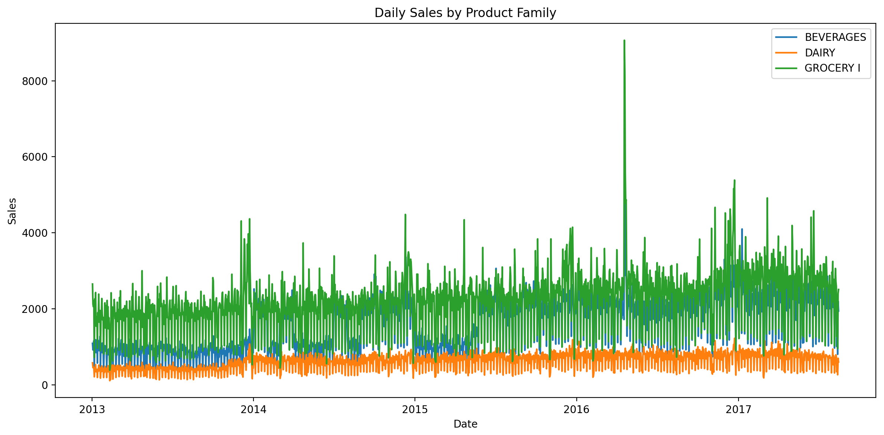
Chapter 4: Data Analysis & Interpretation
Family-wise demand varies clearly
GROCERY I has the highest volume
Beverages and Dairy require separate stock rules

Slide 11
Chapter 5: Findings / Results
Model | RMSE | MAPE
Linear Regression Lags | 290.328 | 17.860
Prophet | 311.009 | 14.123
Seasonal Naive | 405.221 | 13.945
Best model by RMSE: linear_regression_lags
Best RMSE: 290.328
Prophet achieved lowest MAPE but higher RMSE
RMSE was selected for stock-planning model choice

Slide 12
Chapter 6: Conclusions
The project successfully connects forecasting with inventory decisions
Lag-based regression gave the most suitable operational forecast in the current run
Inventory outputs make the forecast useful for reorder planning
The workflow is reproducible through scripts, tables, figures and dashboard output

Slide 13
Chapter 7: Recommendations
Family | Reorder Point | Order Qty
BEVERAGES | 16,218.88 | 30,623.65
DAIRY | 7,017.94 | 12,743.27
GROCERY I | 21,676.35 | 40,913.41
Use family-wise reorder points instead of one general rule
Monitor reorder alerts generated during the planning horizon
Review high-volume GROCERY I more frequently
Use dashboard and CSV outputs for manager review

Slide 14
Chapter 8: Limitations
Scope limited to store 1 and three product families
Inventory policy uses simplified assumptions for lead time and service level
LSTM was not executed because TensorFlow/Keras was unavailable
No live database, supplier constraint or warehouse-capacity logic included

Slide 15
Chapter 9: References
Corporacion Favorita grocery sales dataset
Forecasting: Principles and Practice
M5 forecasting competition literature
Prophet, pandas, NumPy, Matplotlib and statsmodels documentation
Inventory planning references for safety stock and reorder point

Slide 16
Chapter 10: Appendices
Source code structure and module descriptions
Generated output files: model metrics, forecasts and inventory tables
Charts: sales history, forecast vs actual, inventory simulation
Dashboard HTML summary
Notebook and scripts for project verification

