Slide 1

what is git?
a version control system
developed by Linus Torvalds
a de-facto standard

Slide 2
what is a version control system?
Scott Chacon & Ben Straub - Pro Git:
Version control system is a system that records changes to a file or set of files over time so that you can recall specific versions later.

Slide 3

local vcs

Slide 4
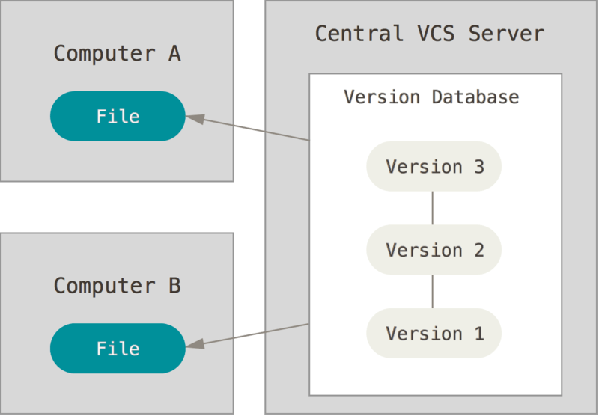
centralized vcs

Slide 5
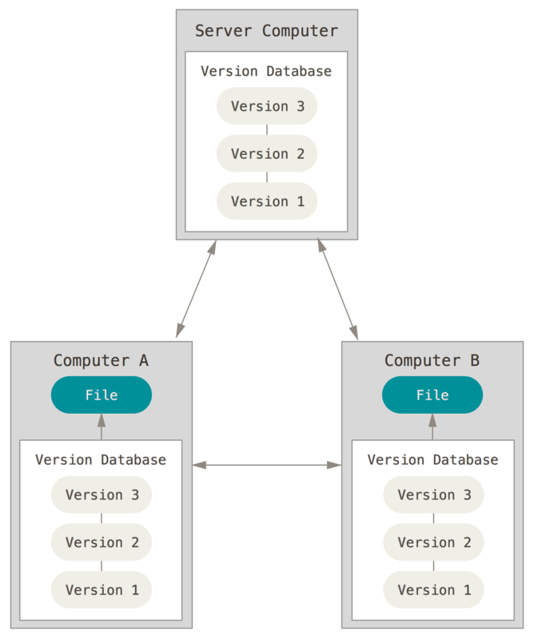
distributed vcs

Slide 6
what is git? (2)
distributed version control system
keep track of changes to code
restore old version
figure out when something went wrong
perform code changes without losing the original code
keep track of who changed what (`git blame`)
synchronize code with different people
non-linear development
has a steep learning curve

Slide 7
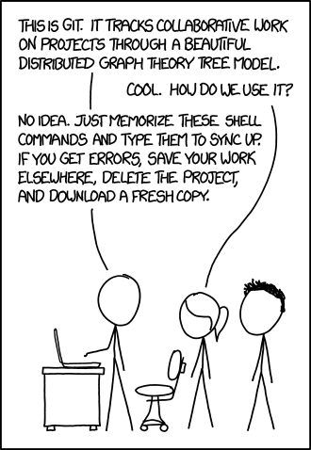
basic git commands
git init
git clone
git add
git commit
git pull
git push
git branch
git checkout
git merge
git reset

Slide 8
snapshots
git keeps snapshots of the entire state of the project
this means it stores the content of all files in your project
the user decides when to take a snapshot
wording:
a snapshot – a commit
taking a snapshot – to commit

Slide 9
a history of snapshots
4e94c83
4e948a93
27e5f6c
bed36b1
68e531a
create branch
2606fc8
80296f
merge branch

Slide 10
get your repository
git init
create new folder
cd there
run git init
git clone <url>
makes a (deep) copy of a repository and stores it locally
the repo can have 1000+ commits
the repo can have only the initial commit

Slide 11
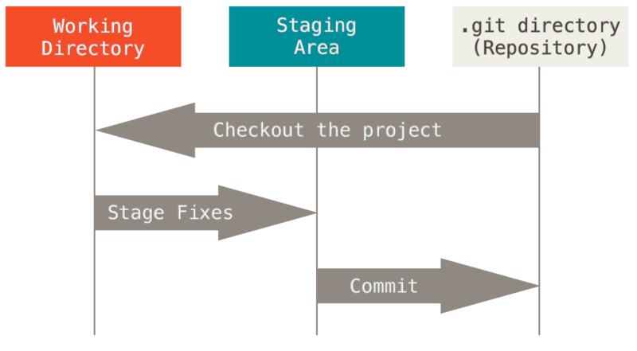
the staging area

Slide 12
the staging area
to add a file to the staging area just type git add <filename>
use wildcards if you want to add more then one file
you can not add a folder (git tracks only files, not folders)

Slide 13
create a commit
command: git commit
saves the changes in the staging area to the repository as a new revision (a commit)
records a message, the author and the committer

Slide 14
workflow (1)
change files
add changed files to staging area (git add)
commit changes (git commit)

Slide 15
show status and log
git status
shows which files on disk have changed
shows files in the staging area
shows how to revert changes
git log
shows a history of commits (messages, author, committer, …)

Slide 16
working with remotes
git push sends committed changes to a remote repository
git pull retrieves committed changes from a remote repository
if you have used git clone <url> to setup your repository this is the default remote repository (origin)

Slide 17
workflow (2)
change files
add changed files to staging area (git add)
commit changes (git commit)
get remote changes (git pull)
fix conflicts
share your work (git push)

Slide 18
branching
branches are used to develop different functions independent from each other
keep the master branch clean of intermediate work
each branch has its own history and current version

Slide 19
create a branch
4e94c83
4e948a93
27e5f6c
bed36b1
master
git branch feature-a
2606fc8
80296f
feature-a

Slide 20
branching
create a branch: git branch <branch_name>
switch to a branch: git checkout <branch_name>
git branch shows all branches

Slide 21
merge a branch
master
4e94c83
4e948a93
27e5f6c
bed36b1
68e531a
2606fc8
80296f
git merge feature-a
feature-a

Slide 22
git merge
git merge <branch_name> merges the branch <branch_name> with the current branch
fast forward merge
use git rebase as an alternative (advanced stuff)

Slide 23
merge conflicts
problem: two branches can't be automatically merged
has to be solved
scares people
not that difficult (thanks to merge tools)

Slide 24
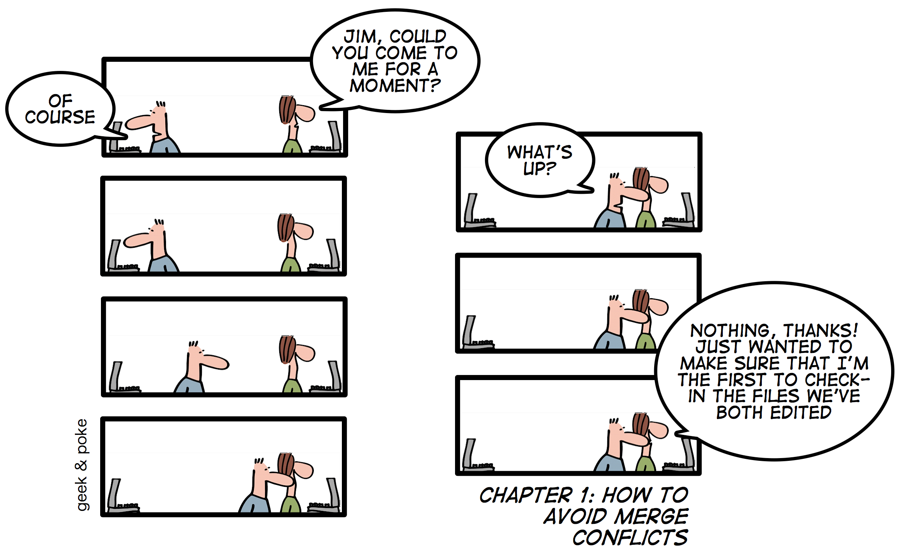
merge conflicts

Slide 25
workflow (3)
switch to a new branch
repeat until the feature is implemented
change files
add changed files to the staging area (git add)
commit changes (git commit)
change to the master branch
git pull changes in the master branch of the remote repository
merge your feature branch into master or rebase it on master
git push changes in master into remote repository

Slide 26
git enables you to…
… keep track of changes to code
… synchronize code with your working team
… test changes to code without losing the original
… restore back to old versions of code
… independently develop new features
more info:
Scott Chacon & Ben Staub - Pro Git
YouTube videos, Google

