Slide 1

COURSE TITLE
Lecture Number
Lecture Name
PRESENTER NAME
DEPARTMENT

Slide 2
Introduction to Reinforcement Learning
Definition
RL is a type of machine learning where an agent learns to make decisions by performing actions and receiving rewards or penalties.
Unlike supervised learning, RL does not rely on labeled data but instead learns from the consequences of its actions

Slide 3
The Chess Example
Problem Statement: Learn to play chess without explicit guidance on every move.
Challenges:
Cost of a teacher to guide every move.
The goodness of a move depends on future moves, not just the immediate action.
Objective: Sequence of moves leading to victory, rather than optimizing individual moves.
Feedback Mechanism: Only receive feedback (win/loss) at the end of the game.

Slide 4
The Maze-Solving Robot Example
Problem Statement: Navigate a maze to reach the exit.
Challenges:
No immediate feedback during the journey.
The goal is to find the shortest path, introducing a time preference.
Objective: Minimize the steps to reach the exit, competing against time.
Feedback Mechanism: Rewarded only upon reaching the exit.

Slide 5
Core Concepts of Reinforcement Learning
Agent, Environment, Actions, and Rewards:
Agent: The learner/decision-maker (chess player or robot).
Environment: The world the agent interacts with (chessboard or maze).
Actions: Possible moves the agent can take (chess moves or directional steps).
Rewards: Feedback from the environment (win/loss or maze exit reward).

Slide 6
Policy: Strategy that the agent uses to decide actions based on the current state.
Value Function: Measures the long-term benefit of states under a certain policy.

Slide 7
The K-Armed Bandit Problem
Definition: The K-Armed Bandit is a hypothetical slot machine with K levers, each offering different rewards.
Objective: Decide which lever to pull to maximize the total reward.
Comparison to Supervised Learning
Supervised Learning: In a classification problem, the teacher provides the correct class (optimal lever) for maximum earnings.
Reinforcement Learning: Instead of being told which lever is best, the agent must try different levers and learn from the outcomes.

Slide 8
Characteristics of the K-Armed Bandit Problem
Single State: Simplified because there’s only one state (one slot machine), so no need to consider transitions between states.
Immediate Reward: The reward is received immediately after pulling a lever, so the effect of the action is instantly known.
Exploration vs. Exploitation
Exploration: Trying different levers to discover which one yields the highest reward.
Exploitation: Continuing to pull the lever that has historically given the highest reward.

Slide 9
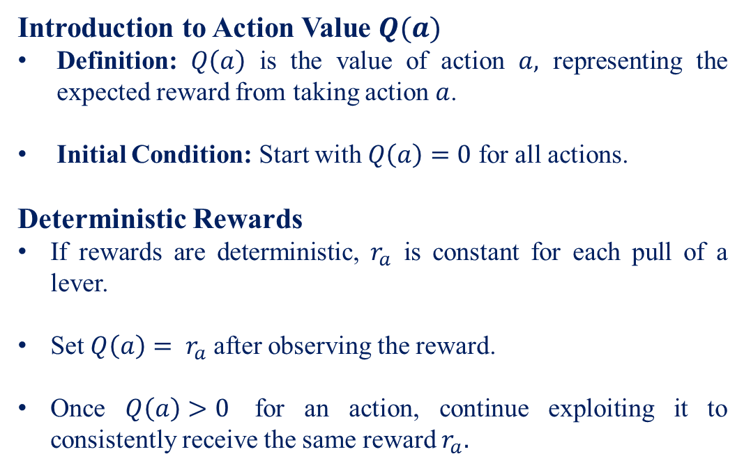
Introduction to Action Value $Q(a)$
Definition: $Q\left(a\right)$ is the value of action $a,$ representing the expected reward from taking action $a$.
Initial Condition: Start with $Q\left(a\right)=0$ for all actions.
Deterministic Rewards
If rewards are deterministic, $r_{a}$ is constant for each pull of a lever.
Set $Q\left(a\right)= r_{a}$ after observing the reward.
Once $Q\left(a\right)>0$ for an action, continue exploiting it to consistently receive the same reward $r_{a}.$

Slide 10
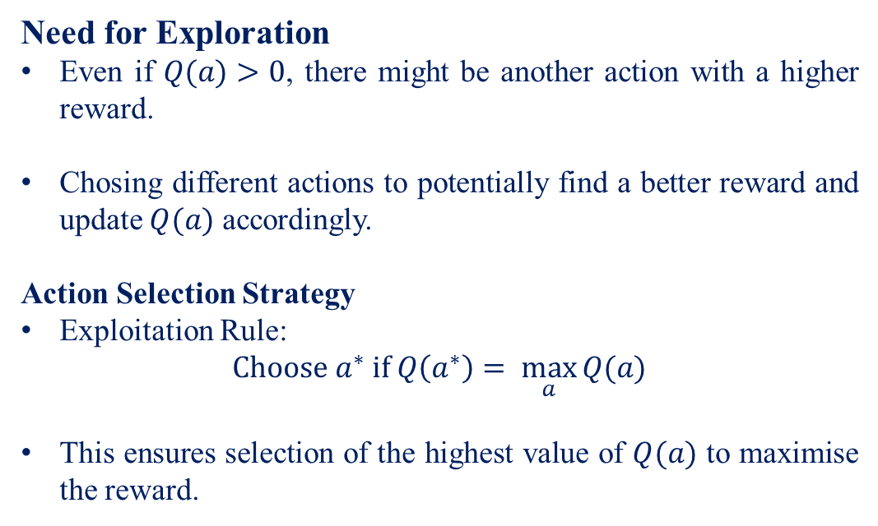
Need for Exploration
Even if $Q(a)>0$, there might be another action with a higher reward.
Chosing different actions to potentially find a better reward and update $Q(a)$ accordingly.
Action Selection Strategy
Exploitation Rule:
$$Choose a^{∗} if Q\left(a^{∗}\right)= \max_{a}{Q(a)}$$
This ensures selection of the highest value of $Q(a)$ to maximise the reward.

Slide 11
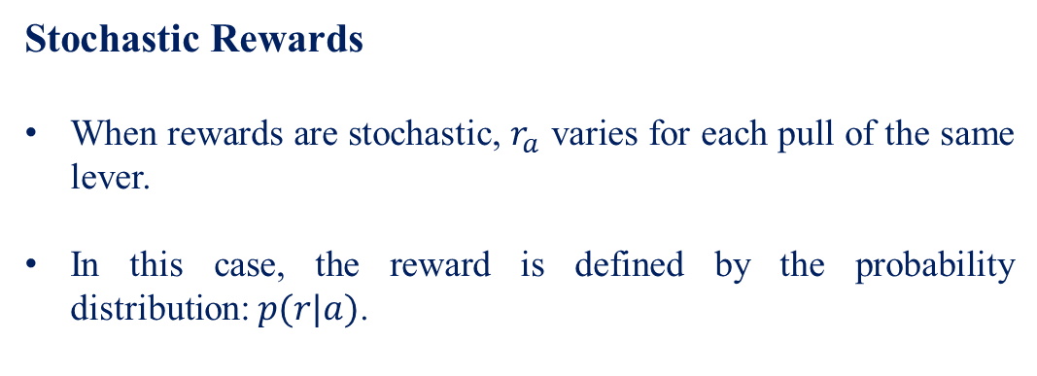
Stochastic Rewards
When rewards are stochastic, $r_{a}$ varies for each pull of the same lever.
In this case, the reward is defined by the probability distribution: $p(r|a)$.

Slide 12
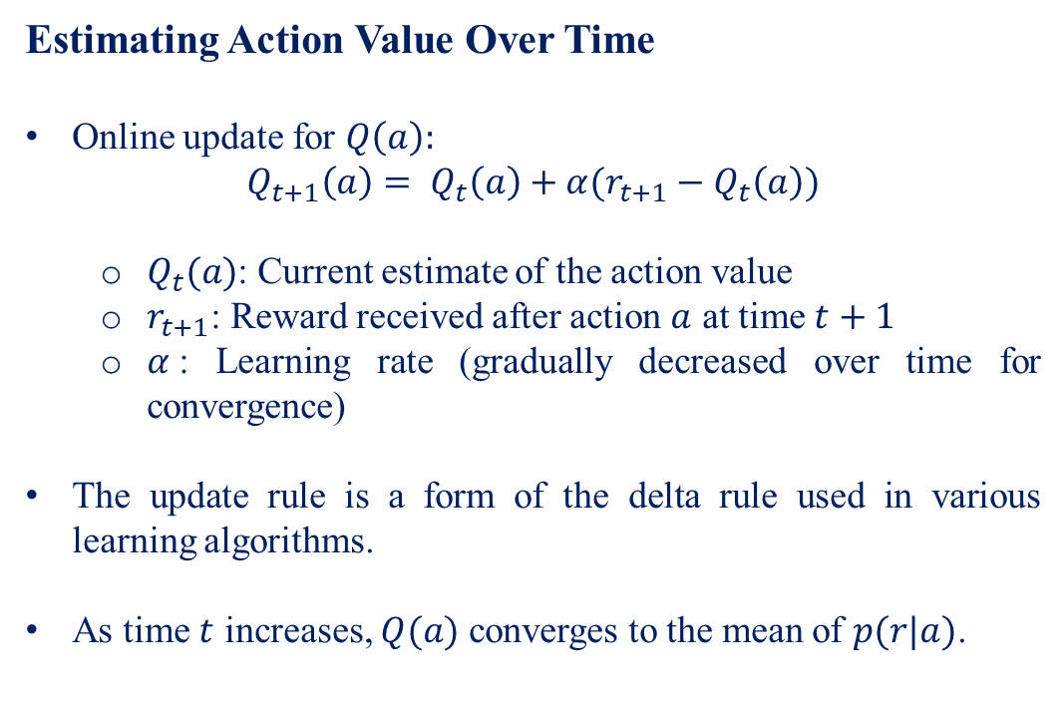
Estimating Action Value Over Time
Online update for $Q\left(a\right):$
$$Q_{t+1}\left(a\right)= Q_{t}\left(a\right)+α(r_{t+1}−Q_{t}\left(a\right))$$
$Q_{t}(a)$: Current estimate of the action value
$r_{t+1}$: Reward received after action $a$ at time $t+1$
$α$: Learning rate (gradually decreased over time for convergence)
The update rule is a form of the delta rule used in various learning algorithms.
As time $t$ increases, $Q(a)$ converges to the mean of $p(r|a)$.

Slide 13
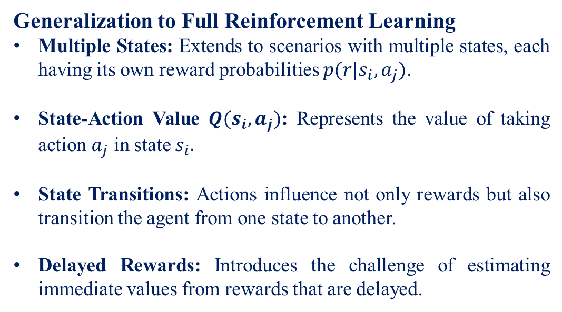
Generalization to Full Reinforcement Learning
Multiple States: Extends to scenarios with multiple states, each having its own reward probabilities $p(r|s_{i}, a_{j})$.
State-Action Value $Q(s_{i}, a_{j})$: Represents the value of taking action $a_{j}$ in state $s_{i}.$
State Transitions: Actions influence not only rewards but also transition the agent from one state to another.
Delayed Rewards: Introduces the challenge of estimating immediate values from rewards that are delayed.

Slide 14
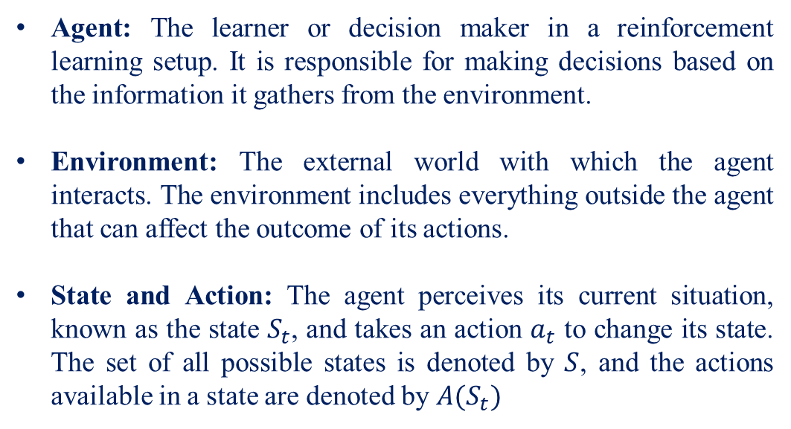
Reinforcement Learning Elements
Agent: The learner or decision maker in a reinforcement learning setup. It is responsible for making decisions based on the information it gathers from the environment.
Environment: The external world with which the agent interacts. The environment includes everything outside the agent that can affect the outcome of its actions.
State and Action: The agent perceives its current situation, known as the state $S_{t}$, and takes an action $a_{t}$ to change its state. The set of all possible states is denoted by $S$, and the actions available in a state are denoted by $A(S_{t})$

Slide 15
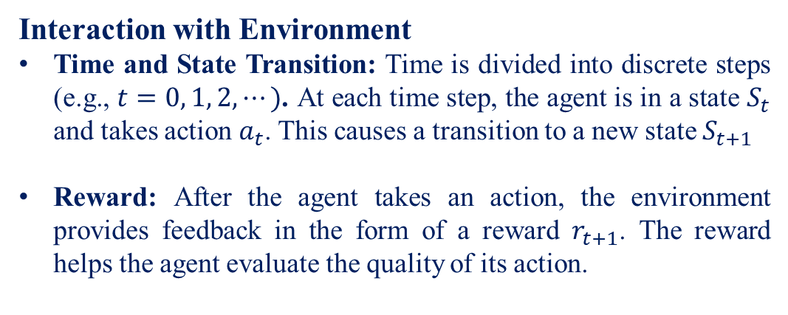
Interaction with Environment
Time and State Transition: Time is divided into discrete steps (e.g., $t=0, 1, 2, ⋯)$. At each time step, the agent is in a state $S_{t}$ and takes action $a_{t}$. This causes a transition to a new state $S_{t+1}$
Reward: After the agent takes an action, the environment provides feedback in the form of a reward $r_{t+1}$. The reward helps the agent evaluate the quality of its action.

Slide 16
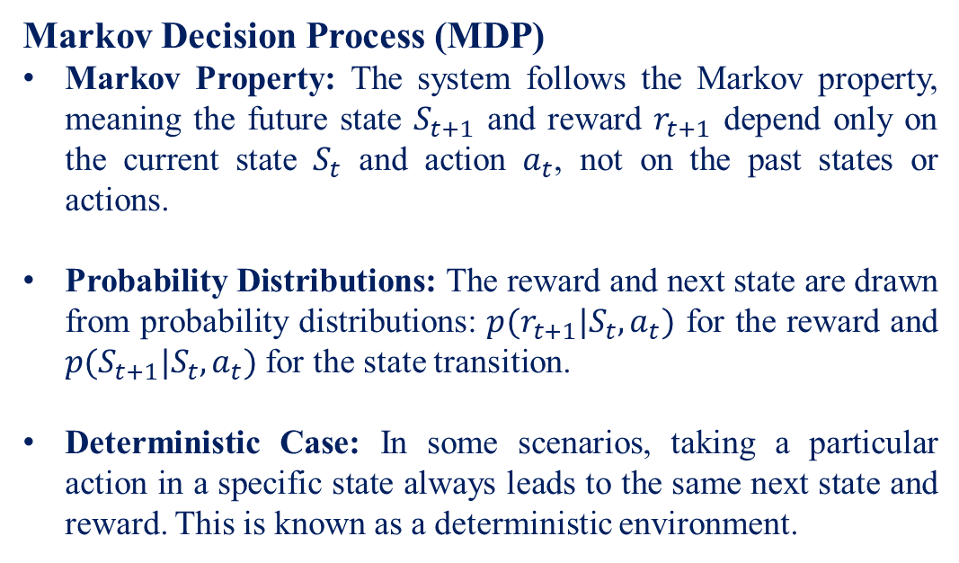
Markov Decision Process (MDP)
Markov Property: The system follows the Markov property, meaning the future state $S_{t+1}$ and reward $r_{t+1}$ depend only on the current state $S_{t}$ and action $a_{t}$, not on the past states or actions.
Probability Distributions: The reward and next state are drawn from probability distributions: $p(r_{t+1}|S_{t}, a_{t})$ for the reward and $p(S_{t+1}|S_{t},a_{t})$ for the state transition.
Deterministic Case: In some scenarios, taking a particular action in a specific state always leads to the same next state and reward. This is known as a deterministic environment.

Slide 17
Episode and Terminal States
Initial State: The state where the agent begins its journey.
Terminal State: A special state where the episode (or task) ends. Once in the terminal state, no further actions lead to a new state, and no rewards are given.
Episode: The sequence of actions taken by the agent from the initial state to the terminal state is called an episode. Each episode represents one trial or one complete attempt at the task.

Slide 18
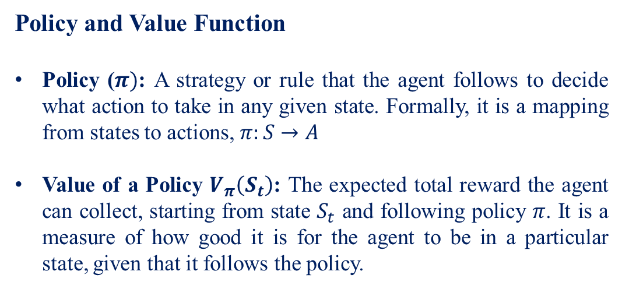
Policy and Value Function
Policy ($π)$: A strategy or rule that the agent follows to decide what action to take in any given state. Formally, it is a mapping from states to actions, $π:S→A$
Value of a Policy $V_{π}\left(S_{t}\right)$: The expected total reward the agent can collect, starting from state $S_{t}$ and following policy $π$. It is a measure of how good it is for the agent to be in a particular state, given that it follows the policy.

Slide 19
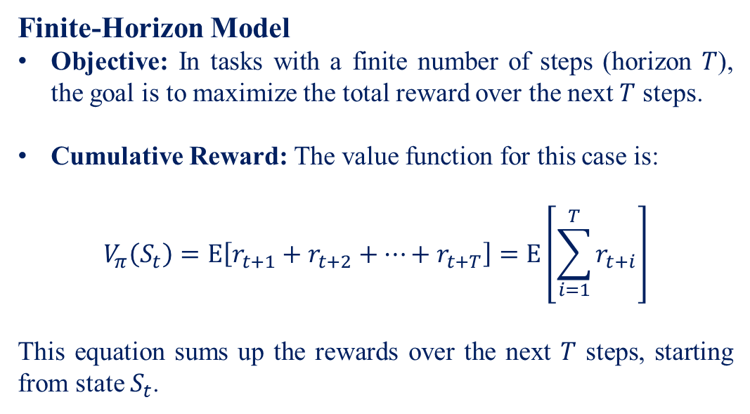
Finite-Horizon Model
Objective: In tasks with a finite number of steps (horizon $T$), the goal is to maximize the total reward over the next $T$ steps.
Cumulative Reward: The value function for this case is:
$$V_{π}\left(S_{t}\right)=E\left[r_{t+1}+r_{t+2}+⋯+r_{t+T}\right]=E\left[\sum_{i=1}^{T}{r_{t+i}}\right]$$
This equation sums up the rewards over the next $T$ steps, starting from state $S_{t}$.

Slide 20
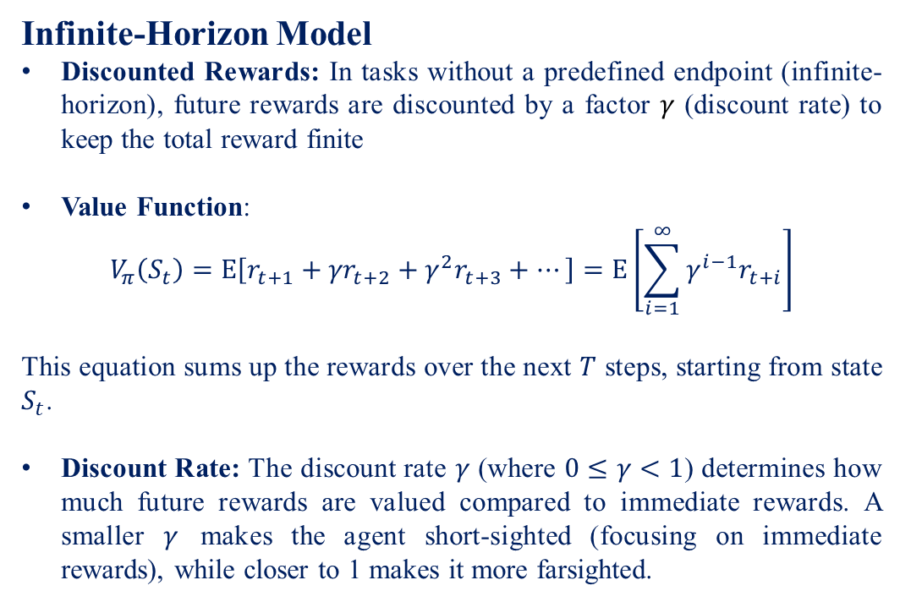
Infinite-Horizon Model
Discounted Rewards: In tasks without a predefined endpoint (infinite-horizon), future rewards are discounted by a factor $γ$ (discount rate) to keep the total reward finite
Value Function:
$$V_{π}\left(S_{t}\right)=E\left[r_{t+1}+{γr}_{t+2}+γ^{2}r_{t+3}+⋯\right]=E\left[\sum_{i=1}^{∞}{γ^{i−1}r_{t+i}}\right]$$
This equation sums up the rewards over the next $T$ steps, starting from state $S_{t}$.
Discount Rate: The discount rate $γ$ (where $0≤γ<1$) determines how much future rewards are valued compared to immediate rewards. A smaller $γ$ makes the agent short-sighted (focusing on immediate rewards), while closer to 1 makes it more farsighted.

Slide 21
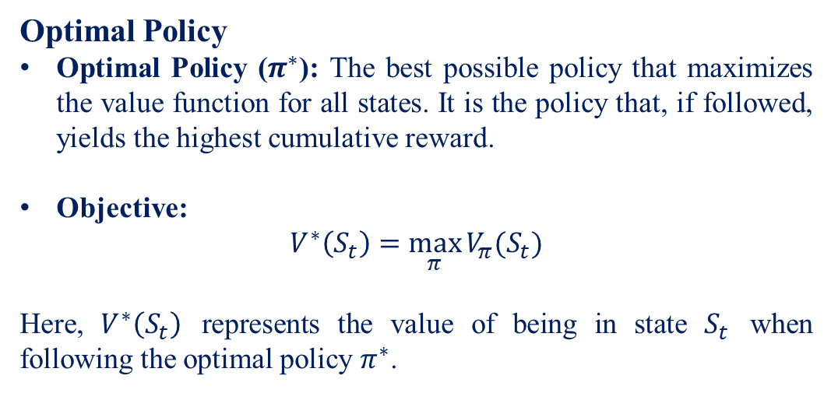
Optimal Policy
Optimal Policy ($π^{∗}$): The best possible policy that maximizes the value function for all states. It is the policy that, if followed, yields the highest cumulative reward.
Objective:
$$V^{∗}\left(S_{t}\right)=\max_{π}{V_{π}(S_{t})}$$
Here, $V^{∗}\left(S_{t}\right)$ represents the value of being in state $S_{t}$ when following the optimal policy $π^{∗}$.

Slide 22
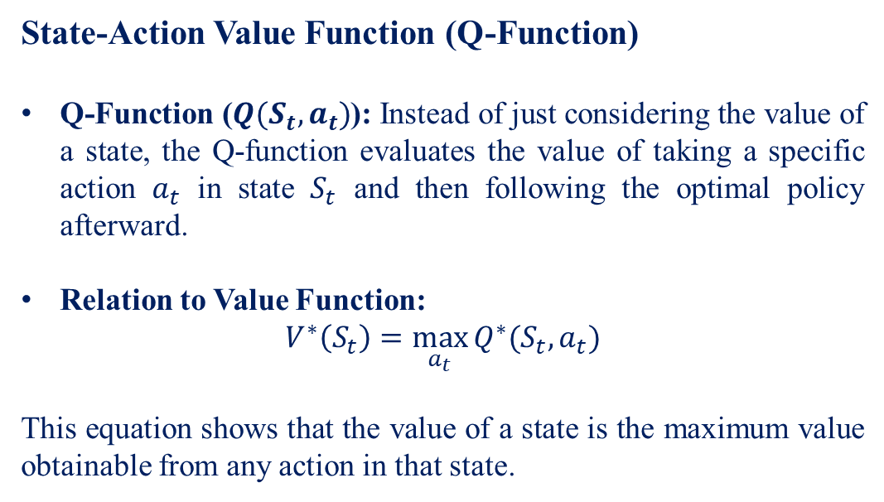
State-Action Value Function (Q-Function)
Q-Function ($Q(S_{t}, a_{t})$): Instead of just considering the value of a state, the Q-function evaluates the value of taking a specific action $a_{t}$ in state $S_{t}$ and then following the optimal policy afterward.
Relation to Value Function:
$$V^{∗}\left(S_{t}\right)=\max_{a_{t}}{Q^{∗}(S_{t}, a_{t}})$$
This equation shows that the value of a state is the maximum value obtainable from any action in that state.

Slide 23
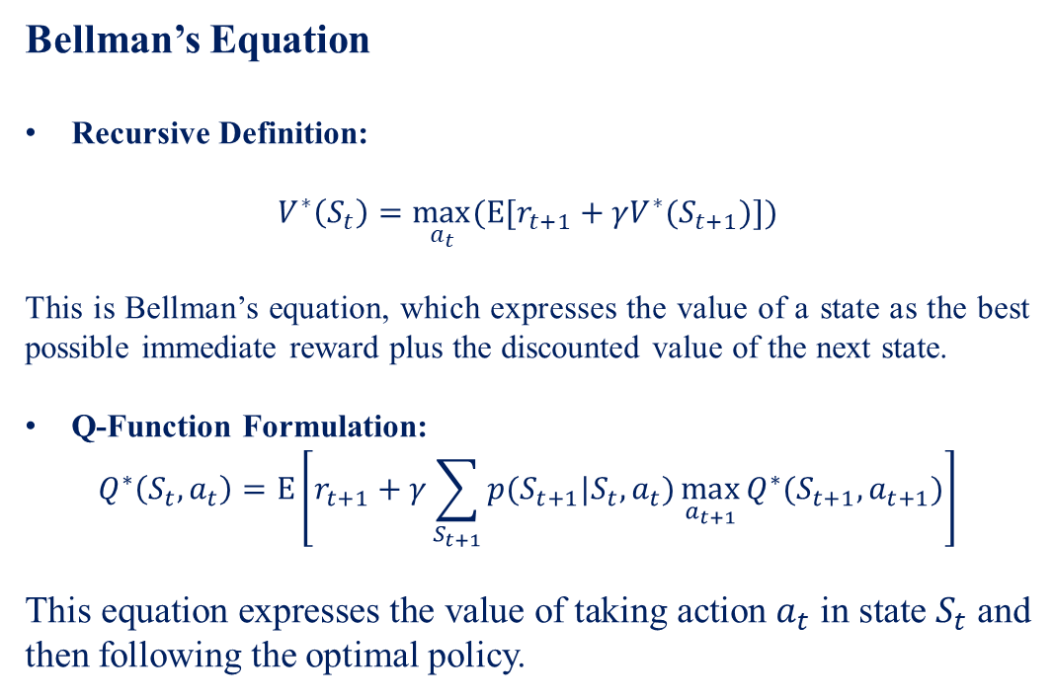
Bellman’s Equation
Recursive Definition:
$$V^{∗}\left(S_{t}\right)=\max_{a_{t}}{(E[r_{t+1}+γV^{∗}(S_{t+1})])}$$
This is Bellman’s equation, which expresses the value of a state as the best possible immediate reward plus the discounted value of the next state.
Q-Function Formulation:
$$Q^{∗}\left(S_{t}, a_{t}\right)=E\left[r_{t+1}+γ\sum_{S_{t+1}}{p(S_{t+1}|S_{t},a_{t})\max_{a_{t+1}}{Q^{∗}(S_{t+1},a_{t+1})}}\right]$$
This equation expresses the value of taking action $a_{t}$ in state $S_{t}$ and then following the optimal policy.

Slide 24
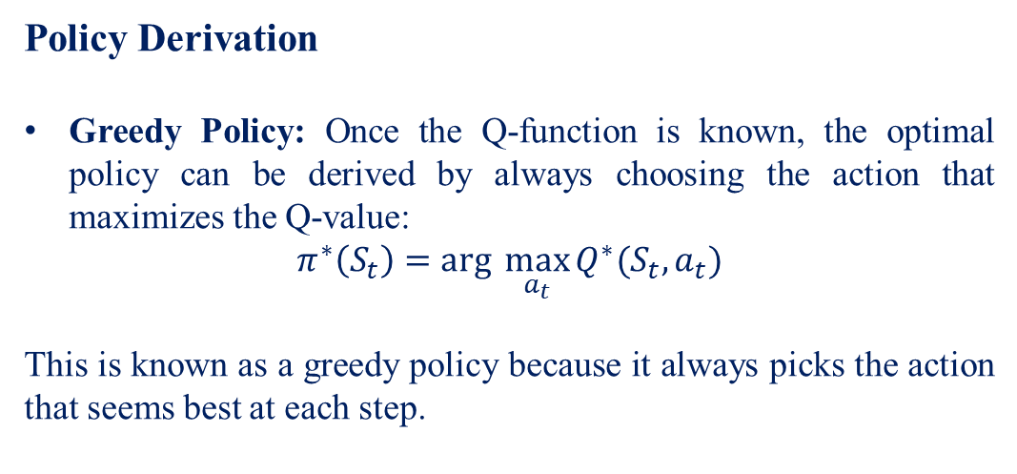
Policy Derivation
Greedy Policy: Once the Q-function is known, the optimal policy can be derived by always choosing the action that maximizes the Q-value:
$$π^{∗}\left(S_{t}\right)=arg \max_{a_{t}}{Q^{∗}(S_{t},a_{t})}$$
This is known as a greedy policy because it always picks the action that seems best at each step.

Slide 25
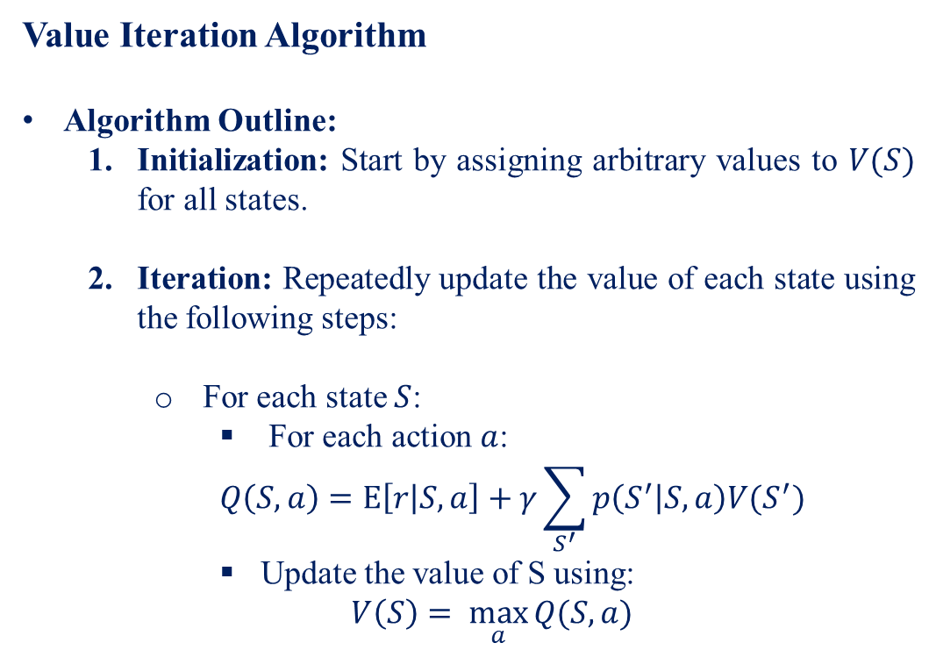
Value Iteration Algorithm
Algorithm Outline:
Initialization: Start by assigning arbitrary values to $V(S)$ for all states.
Iteration: Repeatedly update the value of each state using the following steps:
For each state $S$:
For each action $a$:
$$Q\left(S,a\right)=E\left[r | S,a\right]+γ\sum_{S^{′}}{p\left(S^{′} | S,a\right)V(S^{′})}$$
Update the value of S using:
$$V\left(S\right)= \max_{a}{Q(S,a)}$$

Slide 26
Convergence: Continue updating until the values converge (i.e., the change in values becomes negligible)
Outcome: The algorithm converges to the optimal value function, from which the optimal policy can be derived.

Slide 27
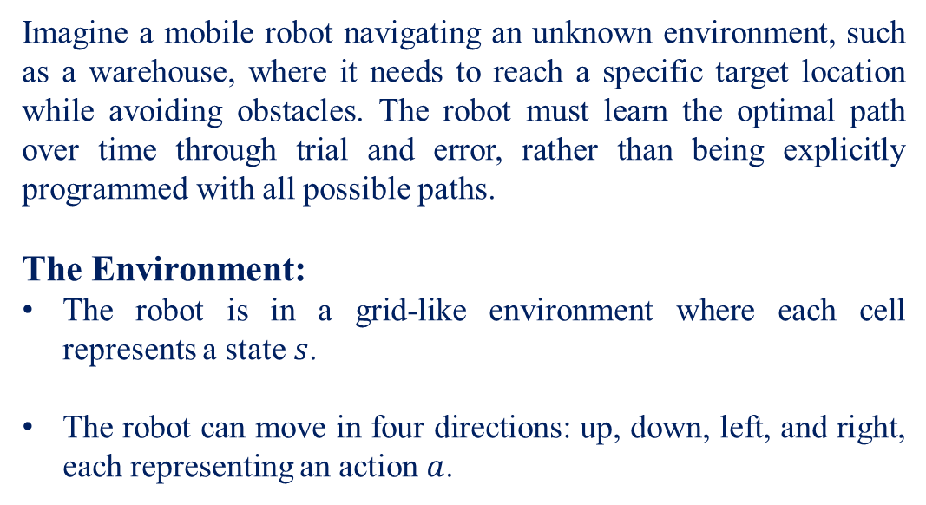
Example: RL in Robotics for Path Planning
Imagine a mobile robot navigating an unknown environment, such as a warehouse, where it needs to reach a specific target location while avoiding obstacles. The robot must learn the optimal path over time through trial and error, rather than being explicitly programmed with all possible paths.
The Environment:
The robot is in a grid-like environment where each cell represents a state $s$.
The robot can move in four directions: up, down, left, and right, each representing an action $a$.

Slide 28
The Agent:
The robot is the agent, which decides the next action to take based on its current state.
Rewards:
The robot receives a positive reward when it reaches the target location.
A small negative reward is given for each move to encourage shorter paths.
A larger negative reward is given if the robot collides with an obstacle.

Slide 29
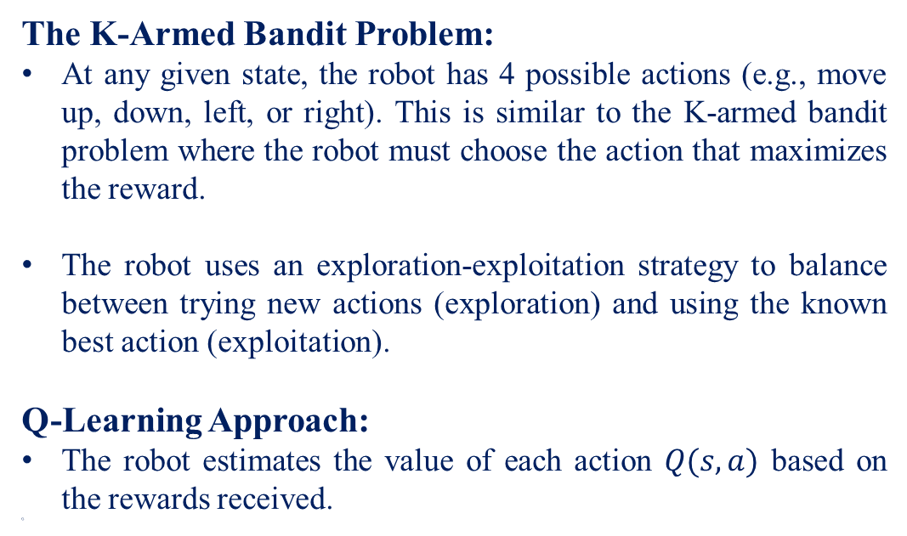
The K-Armed Bandit Problem:
At any given state, the robot has 4 possible actions (e.g., move up, down, left, or right). This is similar to the K-armed bandit problem where the robot must choose the action that maximizes the reward.
The robot uses an exploration-exploitation strategy to balance between trying new actions (exploration) and using the known best action (exploitation).
Q-Learning Approach:
The robot estimates the value of each action $Q(s,a)$ based on the rewards received.
Q-

Slide 30
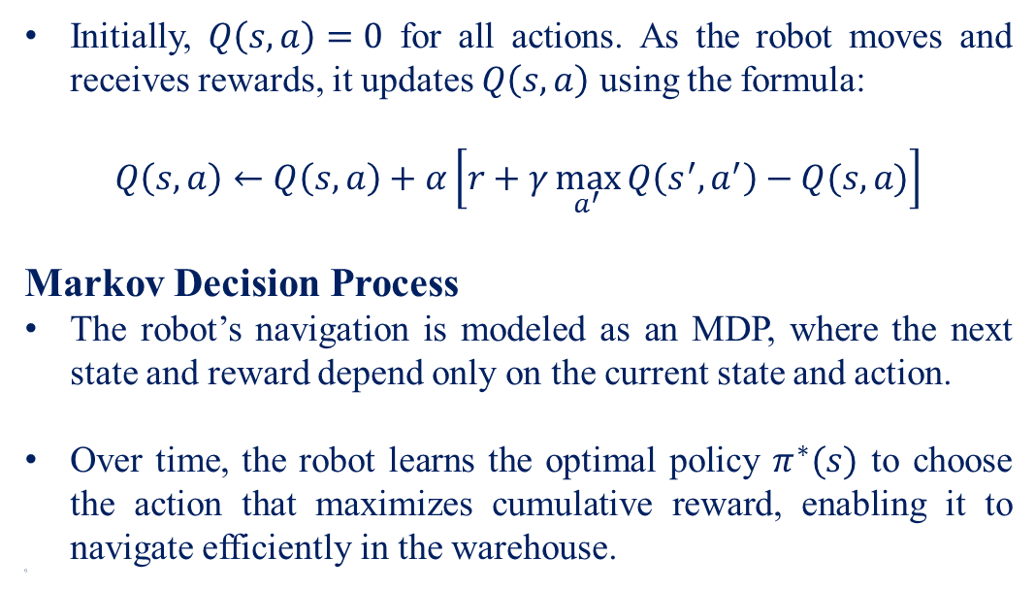
Initially, $Q\left(s,a\right)=0$ for all actions. As the robot moves and receives rewards, it updates $Q\left(s,a\right)$ using the formula:
$$Q\left(s,a\right)←Q\left(s,a\right)+α\left[r+γ\max_{a^{′}}{Q\left(s^{′},a^{′}\right)−Q(s,a)}\right]$$
Markov Decision Process
The robot’s navigation is modeled as an MDP, where the next state and reward depend only on the current state and action.
Over time, the robot learns the optimal policy $π^{∗}(s)$ to choose the action that maximizes cumulative reward, enabling it to navigate efficiently in the warehouse.
Q-

Slide 31
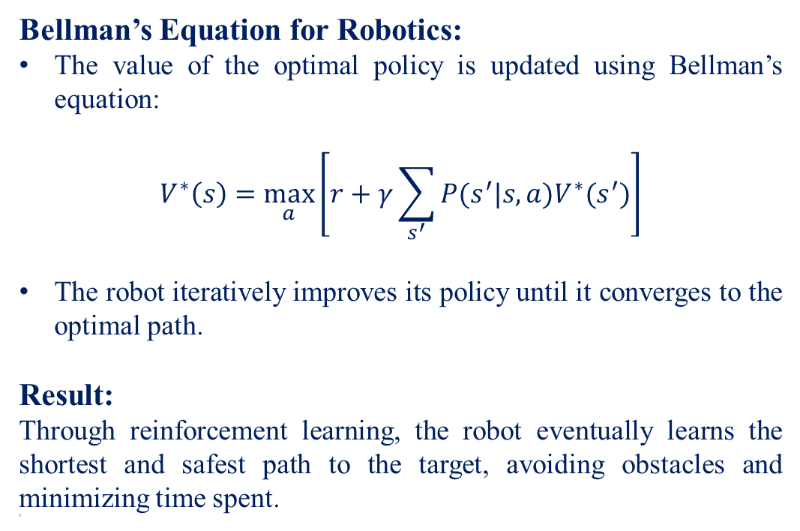
Bellman’s Equation for Robotics:
The value of the optimal policy is updated using Bellman’s equation:
$$V^{∗}\left(s\right)=\max_{a}\left[r+γ\sum_{s^{′}}{P(s^{′}|s,a)V^{∗}(s^{′})}\right]$$
The robot iteratively improves its policy until it converges to the optimal path.
Result:
Through reinforcement learning, the robot eventually learns the shortest and safest path to the target, avoiding obstacles and minimizing time spent.
Q-

Slide 32
Thank You

