Slide 1
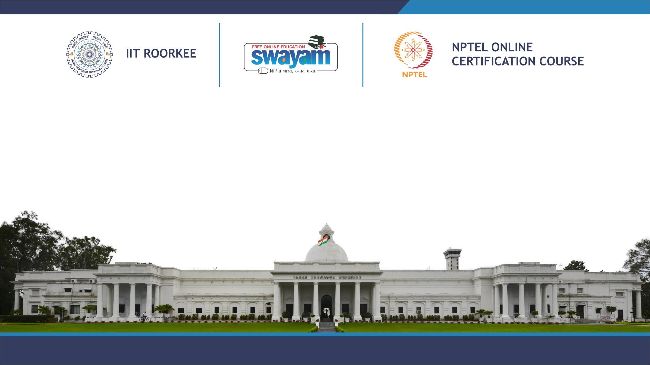
COURSE TITLE
Lecture Number
Lecture Name
PRESENTER NAME
DEPARTMENT

Slide 2
Introduction to Path Planning
Path planning involves determining a feasible route from a start to a goal while avoiding obstacles, crucial for autonomous systems.
Essential for autonomous systems to operate independently without human intervention.
Ensures safe navigation in complex environments while minimizing time, distance, and energy consumption.
Fundamental for robots to perform tasks in structured and unstructured environments, whether on land, air, sea, or space.

Slide 3
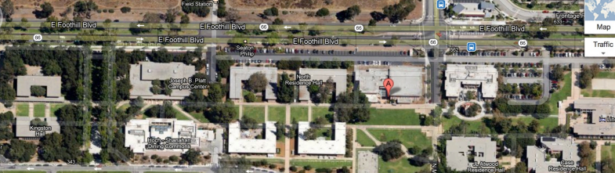
Applications:
Route planning for self-driving cars, considering traffic, obstacles, and road conditions.
Flight path optimization in 3D space for tasks like delivery, surveillance, and mapping.
Efficient movement of robotic arms in manufacturing, minimizing collisions and optimizing cycle time.
Figure: Workspace in recent robotics path planning competitions

Slide 4
Evolution in Path Planning Methods
In 1956, Edsger W. Dijkstra introduced the shortest path algorithm, foundational for later developments.
In 1968, Peter Hart, Nils Nilsson, Bertram Raphael combined Dijkstra’s algorithm with heuristics for improved efficiency.
In 1985, Lydia Kavraki, Jean-Claude Latombe enabled path planning in high-dimensional spaces using sampling-based methods.
In 1990s, Steven M. LaValle facilitated real-time path planning in complex environments.

Slide 5
In 2008, Sertac Karaman, Emilio Frazzoli ensured optimal paths in asymptotic conditions with RRT refinement.
In 2013, Sergey Levine used deep reinforcement learning for complex navigation tasks.

Slide 6
Types of Path Planning Problems
Single-Agent Path Planning
Involves finding a path for a single autonomous agent from a start to a goal while avoiding obstacles.
Example: Determining a route for a mobile robot in a warehouse.
One might face challenges in handling dynamic obstacles or navigating through complex or high-dimensional spaces.

Slide 7
Multi-Agent Path Planning
Addresses path planning for multiple agents that must coordinate their movements to avoid collisions and reach their goals.
Example: Coordinating multiple drones for simultaneous delivery tasks.
One might face challenges in avoiding collisions between agents or ensuring efficient coordination and communication between among agents.

Slide 8
Static Path Planning
Focuses on planning paths in environments where obstacles and goals do not change over time.
Example: Solving a maze with fixed walls and goal locations.
Challenges mainly lie in optimizing the chosen path.

Slide 9
Dynamic Path Planning
Involves planning paths in environments where obstacles or goals can change over time.
Example: Navigating a car through traffic where other vehicles and pedestrians move unpredictably.
Challenges lie in adapting to real-time changes and uncertainties and, replanning and adjusting paths on-the-fly.

Slide 10
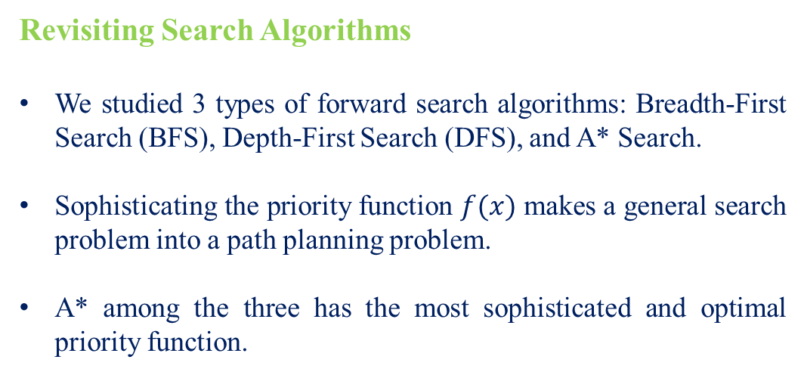
Revisiting Search Algorithms
We studied 3 types of forward search algorithms: Breadth-First Search (BFS), Depth-First Search (DFS), and A* Search.
Sophisticating the priority function $f(x)$ makes a general search problem into a path planning problem.
A* among the three has the most sophisticated and optimal priority function.

Slide 11
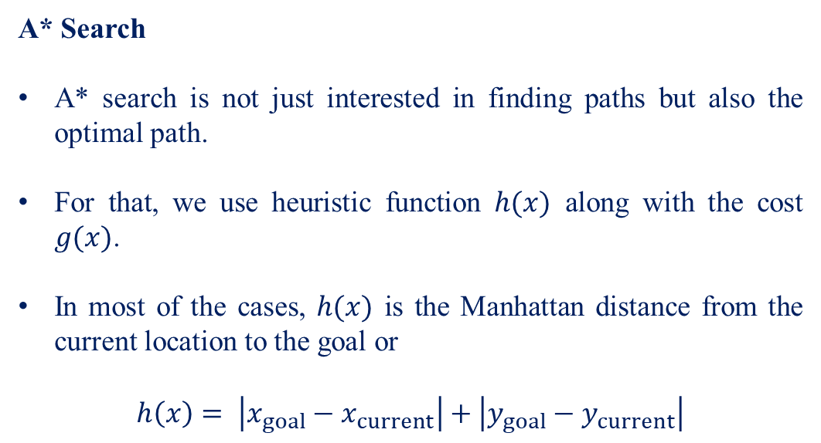
A* Search
A* search is not just interested in finding paths but also the optimal path.
For that, we use heuristic function $h(x)$ along with the cost $g(x)$.
In most of the cases, $h(x)$ is the Manhattan distance from the current location to the goal or
$$h\left(x\right)= \left|x_{goal}−x_{current}\right|+\left|y_{goal}−y_{current}\right|$$

Slide 12
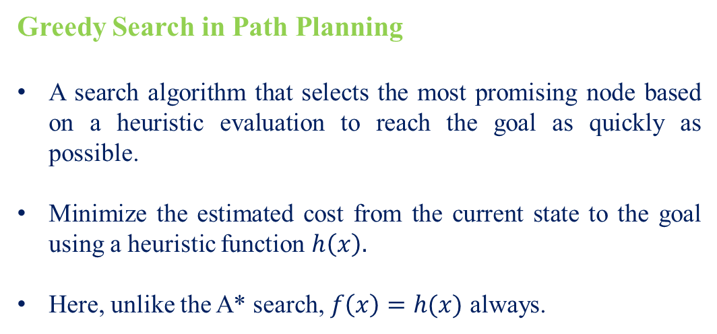
Greedy Search in Path Planning
A search algorithm that selects the most promising node based on a heuristic evaluation to reach the goal as quickly as possible.
Minimize the estimated cost from the current state to the goal using a heuristic function $h\left(x\right).$
Here, unlike the A* search, $f\left(x\right)=h(x)$ always.

Slide 13
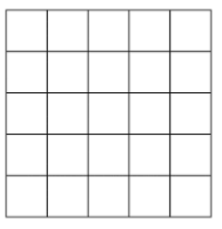
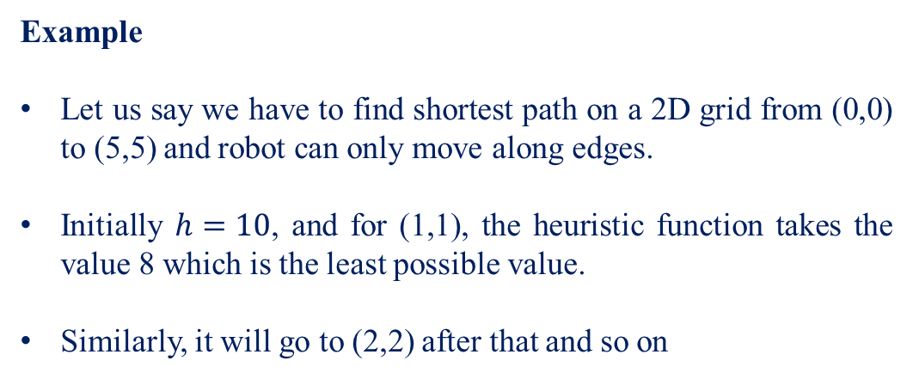
Example
Let us say we have to find shortest path on a 2D grid from (0,0) to (5,5) and robot can only move along edges.
Initially $h=10$, and for (1,1), the heuristic function takes the value 8 which is the least possible value.
Similarly, it will go to (2,2) after that and so on
Goal
Initial Location

Slide 14
It would look something like in the figure.
The algorithm has structure of a general search algorithm.
By sophisticating the priority function, we converted this search algorithm into a path planning algorithm as it did not just search for the path but the optimal path.
Goal
Initial Location

Slide 15
Greedy vs A*
A* is generally more reliable for finding the optimal path than Greedy Search, given an admissible heuristic.
Greedy Search can be faster in some cases because it only considers the heuristic and does not keep track of the path cost. However, this comes at the cost of potentially missing the optimal path.
Both algorithms rely on heuristics, but A* uses a more comprehensive evaluation function, making it less dependent on the heuristic alone.

Slide 16
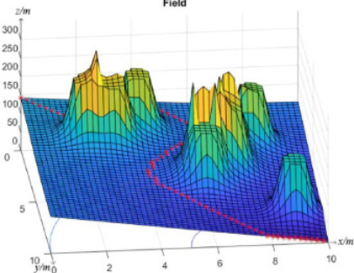
Potential Fields Method
Uses artificial potential fields to guide robots from start to goal.
Attractive force towards the goal and repulsive force from obstacles.
Attractive fields: Pulls robot towards the goal
Repulsive fields: Pushes robot away from obstacles.

Slide 17
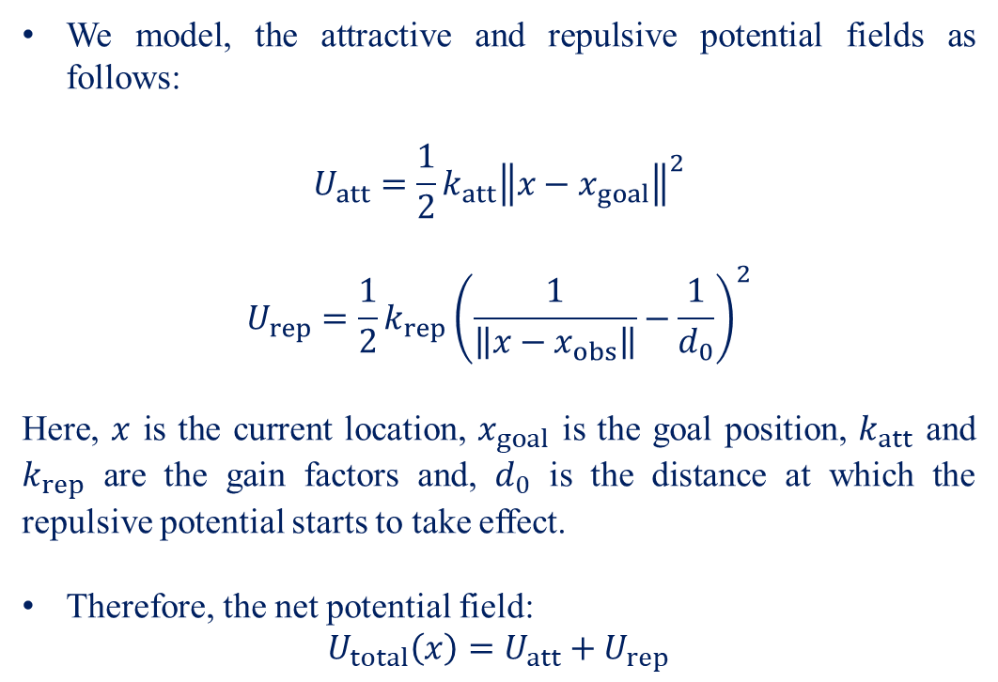
We model, the attractive and repulsive potential fields as follows:
$$U_{att}=\frac{1}{2}k_{att}{\left\|x−x_{goal}\right\|}^{2}$$
$$U_{rep}=\frac{1}{2}k_{rep}{\left(\frac{1}{\left\|x−x_{obs}\right\|}−\frac{1}{d_{0}}\right)}^{2}$$
Here, $x$ is the current location, $x_{goal}$ is the goal position, $k_{att}$ and $k_{rep}$ are the gain factors and, $d_{0}$ is the distance at which the repulsive potential starts to take effect.
Therefore, the net potential field:
$$U_{total}\left(x\right)=U_{att}+U_{rep}$$

Slide 18
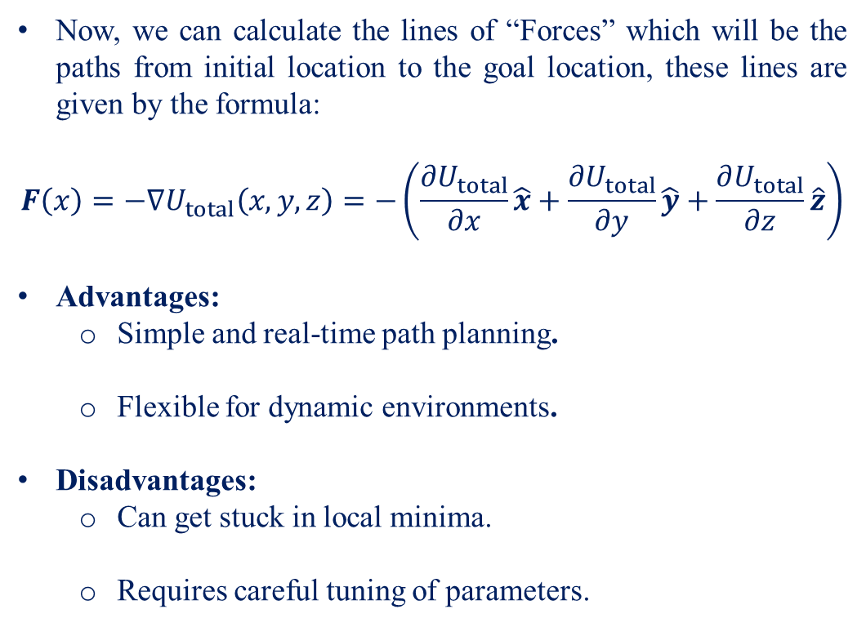
Now, we can calculate the lines of “Forces” which will be the paths from initial location to the goal location, these lines are given by the formula:
$$F\left(x\right)=−∇U_{total}\left(x,y,z\right)=−\left(\frac{∂U_{total}}{∂x}\hat{x}+\frac{∂U_{total}}{∂y}\hat{y}+\frac{∂U_{total}}{∂z}\hat{z}\right)$$
Advantages:
Simple and real-time path planning.
Flexible for dynamic environments.
Disadvantages:
Can get stuck in local minima.
Requires careful tuning of parameters.

Slide 19
Introduction to Sampling Techniques
Definition
Sampling techniques involve generating random samples in the environment to explore possible paths.
Purpose
Used when the environment is too complex or unknown for exact methods.
Helps in finding feasible paths by randomly exploring the space.

Slide 20
Random Sampling
Concept
Generate random points in the search space and connect them to form a path.
Process
Randomly select points within the workspace.
Check connectivity between points and form a graph.
Use Case:
Useful in simple environments where a complete map is not available.

Slide 21
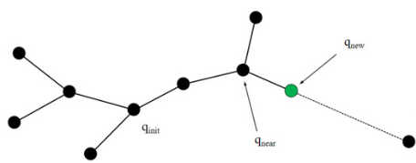
Rapidly-exploring Random Tree (RRT)
Concept
Incrementally builds a tree by randomly sampling and expanding nodes.
Process
Start from an initial point and grow the tree by randomly sampling the space.
Connect new nodes to the nearest existing node.
Advantages:
Efficient in high-dimensional spaces.
Can handle complex and high-dimensional environments.

Slide 22
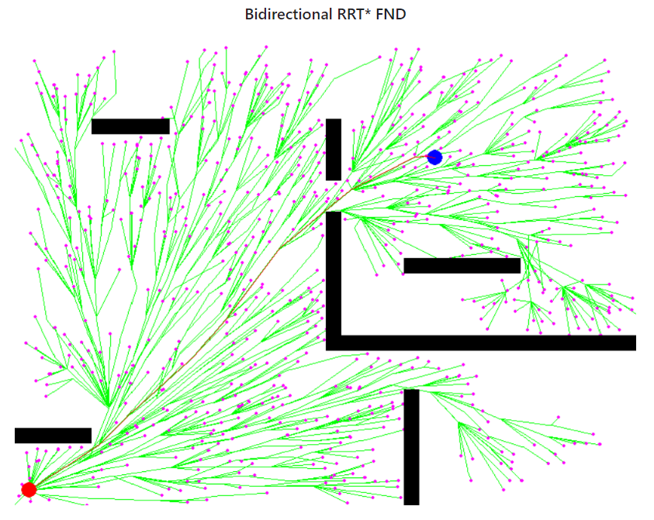
RRT*
Concept
An improved version of RRT that optimizes paths by re-routing and connecting nodes.
Process
Similar to RRT but with a focus on refining paths for optimality.
Reconnect nodes to improve path quality.
Advantages:
Provides better path quality compared to basic RRT.
Balances exploration and optimization.

Slide 23
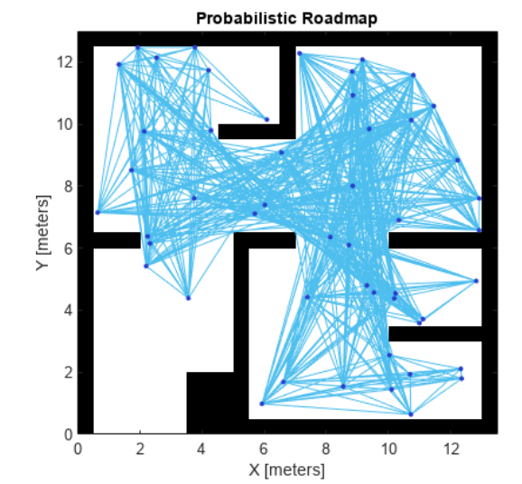
Probabilistic Roadmaps (PRM)
Concept
Builds a roadmap by randomly sampling points and connecting them to form a graph.
Process
Sample points and connect them to create a graph.
Use graph-based search algorithms to find paths.
Advantages:
Provides better path quality compared to basic RRT.
PRM effectively handles complex, high-dimensional environments by creating a roadmap through random sampling.

Slide 24
Thank You

