Slide 1

COURSE TITLE
Lecture Number
Lecture Name
PRESENTER NAME
DEPARTMENT

Slide 2
Search Methods in Robotics
Search Algorithm: Algorithms which enable robots to navigate or locate paths effectively in their environments.
Importance:
Vital for tasks like obstacle avoidance, exploration, and autonomous navigation.
Directly impacts a robot’s efficiency, safety, and reliability in dynamic environments.

Slide 3
Evolution in Search Methods
In 1956, Edsger W. Dijkstra introduced the shortest path algorithm, foundational for later developments.
In 1968, Peter Hart, Nils Nilsson, Bertram Raphael combined Dijkstra’s algorithm with heuristics for improved efficiency.
In 1985, Lydia Kavraki, Jean-Claude Latombe enabled

Slide 4
Modern Integration:
1990s onwards: Integration with AI, leading to adaptive algorithms. Contributions have been made by Stuart Russell and Peter Norvig in their book Artificial Intelligence: A Modern Approach.
Key Milestones:
Development of SLAM (Simultaneous Localization and Mapping) incorporating search methods, with contributions by researchers like Sebastian Thrun and Hugh Durrant-Whyte.

Slide 5
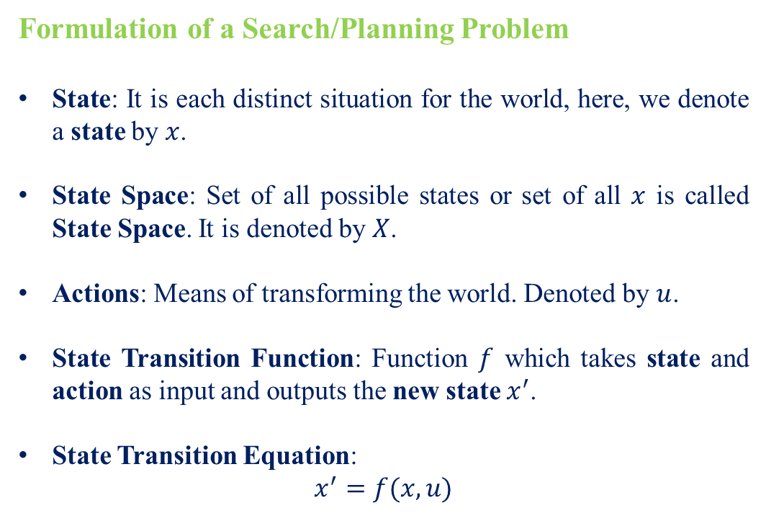
Formulation of a Search/Planning Problem
State: It is each distinct situation for the world, here, we denote a state by $x$.
State Space: Set of all possible states or set of all $x$ is called State Space. It is denoted by $X$.
Actions: Means of transforming the world. Denoted by $u$.
State Transition Function: Function $f$ which takes state and action as input and outputs the new state $x^{′}$.
State Transition Equation:
$$x^{′}=f(x,u)$$

Slide 6
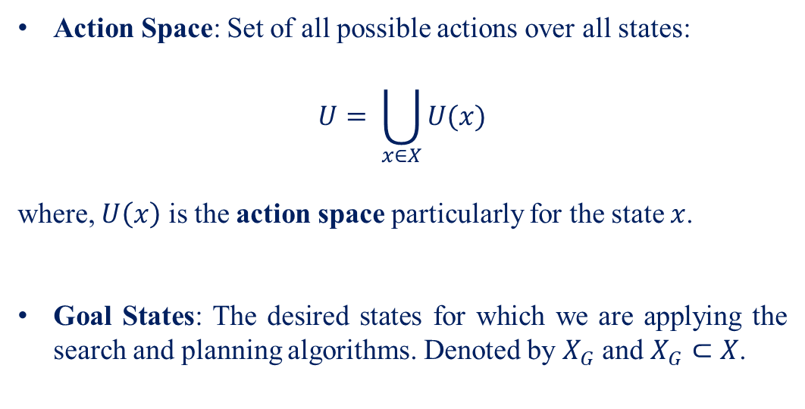
Action Space: Set of all possible actions over all states:
$$U= \bigcup_{x∈X}{U(x)}$$
where, $U\left(x\right)$ is the action space particularly for the state $x$.
Goal States: The desired states for which we are applying the search and planning algorithms. Denoted by $X_{G}$ and $X_{G}⊂X$.

Slide 7
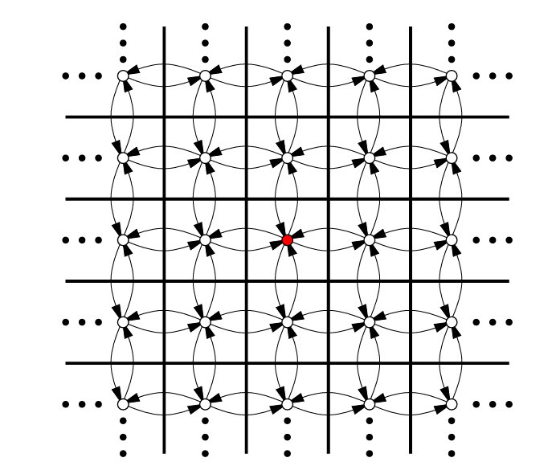
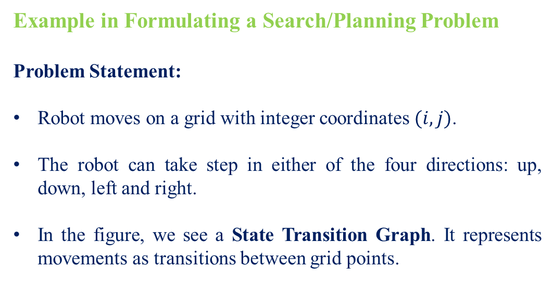
Example in Formulating a Search/Planning Problem
Problem Statement:
Robot moves on a grid with integer coordinates $(i,j)$.
The robot can take step in either of the four directions: up, down, left and right.
In the figure, we see a State Transition Graph. It represents movements as transitions between grid points.

Slide 8
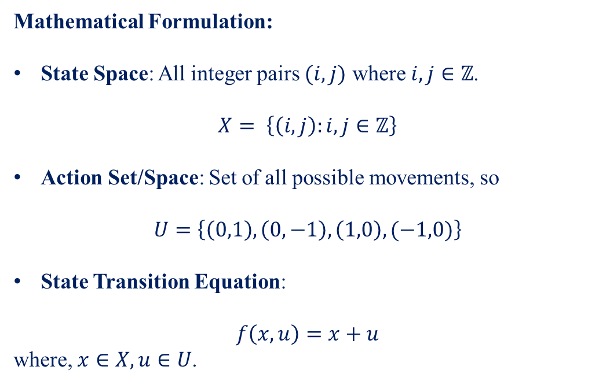
Mathematical Formulation:
State Space: All integer pairs $(i,j)$ where $i,j∈ℤ$.
$$X= \left\{\left(i,j\right):i,j∈ℤ\right\}$$
Action Set/Space: Set of all possible movements, so
$$U=\left\{\left(0,1\right), \left(0,−1\right), \left(1,0\right), (−1,0)\right\}$$
State Transition Equation:
$$f\left(x,u\right)=x+u$$
where, $x∈X, u∈U$.

Slide 9
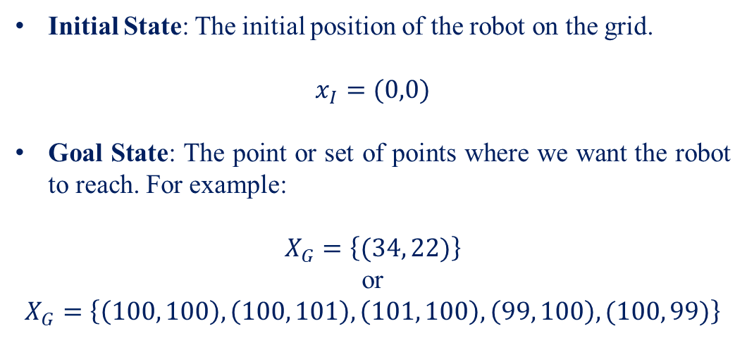
Initial State: The initial position of the robot on the grid.
$$x_{I}=(0,0)$$
Goal State: The point or set of points where we want the robot to reach. For example:
$$X_{G}=\left\{(34, 22)\right\}$$
or
$$X_{G}=\left\{\left(100, 100\right), \left(100, 101\right), \left(101, 100\right), \left(99, 100\right), (100, 99)\right\}$$

Slide 10
Understanding Systematic Search
Systematic search ensures all reachable states are explored, which is critical for determining the existence of solutions in finite or infinite state spaces.
Mostly, we use Graph Search Algorithms. The state transition graph is revealed incrementally as actions are applied, not fully specified in advance.

Slide 11
Systematic Search in Finite Graphs
Important to ensure that the algorithm avoids infinite loops and redundant exploration.
It should also guarantee that the algorithm explores every reachable state.
This way the algorithm can determine in finite time whether a solution exists or not.

Slide 12
Systematic Search in Infinite Graphs
Here, systematicity requires finding a solution in finite time if one exists.
We relax our requirements for systematicity by allowing the algorithm to search indefinitely if no solution exists.
One requirement is that every reachable vertex must eventually be explored as the number of iterations increases.
Here, we make assumption that number of vertices are countably infinite.

Slide 13
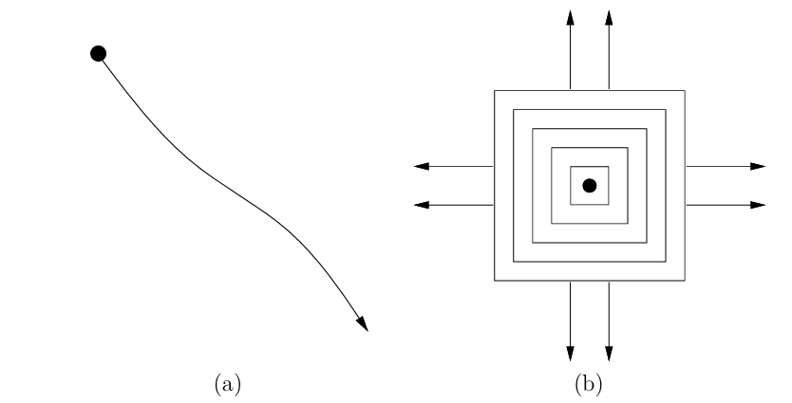
In figure (a), no states are revisited but exploring one direction leaves most of the space undiscovered, hence the systematicity is compromised.
In figure (b), exploration is done in wavefronts which ensures broader coverage, and no state is revisited. Hence, it is systematic.

Slide 14
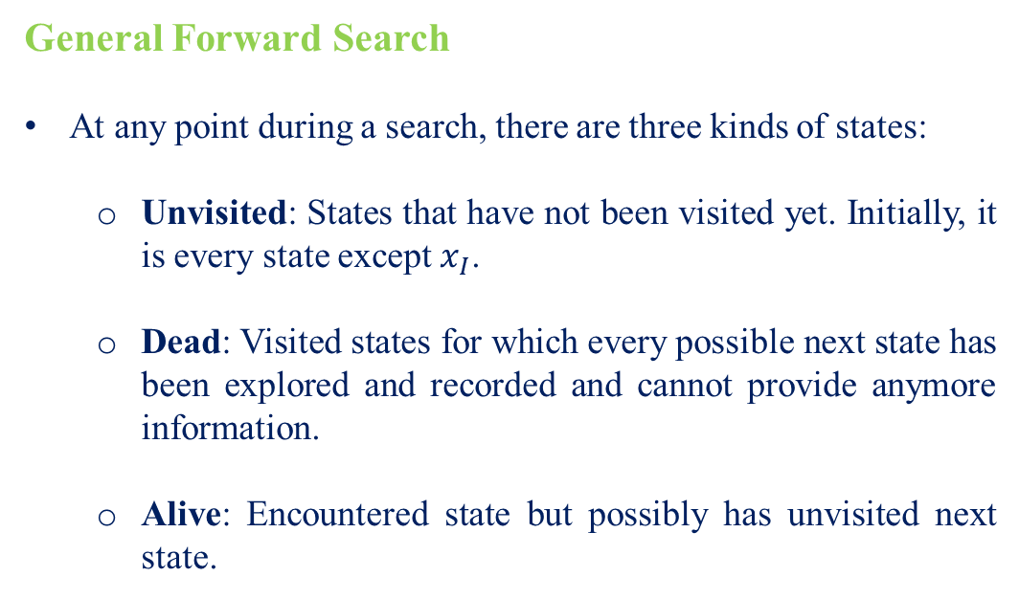
General Forward Search
At any point during a search, there are three kinds of states:
Unvisited: States that have not been visited yet. Initially, it is every state except $x_{I}$.
Dead: Visited states for which every possible next state has been explored and recorded and cannot provide anymore information.
Alive: Encountered state but possibly has unvisited next state.

Slide 15
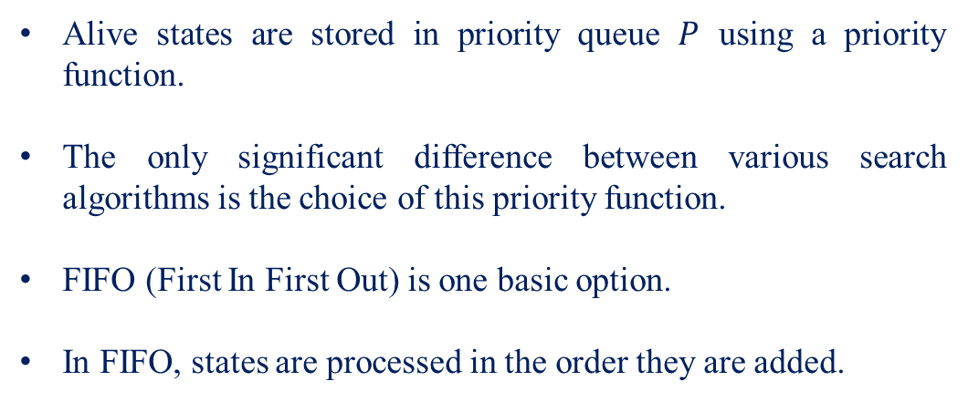
Alive states are stored in priority queue $P$ using a priority function.
The only significant difference between various search algorithms is the choice of this priority function.
FIFO (First In First Out) is one basic option.
In FIFO, states are processed in the order they are added.

Slide 16
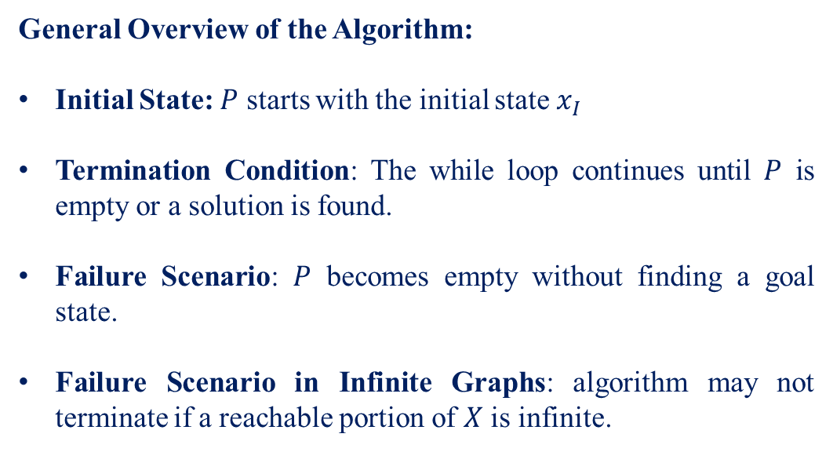
General Overview of the Algorithm:
Initial State: $P$ starts with the initial state $x_{I}$
Termination Condition: The while loop continues until $P$ is empty or a solution is found.
Failure Scenario: $P$ becomes empty without finding a goal state.
Failure Scenario in Infinite Graphs: algorithm may not terminate if a reachable portion of $X$ is infinite.

Slide 17
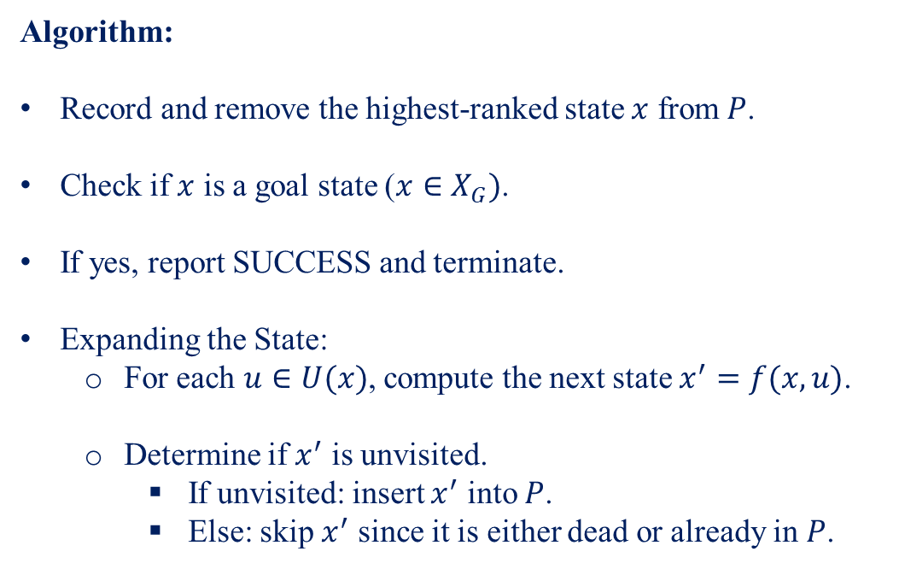
Algorithm:
Record and remove the highest-ranked state $x$ from $P$.
Check if $x$ is a goal state ($x∈X_{G})$.
If yes, report SUCCESS and terminate.
Expanding the State:
For each $u∈U(x)$, compute the next state $x^{′}=f(x,u)$.
Determine if $x^{′}$ is unvisited.
If unvisited: insert $x^{′}$ into $P$.
Else: skip $x^{′}$ since it is either dead or already in $P$.

Slide 18
Particular Forward Search Methods
Breadth-First Search Method
Concept:
Explores all states at the present depth level before moving on to states at the next depth level.
Priority Queue:
FIFO (First In First Out).

Slide 19
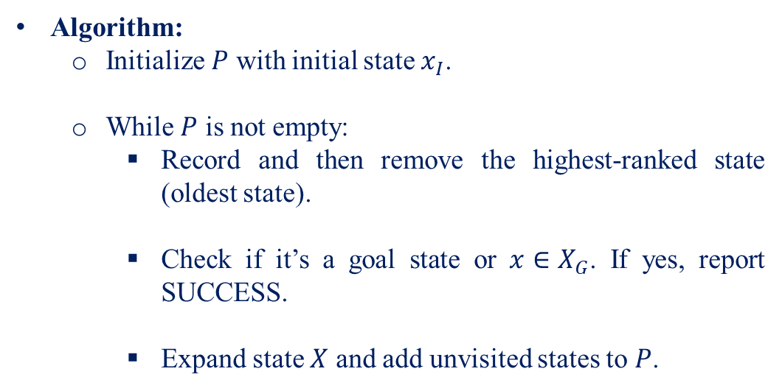
Algorithm:
Initialize $P$ with initial state $x_{I}$.
While $P$ is not empty:
Record and then remove the highest-ranked state (oldest state).
Check if it’s a goal state or $x∈X_{G}$. If yes, report SUCCESS.
Expand state $X$ and add unvisited states to $P$.

Slide 20
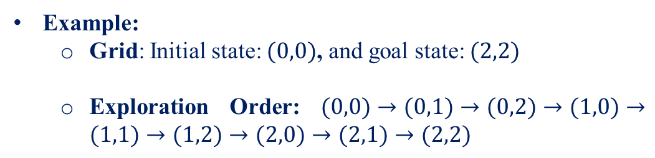
Example:
Grid: Initial state: $(0,0)$, and goal state: $(2,2)$
Exploration Order: $(0,0)→(0,1)→(0,2)→(1,0)→(1,1)→(1,2)→(2,0)→(2,1)→(2,2)$

Slide 21
Depth-First Search Method
Concept:
Explores as far down a branch as possible before backtracking.
Priority Queue:
LIFO (Last In First Out).

Slide 22
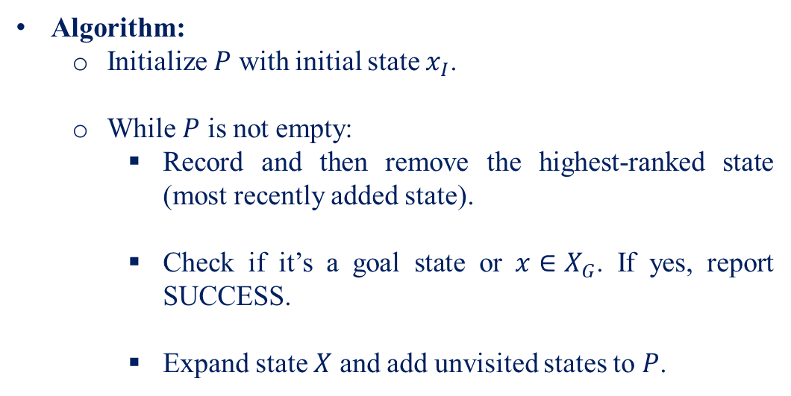
Algorithm:
Initialize $P$ with initial state $x_{I}$.
While $P$ is not empty:
Record and then remove the highest-ranked state (most recently added state).
Check if it’s a goal state or $x∈X_{G}$. If yes, report SUCCESS.
Expand state $X$ and add unvisited states to $P$.

Slide 23
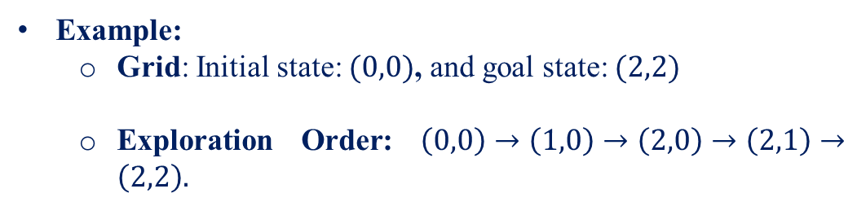
Example:
Grid: Initial state: $(0,0)$, and goal state: $(2,2)$
Exploration Order: $\left(0,0\right)→\left(1,0\right)→\left(2,0\right)→\left(2,1\right)→\left(2,2\right).$

Slide 24
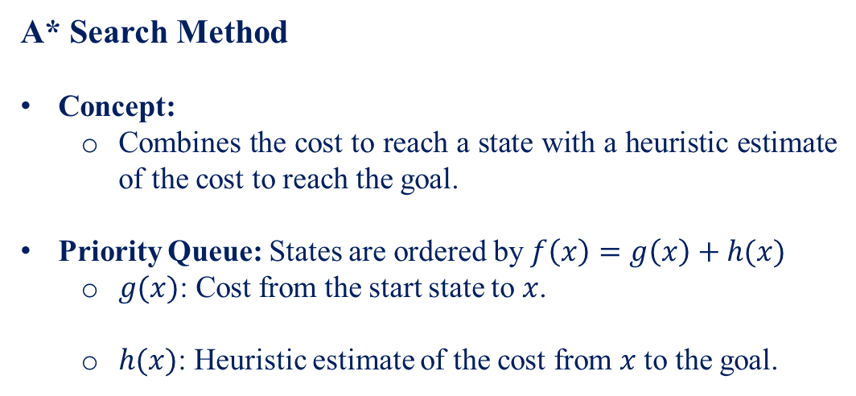
A* Search Method
Concept:
Combines the cost to reach a state with a heuristic estimate of the cost to reach the goal.
Priority Queue: States are ordered by $f\left(x\right)=g\left(x\right)+h(x)$
$g(x)$: Cost from the start state to $x$.
$h(x)$: Heuristic estimate of the cost from $x$ to the goal.

Slide 25
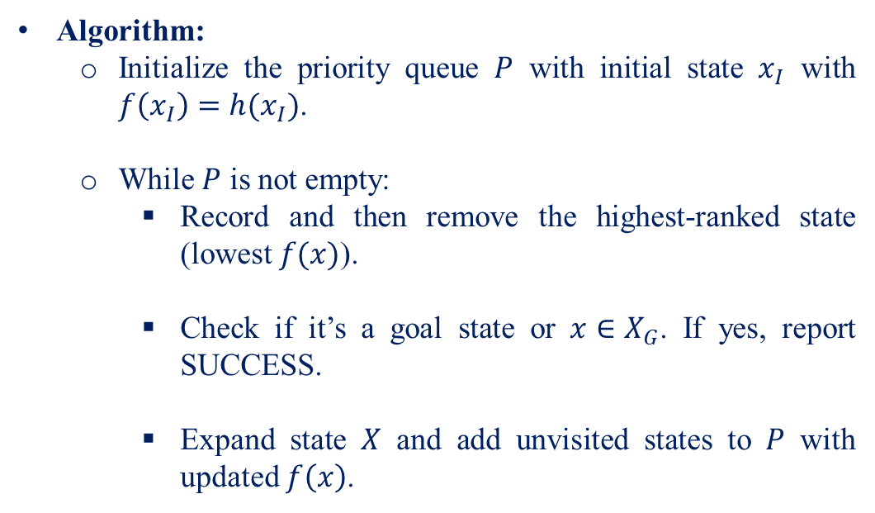
Algorithm:
Initialize the priority queue $P$ with initial state $x_{I}$ with $f\left(x_{I}\right)=h(x_{I})$.
While $P$ is not empty:
Record and then remove the highest-ranked state (lowest $f(x)$).
Check if it’s a goal state or $x∈X_{G}$. If yes, report SUCCESS.
Expand state $X$ and add unvisited states to $P$ with updated $f\left(x\right)$.

Slide 26
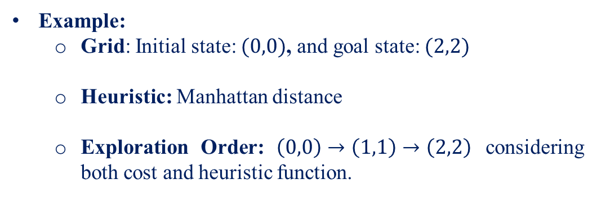
Example:
Grid: Initial state: $(0,0)$, and goal state: $(2,2)$
Heuristic: Manhattan distance
Exploration Order: $\left(0,0\right)→\left(1,1\right)→\left(2,2\right)$ considering both cost and heuristic function.

Slide 27
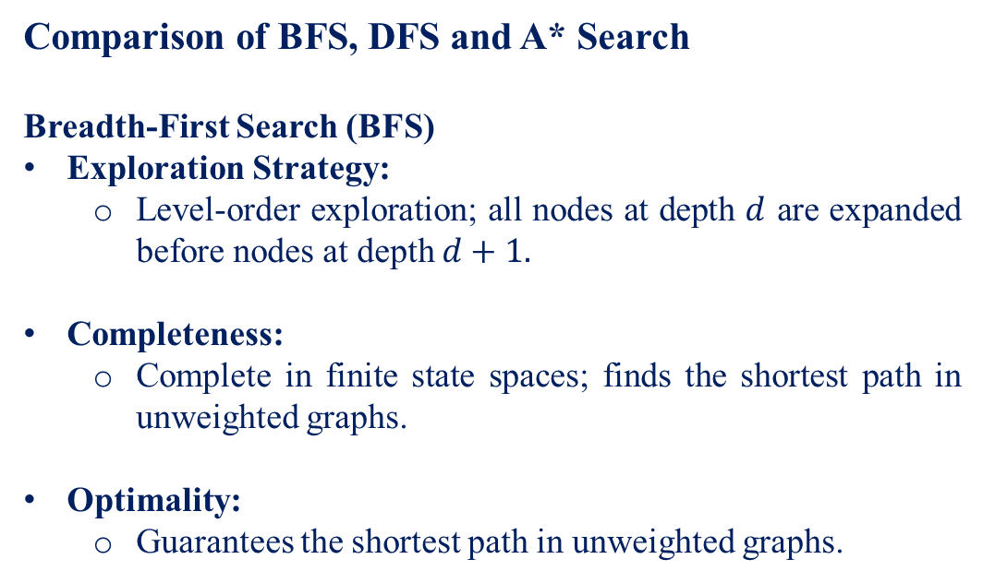
Comparison of BFS, DFS and A* Search
Breadth-First Search (BFS)
Exploration Strategy:
Level-order exploration; all nodes at depth $d$ are expanded before nodes at depth $d+1.$
Completeness:
Complete in finite state spaces; finds the shortest path in unweighted graphs.
Optimality:
Guarantees the shortest path in unweighted graphs.

Slide 28
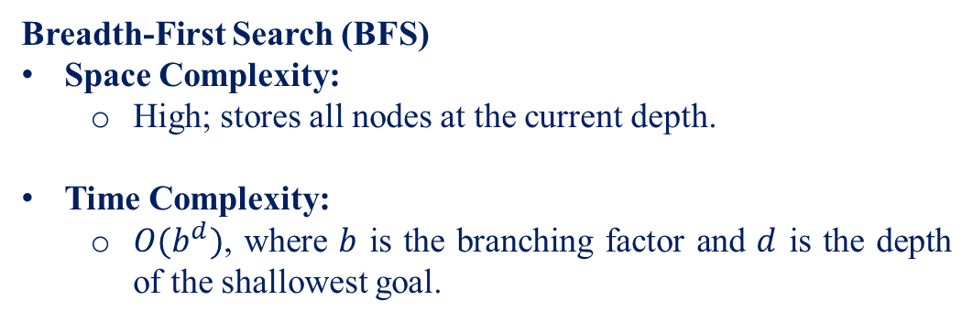
Breadth-First Search (BFS)
Space Complexity:
High; stores all nodes at the current depth.
Time Complexity:
$O(b^{d})$, where $b$ is the branching factor and $d$ is the depth of the shallowest goal.

Slide 29
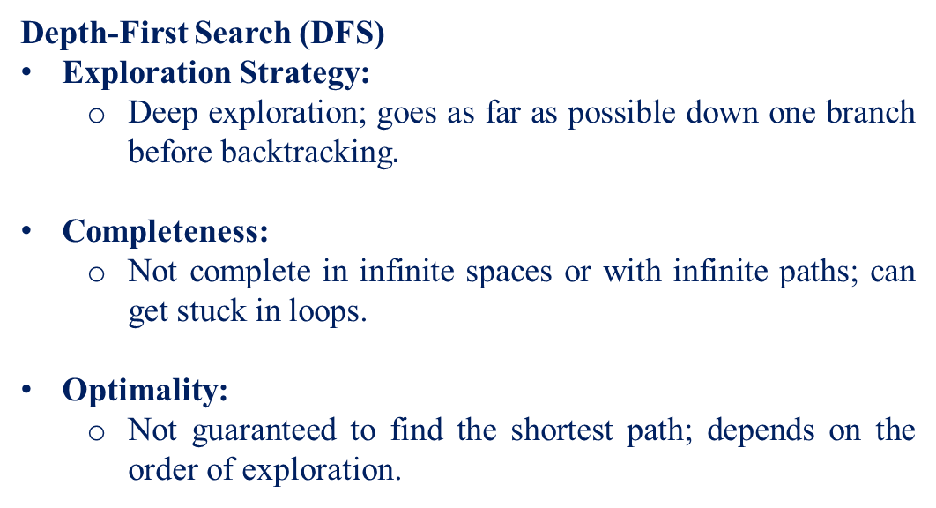
Depth-First Search (DFS)
Exploration Strategy:
Deep exploration; goes as far as possible down one branch before backtracking$.$
Completeness:
Not complete in infinite spaces or with infinite paths; can get stuck in loops.
Optimality:
Not guaranteed to find the shortest path; depends on the order of exploration.

Slide 30
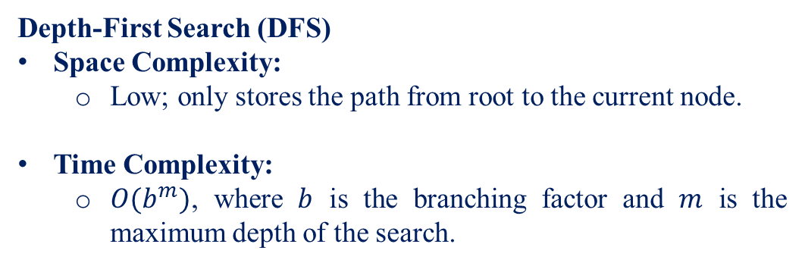
Depth-First Search (DFS)
Space Complexity:
Low; only stores the path from root to the current node.
Time Complexity:
$O(b^{m})$, where $b$ is the branching factor and $m$ is the maximum depth of the search.

Slide 31
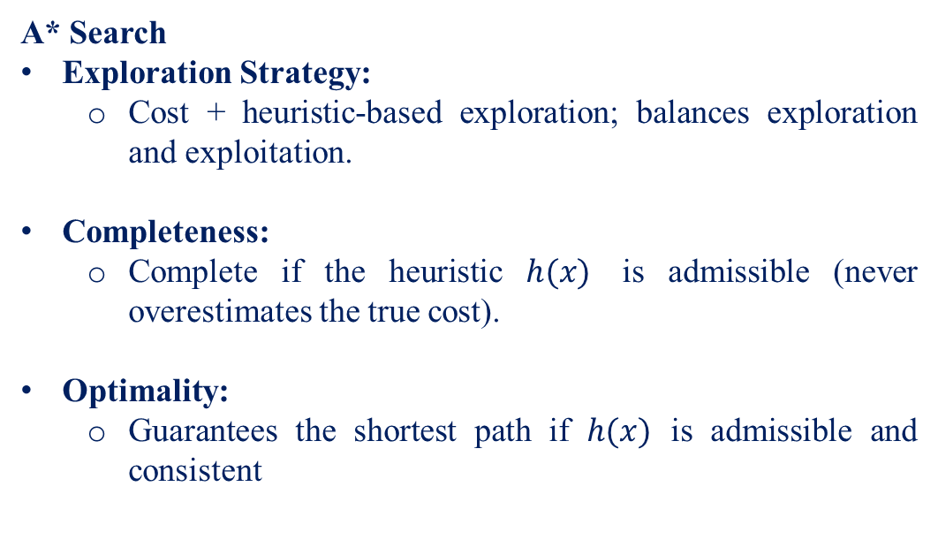
A* Search
Exploration Strategy:
Cost + heuristic-based exploration; balances exploration and exploitation.
Completeness:
Complete if the heuristic $h(x)$ is admissible (never overestimates the true cost).
Optimality:
Guarantees the shortest path if $h(x)$ is admissible and consistent

Slide 32
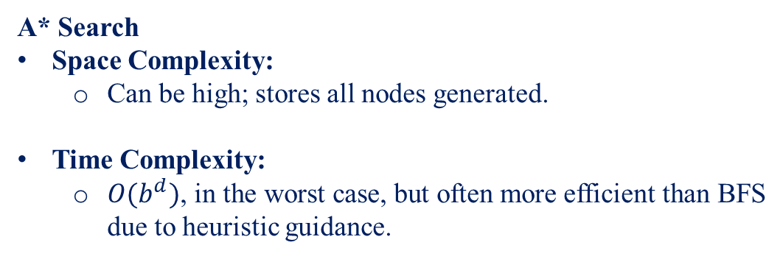
A* Search
Space Complexity:
Can be high; stores all nodes generated.
Time Complexity:
$O(b^{d})$, in the worst case, but often more efficient than BFS due to heuristic guidance.

Slide 33
Thank You

