Slide 1

COURSE TITLE
Lecture Number
Lecture Name
PRESENTER NAME
DEPARTMENT

Slide 2
Robust RBFN Neural Networks
What is an RBFN Neural Network?
An RBFN is a type of artificial neural network that uses radial basis functions as activation functions in its hidden layer neurons.
RBFNs are particularly well-suited for problems requiring smooth interpolation of data points in multidimensional space.
In general, RBFN consists of an input layer, a single hidden layer where the radial basis functions are applied, and an output layer that provides the final prediction or classification.

Slide 3
Structure of an RBFN
Input Layer
This layer receives the input data and passes it to the hidden layer. Each input neuron corresponds to one feature of the input data.
Hidden Layer
Contains neurons with radial basis functions. These neurons measure the distance between the input data and a predetermined center.
The output of each neuron is a function of the distance between the input and the center.
Common radial basis functions include the Gaussian, Multiquadric, and Inverse Multiquadric functions.
Output Layer
Produces the network's final output by linearly combining the outputs from the hidden layer neurons. The weights for this combination are learned during training

Slide 4
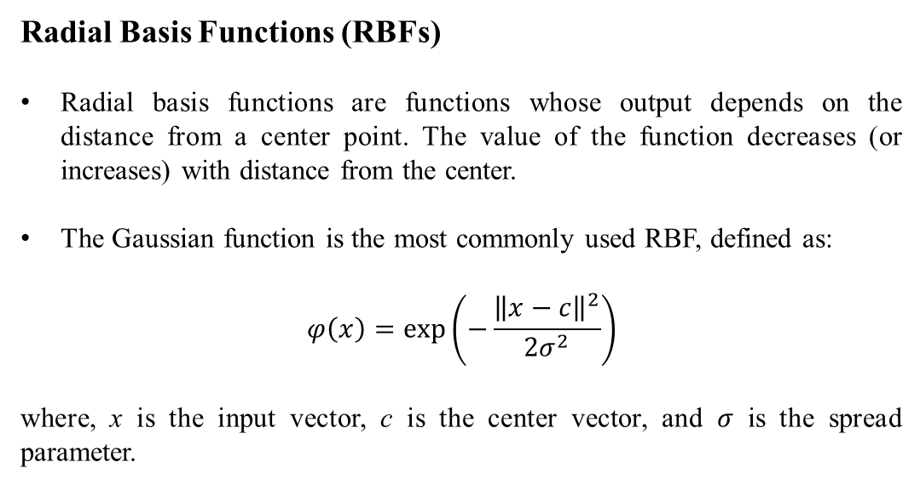
Radial Basis Functions (RBFs)
Radial basis functions are functions whose output depends on the distance from a center point. The value of the function decreases (or increases) with distance from the center.
The Gaussian function is the most commonly used RBF, defined as:
$$φ\left(x\right)=exp\left(−\frac{{\left\|x−c\right\|}^{2}}{2σ^{2}}\right)$$
where, x is the input vector, c is the center vector, and $σ$ is the spread parameter.

Slide 5
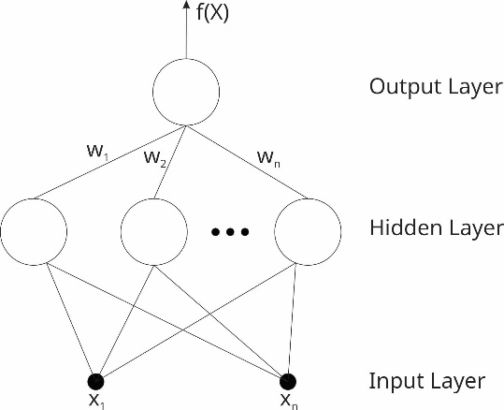
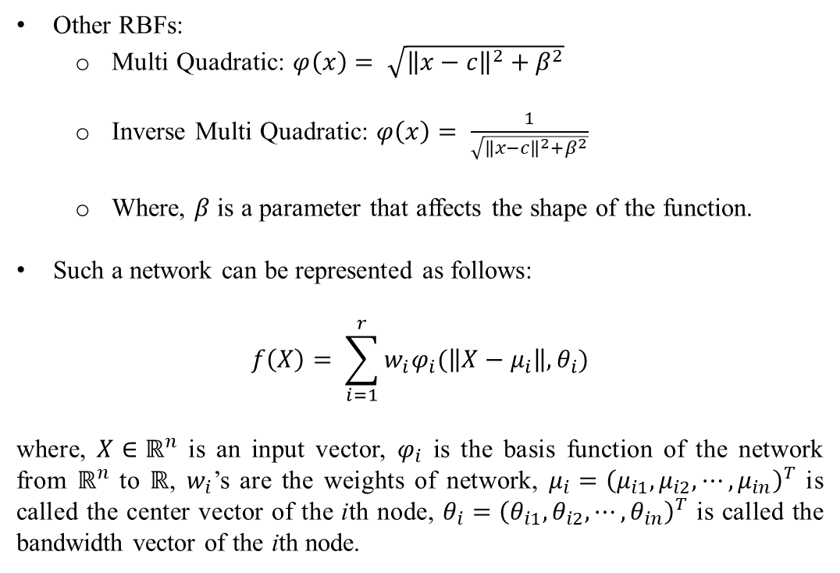
Other RBFs:
Multi Quadratic: $φ\left(x\right)= \sqrt{{\left\|x−c\right\|}^{2}+β^{2}}$
Inverse Multi Quadratic: $φ\left(x\right)= \frac{1}{\sqrt{{\left\|x−c\right\|}^{2}+β^{2}}}$
Where, $β$ is a parameter that affects the shape of the function.
Such a network can be represented as follows:
$$f\left(X\right)= \sum_{i=1}^{r}{w_{i}φ_{i}(\left\|X−μ_{i}\right\|, θ_{i})}$$
where, $X∈ℝ^{n}$ is an input vector, $φ_{i}$ is the basis function of the network from $ℝ^{n}$ to $ℝ$, $w_{i}$’s are the weights of network, $μ_{i}={\left(μ_{i1},μ_{i2}, ⋯,μ_{in}\right)}^{T}$ is called the center vector of the ith node, $θ_{i}={\left(θ_{i1},θ_{i2}, ⋯,θ_{in}\right)}^{T}$ is called the bandwidth vector of the ith node.
Figure 1: Basic Architecture of RBFN

Slide 6
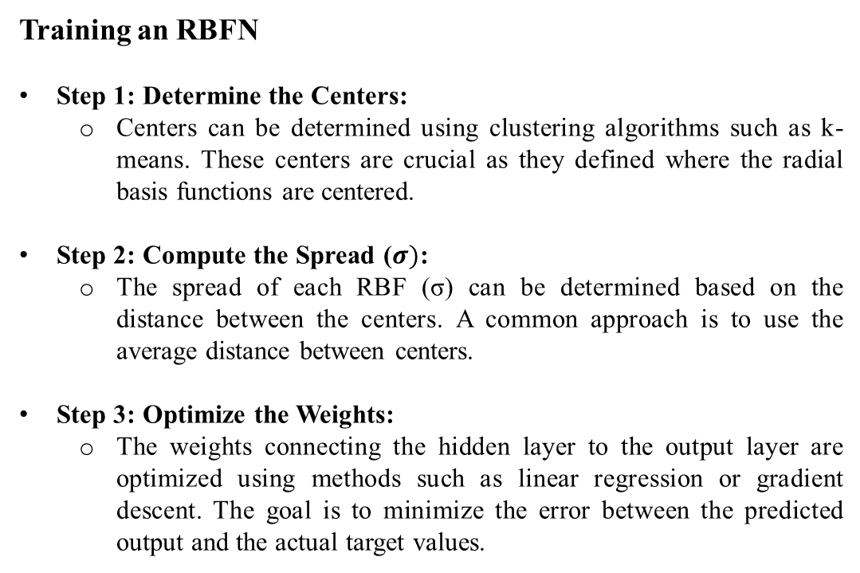
Training an RBFN
Step 1: Determine the Centers:
Centers can be determined using clustering algorithms such as k-means. These centers are crucial as they defined where the radial basis functions are centered.
Step 2: Compute the Spread ($σ)$:
The spread of each RBF (σ) can be determined based on the distance between the centers. A common approach is to use the average distance between centers.
Step 3: Optimize the Weights:
The weights connecting the hidden layer to the output layer are optimized using methods such as linear regression or gradient descent. The goal is to minimize the error between the predicted output and the actual target values.

Slide 7
Function Approximation
The process of estimating a function that best fits a set of data points.
Used in various applications like prediction, interpolation, and data smoothing.
There are two main methods: Parametric and Non-Parametric Methods.

Slide 8
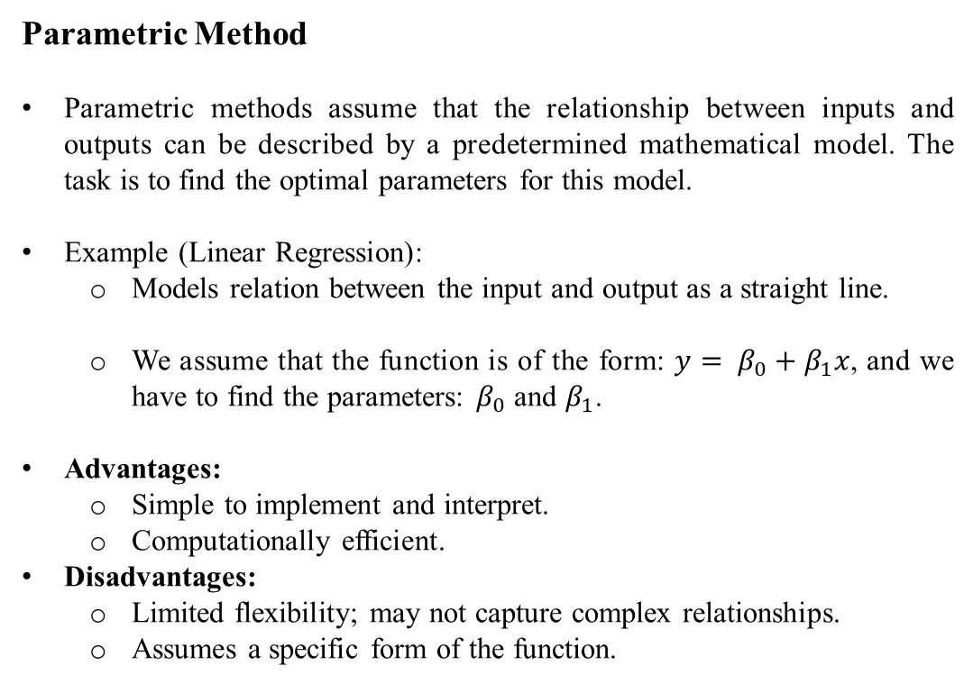
Parametric Method
Parametric methods assume that the relationship between inputs and outputs can be described by a predetermined mathematical model. The task is to find the optimal parameters for this model.
Example (Linear Regression):
Models relation between the input and output as a straight line.
We assume that the function is of the form: $y= β_{0}+β_{1}x$, and we have to find the parameters: $β_{0}$ and $β_{1}$.
Advantages:
Simple to implement and interpret.
Computationally efficient.
Disadvantages:
Limited flexibility; may not capture complex relationships.
Assumes a specific form of the function.

Slide 9
Non-Parametric Method
Non-parametric methods do not start with a predefined formula. Instead, they learn the relationship directly from the data, which is advantageous for handling real-world data that often exhibits complex, nonlinear relationships.
Example (K-Nearest Neighbors (KNN)):
Predicts the value of a new data point based on the values of the k closest points from the training set.
Example: For regression tasks, the predicted value is the average of the k nearest neighbors.
Advantages:
Highly flexible and capable of capturing intricate relationships within the data.
Do not rely on a specific functional form, making them adaptable to various types of data.
Disadvantages:
Computationally intensive, especially with large datasets.
May require a substantial amount of data to achieve good performance.

Slide 10
Function Approximation using RBFN
Radial Basis Function Neural Networks are a good candidate for function approximation because of its faster learning capability.
For function approximation, traditionally we use RBFN with Gaussian functions and the Method of Least Squares.
This methodology works most of the times, but there are certain problems associates with it too:
Difficulty with Constant Functions: When the target function remains nearly constant in certain regions, a Gaussian function struggles to approximate it effectively without using a very large bandwidth. This can lead to inefficiency in the RBF network.
Impact of Outliers: When the training data includes outliers (values significantly different from the majority), the network's response in those regions is often inadequate due to the limitations of the least squares (LS) method.

Slide 11
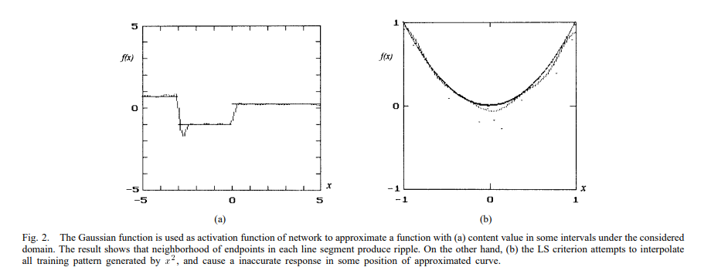
Figure 2: Cases where RBFN with Gaussian function and Least squares method don’t work efficiently
The above images are experimental results conducted by Chien-Cheng Lee, Pau-Choo Chung, Jea-Rong Tsai and Chein-I Chang. The solid curves indicate the underlying curves and dashed curves are the approximate curves generated by RBF network.
Here, Figure 2(a) shows the result of approximating a piecewise constant function.
Figure 2(b) shows a poor approximation result when training pattern contain outliers.

Slide 12
Solution: Robust RBFN!
We can make the RBFN ignorant towards these problems by changing two things used in the traditional RBFN.
Instead of Gaussian activation function, we propose a composite of a set of sigmoidal functions which aims at approximating a given function with nearly constant values.
Use a method from robust statistics to reduce the impact of outliers. The method is called Hample’s M Estimator which is efficient in handling large errors.

Slide 13
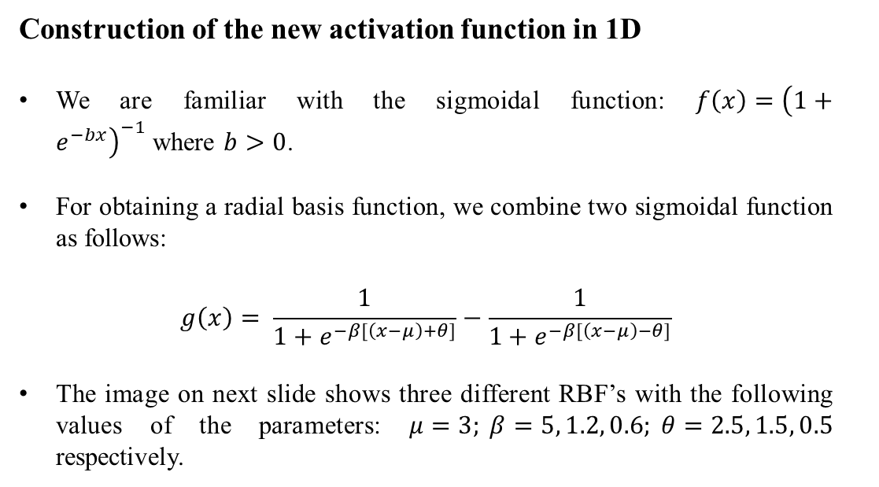
Construction of the new activation function in 1D
We are familiar with the sigmoidal function: $f\left(x\right)={\left(1+e^{−bx}\right)}^{−1}$where $b>0$.
For obtaining a radial basis function, we combine two sigmoidal function as follows:
$$g\left(x\right)= \frac{1}{1+e^{−β[\left(x−μ\right)+θ]}}−\frac{1}{1+e^{−β[\left(x−μ\right)−θ]}}$$
The image on next slide shows three different RBF’s with the following values of the parameters: $μ=3; β=5, 1.2, 0.6; θ=2.5, 1.5, 0.5$ respectively.

Slide 14
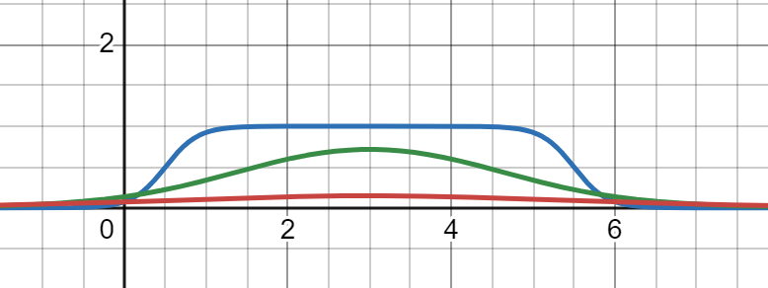
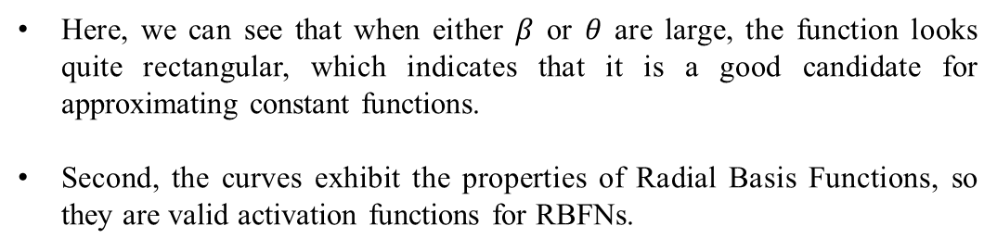

g(x)
$$μ$$
x
Figure 3: Three one-dimensional sigmoidal RBFs with different parameters and same centre.
Here, we can see that when either $β$ or $θ$ are large, the function looks quite rectangular, which indicates that it is a good candidate for approximating constant functions.
Second, the curves exhibit the properties of Radial Basis Functions, so they are valid activation functions for RBFNs.

Slide 15
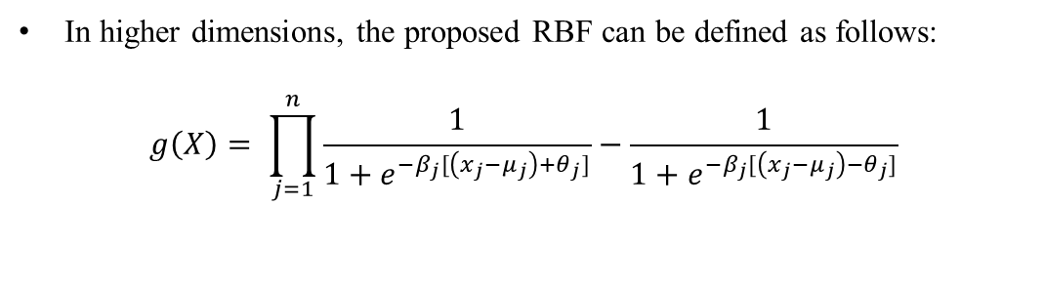
In higher dimensions, the proposed RBF can be defined as follows:
$$g\left(X\right)= \prod_{j=1}^{n}{\frac{1}{1+e^{−β_{j}[\left(x_{j}−μ_{j}\right)+θ_{j}]}}−\frac{1}{1+e^{−β_{j}[\left(x_{j}−μ_{j}\right)−θ_{j}]}}}$$

Slide 16
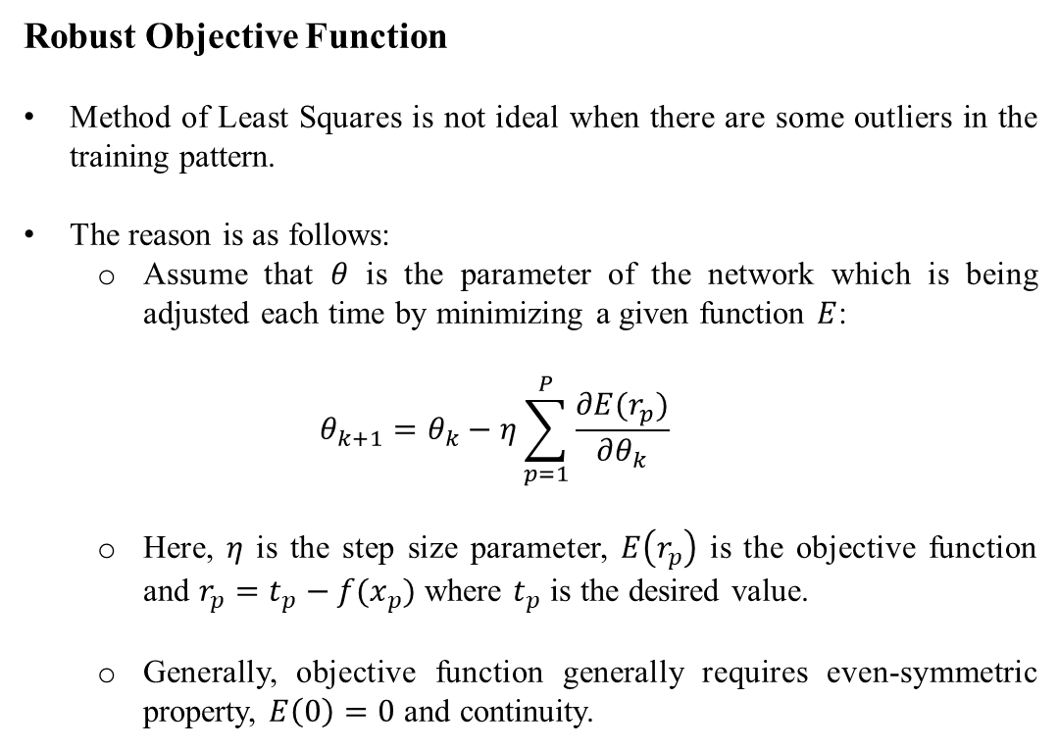
Robust Objective Function
Method of Least Squares is not ideal when there are some outliers in the training pattern.
The reason is as follows:
Assume that $θ$ is the parameter of the network which is being adjusted each time by minimizing a given function $E$:
$$θ_{k+1}=θ_{k}−η\sum_{p=1}^{P}{\frac{∂E(r_{p})}{∂θ_{k}}}$$
Here, $η$ is the step size parameter, $E\left(r_{p}\right)$ is the objective function and $r_{p}=t_{p}−f(x_{p})$ where $t_{p}$ is the desired value.
Generally, objective function generally requires even-symmetric property, $E\left(0\right)=0$ and continuity.

Slide 17
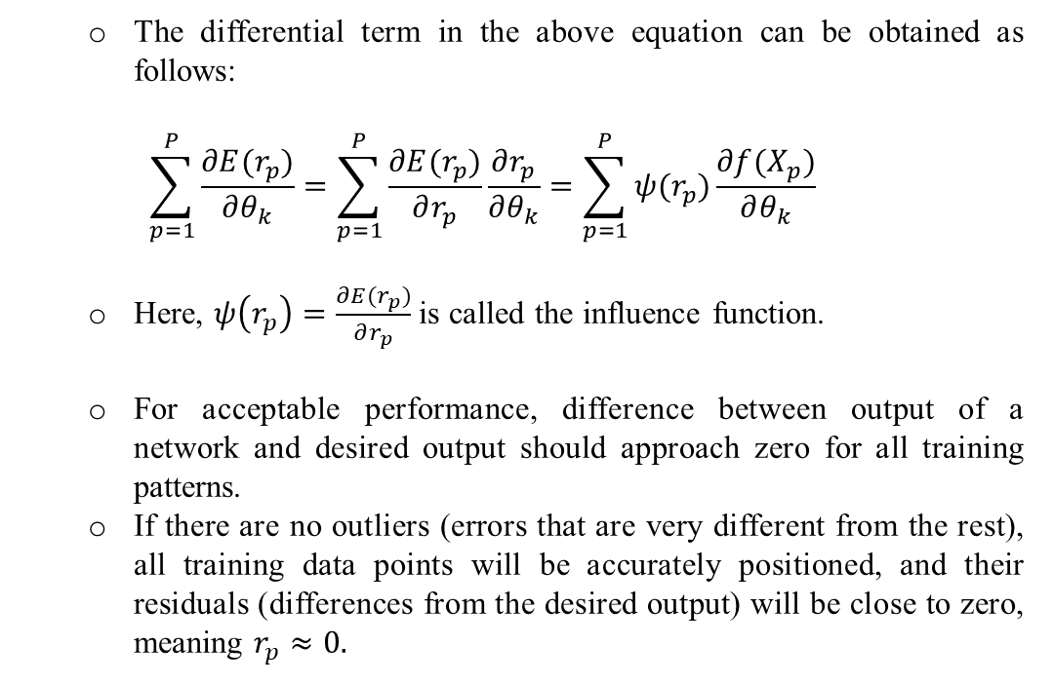
The differential term in the above equation can be obtained as follows:
$$\sum_{p=1}^{P}{\frac{∂E(r_{p})}{∂θ_{k}}}=\sum_{p=1}^{P}{\frac{∂E(r_{p})}{∂r_{p}}\frac{∂r_{p}}{∂θ_{k}}}=\sum_{p=1}^{P}{ψ(r_{p})\frac{∂f(X_{p})}{∂θ_{k}}}$$
Here, $ψ\left(r_{p}\right)=\frac{∂E(r_{p})}{∂r_{p}}$ is called the influence function.
For acceptable performance, difference between output of a network and desired output should approach zero for all training patterns.
If there are no outliers (errors that are very different from the rest), all training data points will be accurately positioned, and their residuals (differences from the desired output) will be close to zero, meaning $r_{p}≈0.$

Slide 18
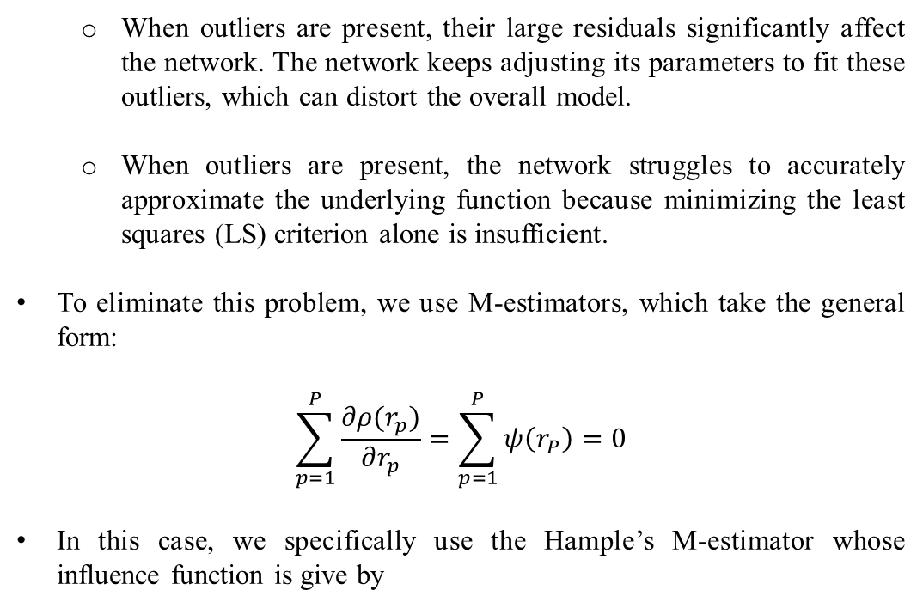
When outliers are present, their large residuals significantly affect the network. The network keeps adjusting its parameters to fit these outliers, which can distort the overall model.
When outliers are present, the network struggles to accurately approximate the underlying function because minimizing the least squares (LS) criterion alone is insufficient.
To eliminate this problem, we use M-estimators, which take the general form:
$$\sum_{p=1}^{P}{\frac{∂ρ(r_{p})}{∂r_{p}}=\sum_{p=1}^{P}{ψ\left(r_{P}\right)=0}}$$
In this case, we specifically use the Hample’s M-estimator whose influence function is give by

Slide 19
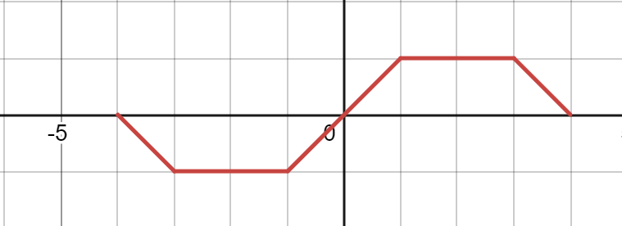



$$ψ\left(r\right)=\left\{\begin{aligned}r, a>\left|r\right| \\ &a sgn(r), a≤\left|r\right|≤b \\ \frac{c−\left|r\right|}{c−\left|b\right|}a∙sgn\left(r\right), b≤\left|r\right|≤c \\ 0, otherwise\end{aligned}\right.$$
The following figure shows an Hample’s M-estimator with a = 1, b = 3, c = 4
$$ψ(r)$$
$$r$$
Figure 4: Hample’s M-estimator

Slide 20
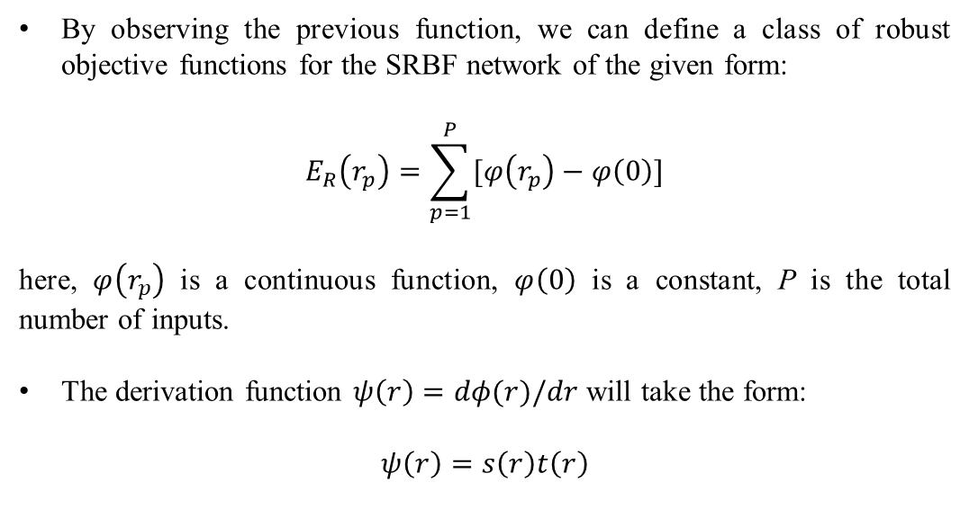
By observing the previous function, we can define a class of robust objective functions for the SRBF network of the given form:
$$E_{R}\left(r_{p}\right)=\sum_{p=1}^{P}{[φ\left(r_{p}\right)−φ\left(0\right)]}$$
here, $φ\left(r_{p}\right)$ is a continuous function, $φ\left(0\right)$ is a constant, P is the total number of inputs.
The derivation function $ψ\left(r\right)=dφ(r)/dr$ will take the form:
$$ψ\left(r\right)=s\left(r\right)t\left(r\right)$$

Slide 21
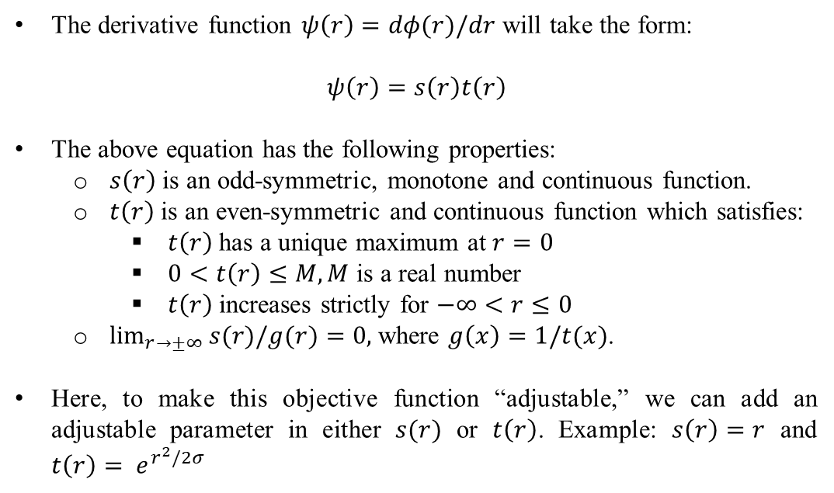
The derivative function $ψ\left(r\right)=dφ(r)/dr$ will take the form:
$$ψ\left(r\right)=s\left(r\right)t\left(r\right)$$
The above equation has the following properties:
$s\left(r\right)$ is an odd-symmetric, monotone and continuous function.
$t\left(r\right)$ is an even-symmetric and continuous function which satisfies:
$t\left(r\right)$ has a unique maximum at $r=0$
$0<t\left(r\right)≤M, M$ is a real number
$t\left(r\right)$ increases strictly for $−∞<r≤0$
$\lim_{r→±∞}{s(r)/g(r)}=0,$ where $g\left(x\right)=1/t(x)$.
Here, to make this objective function “adjustable,” we can add an adjustable parameter in either $s(r)$ or $t\left(r\right)$. Example: $s\left(r\right)=r$ and $t\left(r\right)= e^{r^{2}/2σ}$

Slide 22
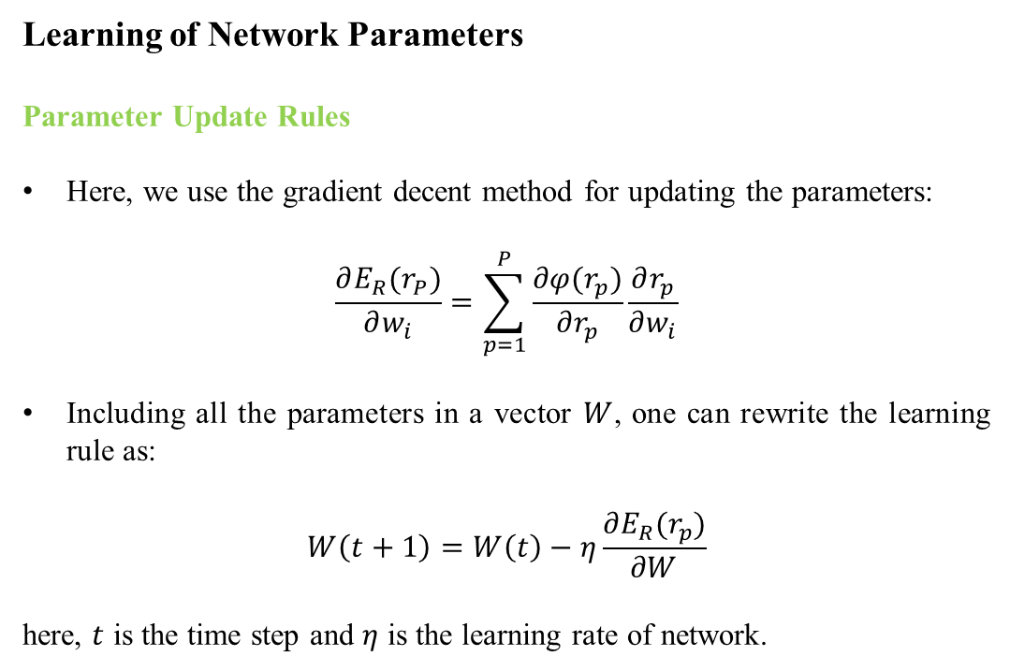
Learning of Network Parameters
Parameter Update Rules
Here, we use the gradient decent method for updating the parameters:
$$\frac{∂E_{R}(r_{P})}{∂w_{i}}=\sum_{p=1}^{P}{\frac{∂φ(r_{p})}{∂r_{p}}\frac{∂r_{p}}{∂w_{i}}}$$
Including all the parameters in a vector $W$, one can rewrite the learning rule as:
$$W\left(t+1\right)=W\left(t\right)−η\frac{∂E_{R}(r_{p})}{∂W}$$
here, $t$ is the time step and $η$ is the learning rate of network.

Slide 23
Adaptive Growing Technique of Network
For an RBF network to perform effectively, determining the appropriate size is crucial. Since the optimal size is typically unknown initially, an adaptive approach is often employed. This method dynamically modifies the number of nodes according to specific guidelines:
Add Node: If the network is underperforming or learning too slowly (indicated by a large or stagnant objective function), a new node is added at the point where the error (residual) is highest. This strategy allows the network to improve by concentrating on the areas with the most significant issues.
Delete Node: After several tries (iterations), we remove nodes that have very small importance (weights). These nodes don’t contribute much to the learning process, so removing them makes the network more efficient.

Slide 24
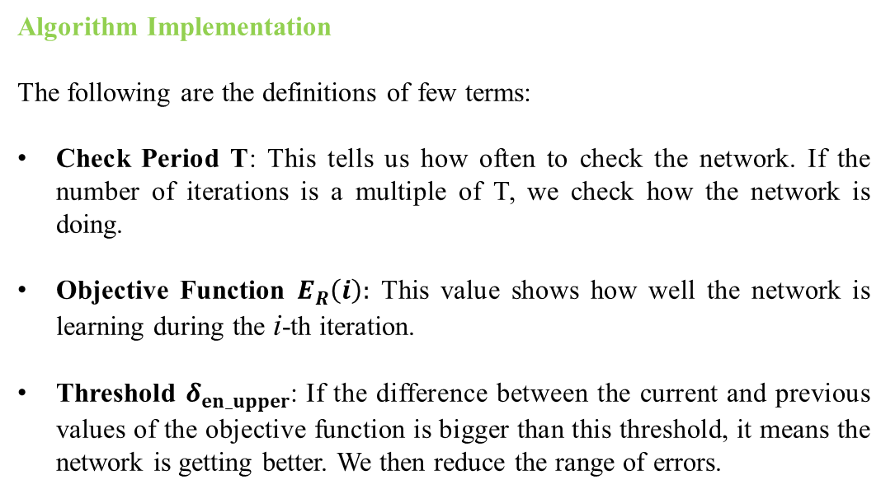
Algorithm Implementation
The following are the definitions of few terms:
Check Period T: This tells us how often to check the network. If the number of iterations is a multiple of T, we check how the network is doing.
Objective Function $E_{R}\left(i\right):$ This value shows how well the network is learning during the i-th iteration.
Threshold $δ_{en_upper}$: If the difference between the current and previous values of the objective function is bigger than this threshold, it means the network is getting better. We then reduce the range of errors.

Slide 25
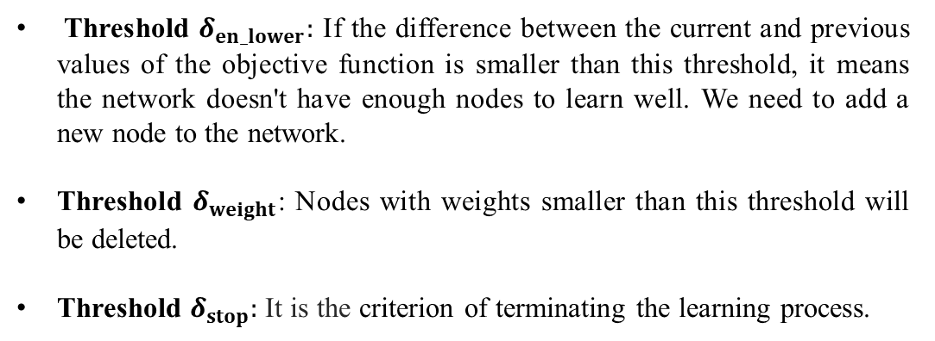
Threshold $δ_{en_lower}:$ If the difference between the current and previous values of the objective function is smaller than this threshold, it means the network doesn't have enough nodes to learn well. We need to add a new node to the network.
Threshold $δ_{weight}$: Nodes with weights smaller than this threshold will be deleted.
Threshold $δ_{stop}:$ It is the criterion of terminating the learning process.

Slide 26
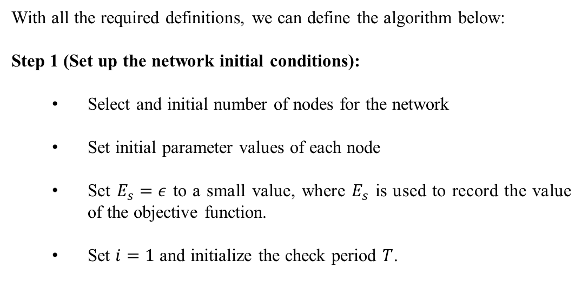
With all the required definitions, we can define the algorithm below:
Step 1 (Set up the network initial conditions):
Select and initial number of nodes for the network
Set initial parameter values of each node
Set $E_{s}=ε$ to a small value, where $E_{s}$ is used to record the value of the objective function.
Set $i=1$ and initialize the check period $T$.

Slide 27
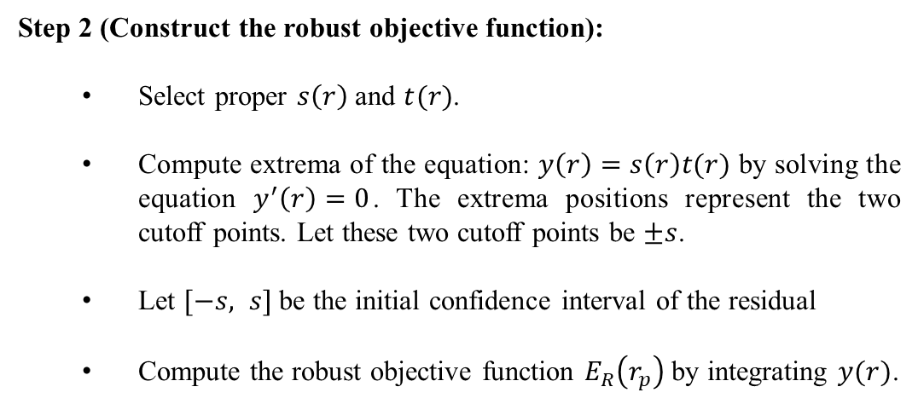
Step 2 (Construct the robust objective function):
Select proper $s\left(r\right)$ and $t(r)$.
Compute extrema of the equation: $y\left(r\right)=s\left(r\right)t(r)$ by solving the equation $y^{′}\left(r\right)=0$. The extrema positions represent the two cutoff points. Let these two cutoff points be $±s$.
Let $[−s, s]$ be the initial confidence interval of the residual
Compute the robust objective function $E_{R}\left(r_{p}\right)$ by integrating $y(r)$.

Slide 28
Step 3 (Compute output)
Compute output of the network for all training patterns.
Step 4 (Compute the Robust Objective Function)
Compute the value of robust objective function of the network.

Slide 29
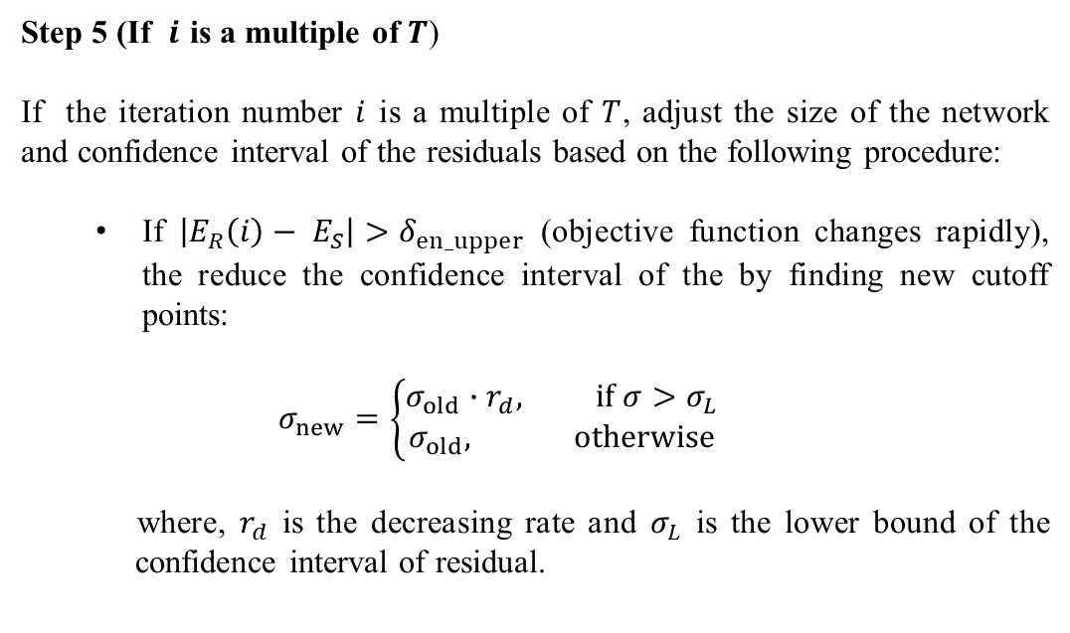
Step 5 (If $i$ is a multiple of $T$)
If the iteration number $i$ is a multiple of $T$, adjust the size of the network and confidence interval of the residuals based on the following procedure:
If $\left|E_{R}\left(i\right)− E_{S}\right|>δ_{en_upper}$ (objective function changes rapidly), the reduce the confidence interval of the by finding new cutoff points:
$$σ_{new}=\left\{\begin{aligned}σ_{old}∙r_{d}, if σ>σ_{L} \\ σ_{old}, otherwise\end{aligned}\right.$$
where, $r_{d}$ is the decreasing rate and $σ_{L}$ is the lower bound of the c confidence interval of residual.

Slide 30
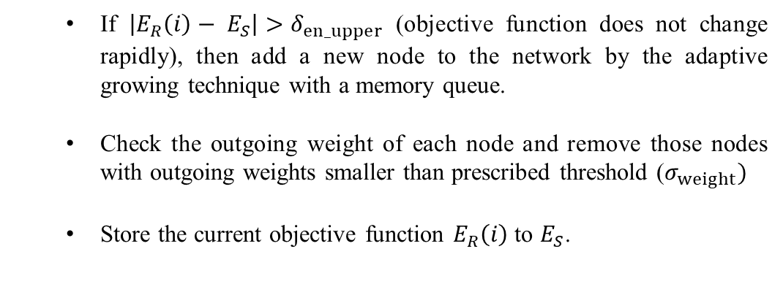
If $\left|E_{R}\left(i\right)− E_{S}\right|>δ_{en_upper}$ (objective function does not change rapidly), then add a new node to the network by the adaptive growing technique with a memory queue.
Check the outgoing weight of each node and remove those nodes with outgoing weights smaller than prescribed threshold ($σ_{weight})$
Store the current objective function $E_{R}\left(i\right)$ to $E_{S}$.

Slide 31
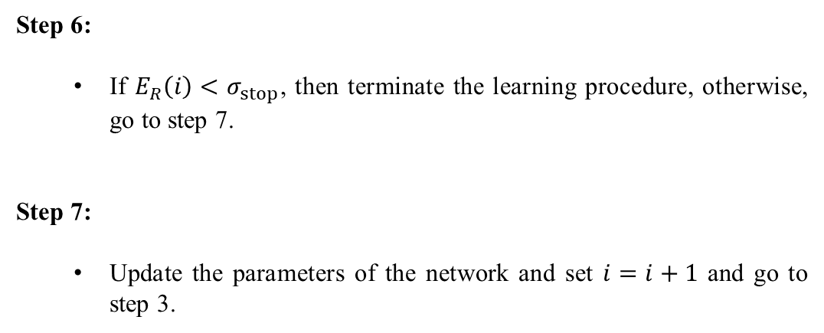
Step 6:
If $E_{R}\left(i\right)<σ_{stop}$, then terminate the learning procedure, otherwise, go to step 7.
Step 7:
Update the parameters of the network and set $i=i+1$ and go to step 3.

Slide 32
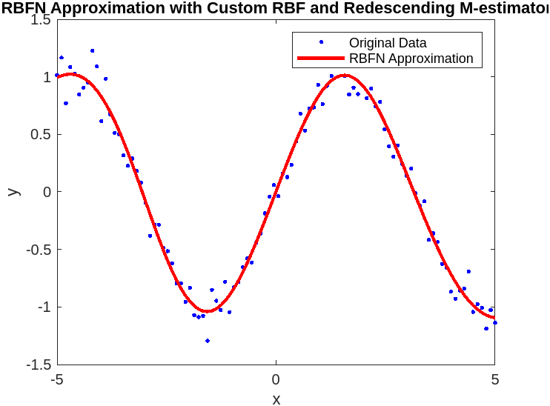
Simulation Results

Slide 33
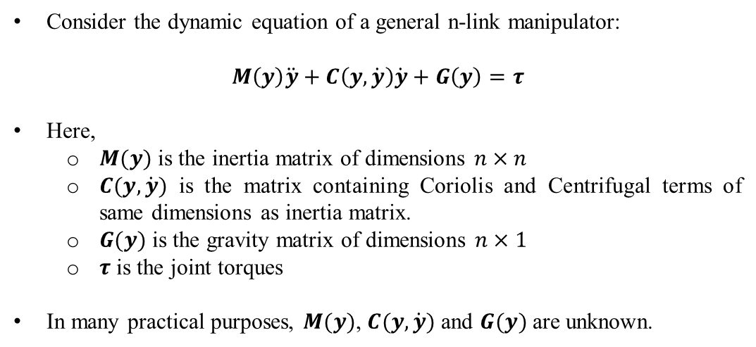
Robust Control of Single Link Manipulator using RBF Neural Networks
Consider the dynamic equation of a general n-link manipulator:
$$M\left(y\right)\ddot{y}+C\left(y, \dot{y}\right)\dot{y}+G\left(y\right)=τ$$
Here,
$M(y)$ is the inertia matrix of dimensions $n×n$
$C(y,\dot{y})$ is the matrix containing Coriolis and Centrifugal terms of same dimensions as inertia matrix.
$G(y)$ is the gravity matrix of dimensions $n×1$
$τ$ is the joint torques
In many practical purposes, $M(y)$, $C(y,\dot{y})$ and $G(y)$ are unknown.

Slide 34
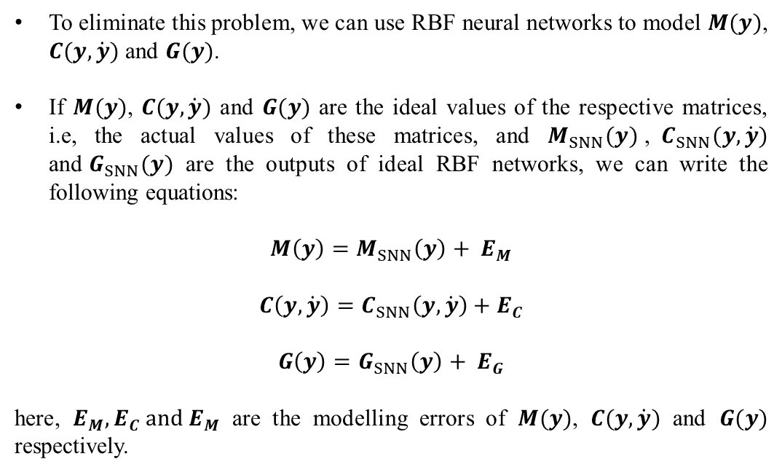
To eliminate this problem, we can use RBF neural networks to model $M(y)$, $C(y,\dot{y})$ and $G(y)$.
If $M(y)$, $C(y,\dot{y})$ and $G(y)$ are the ideal values of the respective matrices, i.e, the actual values of these matrices, and $M_{SNN}(y)$,${ C}_{SNN}(y,\dot{y})$ and${ G}_{SNN}(y)$ are the outputs of ideal RBF networks, we can write the following equations:
$$M\left(y\right)=M_{SNN}\left(y\right)+ E_{M}$$
$$C\left(y,\dot{y}\right)=C_{SNN}\left(y,\dot{y}\right)+E_{C}$$
$$G\left(y\right)=G_{SNN}\left(y\right)+ E_{G}$$
here, $E_{M},E_{C} and E_{M}$ are the modelling errors of $M(y)$, $C(y,\dot{y})$ and $G(y)$ respectively.

Slide 35
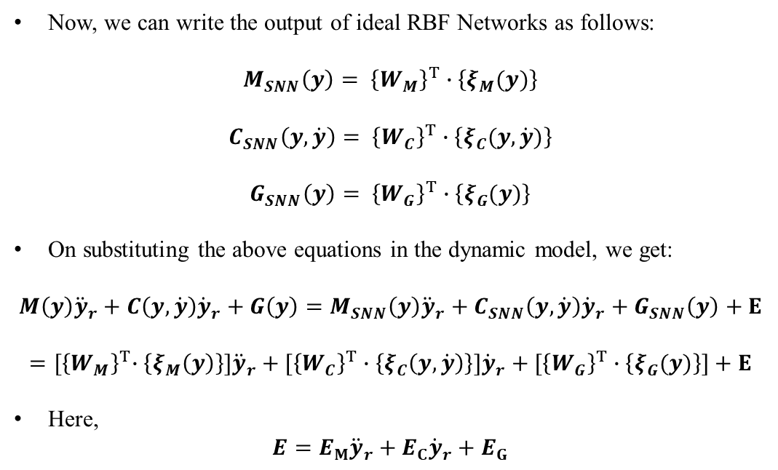
Now, we can write the output of ideal RBF Networks as follows:
$$M_{SNN}\left(y\right)= {\left\{W_{M}\right\}}^{T}∙\left\{ξ_{M}(y)\right\}$$
$$C_{SNN}\left(y,\dot{y}\right)= {\left\{W_{C}\right\}}^{T}∙\left\{ξ_{C}(y, \dot{y})\right\}$$
$$G_{SNN}\left(y\right)= {\left\{W_{G}\right\}}^{T}∙\left\{ξ_{G}(y)\right\}$$
On substituting the above equations in the dynamic model, we get:
$$M\left(y\right){\ddot{y}}_{r}+C\left(y, \dot{y}\right){\dot{y}}_{r}+G\left(y\right)=M_{SNN}\left(y\right){\ddot{y}}_{r}+C_{SNN}\left(y,\dot{y}\right){\dot{y}}_{r}+G_{SNN}\left(y\right)+E$$
$$={[\left\{W_{M}\right\}}^{T}∙\left\{ξ_{M}\left(y\right)\right\}]{\ddot{y}}_{r}+[{\left\{W_{C}\right\}}^{T}∙\left\{ξ_{C}\left(y, \dot{y}\right)\right\}]{\dot{y}}_{r}+[{\left\{W_{G}\right\}}^{T}∙\left\{ξ_{G}(y)\right\}]+E$$
Here,
$$E=E_{M}{\ddot{y}}_{r}+E_{C}{\dot{y}}_{r}+E_{G}$$

Slide 36
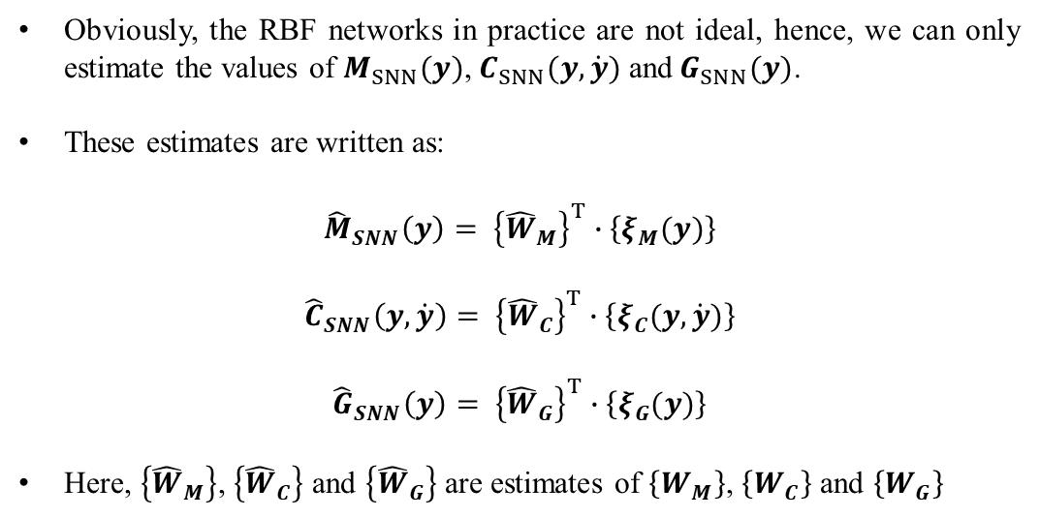
Obviously, the RBF networks in practice are not ideal, hence, we can only estimate the values of $M_{SNN}(y)$,${ C}_{SNN}(y,\dot{y})$ and${ G}_{SNN}(y)$.
These estimates are written as:
$${\hat{M}}_{SNN}\left(y\right)= {\left\{{\hat{W}}_{M}\right\}}^{T}∙\left\{ξ_{M}(y)\right\}$$
$${\hat{C}}_{SNN}\left(y,\dot{y}\right)= {\left\{{\hat{W}}_{C}\right\}}^{T}∙\left\{ξ_{C}(y, \dot{y})\right\}$$
$${\hat{G}}_{SNN}\left(y\right)= {\left\{{\hat{W}}_{G}\right\}}^{T}∙\left\{ξ_{G}(y)\right\}$$
Here, $\left\{{\hat{W}}_{M}\right\}$, $\left\{{\hat{W}}_{C}\right\}$ and $\left\{{\hat{W}}_{G}\right\}$ are estimates of $\left\{W_{M}\right\}$, $\left\{W_{C}\right\}$ and $\left\{W_{G}\right\}$

Slide 37

Controller Design
First, let us define the error terms:
$$e\left(t\right)= y_{d}\left(t\right)−y(t)$$
$${\dot{y}}_{r}=r\left(t\right)+\dot{y}(t)$$
$${\ddot{y}}_{r}=\dot{r}\left(t\right)+\ddot{y}(t)$$
Defining,
$$r= \dot{e}+Λe$$
we have,
$${\dot{y}}_{r}={\dot{y}}_{d}+Λe$$
$${\ddot{y}}_{r}={\ddot{y}}_{d}+Λ\dot{e}$$

Slide 38
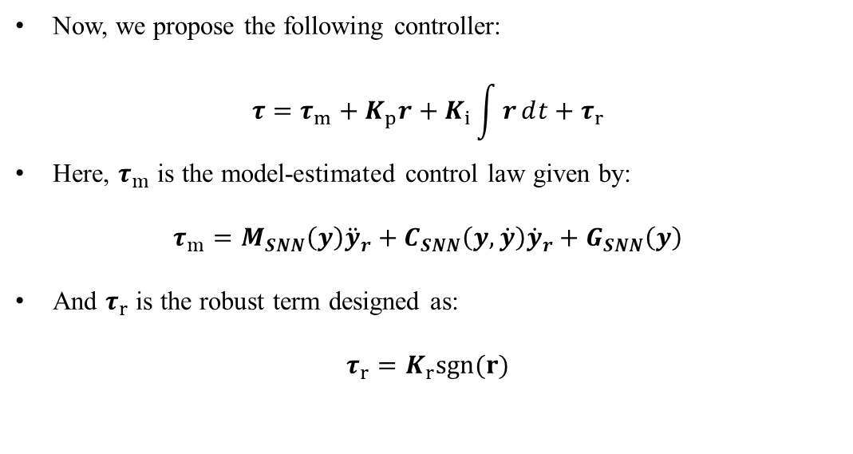
Now, we propose the following controller:
$$τ=τ_{m}+K_{p}r+K_{i}\int{rⅆt}+τ_{r}$$
Here, $τ_{m}$ is the model-estimated control law given by:
$$τ_{m}=M_{SNN}\left(y\right){\ddot{y}}_{r}+C_{SNN}\left(y,\dot{y}\right){\dot{y}}_{r}+G_{SNN}\left(y\right)$$
And $τ_{r}$ is the robust term designed as:
$$τ_{r}=K_{r}sgn(r)$$

Slide 39
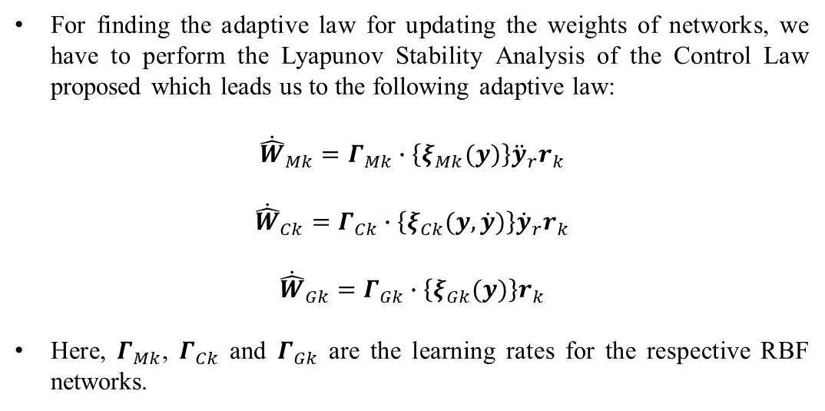
For finding the adaptive law for updating the weights of networks, we have to perform the Lyapunov Stability Analysis of the Control Law proposed which leads us to the following adaptive law:
$${\dot{\hat{W}}}_{Mk}=Γ_{Mk}∙\left\{ξ_{Mk}(y)\right\}{\ddot{y}}_{r}r_{k}$$
$${\dot{\hat{W}}}_{Ck}=Γ_{Ck}∙\left\{ξ_{Ck}(y, \dot{y})\right\}{\dot{y}}_{r}r_{k}$$
$${\dot{\hat{W}}}_{Gk}=Γ_{Gk}∙\left\{ξ_{Gk}(y)\right\}r_{k}$$
Here, $Γ_{Mk}$, $Γ_{Ck}$ and $Γ_{Gk}$ are the learning rates for the respective RBF networks.

Slide 40
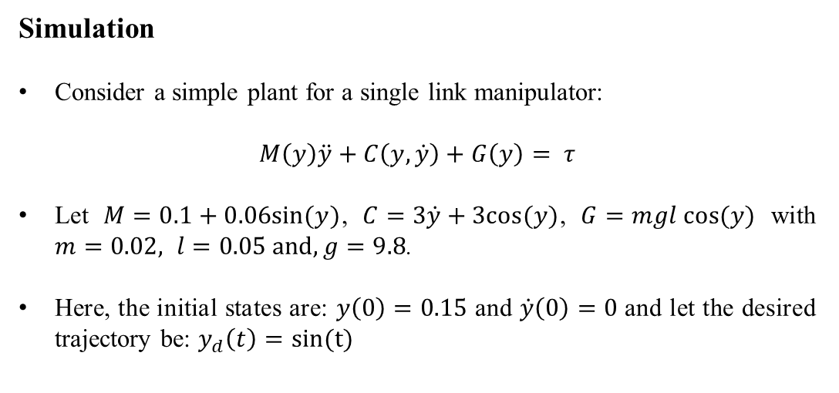
Simulation
Consider a simple plant for a single link manipulator:
$$M\left(y\right)\ddot{y}+C\left(y,\dot{y}\right)+G\left(y\right)= τ$$
Let $M=0.1+0.06sin(y)$, $C=3\dot{y}+3cos(y)$, $G=mgl cos(y)$ with $m=0.02, l=0.05 and, g=9.8$.
Here, the initial states are: $y\left(0\right)=0.15$ and $\dot{y}\left(0\right)=0$ and let the desired trajectory be: $y_{d}\left(t\right)=sin(t)$

Slide 41
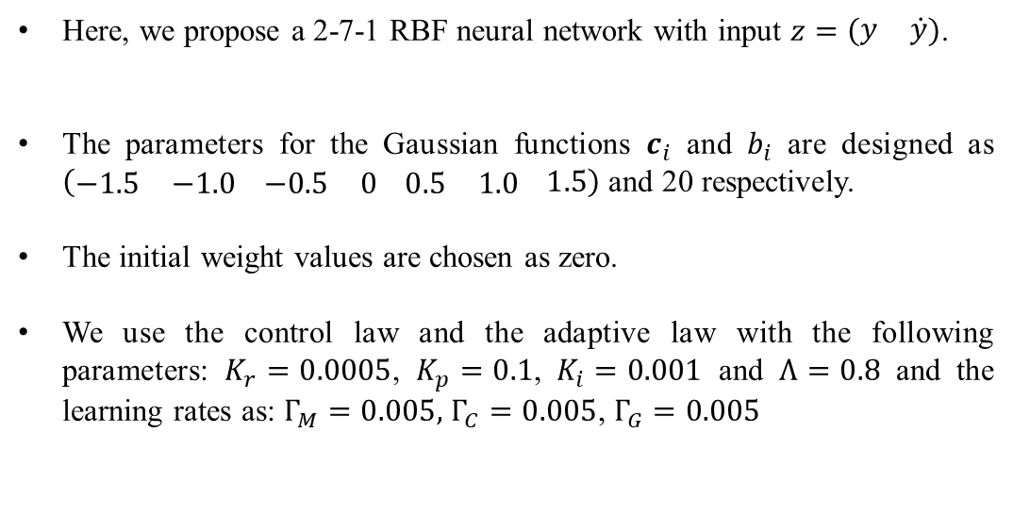
Here, we propose a 2-7-1 RBF neural network with input $z=\left(\begin{matrix}y & \dot{y}\end{matrix}\right)$.
The parameters for the Gaussian functions $c_{i}$ and $b_{i}$ are designed as $\left(\begin{matrix}−1.5 & −1.0\end{matrix} \begin{matrix}−0.5 & 0\end{matrix} \begin{matrix}0.5 & 1.0\end{matrix} 1.5\right)$ and 20 respectively.
The initial weight values are chosen as zero.
We use the control law and the adaptive law with the following parameters: $K_{r}=0.0005$, $K_{p}=0.1$, $K_{i}=0.001$ and $Λ=0.8$ and the learning rates as: $Γ_{M}=0.005,$ $Γ_{C}=0.005$, $Γ_{G}=0.005$

Slide 42
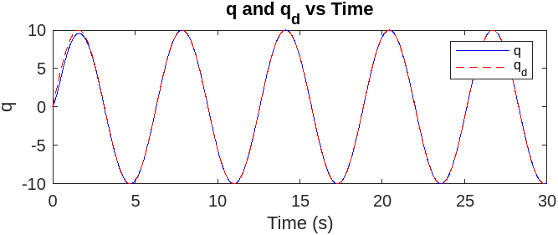
Output
Position Tracking

Slide 43
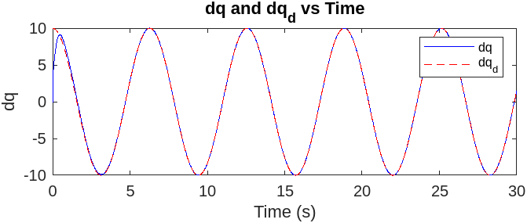
Velocity Tracking

Slide 44
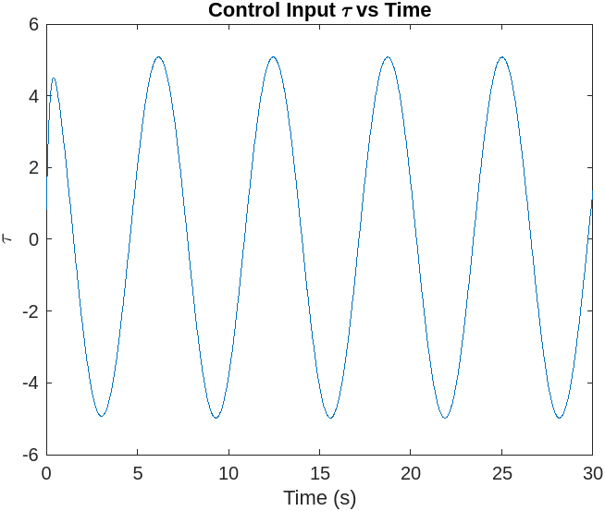
Control Input

Slide 45
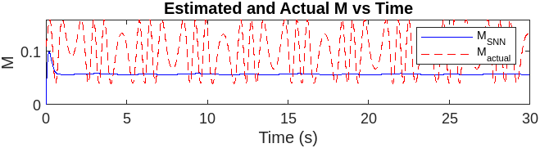
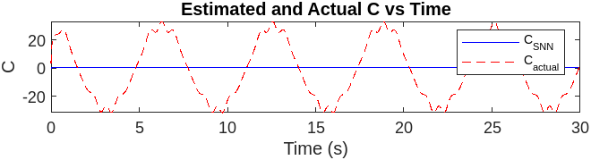
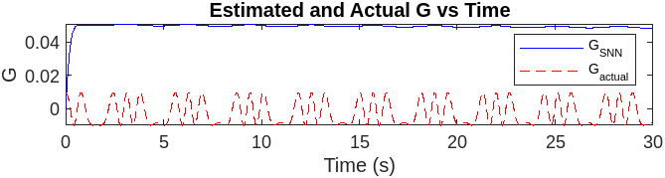
Estimated values of $M_{SNN}(y)$,${ C}_{SNN}(y,\dot{y})$ and${ G}_{SNN}(y)$

Slide 46
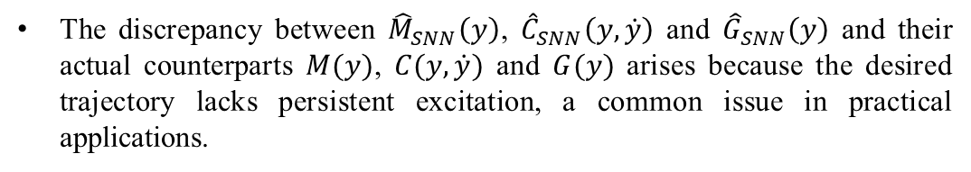
The discrepancy between ${\hat{M}}_{SNN}\left(y\right)$, ${\hat{C}}_{SNN}\left(y,\dot{y}\right)$ and ${\hat{G}}_{SNN}\left(y\right)$ and their actual counterparts $M(y)$, $C(y,\dot{y})$ and $G(y)$ arises because the desired trajectory lacks persistent excitation, a common issue in practical applications.

Slide 47
Thank You

