Slide 1

COURSE TITLE
Lecture Number
Lecture Name
PRESENTER NAME
DEPARTMENT

Slide 2
Sampling Based Path Planning
Why Sampling in Path Planning?
Sampling Algorithms are well-suited for high-dimensional configuration spaces, where traditional grid-based methods become computationally infeasible.
They can handle large and complex environments, adapting well to different problem sizes without a significant increase in computational resources.
These algorithms are versatile and can be easily adapted to various constrains and environments, including dynamic or partially known spaces.

Slide 3
Key Algorithms in Sampling Based Path Planning
Rapidly-exploring Random Trees (RRT): Efficiently explores the space by incrementally building a tree structure from the start point.
RRT Connect: An extension of RRT that aggressively tries to connect the start and goal, improving convergence speed.
RRT* (RRT-Star): An optimization RRT that refines the tree over time to ensure an optimal path.
Probabilistic Roadmap (PRM): Creates a global graph by connecting randomly sampled nodes in free space, suitable for multi-query planning.

Slide 4
Rapidly-exploring Random Trees (RRT)
Introduction
Incremental sampling and searching approach based.
No tuning parameters are needed.
Incrementally construct the search tree.
Exploration: In the region of interest the tree densely covers the space.
This method is very suitable for high dimension space.
Using this method motion planning for both algebraic constraints (arising from obstacle) and differential constraints (arising from nonholonomic and dynamics).

Slide 5
Definition
A dense sequence of samples is used as a guide in the incremental construction of tree. If the sequence is random, the resulting tree is called a rapidly exploring random tree (RRT).
The main idea of this method → to bias the exploration toward unexplored portions of the space.
This family of trees, whether the sequence is random or deterministic, will be referred to as rapidly exploring dense trees (RDTs).

Slide 6
Working Steps
Construction of tree: Build a rapidly exploring random tree in search space from the starting node.
Starting Node

Slide 7
Pick a random node in the search space
Random Node
Starting Node

Slide 8
Search nearest node: Find the nearest node in the tree from the random node
Random Node
Starting Node

Slide 9

Extend RRT: Extend from the nearest node towards the random node by a small step as long as possible by avoiding the obstacle.
$$δ$$
Random Node
Starting Node

Slide 10
Add that node as a new edge and vertex of the tree.
New Node
Starting Node

Slide 11
Repeat the steps 2 to 5 to explore the search space by extending more and more nodes to the trees.

Slide 12
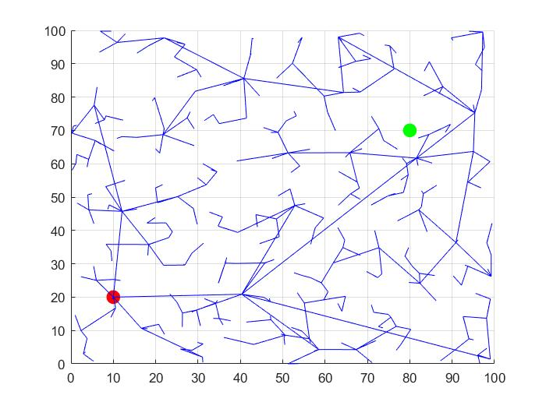
The iterative process from step 2 to step 5 will able to explore the search space.
Once the RRT reaches the goal → Backtracking will be done along tree to identify edges that lead from start node to goal node.
Goal node
Starting node

Slide 13
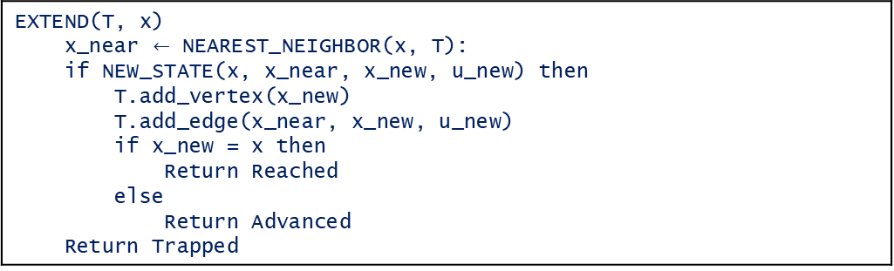
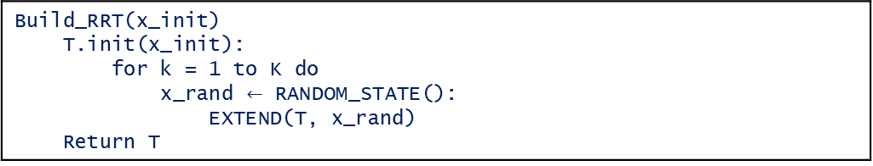
Algorithm
Build_RRT(x_init) T.init(x_init): for k = 1 to K do x_rand $←$ RANDOM_STATE(): EXTEND(T, x_rand) Return T
EXTEND(T, x) x_near $←$ NEAREST_NEIGHBOR(x, T): if NEW_STATE(x, x_near, x_new, u_new) then T.add_vertex(x_new) T.add_edge(x_near, x_new, u_new) if x_new = x then Return Reached else Return Advanced Return Trapped

Slide 14
RRT-Connect
Introduction
This method construct two incrementally two RRT from the starting node and from the goal node.
The trees each explore space around them and also advance towards each other through the use of a simple greedy heuristic → explore the space very well.
Grows the trees towards each other (rather then towards random configurations).
Path is found when two trees meet.

Slide 15
Introduction
In RRT connect it grows with multiple epsilons so that the greediness becomes stronger, and the two trees advance faster towards each other.
This technique is more probable to find a solution faster with respect to the normal RRT method.
The RRT-Connect planner is useful for path planning problems that involve no differential constraints.

Slide 16
Working Steps
Construction of trees: Build a rapidly exploring random tree in search space from the both nodes starting and goal node.
Starting Node
Goal Node

Slide 17
Pick a random node in the search space for both trees to explore in the search space
Random Node
Random Node
Starting Node
Goal Node

Slide 18
Extend RRT: Extend from the nearest node towards the random node by a small step as long as possible by avoiding the obstacle.
Random Node
New
Node
New Node
Random Node
Starting Node
Goal Node

Slide 19
Convert the new nodes to the target for the other tree
Target Node
Starting Node
Goal Node

Slide 20
Find the node nearest to the target node.
Target Node
Nearest Node
Starting Node
Goal Node

Slide 21

Extend from the nearest node towards the random node by a small step as long as possible by avoiding the obstacle.
$$δ$$
New Node
Target Node
Nearest Node
Starting Node
Goal Node

Slide 22
Add that node as a new edge and vertex of the tree.
New Node
Target Node
Nearest Node
Starting Node
Goal Node

Slide 23
Repeat the step 6 to 7 to reach the target node.

Slide 24
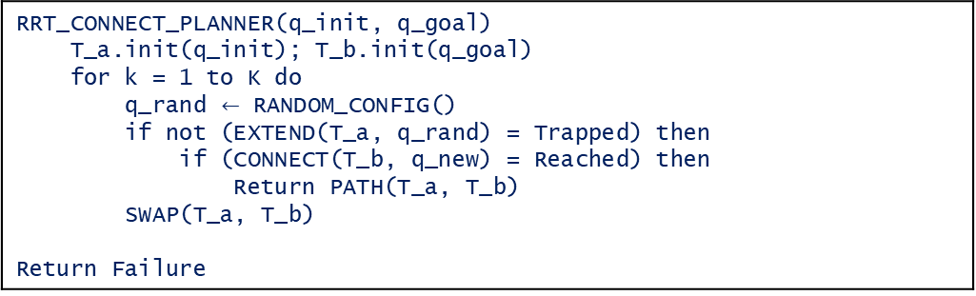
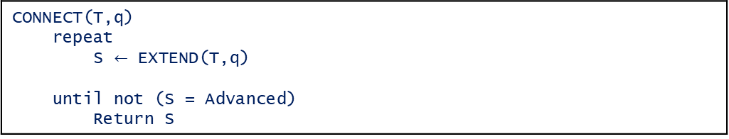
Algorithm
CONNECT(T,q) repeat S $←$ EXTEND(T,q) until not (S = Advanced) Return S
RRT_CONNECT_PLANNER(q_init, q_goal) T_a.init(q_init); T_b.init(q_goal) for k = 1 to K do q_rand $←$ RANDOM_CONFIG() if not (EXTEND(T_a, q_rand) = Trapped) then if (CONNECT(T_b, q_new) = Reached) then Return PATH(T_a, T_b) SWAP(T_a, T_b) Return Failure

Slide 25
RRT-Connect
Introduction
RRT or RRT- connect method is not able to find the optimal path between the starting node and goal node.
RRT* ensures asymptotic optimality → This method is useful to find the optimal path.
This method is useful to deal with differential constraints also.
Two main techniques involved in this technique → Path optimization and Intelligent Sampling.

Slide 26
Working Steps
Construction of tree: Build a rapidly exploring random tree in search space from the both nodes starting and goal node.
Starting Node

Slide 27
Pick a random node in the search space.
Random Node
Starting Node

Slide 28
Search nearest node: Find the nearest node in the tree from the random node.
Random Node
Starting Node

Slide 29

Consider the new node from the nearest node towards the random node by a small step as long as possible by avoiding the obstacle.
New Node
$$δ$$
Random Node
Starting Node

Slide 30
Consider all nodes in the vicinity of the new nodes → those nodes are named as Neighborhood nodes
Neighborhood Node
New Node
Vicinity of
New node
Random Node
Starting Node

Slide 31
Evaluates the total cost as the additive combination of the cost associated with reaching each neighborhood node and the cost of the trajectory to the new node.
Neighborhood Node
New Node
Vicinity of
New node
Random Node
Starting Node

Slide 32
The node that yields the lowest cost becomes the new node of the tree.
Add that node as a new edge and vertex of the tree.
New Node

Slide 33
Repeat the steps 2 to 6 to explore the search space by extending more and more nodes to the trees.
The iterative process from step 2 to step 5 will able to explore the search space
Once the RRT reaches the goal → Backtracking will be done along tree to identify edges that lead from start node to goal node.

Slide 34
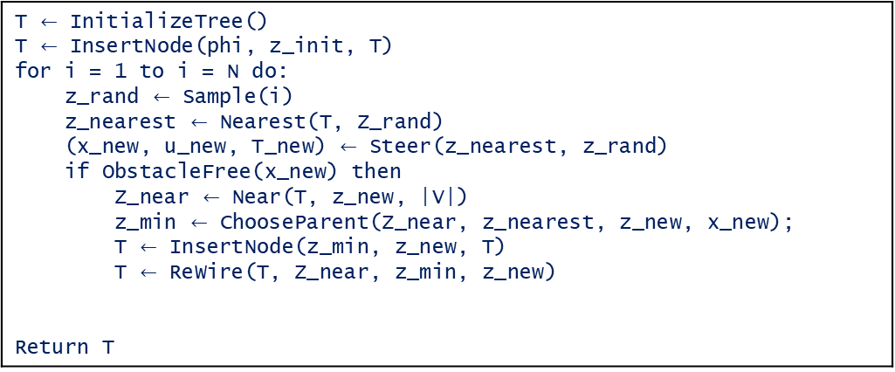
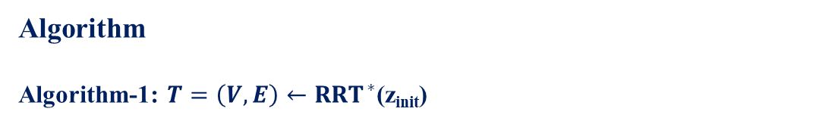
Algorithm
Algorithm-1: $T=\left(V,E\right)←{RRT}^{∗}$(z_{init})
T $←$ InitializeTree() T $←$ InsertNode(phi, z_init, T) for i = 1 to i = N do: z_rand $←$ Sample(i) z_nearest $←$ Nearest(T, Z_rand) (x_new, u_new, T_new) $←$ Steer(z_nearest, z_rand) if ObstacleFree(x_new) then Z_near $←$ Near(T, z_new, |V|) z_min $←$ ChooseParent(Z_near, z_nearest, z_new, x_new); T $←$ InsertNode(z_min, z_new, T) T $←$ ReWire(T, Z_near, z_min, z_new) Return T

Slide 35
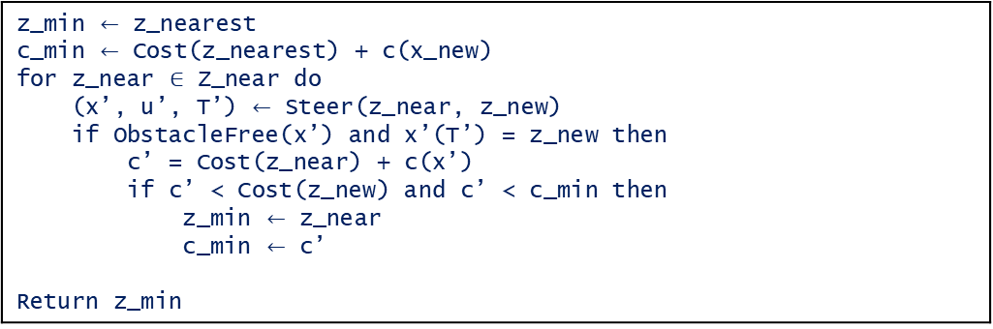
Algorithm-2: $z_{min}←ChooseParent(Z_{near}, z_{nearest}, x_{new})$
z_min $←$ z_nearest c_min $←$ Cost(z_nearest) + c(x_new) for z_near $∈$ Z_near do (x’, u’, T’) $←$ Steer(z_near, z_new) if ObstacleFree(x’) and x’(T’) = z_new then c’ = Cost(z_near) + c(x’) if c’ < Cost(z_new) and c’ < c_min then z_min $←$ z_near c_min $←$ c’ Return z_min

Slide 36
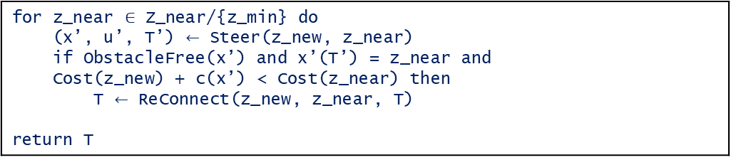
Algorithm-2: $T←Rewire(T, Z_{near}, z_{min}, z_{new})$
for z_near $∈$ Z_near/{z_min} do (x’, u’, T’) $←$ Steer(z_new, z_near) if ObstacleFree(x’) and x’(T’) = z_near and Cost(z_new) + c(x’) < Cost(z_near) then T $←$ ReConnect(z_new, z_near, T) return T

Slide 37
Probabilistic Roadmaps (PRM)
Introduction
Random Sampling is used to generate nodes in the configuration space.
PRM constructs an indirect graph (roadmap) where nodes represent collision-free configurations, and edges represent valid paths between them.
Provide global coverage of the free space, suitable when there are multiple goal points.
Very effective for high-dimensional spaces as it samples the space probabilistically.

Slide 38
Working Principle
A random node/point is generated in the configuration space.
New Node

Slide 39
Check whether the new node lies in the free space or not. If the node does lie or intersect with an obstacle, ignore them.
Invalid nodes

Slide 40
This newly generated node is then connected to the closest nodes through a straight line.

Slide 41
Then check if the connection between two nodes lies in free space or not. If the connection lies in the free space, let it be, else remove it.

Slide 42
The iteration for this new node ends here, add more nodes as per requirements and repeat the process.

Slide 43
For executing the path, we can use various graph search algorithms like Breadth-First Search, Depth-First Search, Dijkstra’s Algorithm to find the path between two nodes.
Start Node
Goal Node

Slide 44
For example, in the previous figure, there are multiple paths from start to goal, but the highlighted one (optimal path) below can be found using one of the algorithms mentioned above
Start Node
Goal Node
NOTE: The optimal found using graph search algorithms may not be optimal in a global sense. Usually, the optimal path is optimal with the map only.

Slide 45
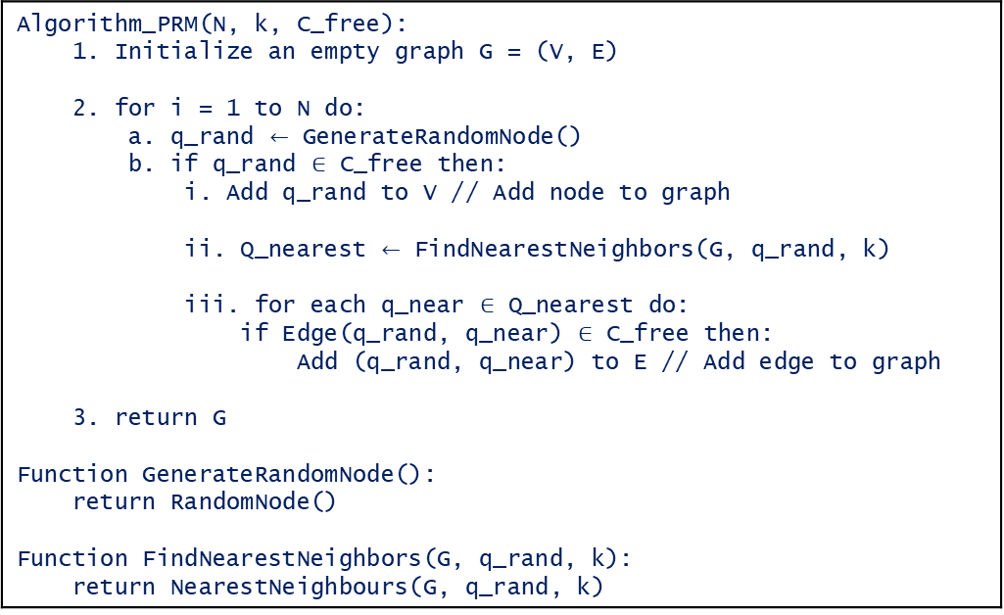
Algorithm
Algorithm_PRM(N, k, C_free): 1. Initialize an empty graph G = (V, E) 2. for i = 1 to N do: a. q_rand $←$ GenerateRandomNode() b. if q_rand $∈$ C_free then: i. Add q_rand to V // Add node to graph ii. Q_nearest $←$ FindNearestNeighbors(G, q_rand, k) iii. for each q_near $∈$ Q_nearest do: if Edge(q_rand, q_near) $∈$ C_free then: Add (q_rand, q_near) to E // Add edge to graph 3. return G Function GenerateRandomNode(): return RandomNode() Function FindNearestNeighbors(G, q_rand, k): return NearestNeighbours(G, q_rand, k)

Slide 46
Thank You

