Slide 1
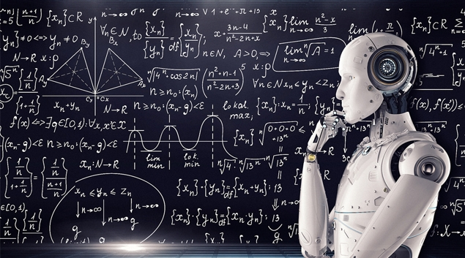
Predicting the Age of Death
https://www.healthcarefinancenews.com/news/machine-learning-overtakes-humans-when-it-comes-predicting-death-or-heart-attack

Slide 2
GROUP MEMEBERS
Sachin Chaudhary - 0792544
Parth Bhavinkumar Brahmbhatt - 0793999
Ruchit Alpeshbhai Patel - 0789968
Ritik Rajeshbhai Patel - 0801738

Slide 3
CONTENTS
1. Problem Statement
2. Project Objectives
3. Dataset Information
4. Data exploration and Visualizations
5. Implementing ML Models
7. Challenges faced
8. References
Why Age Dataset
6. Models performance evaluation
9. Project documents link

Slide 4
Why Age Dataset
Age Dataset is a structured general-purpose dataset on life, work, and death of 1.22 million distinguished people available in public domain. It is the largest on notable deceased people and includes individuals from a variety of social groups, including but not limited to 107k females, 124 non-binary people, and 90k researchers, who are spread across more than 300 contemporary or historical regions.
Historic recurrence is the repetition of similar events in history. Several fields of study can benefit from a large, structured, and accurate dataset of historical figures. In our project we aim Identifying the historical data and analyzing the trends/deeper insights in the data.
Favorite theory of mine is that no occurrence is sole and solitary, but is merely a repetition of a thing which has happened before, and perhaps often. - Mark Twain

Slide 5
Problem Statement
Determine the Age of death of a person with various Machine learning Models using significant features and Comparing performance models to determine the best based on various performance evaluation metrics.

Slide 6
PROBLEM OBJECTIVE
Identify the age of death of various people by taking into consideration analysis of various factors like age, sex, occupation, work history, demographics, birth and death year.
Build a ML model based on the correlated data and training it to predict such cases according to the input data given.

Slide 7
DATA SET INFORMATION
This dataset was published on Wikipedia Article “List of datasets for machine-learning research” in biological data section.
This public domain data set was created by Issa and Rahimberdi Annamoradnejad in June 2022 and published at icwsm workshop.
Data format is text stored in CSV file uploaded on GitHub.
A structured general-purpose dataset on life, work, and death of 1.22 million distinguished people.

Slide 8
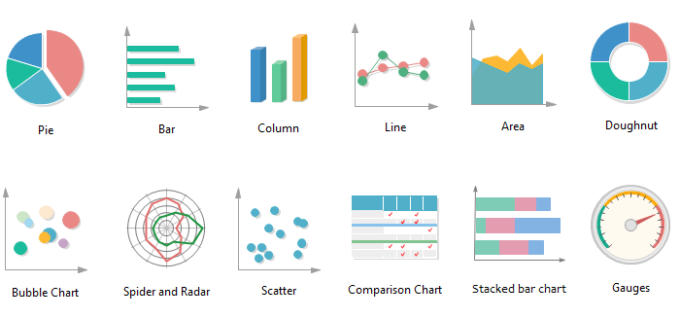

Data exploration and Visualizations
https://www.edrawsoft.com/chart/choose-right-chart.html

Slide 9
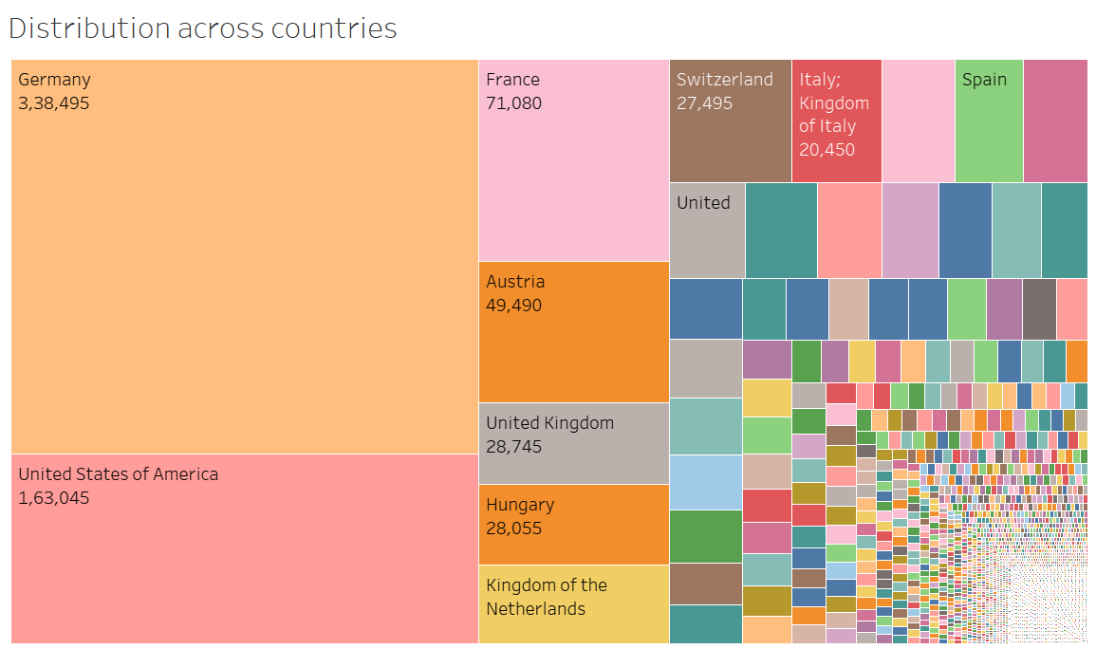
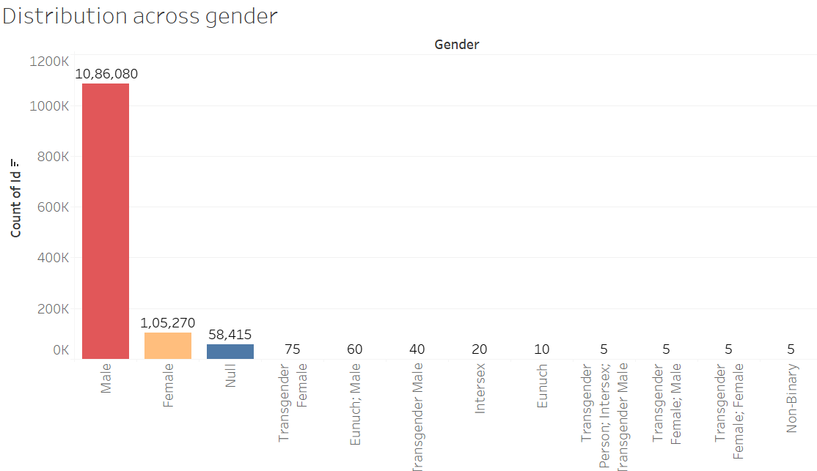
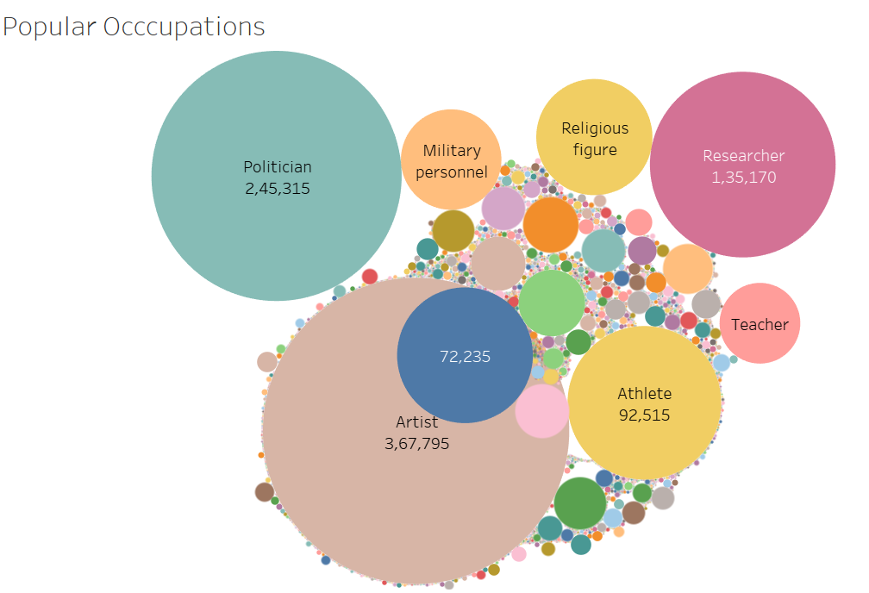
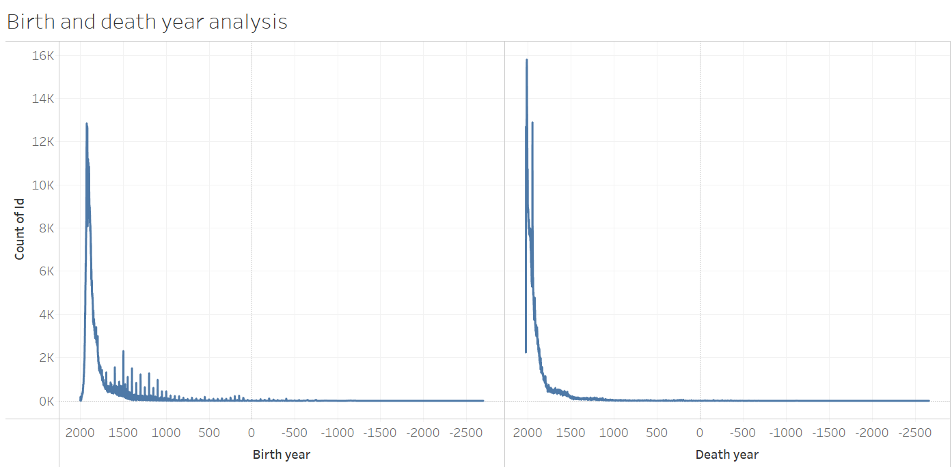
Raw File EDA

Slide 10
Dropped unnecessary columns like ID, Short Description, Name.
Changed data types for numerical data.
Filtered data for Gender to only include Male, Female.
Filtered Birth to only include value greater than equal to 1800.
Encoded and scaled required feature data.
Filtered data to include records from top five countries.
Data Cleaning:

Slide 11
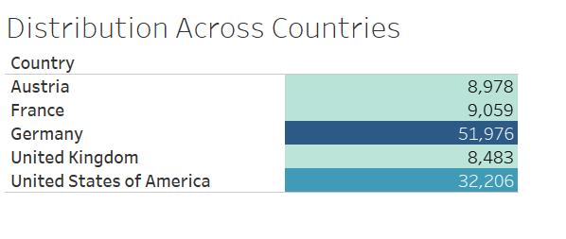
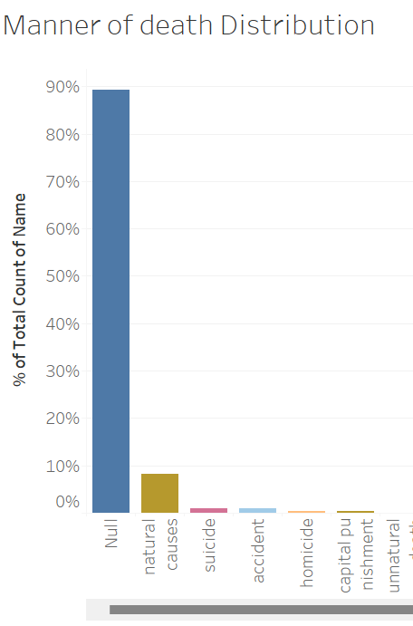
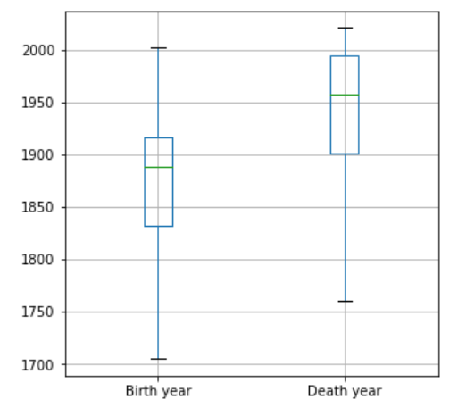
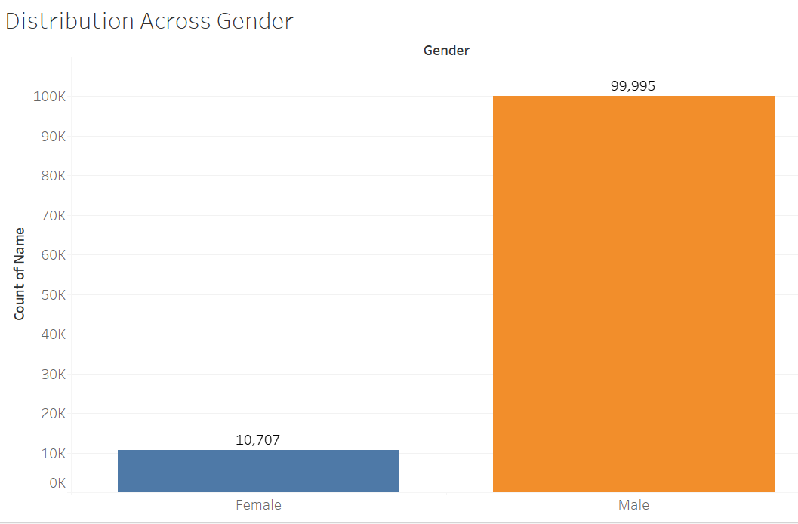
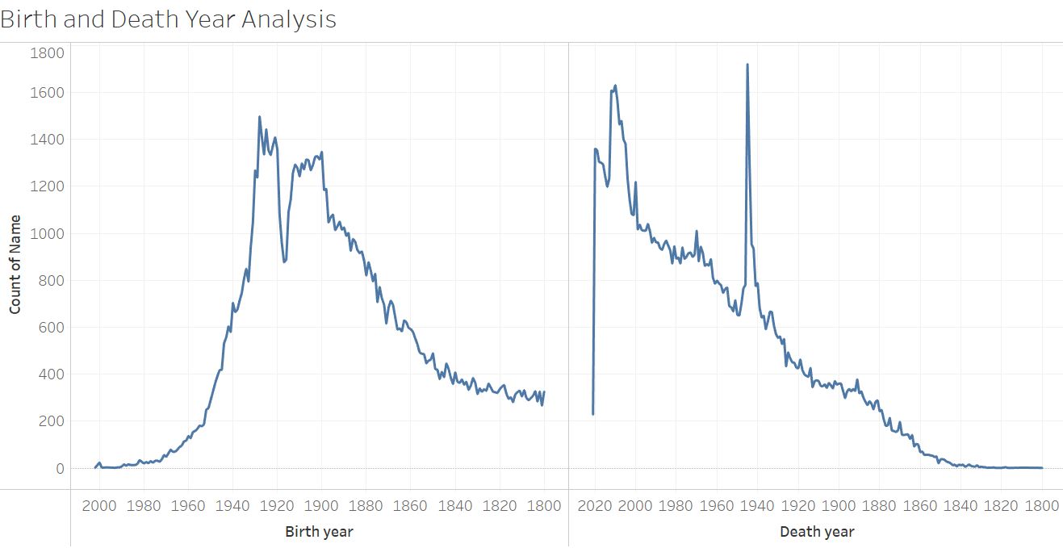
Cleaned File EDA
Birth and Death Year Distribution
Gender bias on Wikipedia, also known as the Wikipedia gender gap, refers to the fact that Wikipedia contributors are mostly male, that relatively few biographies on Wikipedia are about women, and that topics of interest to women are less well-covered.

Slide 12
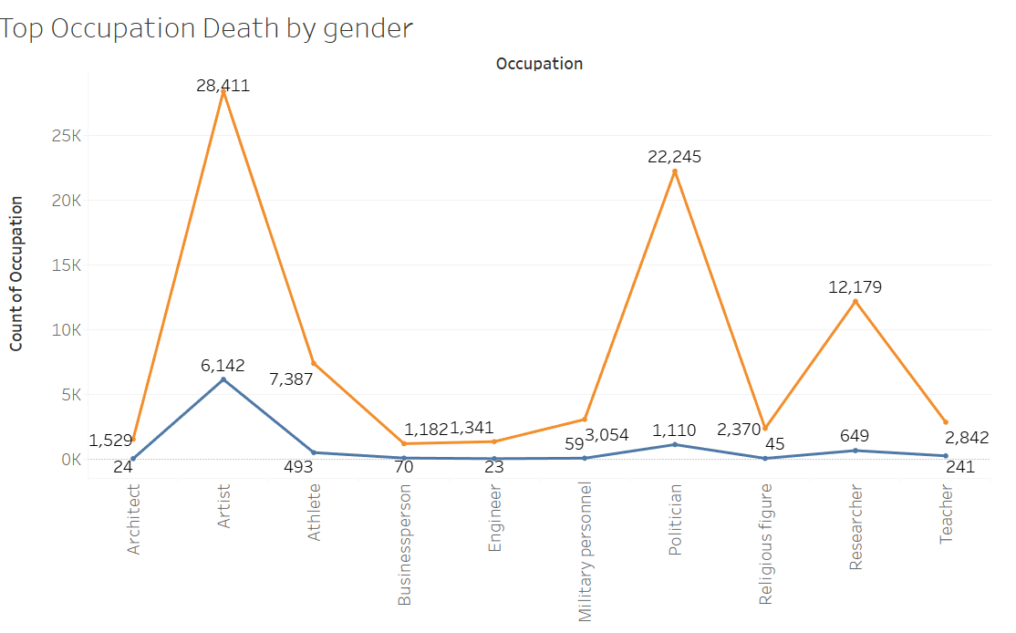
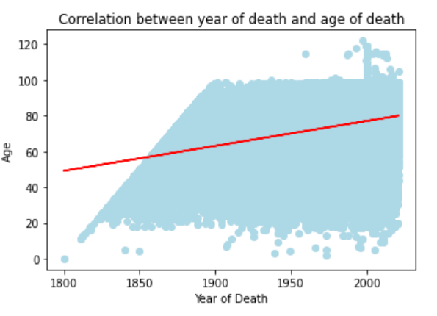
More data Insights

Slide 13
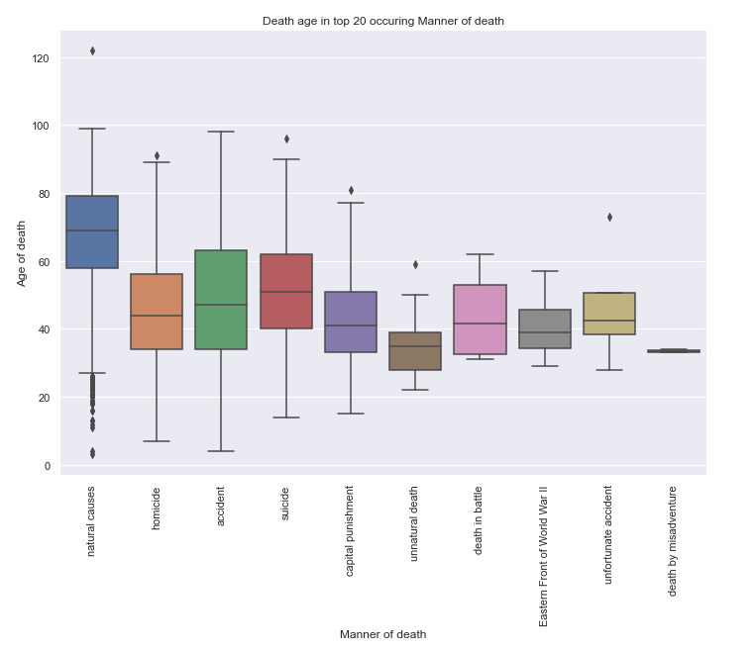
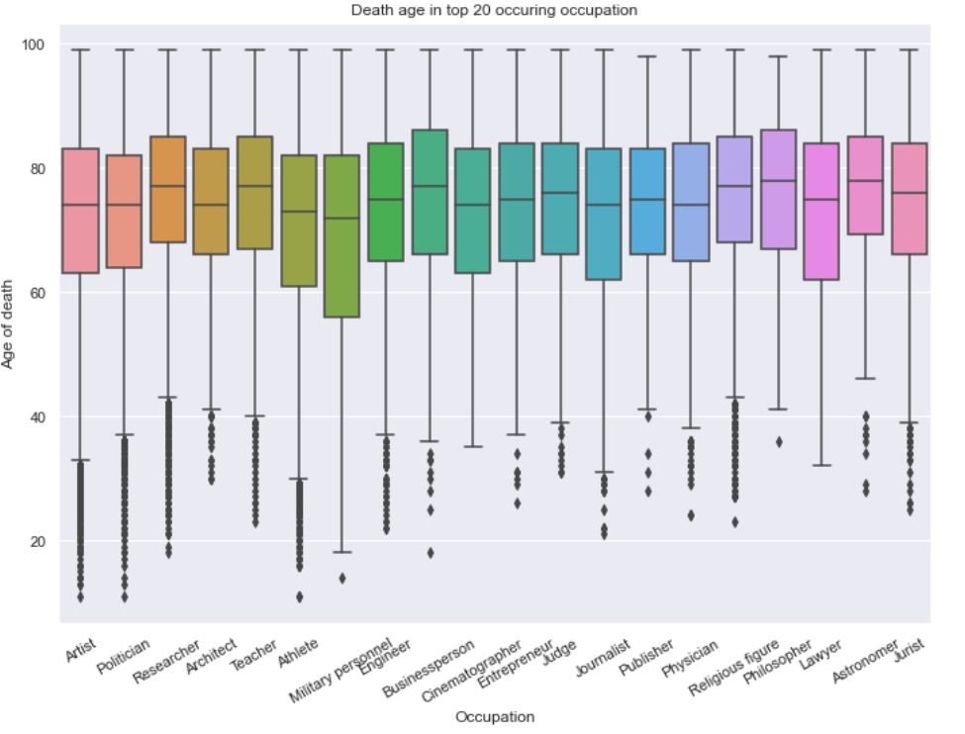

Slide 14
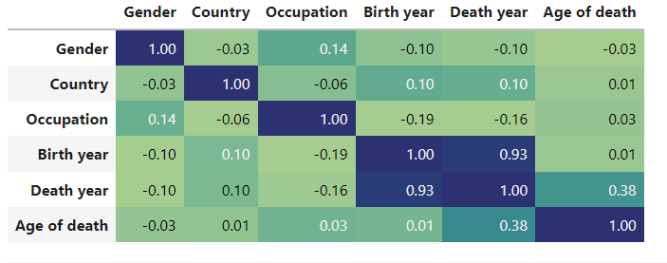
Correlation matrix table showing correlation coefficients between variables

Slide 15

Implementing ML Models
CSA Images/Mod Art Collection/Getty Image

Slide 16
KNN
Gaussian Naive Bayes
Decision Tree Classifier
Random Forest Classifier
SVC

Slide 17
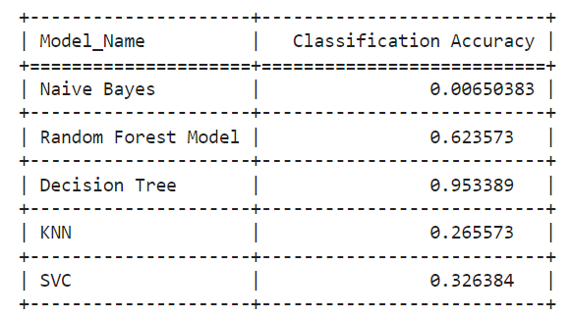
Models performance evaluation

Slide 18
Accuracy:
Recall:
Precision:
F1 score:
Gaussian Naive Bayes
Decision Tree Classifier
Random Forest Classifier
SVC
KNN
accuracy 0.2655
precision 0.2655
f1 score 0.2655
accuracy 0.0065
precision 0.0065
accuracy 0.9533
recall 0.9533
precision 0.9533
f1 score 0.9533
accuracy 0.6235
recall 0.6235
precision 0.6235
f1 score 0.6235
accuracy 0.3263
precision 0.3263
f1 score 0.3263
recall 0.2657
recall 0.0065
f1 score 0.0065
recall 0.3263

Slide 19
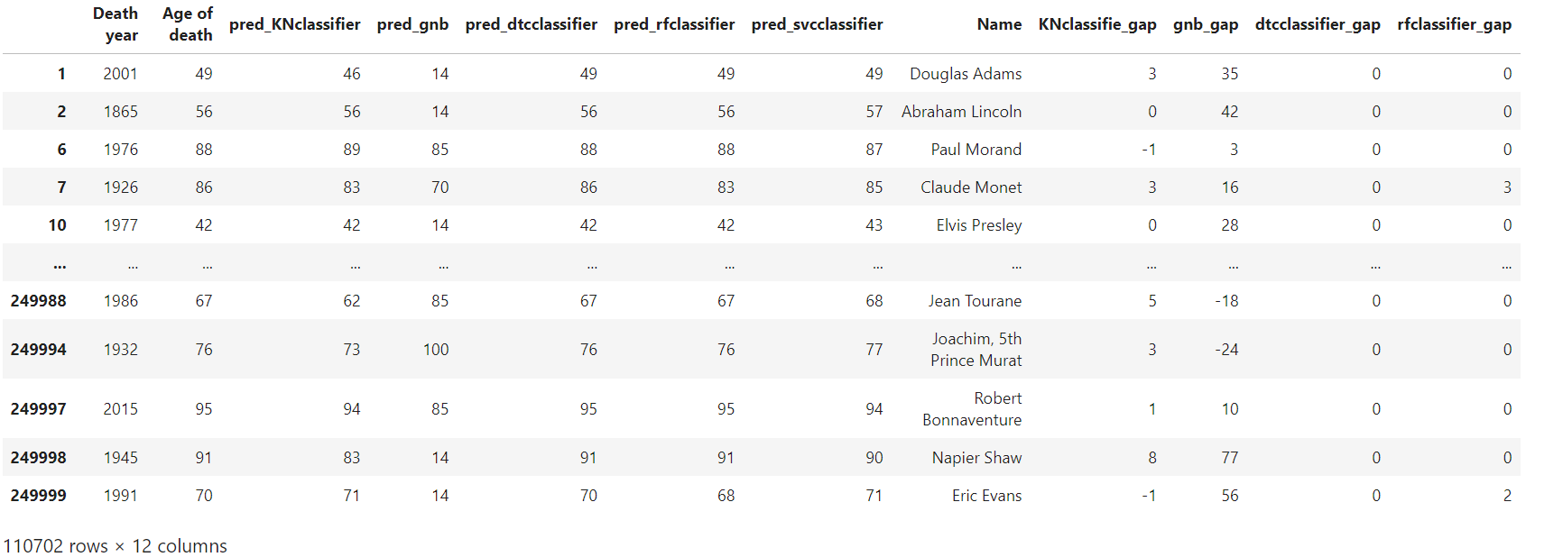
Age Prediction results:

Slide 20
Data issues like null, outliers, unsymmetrical data distribution made us to drop a lot of records.
ML model performance issues due to low correlation between variables.
Less features in data set for prediction.
Age of death prediction is based on death year, country, gender, occupation and manner of death. We don’t have information like lifestyle, illness conditions and other external factors like war, pandemic to train model for better results.
CHALLENGES

Slide 21
Proceedings of the ICWSM Workshop: https://workshop-proceedings.icwsm.org/abstract?id=2022_82
Gender bias on Wikipedia: https://en.wikipedia.org/wiki/Gender_bias_on_Wikipedia#:~:text=The%20authors%20found%20that%20women,themselves%2C%20and%203)%20that%20external
References

Slide 22
Data set (by author): here
Data set (local GitHub): here
Python file (GitHub): here
PPT (GitHub): here
Project proposal (GitHub) : here
Tableau file (GitHub) : here
Project document Links

Slide 23
Thank you

