Slide 1

Prediction of mental health based on severity
Vanita Patel (0734890)
Jinali Patel (0734623)
Kavya Bulusu (0734186)

Slide 2
Agenda
Why Mental Health?
Statistical Coverage
Problem Statement
Importance of data analytics
Data Science Formulation
Kind of Data
Finding a valid dataset
Dataset
Five Framing guidelines
Challenges
References
Questions

Slide 3
Why Mental Health?
One of the greatest challenges in health care industry of 21st century
Every person has the opportunity to achieve the best possible mental health and well-being
What is our developed technology doing with this issue?
Goal – To summarize the current status of the issue and offer some options and recommendations for advancing a mental health information agenda
Plan - To analyse the data that is available for mental health in our society and provide a platform to the mental health distressed candidates to come up with their condition to get coached up or treated according to their situation

Slide 4
Statistical Coverage
In any given year, 1 in 5 people in Canada are experiencing a mental health problem or illness
Currently more than 6.7 million people are living with mental health conditions in Canada
More than 28% of people aged 20-29 experience a mental illness per year
Suicide accounts for 24% of all deaths among 15-24-year olds and 16% among 25-44-year olds and rate of suicide in male is almost four times higher than female

Slide 5
Problem Statement
Understand the impact of poverty, violence, civil conflict, and migration on mental, neurological and substance use disorders
Reduce the duration of untreated illness by developing culturally‐sensitive early interventions for mental, neurological and substance use disorders across settings

Slide 6
Importance of data analytics
Data is the fuel for any technical engine these days
Age of the data is becoming younger day-by-day
Meaningful information derived from the data, understanding it are the important components to cycle up the problem
The analysis process that we make, tools and techniques we use is all that declare the success rating of our project
Looking at a broader perspective, a wide range of audience gets interacted and impressed when you show them some graphs with numbers.

Slide 7
Data Science Formulation
Identify the affected candidates by taking into consideration analysis of various factors like age, sex, family history, work history, type of treatment, demographics etc.
Build a supervised model based on the correlated data and training it to predict such cases in future according to the input data given by the person from the platform.
Taking the benefits from the results derived, a platform (website) will be created and this acts as a source to take the input of any future data to the model to predict the seriousness of the person and looking at this, we try to raise awareness in improving the conditions for those mental health disorders.

Slide 8
Kind of Data
Analysing the data that is fictional in nature gives us a way to apply the technical and the domain knowledge that we have learnt
But working on real time data considering a societal issue as an objective provides a way to extend a solution besides the former
We take this advantage to work on a real-time data

Slide 9

Route map – finding a valid dataset

Slide 10

Email communication
Kaggle
Open health Canada
Youth Mental Health Canada(YMHC) research unit , Hamilton
University of Toronto :– Research group
Statistics Canada

Slide 11
Dataset
“Finalized” – data from Statistics Canada
An EFT (Electronic File Transfer) public usage data file that is authenticated
Canadian Community Health Survey (CCHS) Data
Survey taken by an interviewer
2 years of Data (2015,2016)
All provinces in Canada
High volume of data (more than 120000*1285)
Self-reported and derived variables

Slide 12
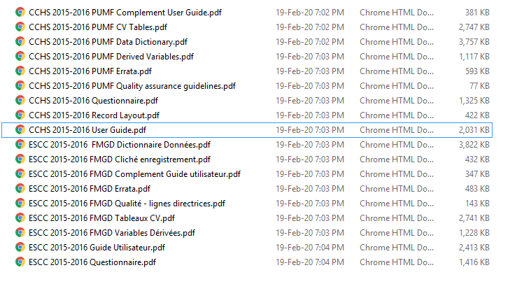
Glimpse of data files

Slide 13
Five framing guidelines
Consent
user’s agreement (Questionnaire document)
official procedures sign off
Clarity
note - specifies the main goal for the data collection
official mail communication stating our need for the dataset
Consistency and Trust
collected by the government officials , a huge program that took place in all the provinces of Canada for the benefit of society
working on this dataset only for our analysis with no misuse
Control and Transparency
certain authentication procedures that are to get followed to access the dataset to control and cover up the transparency
maintain the control over the dataset by only providing an access only to our team working on it
Consequences
personal information is being hidden
would not harm the respondents in any way

Slide 14
Challenges
Respective columns are to be picked for analysis
Appropriate target variable is to be chosen for the prediction
Different techniques and algorithms are to be implemented to have the best outcomes
Data cleaning tool that would be capable enough for the huge size of the dataset is to be chosen
Collaboration with mental health associations in order to have an extended public usage website which gives them the information of the respective organization they can visit to

Slide 15
References
Electronic File Transfer Service - Welcome to the Electronic File Transfer Service - Attention. (2020). Retrieved 19 February 2020, from https://www75.statcan.gc.ca/eft-tef/en/operations
DJ Patil, M. (2020). The five Cs. Retrieved 20 February 2020, from https://www.oreilly.com/radar/the-five-cs/
Fast Facts about Mental Illness - CMHA National. (2020). Retrieved 20 February 2020, from https://cmha.ca/fast-facts-about-mental-illness
(2020). Retrieved 6 February 2020, from https://www.ibm.com/garage/method/practices/discover/business-problem-to-ai-data-science-solution

Slide 16


Slide 17


