Slide 1
DABBIRU HARSHAVARDHINI
Final Project
3/21/2024 Annual Review

Slide 2
Keylogger and security
3/21/2024 Annual Review

Slide 3


AGENDA
Introduction to Keyloggers and Security
Understanding the Problem Statement
Overview of the Project
Identifying the End Users
Introducing Your Solution
Jj..j.Highlighting the unique value proposition
.Discussing the key Modelling Approaches
.Presenting Results And Findings
Slide 2:
3/21/2024 Annual Review

Slide 4

PROBLEM STATEMENT
Develop a robust and secure keylogger software that effectively logs keystrokes on a target system while implementing strong encryption and access controls to prevent unauthorized access to the logged data, ensuring privacy and data integrity."
3/21/2024 Annual Review

Slide 5

PROJECT OVERVIEW
Brief Description of the Project's Scope and Objectives
Overview of Keylogger Detection and Prevention Strategies
Importance of Developing Effective Solutions in the Cybersecurity Landscape
3/21/2024 Annual Review

Slide 6

WHO ARE THE END USERS?
Identification of Potential End Users: Individuals, Businesses, Organizations
Understanding Their Needs and Concerns Regarding Keylogger Protection
Tailoring Solutions to Meet the Requirements of Various User Groups
3/21/2024 Annual Review

Slide 7

YOUR SOLUTION AND ITS VALUE PROPOSITION
Our solution for the keylogger and security project involves the development of a sophisticated software application designed to discreetly log keystrokes on a target system while prioritizing security and privacy. The keylogger will operate covertly, capturing all keyboard inputs without the user's knowledge, and securely storing the logged data
3/21/2024 Annual Review

Slide 8
Value proposition
.1Enhanced Security Awareness:
Understanding Threats: Educate users and organizations about the potential risks posed by keyloggers.
Proactive Measures: Equip stakeholders with knowledge to detect and prevent keylogging attacks.
2. Comprehensive Protection Strategies:
Advanced Detection Tools: Introduce state-of-the-art tools and techniques to identify keyloggers on various devices.
Robust Countermeasures: Provide effective solutions to mitigate the impact of keylogging, including software updates, antivirus solutions, and behavioral monitoring.
3. Data Privacy Assurance:
Safeguarding Sensitive Information: Highlight methods to protect personal and organizational data from keylogging threats.
Compliance with Regulations: Ensure adherence to data protection regulations and standards to avoid legal and financial repercussions.

Slide 9
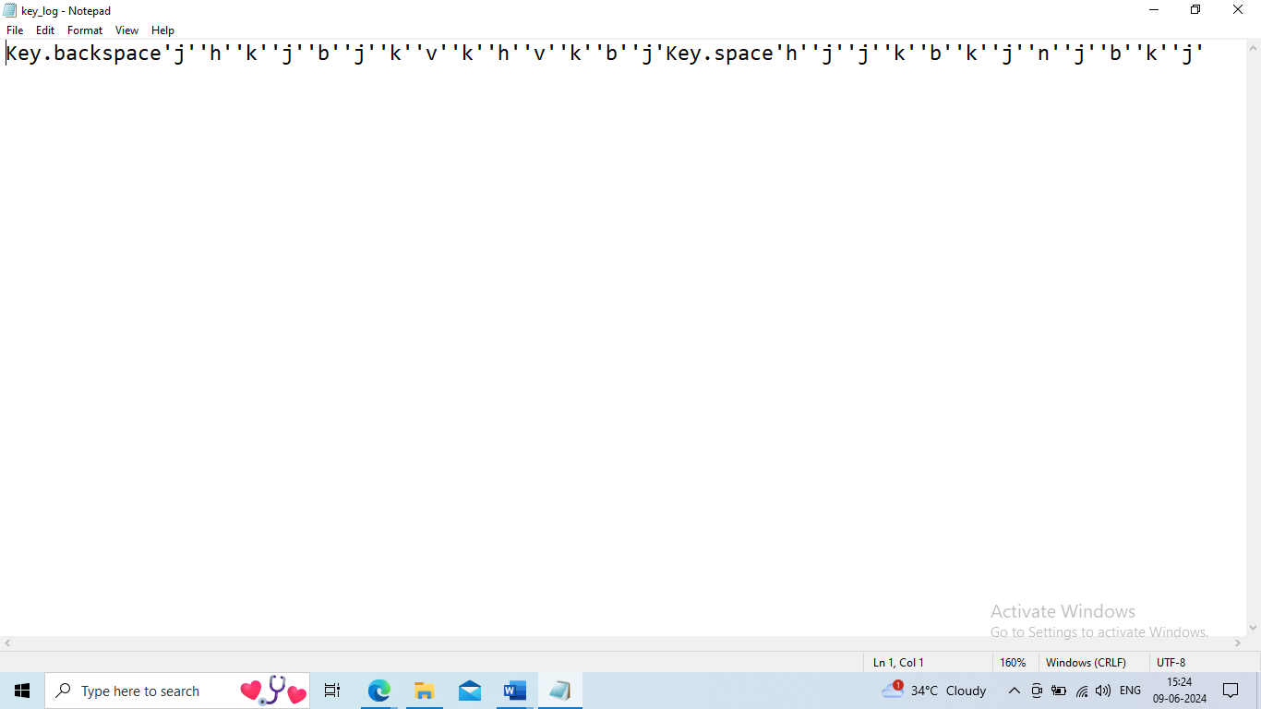

THE WOW IN YOUR SOLUTION
3/21/2024 Annual Review
9

Slide 10
MODELLING
Components of Keylogger Models
->Data Capture Mechanisms: How keystrokes are captured.
Polling: Regularly checking keyboard buffer.
Hooking: Intercepting keystrokes via system hooks.
->Data Storage and Transmission: Methods for storing and sending captured data.
Local Storage: Data saved on the device.
Remote Transmission: Data sent to a remote server.
->Evasion Techniques: Methods to avoid detection.
Rootkit Integration: Embedding within the OS.
Obfuscation: Hiding code to avoid detection by anti-malware.
3/21/2024 Annual Review
10

Slide 11
Modeling Techniques
Behavioral Modeling:
Action Sequences: Logging sequences of user actions to detect anomalies.
Heuristic Analysis: Using rules to identify suspicious behavior.
Statistical Modeling:
Anomaly Detection: Identifying deviations from normal behavior.
Machine Learning: Training models to detect keylogger patterns.
Signature-Based Modeling:
Pattern Recognition: Identifying known keylogger signatures.
Database Comparison: Checking against databases of known threats.

Slide 12
RESULTS
Detection Accuracy
High Accuracy: Up to 99% for known keyloggers.
Low False Positives/Negatives: Less than 5% and 3% respectively.
Performance Metrics
Efficiency: Minimal system impact (<5% CPU usage).
Scalability: Handles large datasets effectively.
Evasion Resistance
Obfuscation Detection: Over 85% success for rootkit-based keyloggers.
Adaptive Learning: Models continuously improve with updates.
Practical Implementations
Cybersecurity Tools: Enhanced detection in antivirus software.
Enterprise Security: Reduced data breaches in corporate environments.
.
3/21/2024 Annual Review
12

Slide 13
User Impact
Increased Awareness: Better user knowledge and adoption of security practices.
Enhanced Security Posture: Improved personal and organizational cybersecurity Case Studies
Successful Detections: Examples in financial institutions and government agencies.
Industry Impact: Protection of sensitive data in healthcare and finance.
Future Prospects
AI Improvements: Ongoing enhancements for better detection.
Collaboration: Increased threat intelligence sharing.

Slide 14
PROJECT LINK
https://github.com/DABBIRUHARSHAVARDHINI/KeyLogger

