Slide 1
Spring Framework
--Santosh Kumar Mondal
Notes:
<beans
xmlns="http://www.springframework.org/schema/beans"
xmlns:xsi="http://www.w3.org/2001/XMLSchema-instance"
xmlns:context="http://www.springframework.org/schema/context"
xmlns:tx="http://www.springframework.org/schema/tx"
xmlns:aop="http://www.springframework.org/schema/aop"
xsi:schemaLocation="http://www.springframework.org/schema/beans
http://www.springframework.org/schema/beans/spring-beans.xsd
http://www.springframework.org/schema/context
http://www.springframework.org/schema/context/spring-context.xsd
http://www.springframework.org/schema/tx
http://www.springframework.org/schema/tx/spring-tx.xsd
http://www.springframework.org/schema/aop
http://www.springframework.org/schema/aop/spring-aop.xsd">
</beans>

Slide 2
Spring Bean
A Java Object.
A Java Object created and managed by Spring Container.
<bean name=“bean1” class=“com.dac.Hello” />

Slide 3
Spring Bean Attribute - Basic
id
Unique bean identifier.
name
Bean identifier, can have multiple aliases separated by comma.
class
Fully qualified name of the java class.
Notes:
<bean name=“sampl1,sample2” class="com.dac.Sample" >
</bean>
<bean id=“sample1” class="com.dac.Sample" >
</bean>

Slide 4
Spring Bean Attribute - Continue
abstract
instance can’t be created.
parent
Bean inheritance.
primary
Default bean to autowire. Used in DI.
Notes:
<bean name=“sampl1” class="com.dac.Sample" abstract=“true”>
</bean>
<bean name=“sampl2” class="com.dac.Sample" parent=“sample1”>
</bean>
<bean name=“sampl2” class="com.dac.Sample" primary=“true”>
</bean>

Slide 5
Spring Bean Attribute - Continue
autowire
Inject dependency. Or collaborate multiple bean.
byName
Autowire by property name.
byType
Autowire by property data type
Contructor
Autowire applies to constructor argument.
Notes:
<bean name=“sampl2” class="com.dac.Sample" autowire=“byName”>
</bean>
<bean name=“sampl2” class="com.dac.Sample" autowire=“byType”>
</bean>

Slide 6
Spring Bean Attribute - Continue
lazy-init
Default value is false. If true, will create bean on first request.
init-method
This method will be called after bean instance is created by container.
destroy-method
This method will be called when bean instance is removed from the container.
Notes:
<bean name=“sampl2” class="com.dac.Sample" lazy-init=“true”>
</bean>
<bean name=“sampl2” class="com.dac.Sample" init-method=“init”>
</bean>
<bean name=“sampl2” class="com.dac.Sample" destroy-method=“destroy”>
</bean>

Slide 7
Spring Bean Attribute Continue
scope
Application Context Aware
singleton
prototype
Web Context Aware
request
session
global-session
Notes:
<bean name=“sampl2” class="com.dac.Sample" scope=“singleton”>
</bean>
<bean name=“sampl2” class="com.dac.Sample" scope=“prototype”>
</bean>

Slide 8
Spring Bean Property Element
property
Inject value into bean property
Attributes
name
name of the bean property
Value
Primitive value of the bean property
ref
Reference value of the bean property.
Notes:
<bean name=“sampl2” class="com.dac.Sample" >
<property name=“rollno” value=“100” />
</bean>

Slide 9
Spring Bean Constructor Element
constructor-arg
Inject value into bean during construction.
Attributes
name
value
ref
type
index
Notes:
<bean name=“sampl2” class="com.dac.Sample" >
<property name=“rollno” value=“100” />
</bean>

Slide 10
Injecting Collections
List
Set
Map
Properties
Notes:
<bean name=“sampl2” class="com.dac.Sample" >
<property name="list">
<list>
<value>India</value>
<value>Pakistan</value>
</list>
</property>
<property name="set">
<set>
<value>India</value>
<value>Pakistan</value>
</set>
</property>
<property name="map">
<map>
<entry key="india" value="Hello india"></entry>
</map>
</property>
<property name="props">
<props>
<prop key="india">Hello prop india</prop>
</props>
</property>
</bean>

Slide 11
Dependency Injection
Injecting bean of reference type.
Injecting bean - autowire byName
Injecting bean - autowire byType
Injecting bean - @autowire Annotation
Notes:
<context:annotation-config></context:annotation-config>

Slide 12
Annotating & Auto-Discovery Bean
@Component
A general purpose annotation indicating class is a Spring Component.
@Controller
Indicate defined class as Spring MVC Controller.
@Repository
Indicate defined class as Spring data repository.
@Service
Indicate defined class as Service. Used in Restful Web Service.
Notes:
<context:component-scan base-package="com.dac"></context:component-scan>

Slide 13
Aspect Oriented Programming
AOP helps to modularize Cross Cutting Concern.
Cross Cutting Concern are common functionality that affects the multiple point of an application.
Security
Logging
Validation

Slide 14
AOP Terminology
ASPECT
The key unit of AOP.
A java class with cross cutting concern or common functionality.
Application can have multiple number of aspects

Slide 15
AOP Terminology
ADVICE
An actual action to be taken, before or after method execution.
Job of an aspect is Advice.
Types of Advice
Before
Functionality takes place before method is invoked.
After
Functionality takes place after method is invoked
Around
Functionality takes place before and after method is invoked.

Slide 16
AOP Terminology
Join Point
A point in the execution of an application, where Aspect will be plugged.
In simple, where to apply the aspect.
Pointcut
A set of one or more Joint Point.

Slide 17
Selecting JoinPoint
execution()
Matches join point that are method execution.
within()
Limits matching to join point with certain type.
args()
Limits joint point to the execution of method, whose argument are instance of given type

Slide 18
Writing JoinPoint
execution( * com.dac.Student.program(..))
execution( * com.dac.Student.program(String, ..) and args(name, ..))

Slide 19
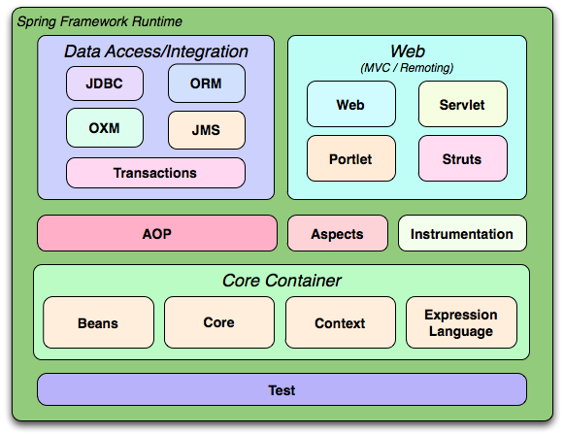
Spring Framework Overview

Slide 20
Thank You

