Slide 1
The Model SetUp
Open file:
1_setups.nlogox

Slide 2
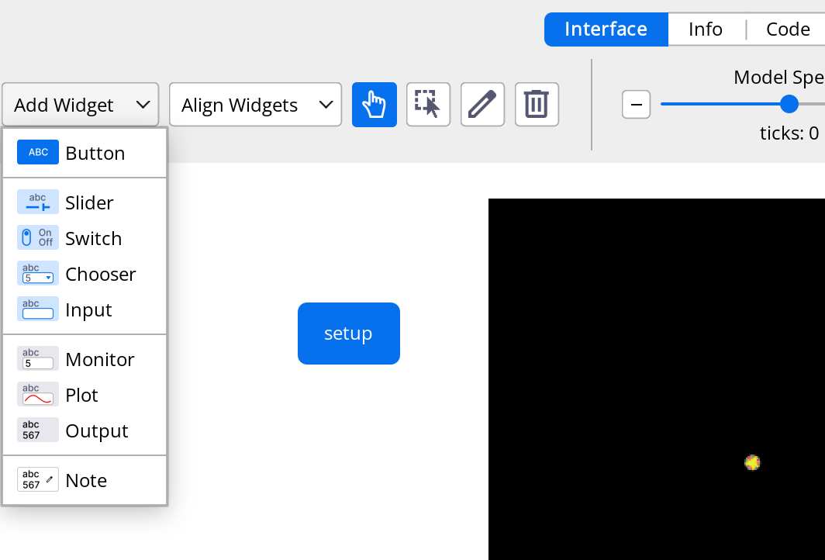
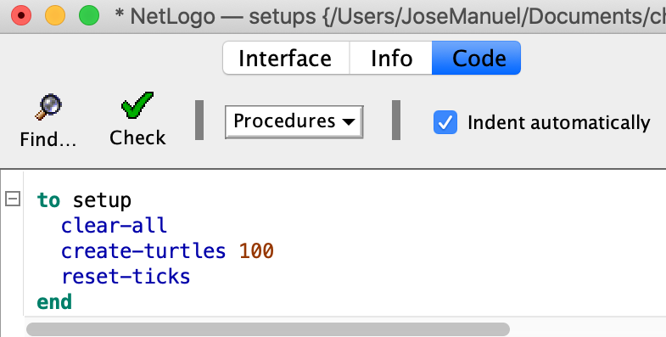
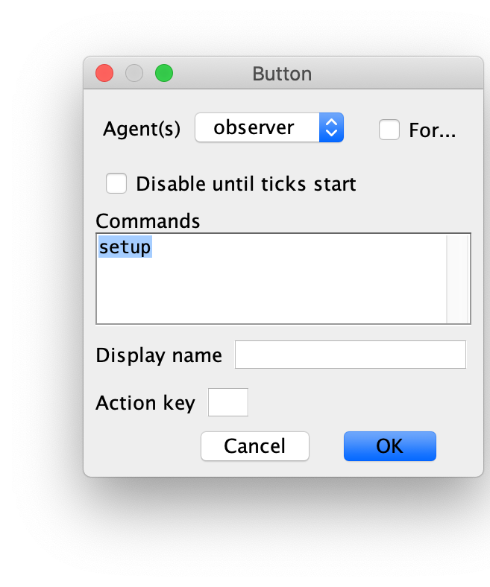
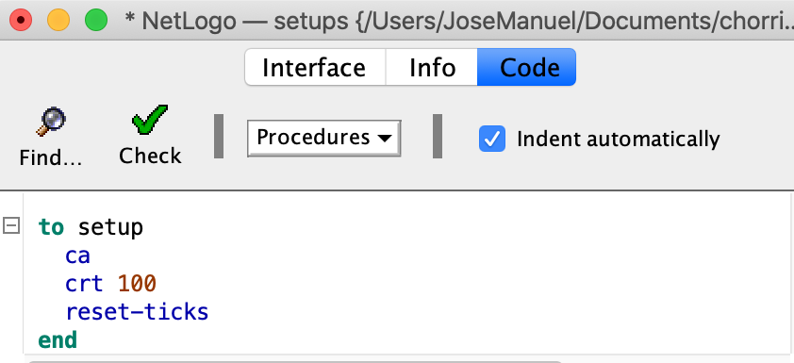
Creating simple agents
o
100 agents

Slide 3
Creating simple agents
This block (setup–end) clears the memory (clear-all), creates 100 agents (create-turtles), and starts fresh (reset-ticks).
o
100 agents
Alternative commands (from above)

Slide 4
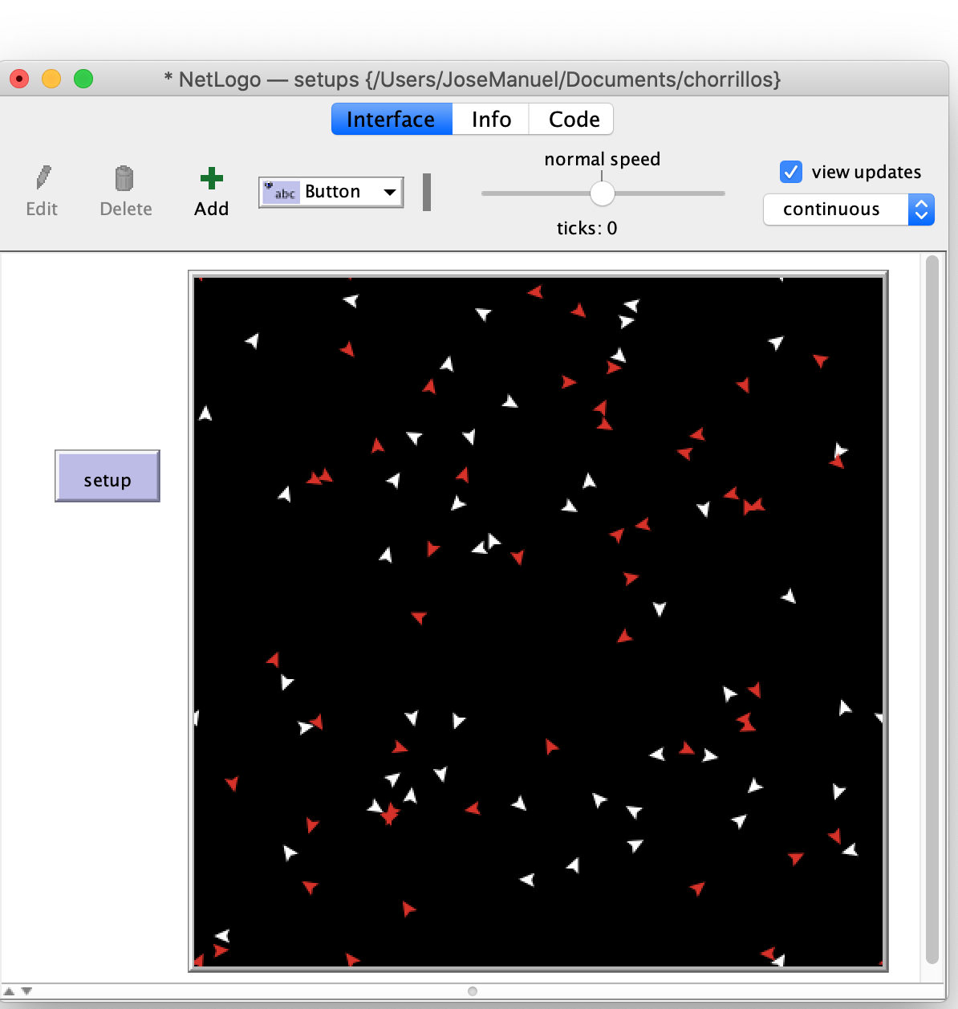
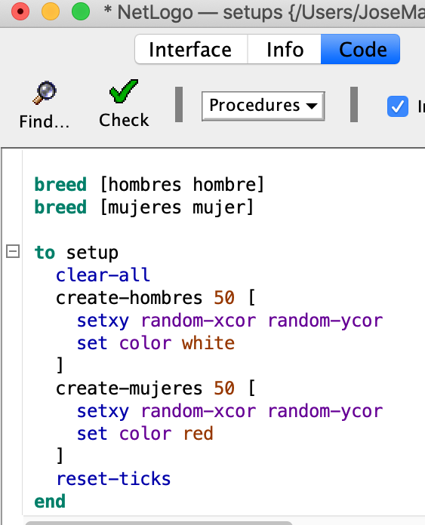
Creating and locating simple agents
o
100 agents located randomly on
the grid

Slide 5
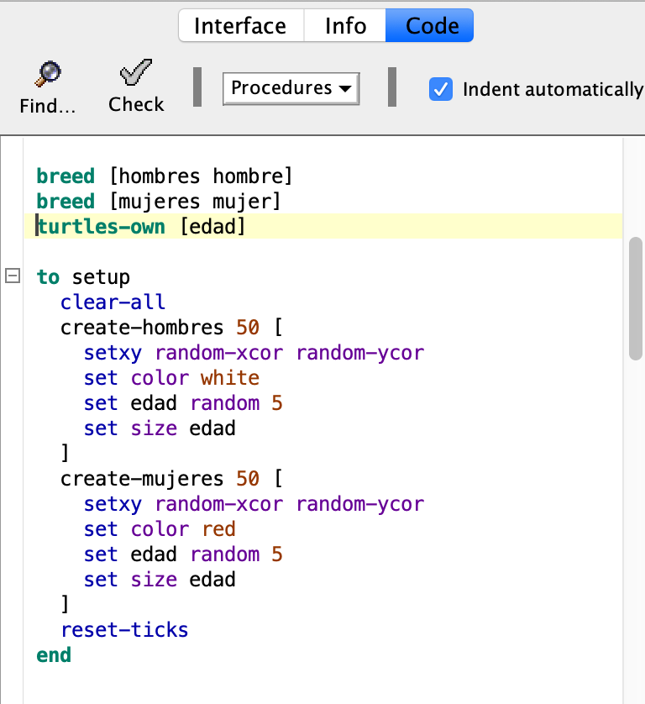
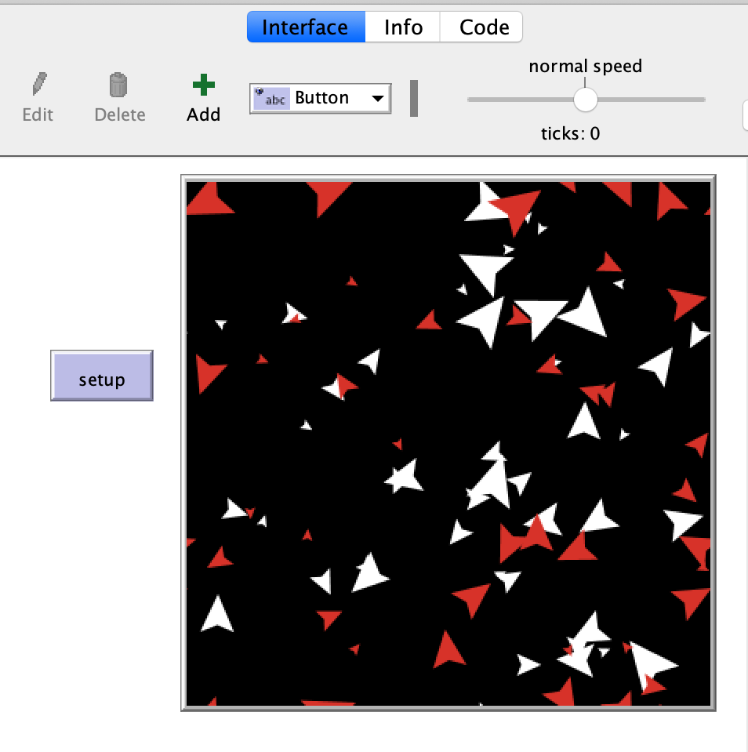
Creating agents with attributes
o
100 agents located randomly on
the grid.
Size and color based on attributes

Slide 6
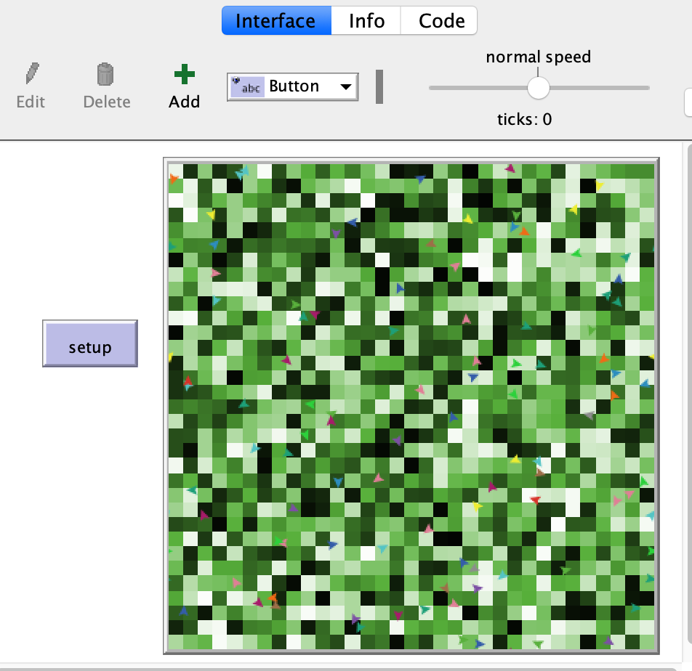
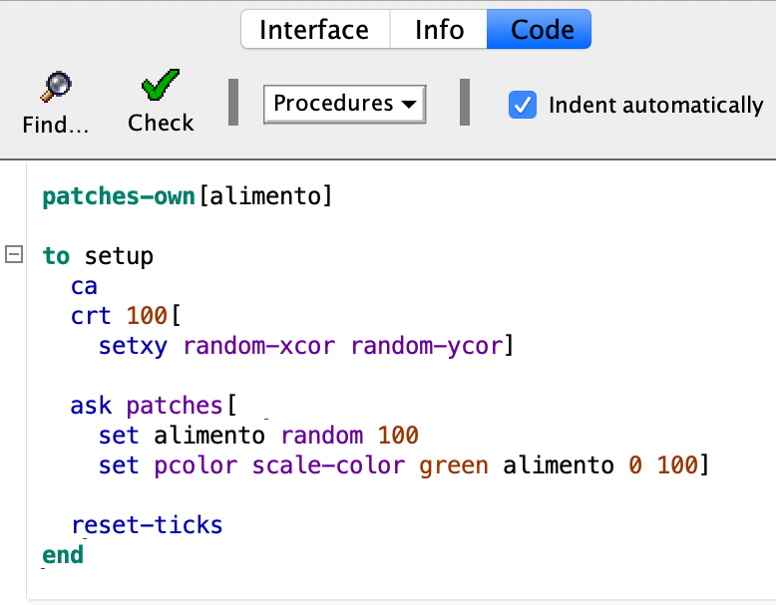
Creating the world of the agents
o
Coloring each “patch” based on a patch variable

