Slide 1
The Agents in a World
Use code:
2_agentsInWorld.nlogox

Slide 2
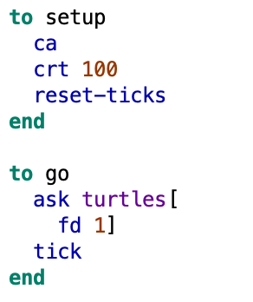
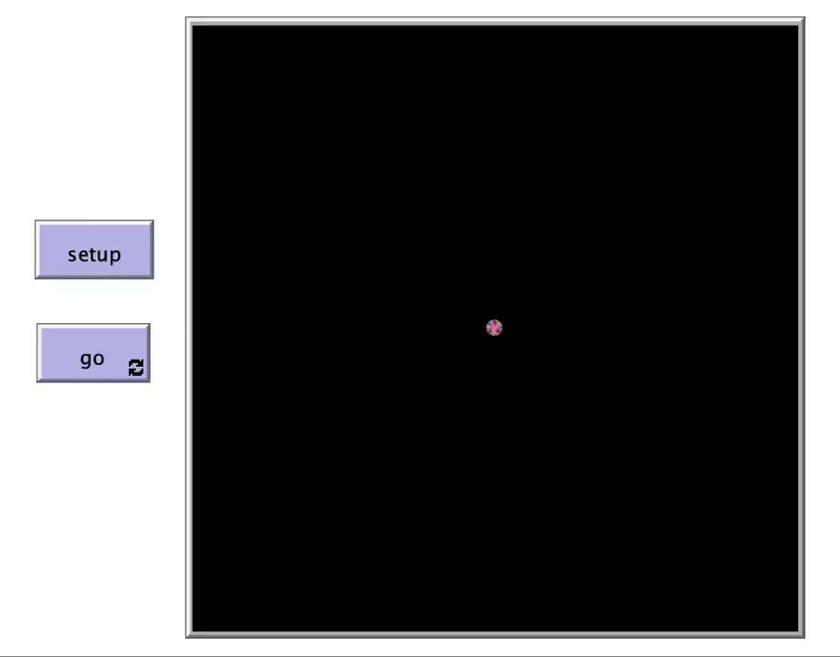
Moving
Button
for action
Action happens within the GO block

Slide 3
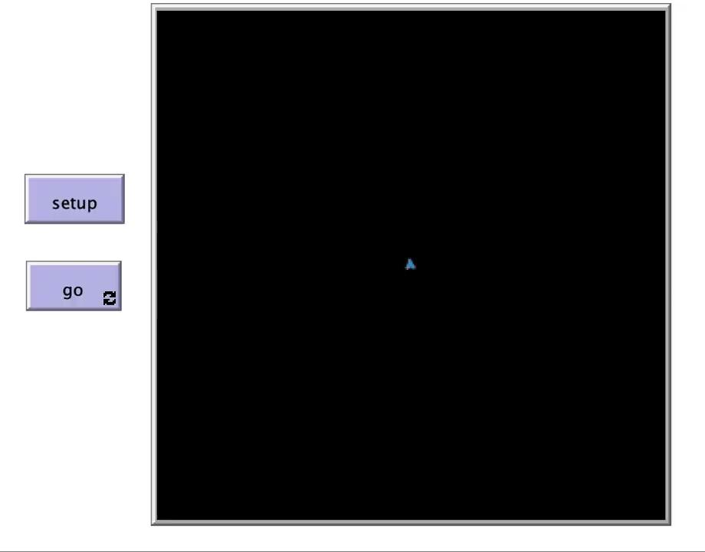
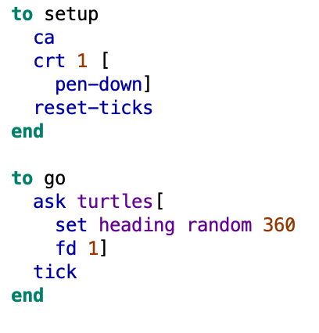
Trajectories: random walk
Agent walks following some random angle at each step.

Slide 4
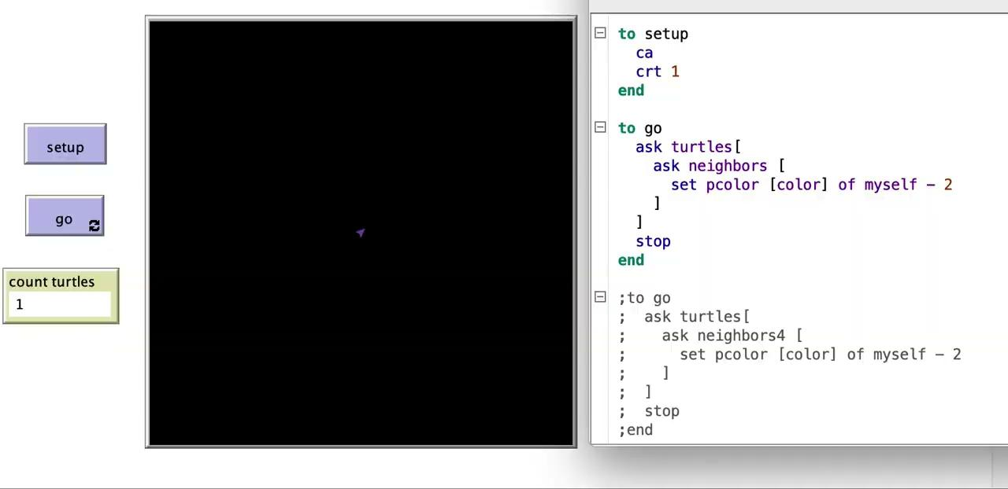
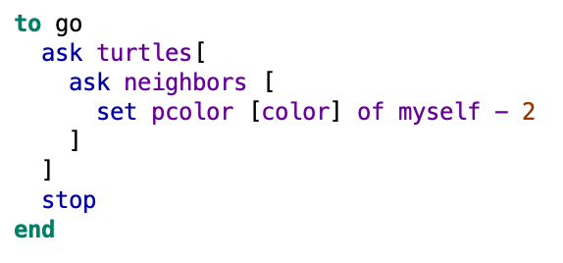
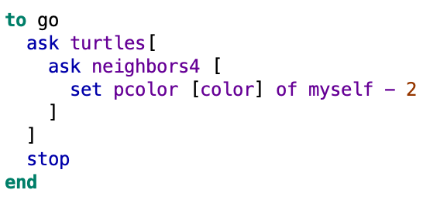
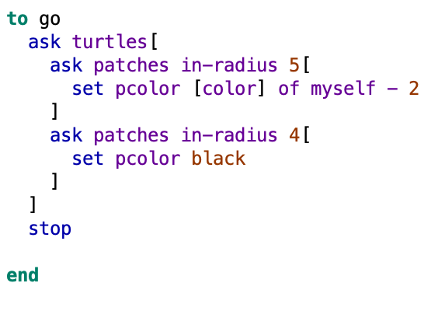
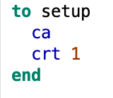
Neighbor Patches
I
II
III

Slide 5
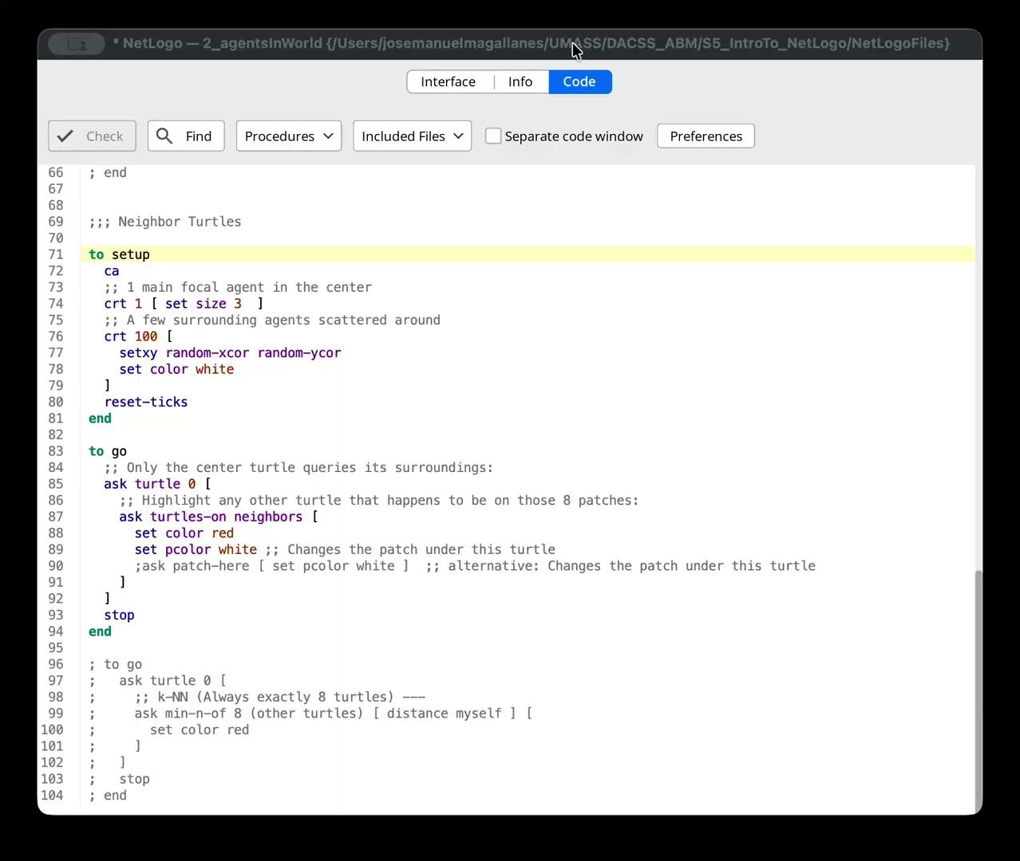
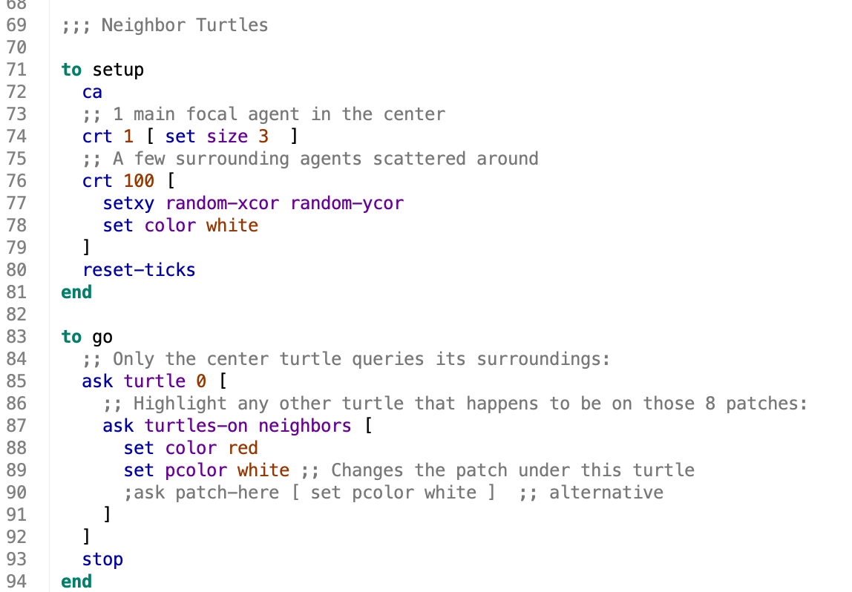

Neighbor Turtles
Make changes to the turtles standing on the neighbor patches
(possibly none)
Make changes to K closest neighbors

