Slide 1
Subroutines
Use code: subroutines.nlogox

Slide 2
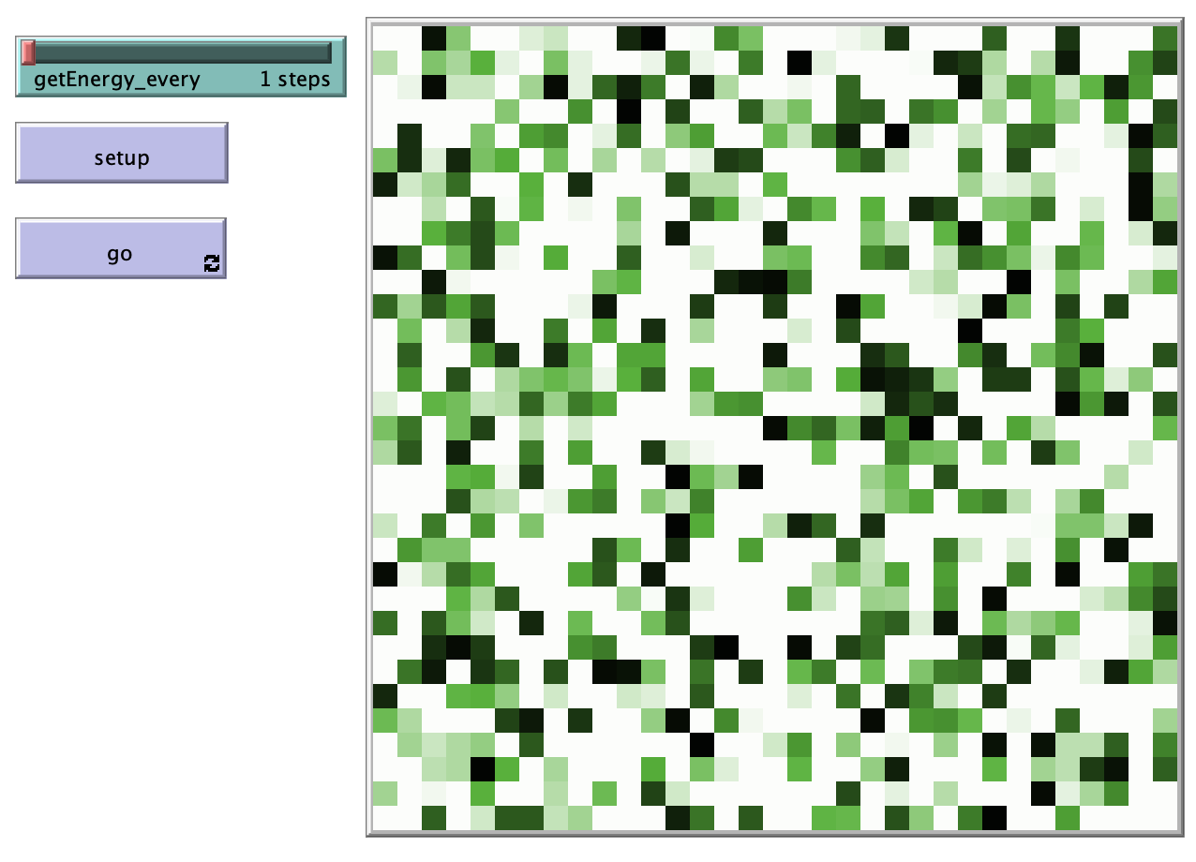
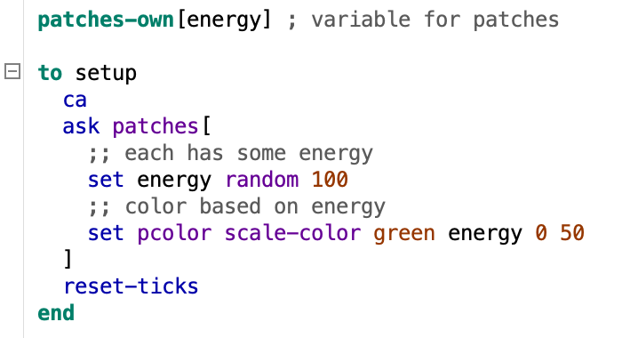
Set Up

Slide 3
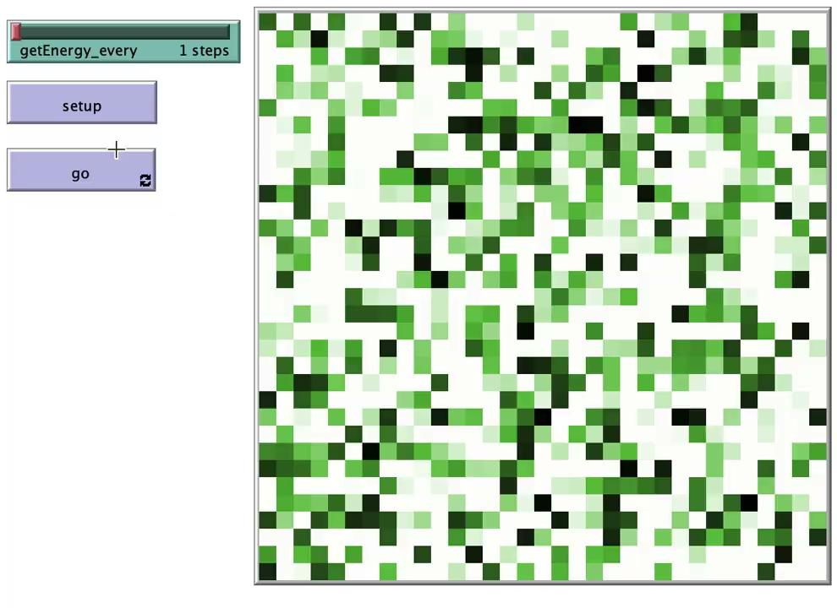
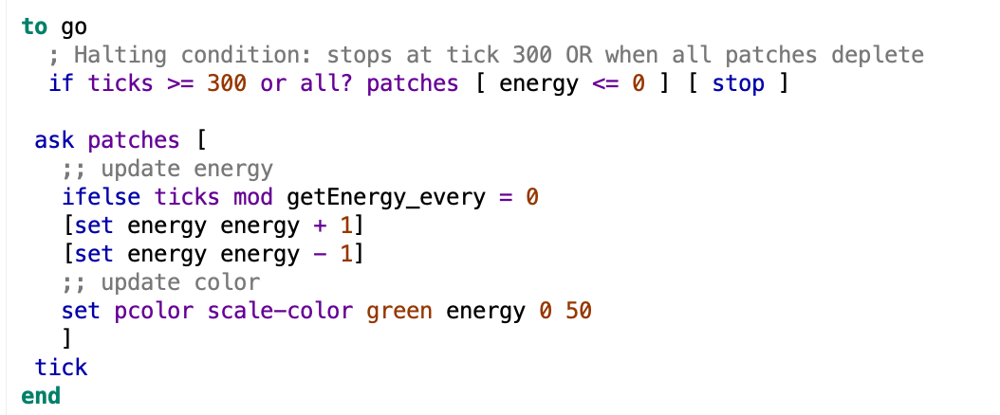
No SubRoutines here….

Slide 4
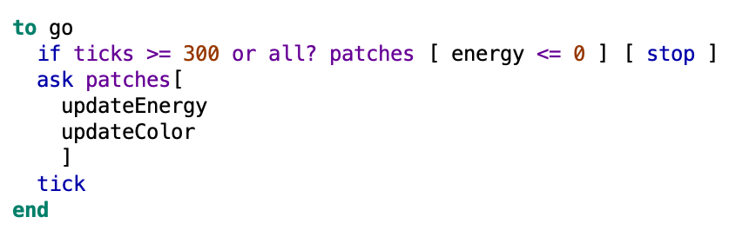
NOW!...with SubRoutines

Slide 5
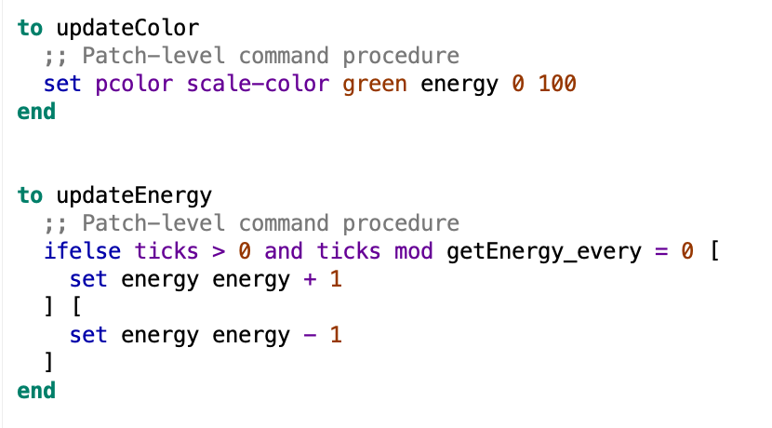
NOW!...with SubRoutines

Slide 6
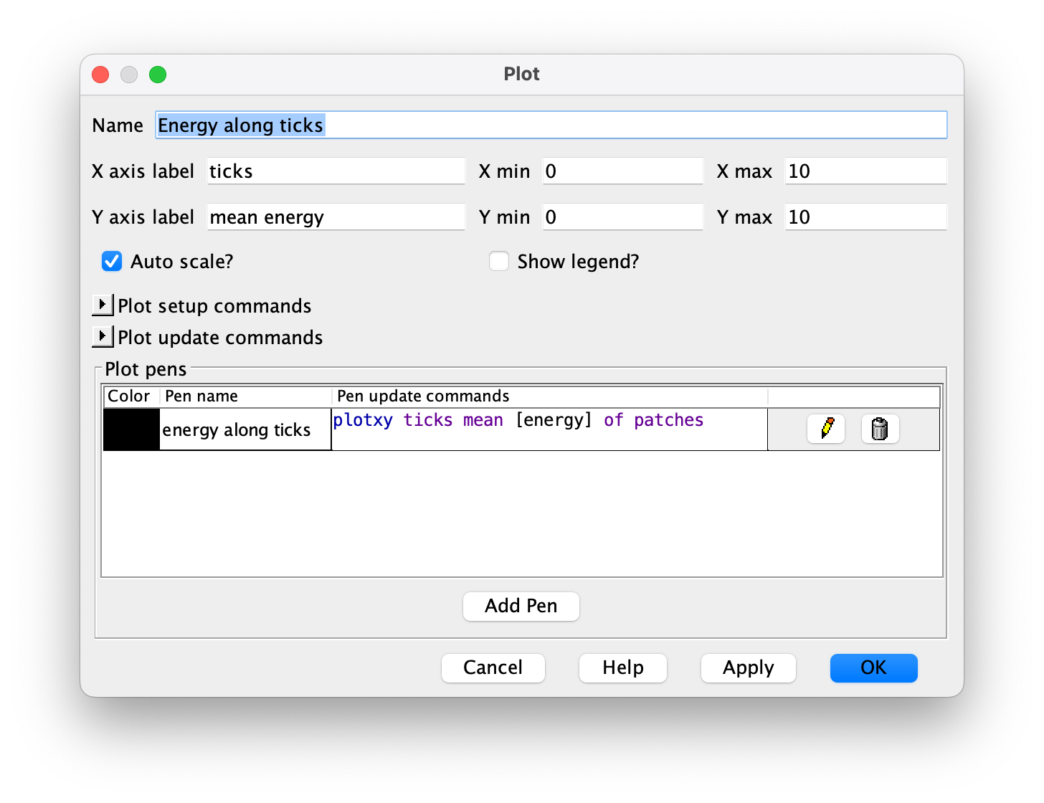
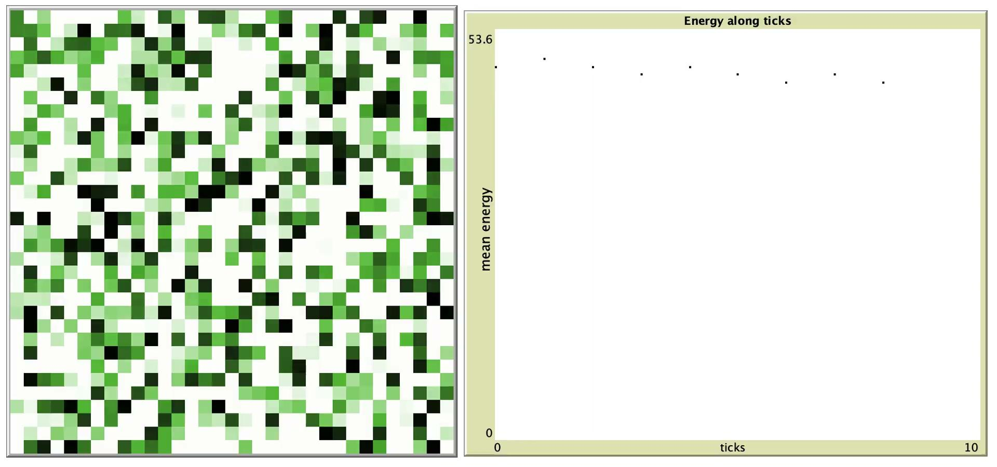
Using “Reporters”
NO REPORTER

Slide 7

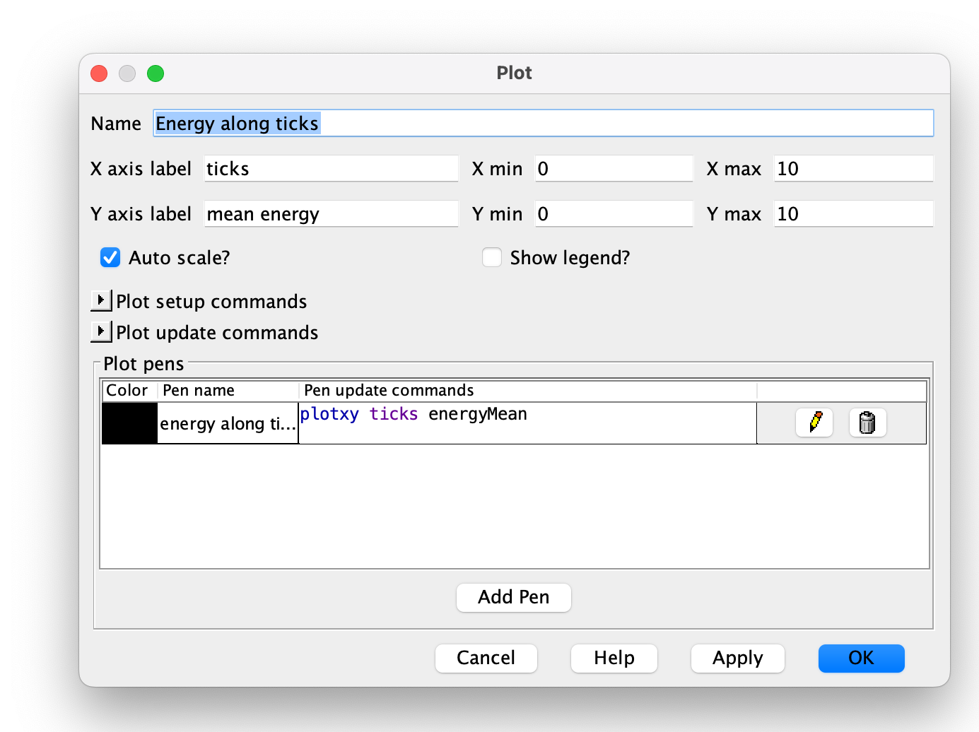
Using “Reporters”
NO REPORTER
with REPORTER

