Slide 1
Scenarios
Use code: Wolf_Sheep_Predation_simpler.nlogox

Slide 2
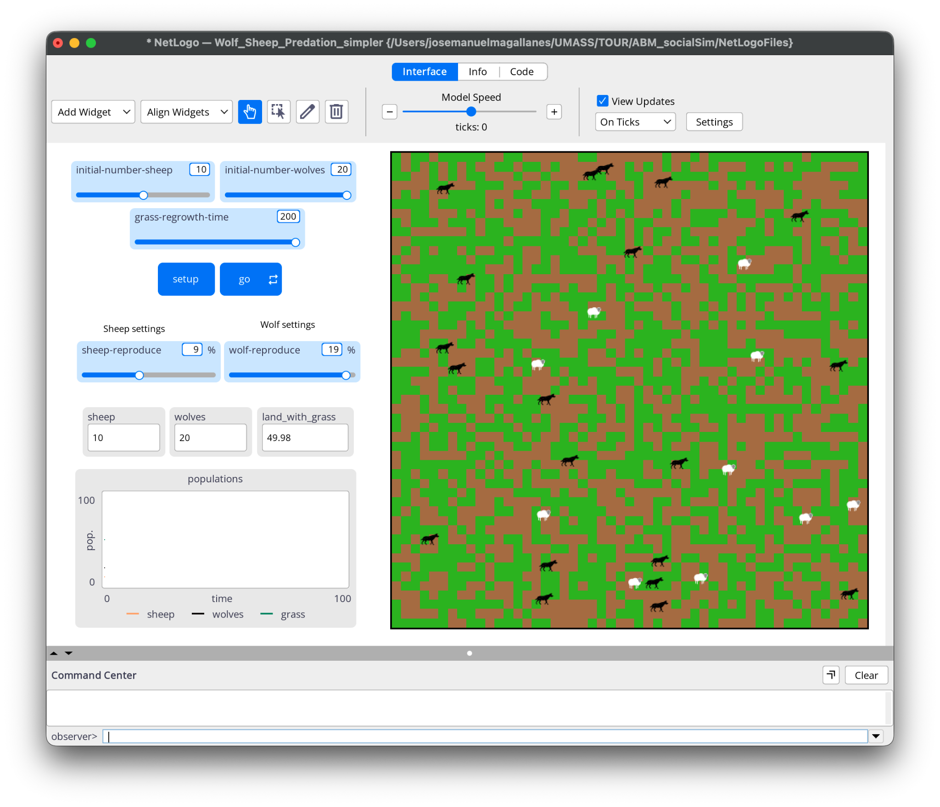
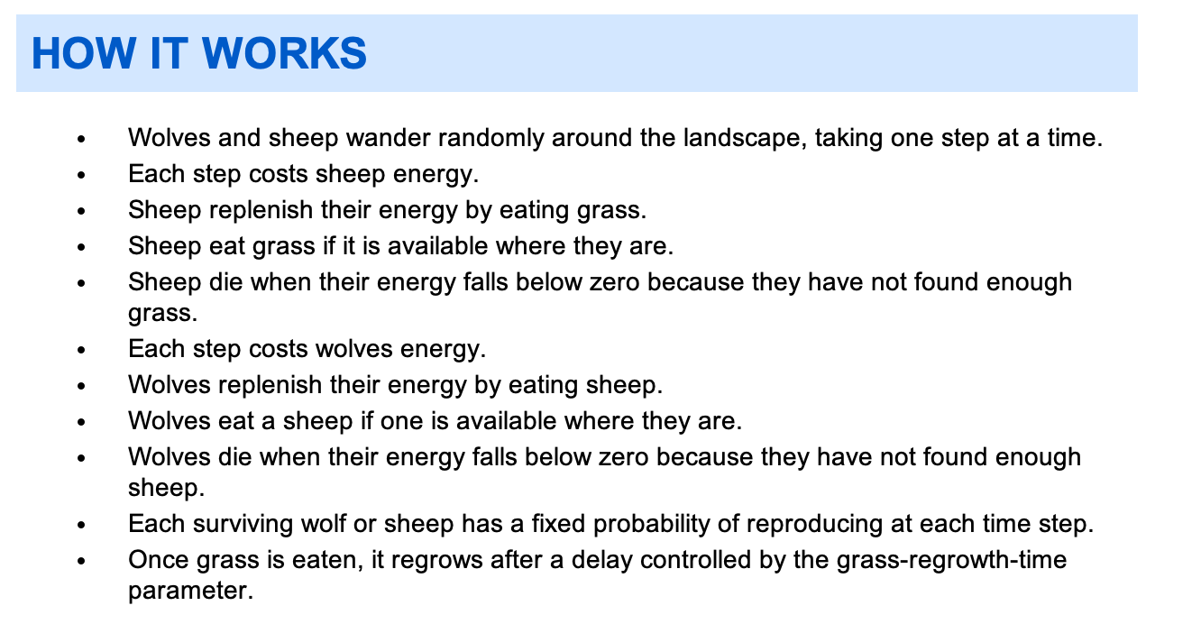
The case: Wolf and Sheep

Slide 3
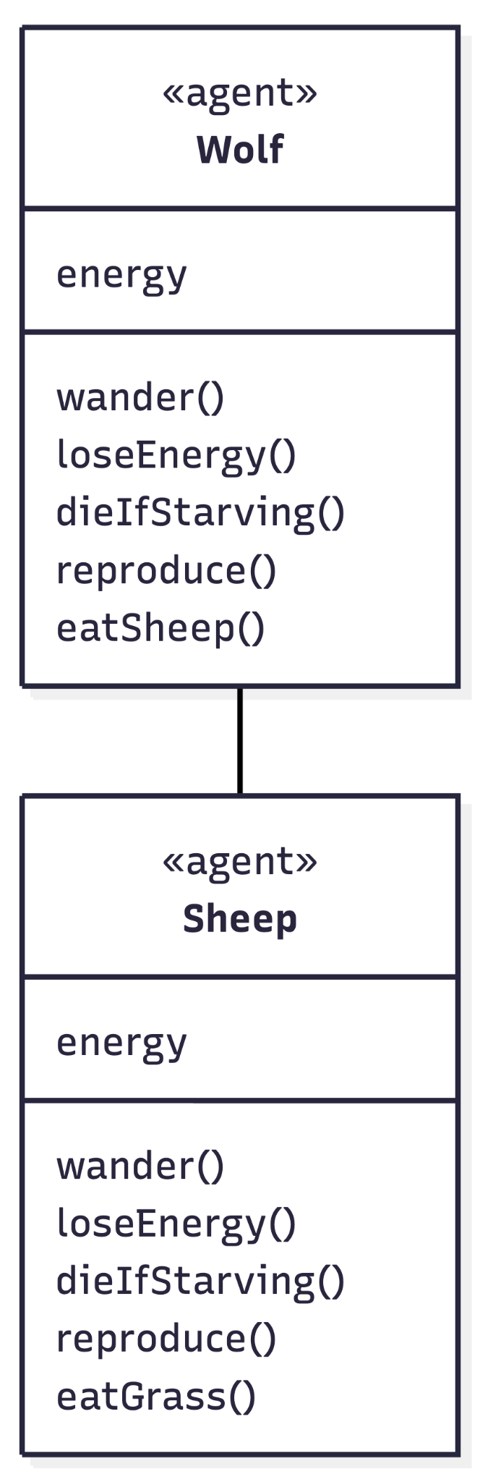
The case: Wolf and Sheep

Slide 4
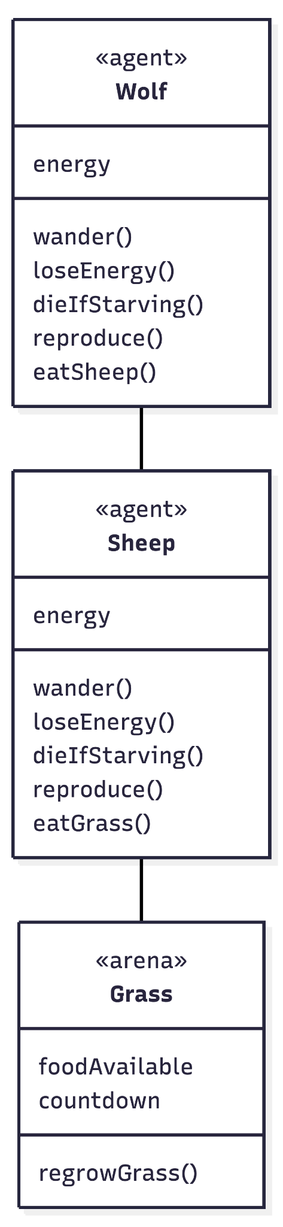
The case: Wolf and Sheep

Slide 5
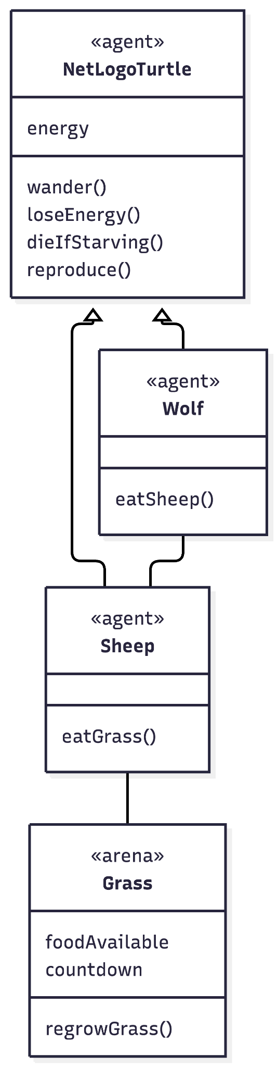
The case: Wolf and Sheep

Slide 6
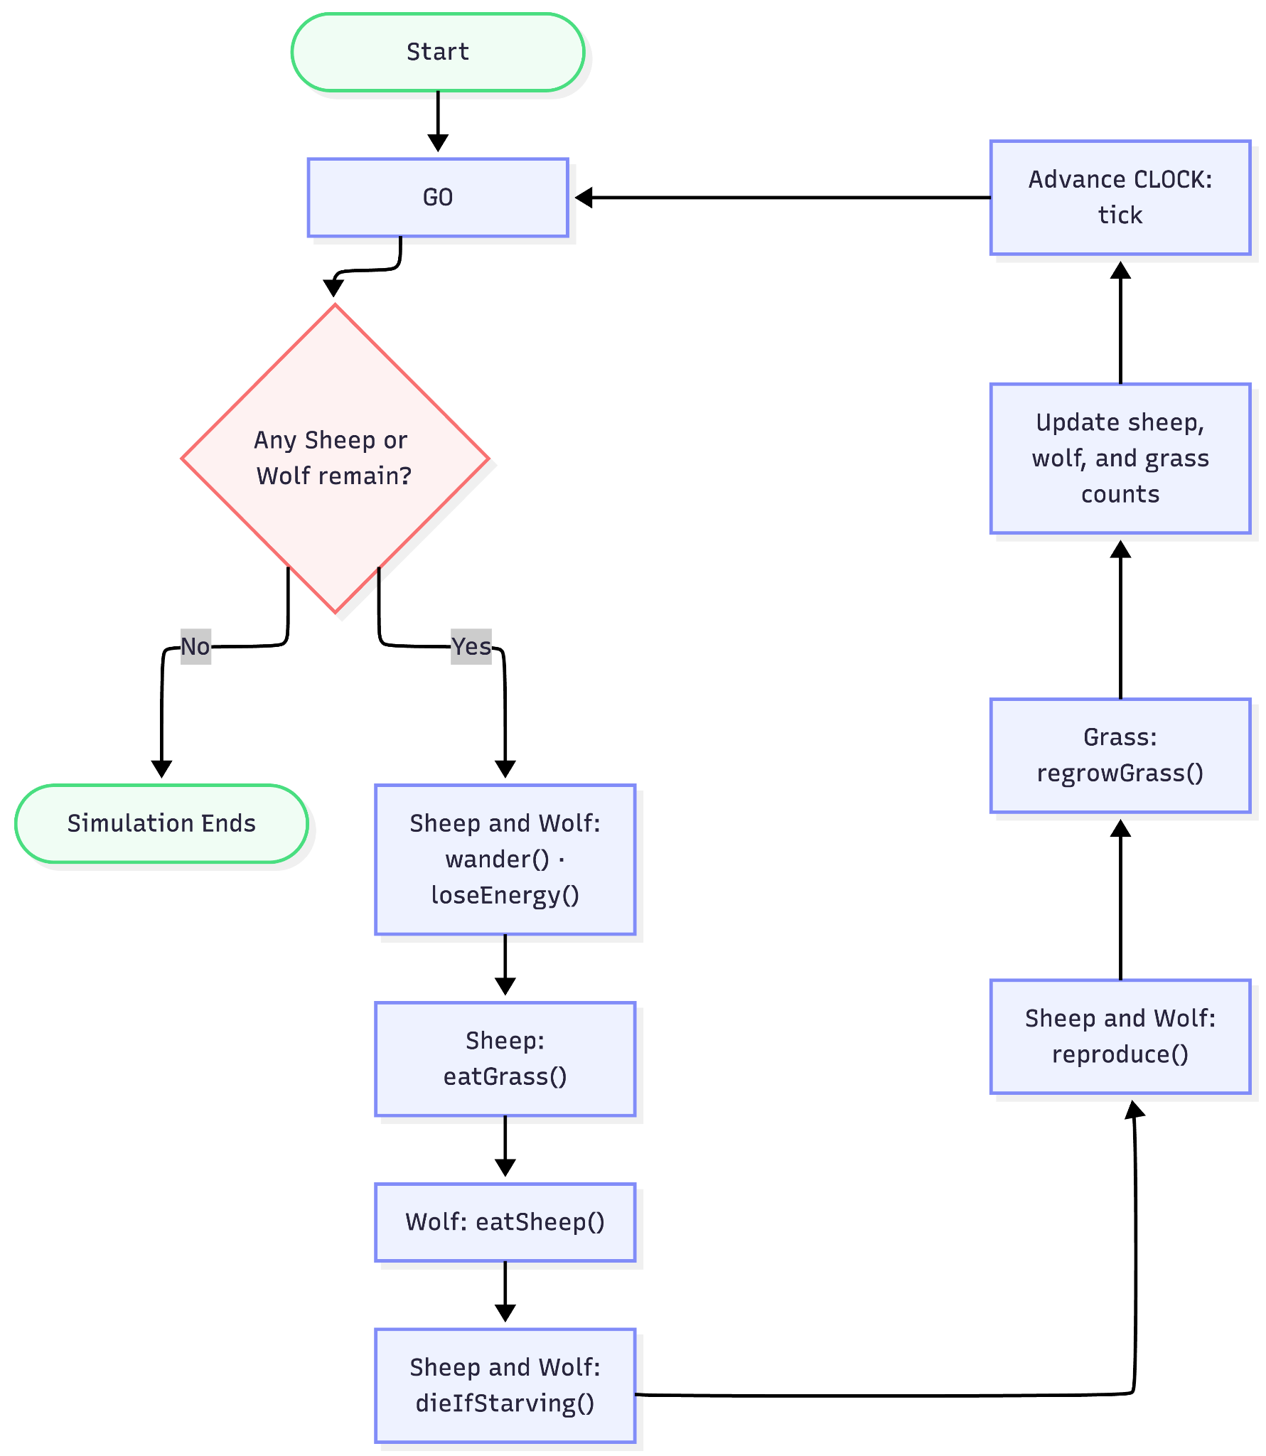
The case: Wolf and Sheep

Slide 7
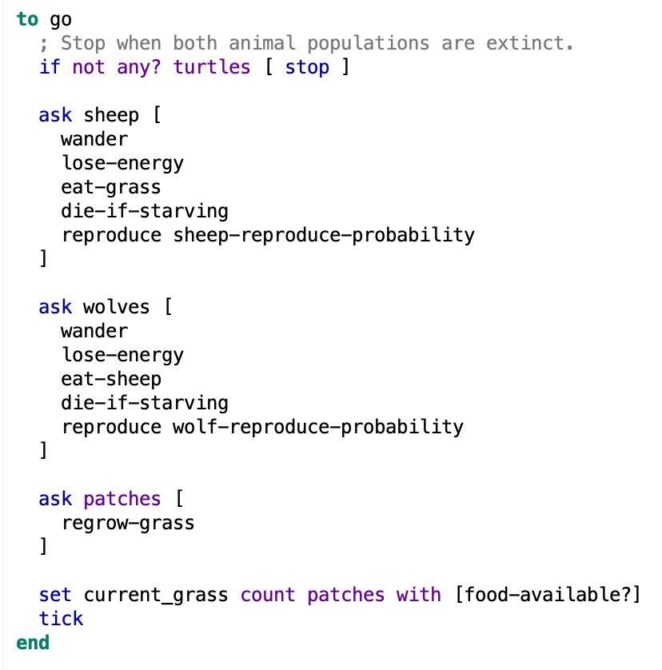
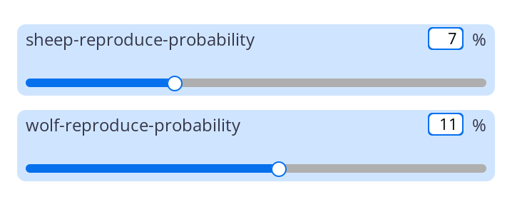
The case: Wolf and Sheep

Slide 8
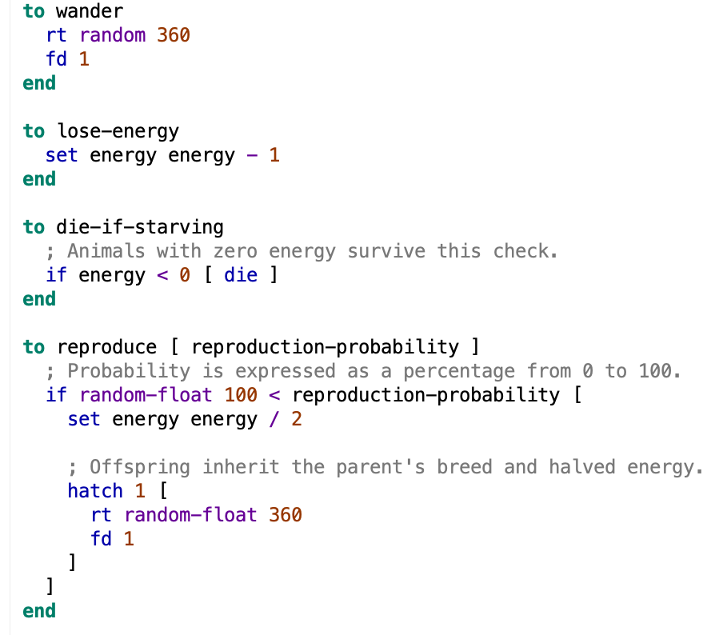
The case: Wolf and Sheep
Common procedures

Slide 9
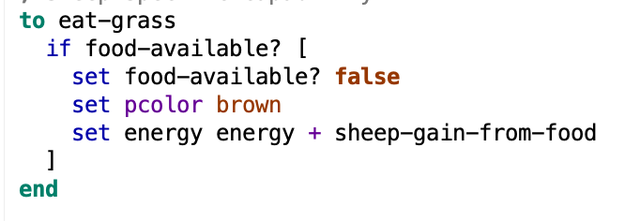
The case: Wolf and Sheep
SHEEP procedures

Slide 10
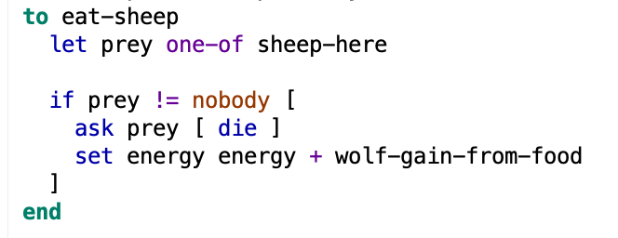
The case: Wolf and Sheep
WOLVES procedures

Slide 11
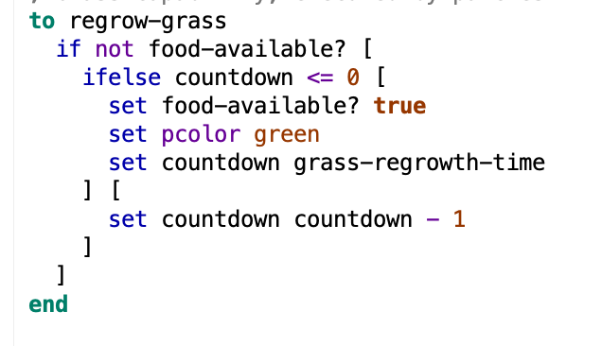
The case: Wolf and Sheep
PATCHES procedures

Slide 12
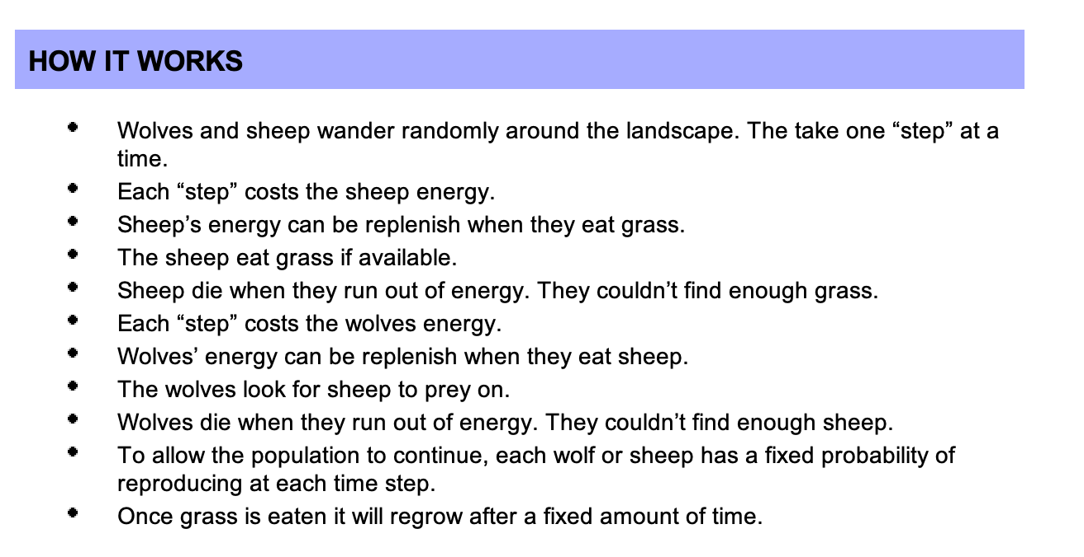
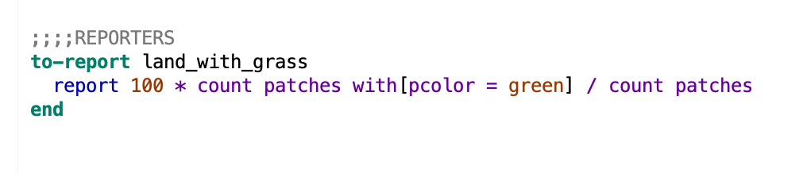
The case: Wolf and Sheep
using REPORTERS
You will get a VALUE when you call a “reporter”

Slide 13
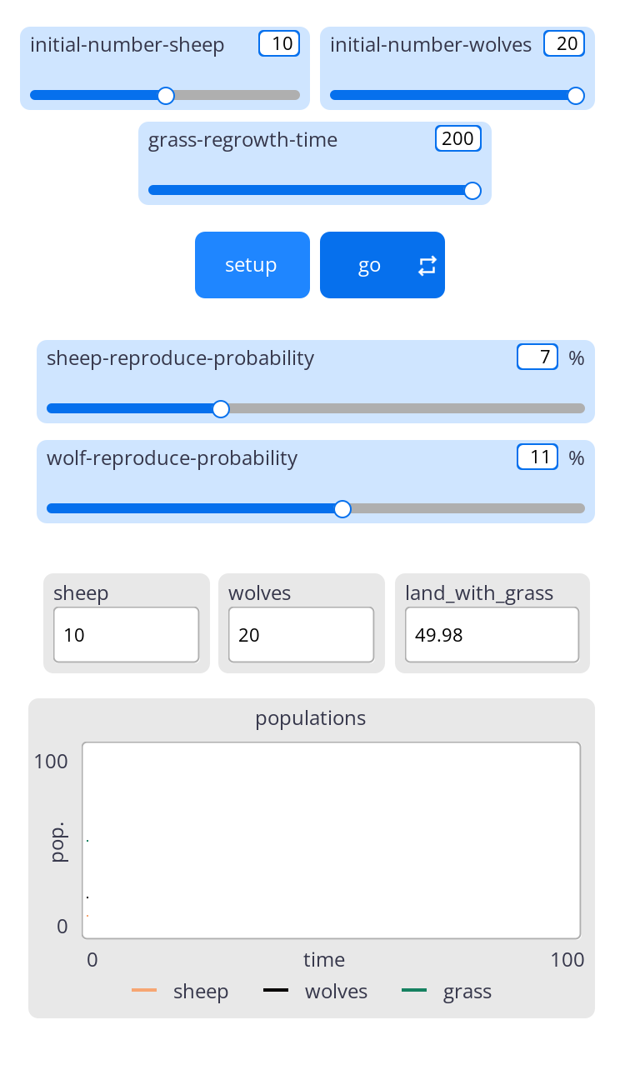
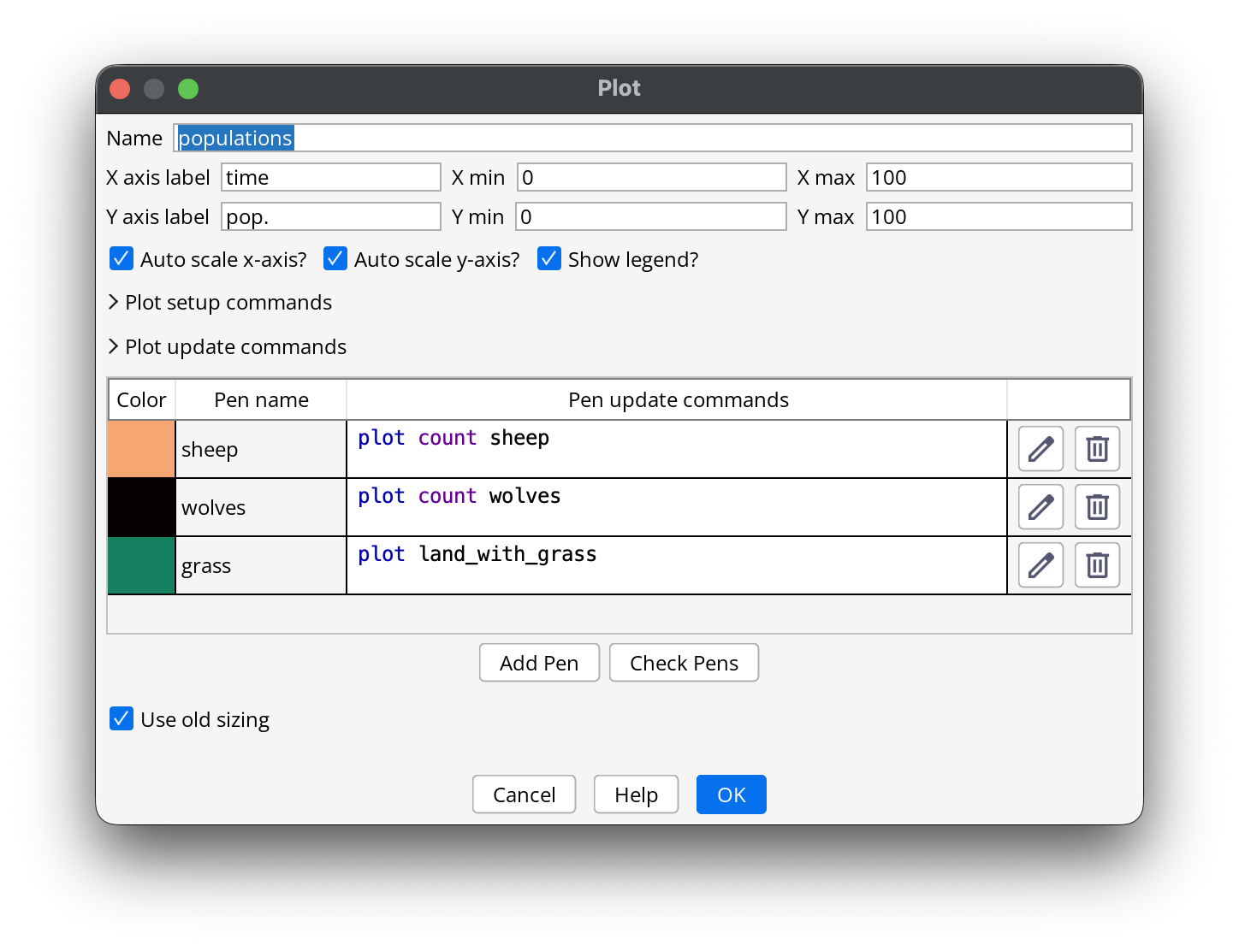
You will get a VALUE when you call a “reporter”

Slide 14
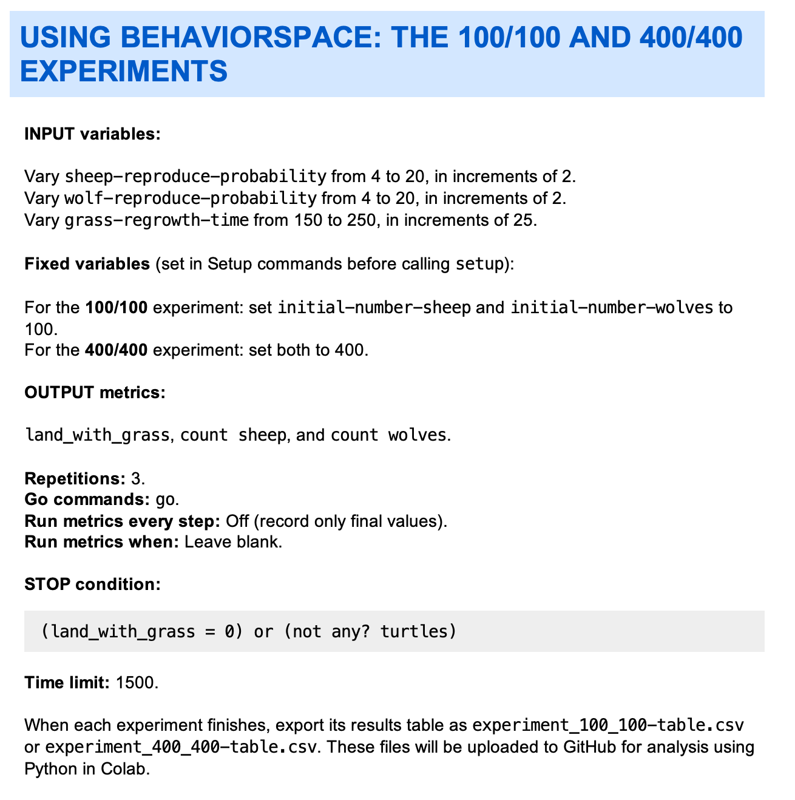
Scenario Analysis
IMPORTANT FOR THE HOMEWORK

Slide 15
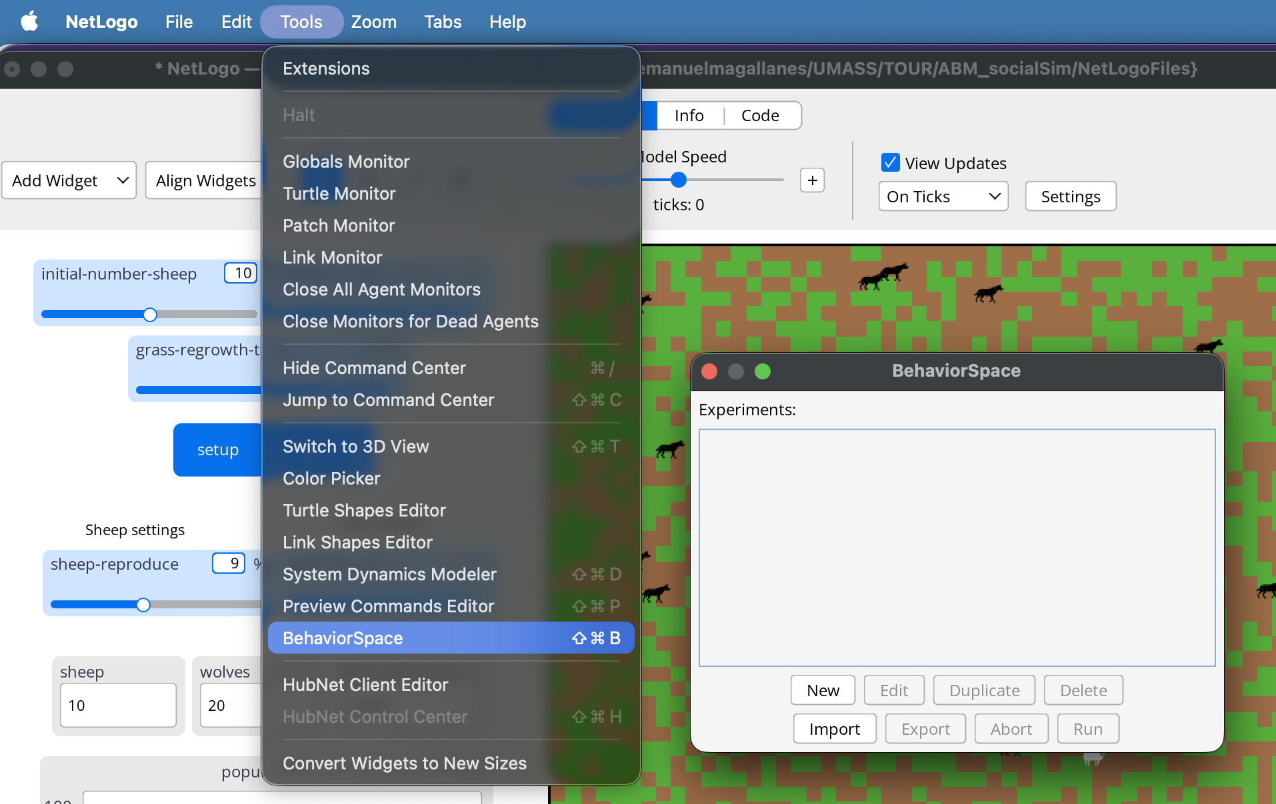
Scenario Analysis
Using:
Behavior
Space

Slide 16
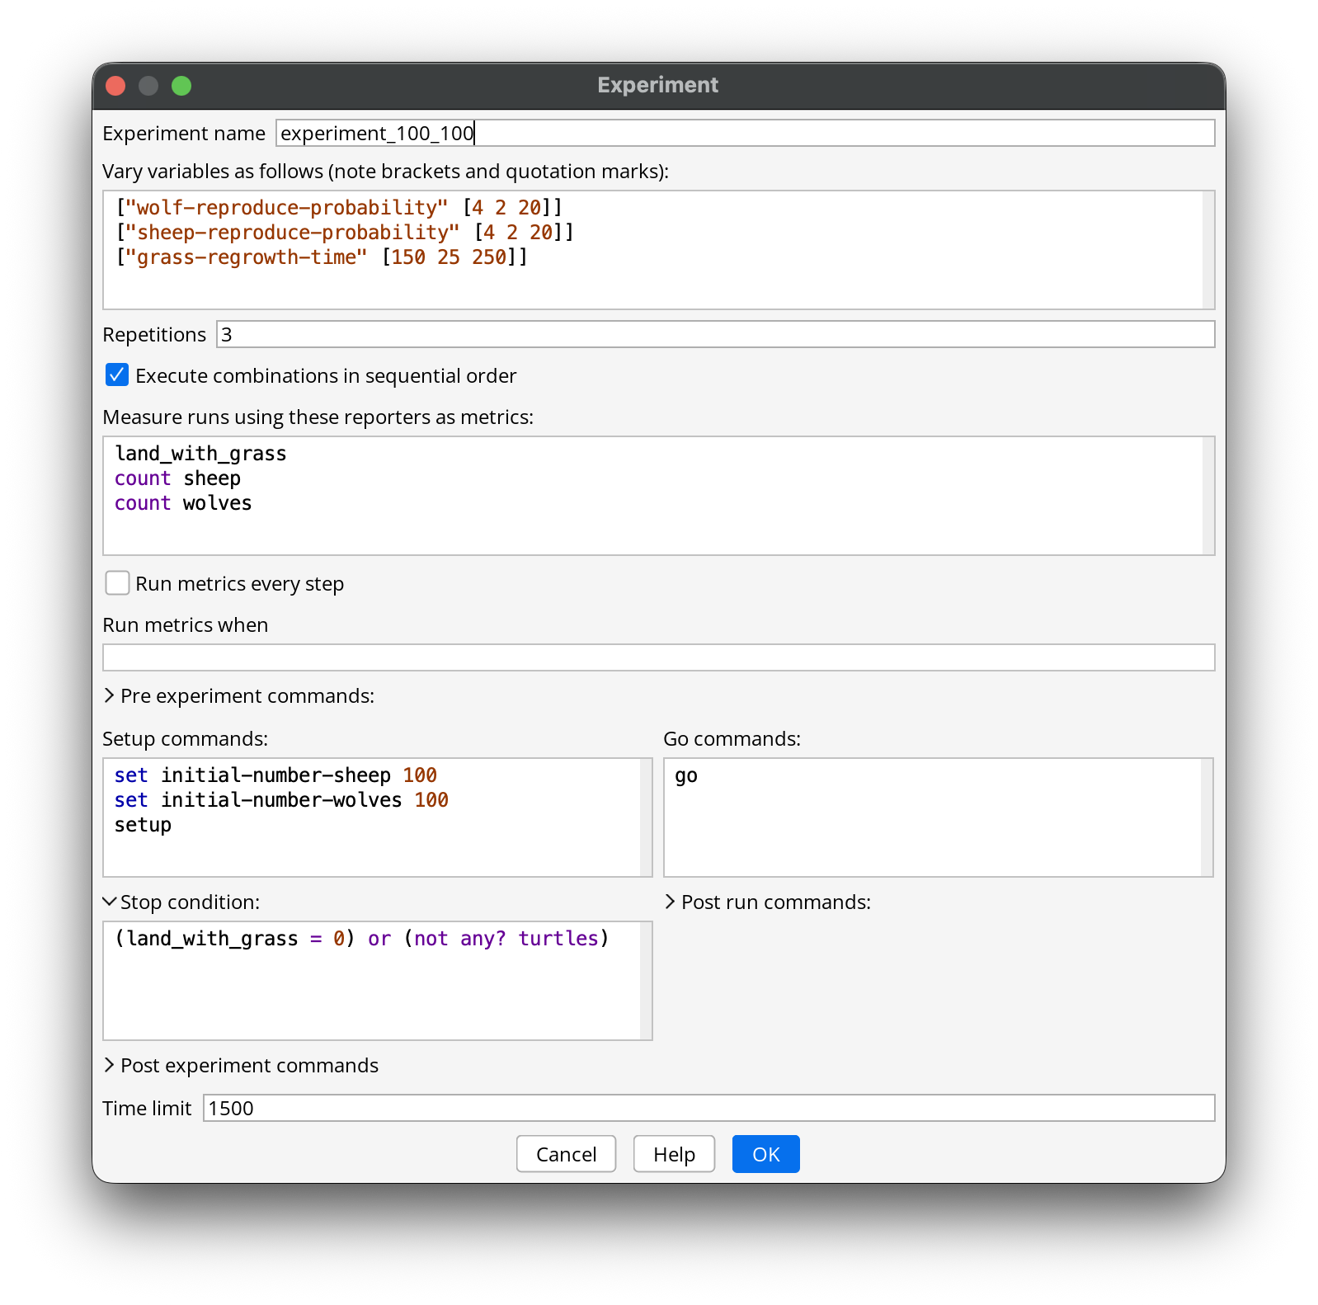
Scenario Analysis
Using:
Behavior
Space

Slide 17

Scenario Analysis
Using:
Behavior
Space

Slide 18
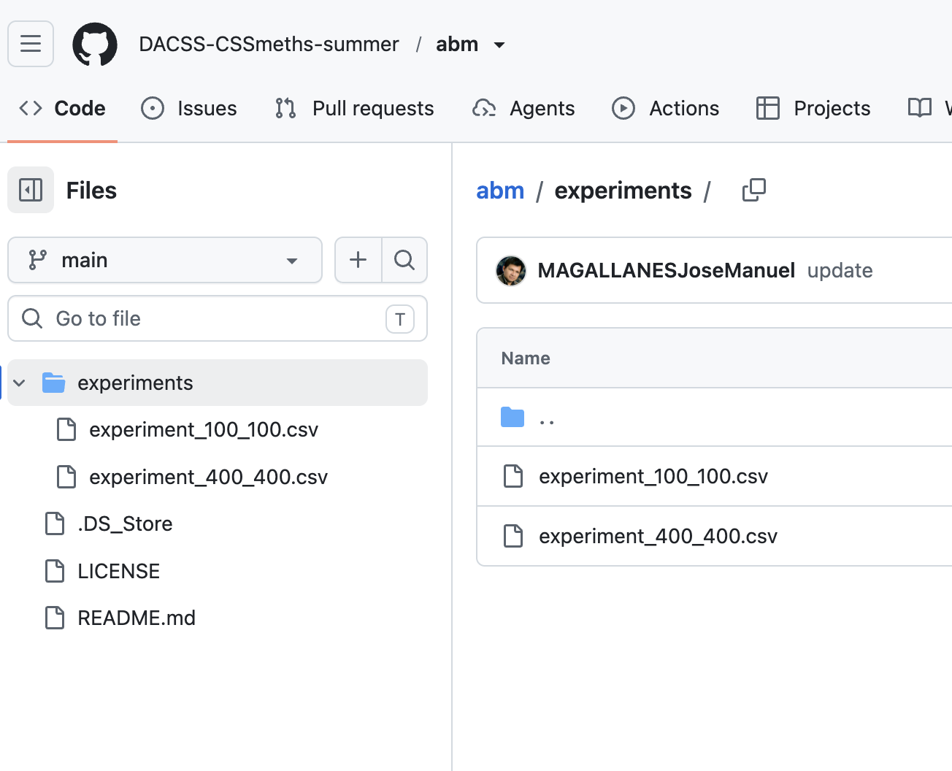
Scenario Analysis
Using:
Behavior
Space

Slide 19
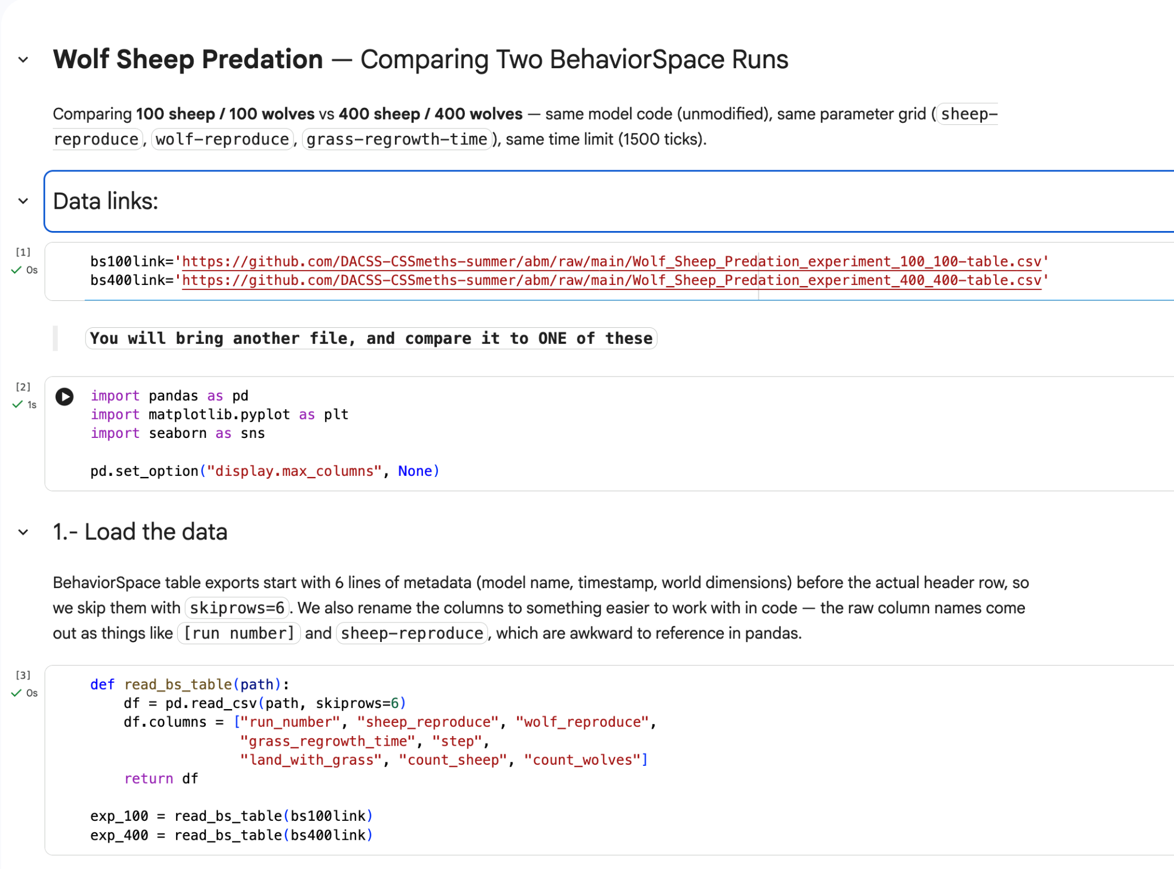
Scenario Analysis
Results from the Behavior Space experiments will need to be analyzed OUTSIDE NetLogo
VISIT THE COLAB NOTEBOOK LINK PROVIDED

