Slide 1
Methods

Slide 2
Flow diagram for genomic analysis
Suspect pneumococcal carriage
(n = 396)
WGS failure
(RNA contamination, etc)
(n = ?)*
*I will trust data from workLab team
Successful WGS data obtained
(n = 346)
Intra-species contamination
(n = 32)
Pass QC WGS data
(n = 314)

Slide 3
Epidemiological data & pneumococcal carriage
900 children were evenly assessed from Lombok and Sumbawa (n = 450)
396 children (44%) had pneumococcal carriage that were:
slightly higher among females (45.12% (208/461) compared to males (42.82% (188/439)
Slightly higher in Sumbawa (n = 204, 45.33%) compared to Lombok (n = 192, 42.67%)
Epidemiological analysis
Multivariable logistic regression model, refined using a stepwise backward elimination process to identify key variables.
Variables with a significance level greater than 0.05 were removed from the model. All statistical analyses and data visualizations were performed using R version 4.4.3.
P values < 0.05 were considered statistically significant.

Slide 4
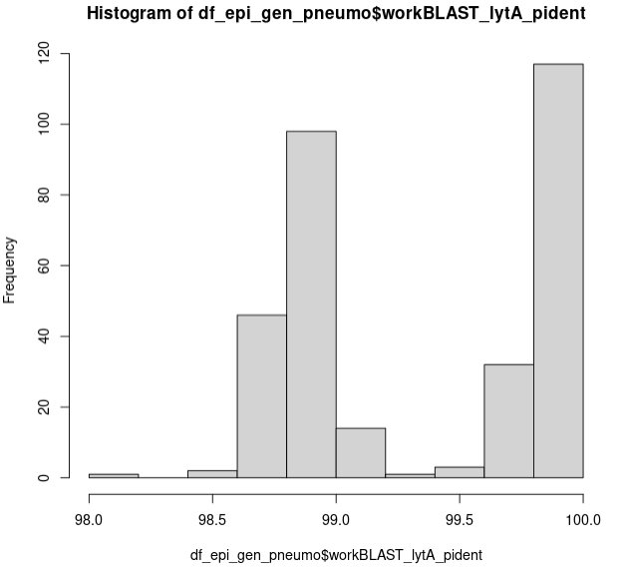
Genomic data
346 samples (161 from Lombok and 153 from Sumbawa) proceeded to WGS analysis.
314 fasta data (91%, 314/345) are considered appropriate for further analysis for tree reconstruction according to genome length (1.9-2.3Mb) and distance QC; I personally re-checked lytA gene for S. pneumoniae species identification.
Genomic analysis
Descriptive analysis for genomic aspects of pneumococcal carriage:
Serotype, GPSC, and ST
PCV13 vaccine type classification
Phylogenetic tree: The core genome of the selected data was annotated using Prokka, extracted and aligned using Panaroo. The tree was reconstructed using RAxML with the GTR+Γ substitution model.

Slide 5
Results

Slide 6
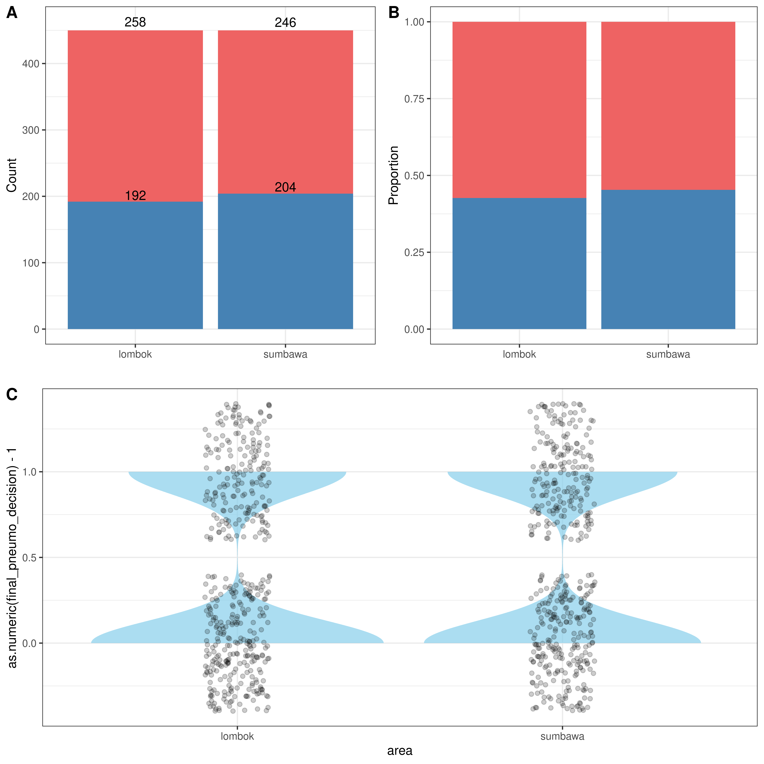
Epidemiological analysis
No statistically significant difference occured among pneumococcal carriage between Lombok and Sumbawa
(χ² = 0.55, p = 0.46).

Slide 7
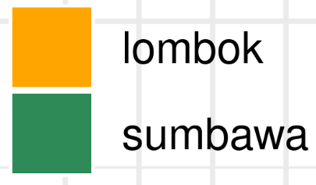
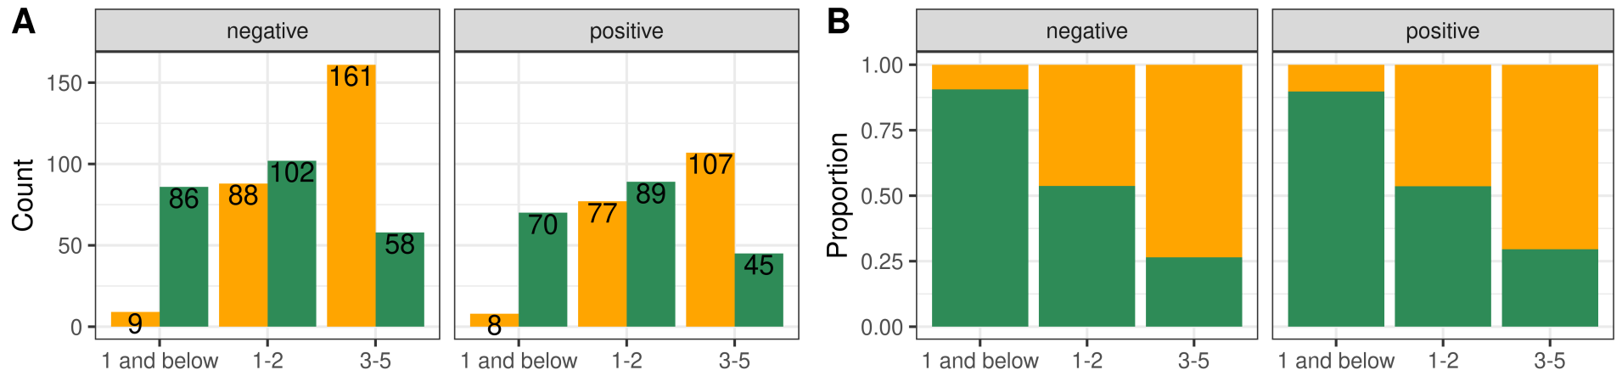
Epidemiological analysis
Among children assessed in Lombok, 3.78% (17/450) were under 1 year of age, with a pneumococcal carriage rate of 47.06% (8/17). In Sumbawa, 34.67% (156/450) of children were under 1 year, with a similar carriage rate of 44.87% (70/156).

Slide 8
Epidemiological Model
Only the presence of at least one respiratory illness in the past 24 hours was significantly associated with increased odds of pneumococcal carriage (adjusted OR = 2.04, 95% CI: 1.39–3.00).
We also tested the final model with area (Lombok and Sumbawa). The addition of area resulted in a minimal improvement in model fit, but did not significantly improve the model (χ²(1) = 0.75, p = 0.387).

Slide 9
Epidemiological Model
Only the presence of at least one respiratory illness in the past 24 hours was significantly associated with increased odds of pneumococcal carriage (adjusted OR = 2.04, 95% CI: 1.39–3.00).
Variable | Value | Model 1 OR (95% CI) | Model 1 p-value | Final model OR (95% CI) | Final model p-value
contact_otherChildren | no (Intercept)
 | yes | 0.6 (0.37-0.98) | 0.04 | 0.71 (0.48-1.05) | 0.09
illness_past24h_cough | no (Intercept)
 | yes | 0.58 (0.32-1.02) | 0.06 | 0.68 (0.4-1.13) | 0.13
illness_past24h_difficulty_compiled | no (Intercept)
 | ≥ 1 respiratory illness | 2.78 (0.97-8.08) | 0.06 | 2.04 (1.39-3) | < 0.001
n_child_1to2yo | (numeric 0-2) | 2.3 (0.98-5.92) | 0.06 | 1.8 (0.81-4.2) | 0.16

Slide 10
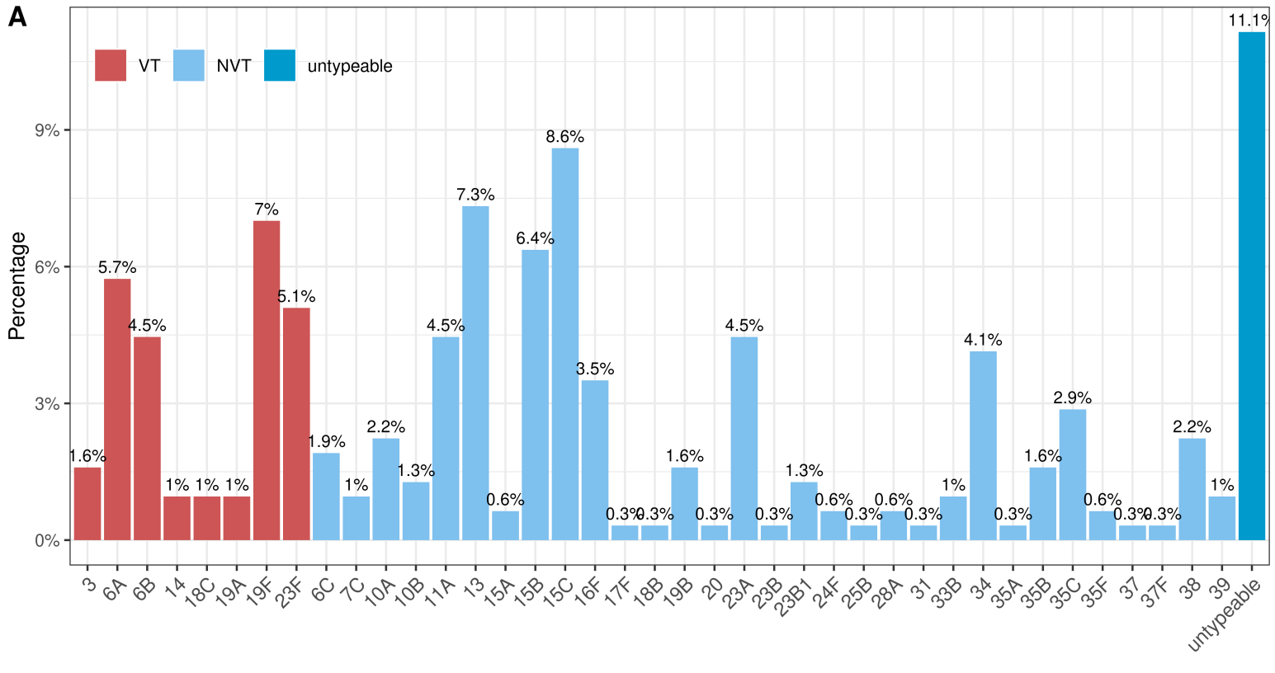
Genomic analysis
Untypeable remained the most dominant "serotype" (11.1%), followed by serotype 15C (8.6%), serotype 13 (7.3%) and 19F (7%)

Slide 11
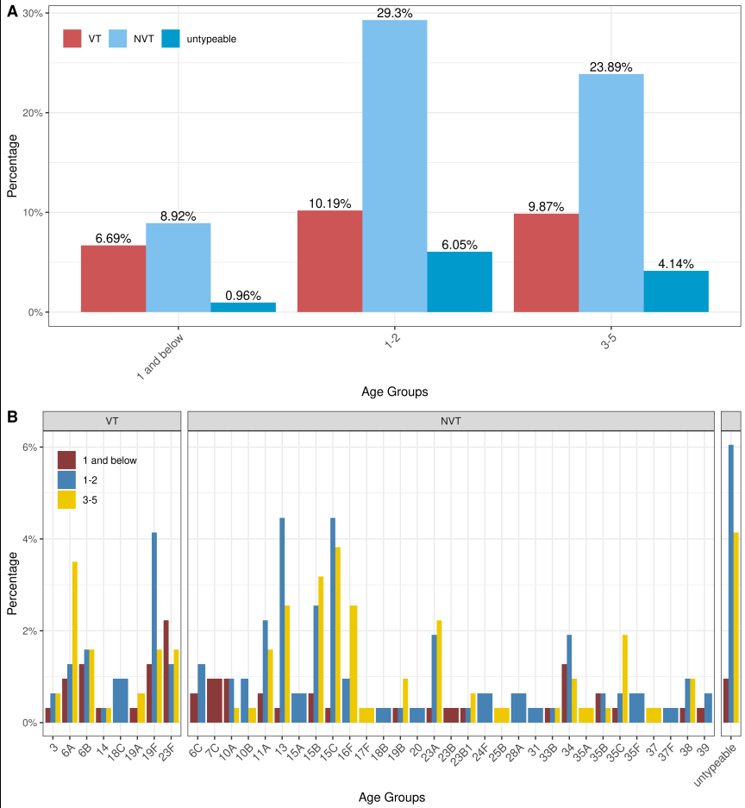
Genomic analysis
Children aged 1–2 years carried pneumococci of both vaccine types (VTs) and non-vaccine types (NVTs).
Serotype shifts occurred in children aged 3–5 years, predominantly involving untypeable strains, 15C, and 6A.

Slide 12
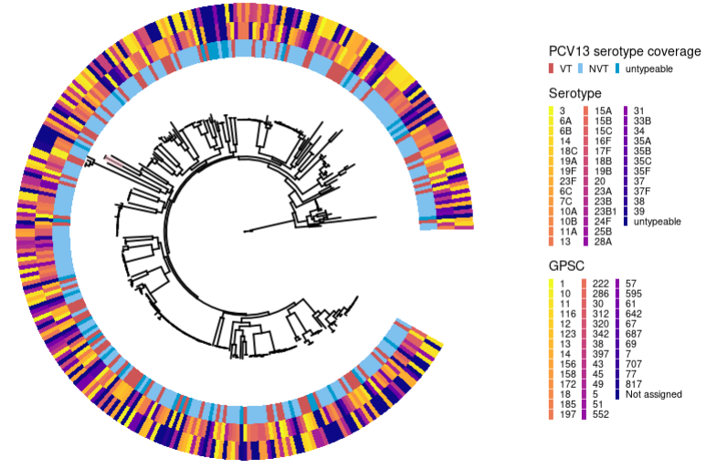
Genomic analysis (serotype & GPSC)
Genomic data are too diverse; no clusters appear in phylogenetic tree.

Slide 13
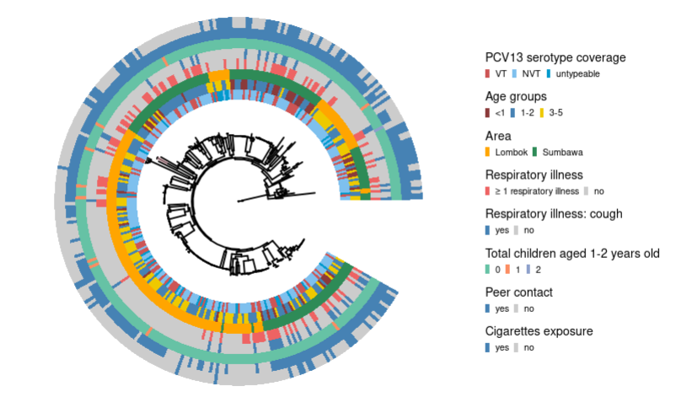
Genomic analysis (epiData)
Genomic data are too diverse; no clusters appear in phylogenetic tree.

Slide 14
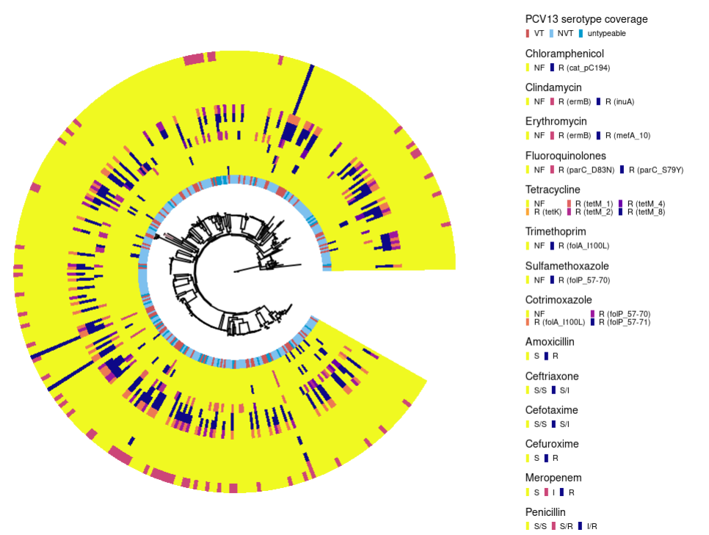
Genomic analysis (AMR)
Genomic data are too diverse; no clusters appear in phylogenetic tree.

