Slide 1
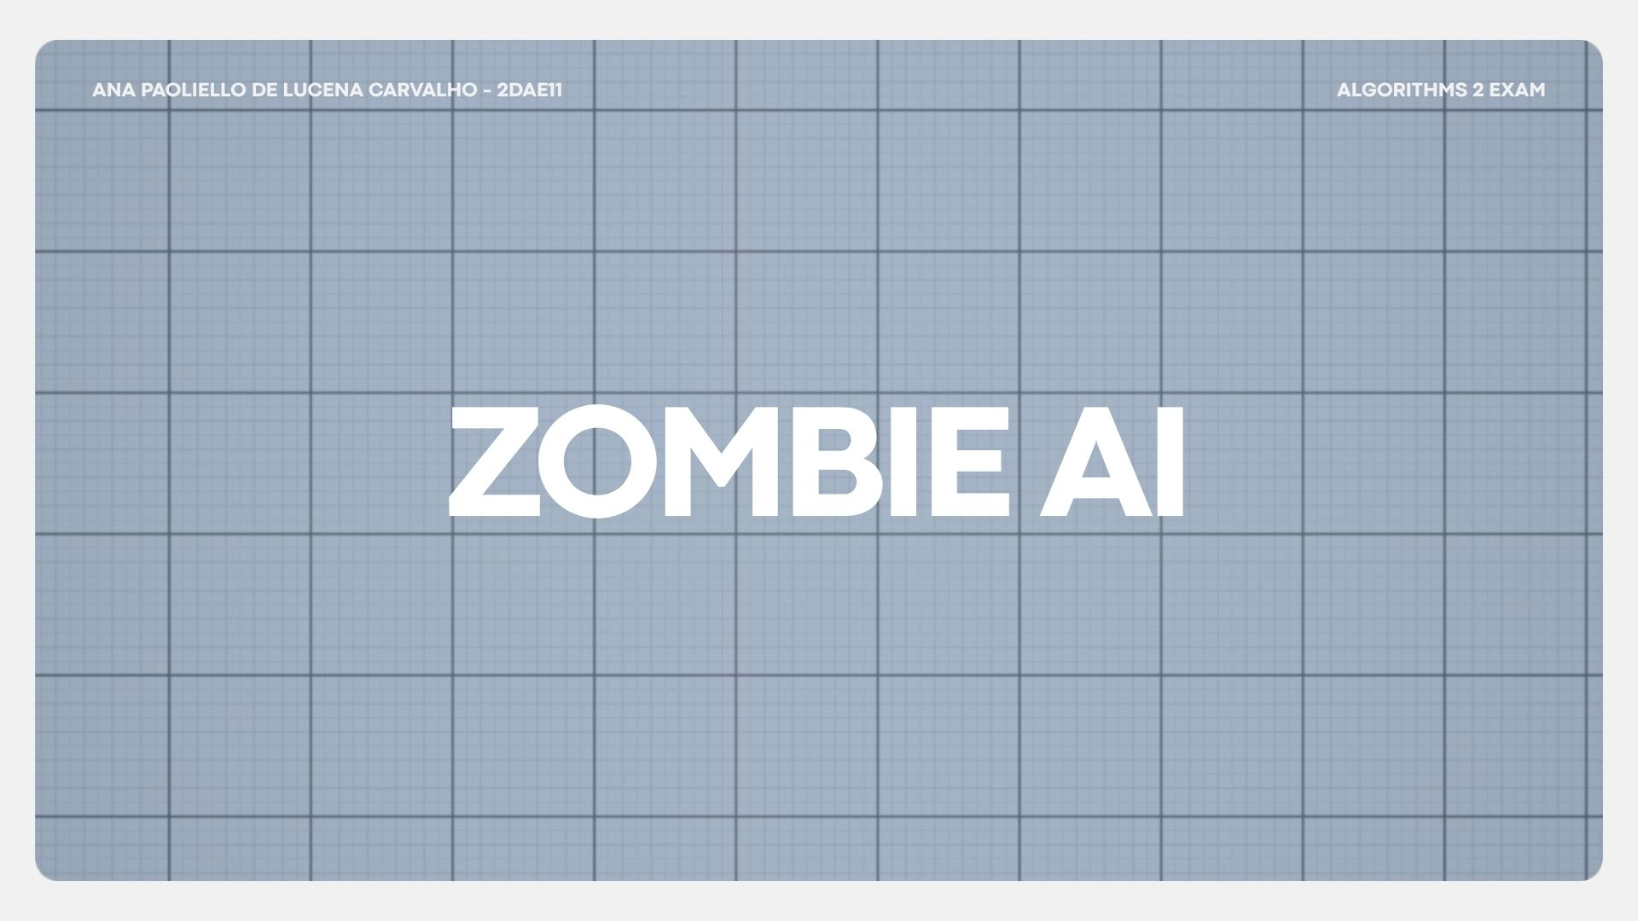

Slide 2
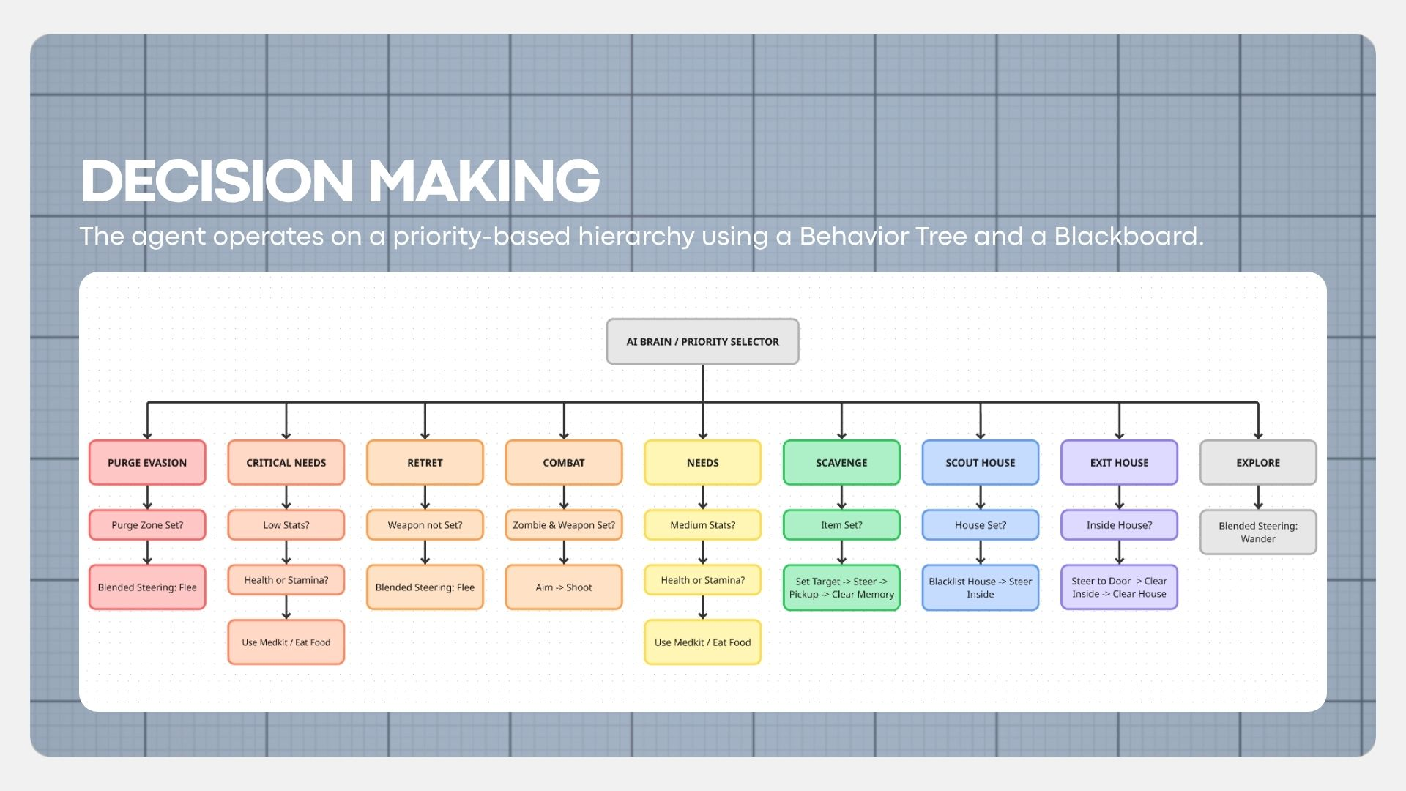

Slide 3
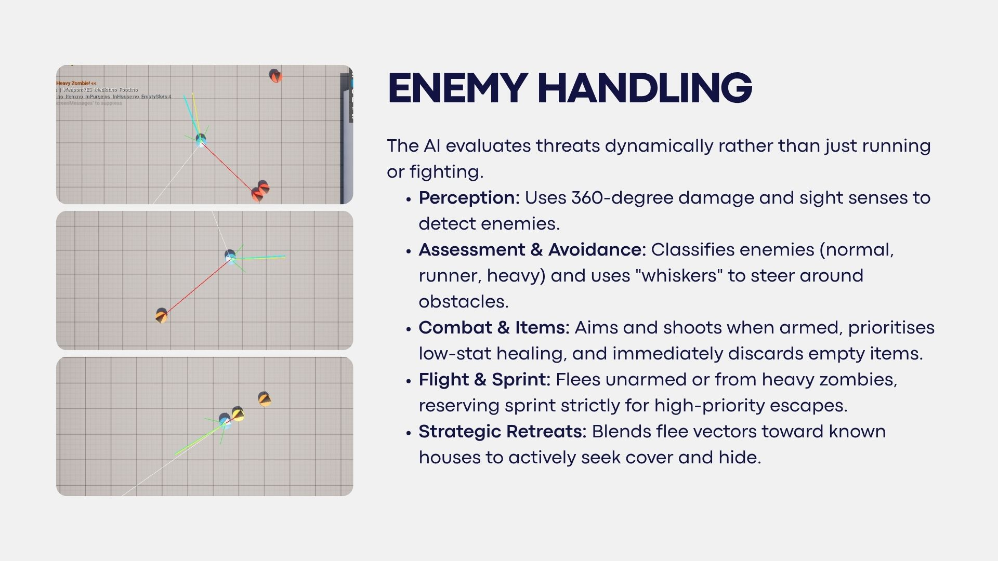
Notes:
How does your agent deal with enemies (aiming, shooting, item usage, avoidance, hiding, usage of sprint, …)? USE IMAGES/GIFS

Slide 4
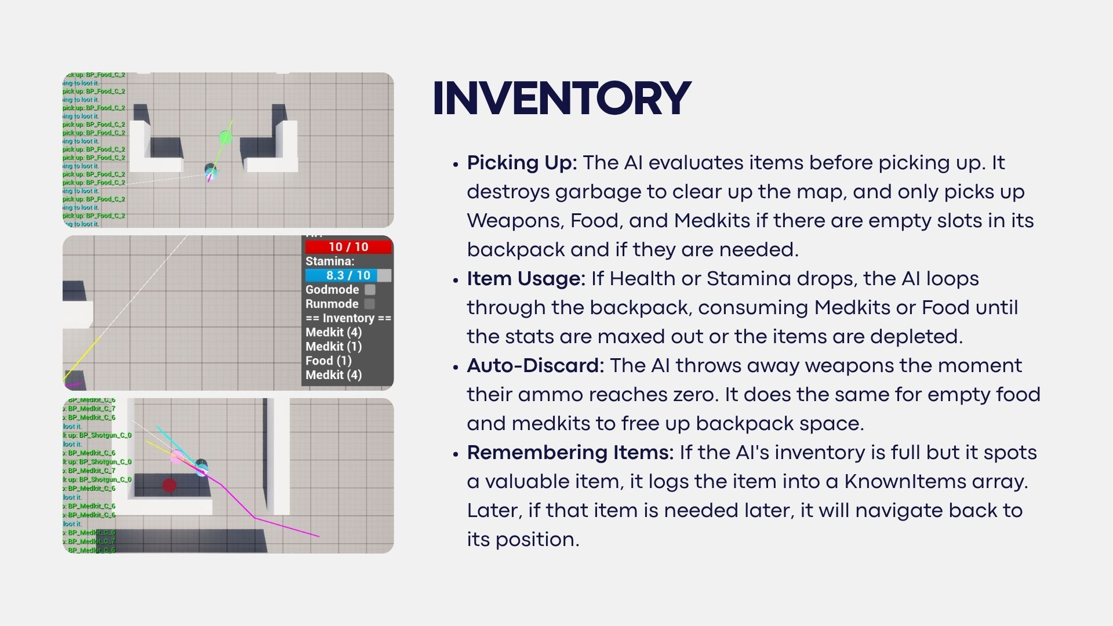
Notes:
How does your agent manage the inventory (inventory organization, item usage, picking up and remembering items,…)?

Slide 5
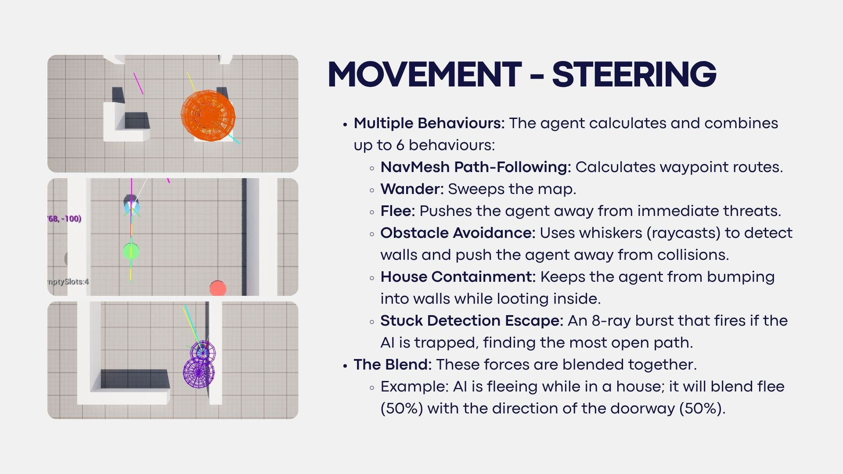
Notes:
How many steering behaviors does it use? Does it use blended steering? Use blended steering even if it works better without

Slide 6
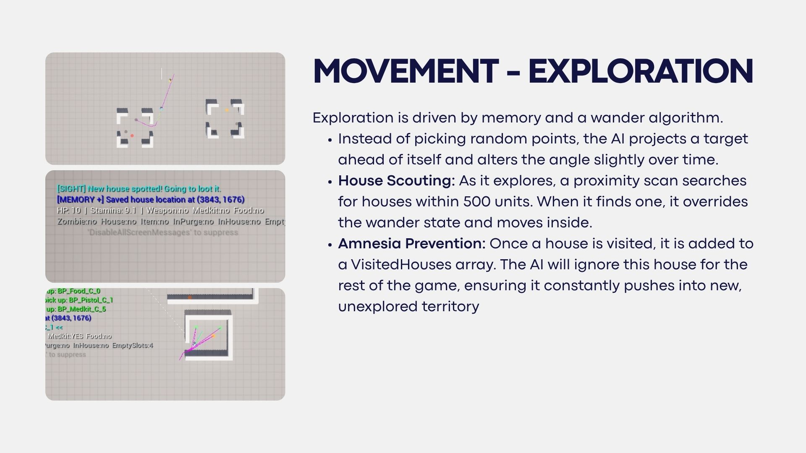
Notes:
How does your agent explore the world ( how does it traverse the world, when and why does it visit houses, does it have a memory?)? USE IMAGES/GIFS

Slide 7
