Slide 1
GPP Exam: Zombie AI
Ayko Acket

Slide 2
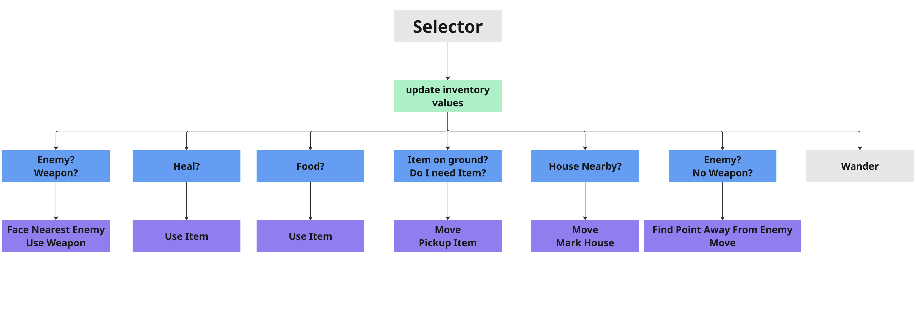
Decision Making

Slide 3
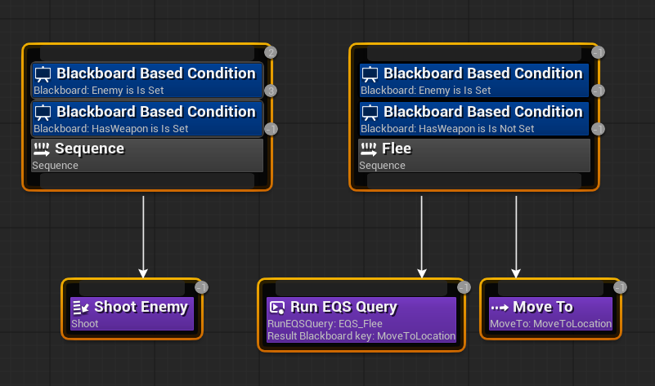
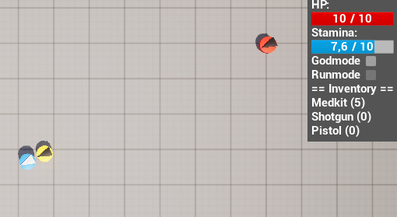
Enemy handling

Slide 4
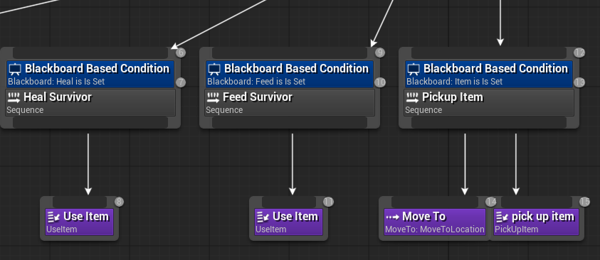
Inventory
It only picks up items if the amount It currently has is less than the new item.
Heals and eats when it goes below half of the max.

Slide 5
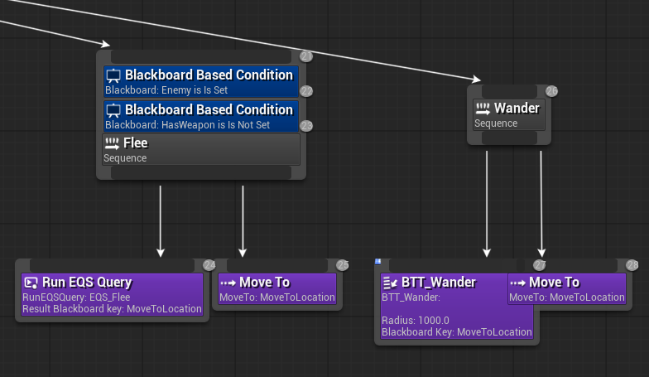
Movement - Steering
Flee
Seek
Wander
face

Slide 6
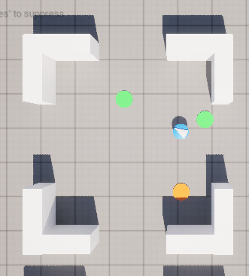
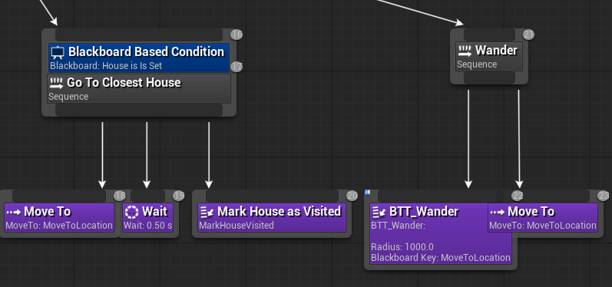
Movement - Exploration

