Slide 1
GPP Exam: Zombie AI
Bauwen De Ron 2DAE19

Slide 2
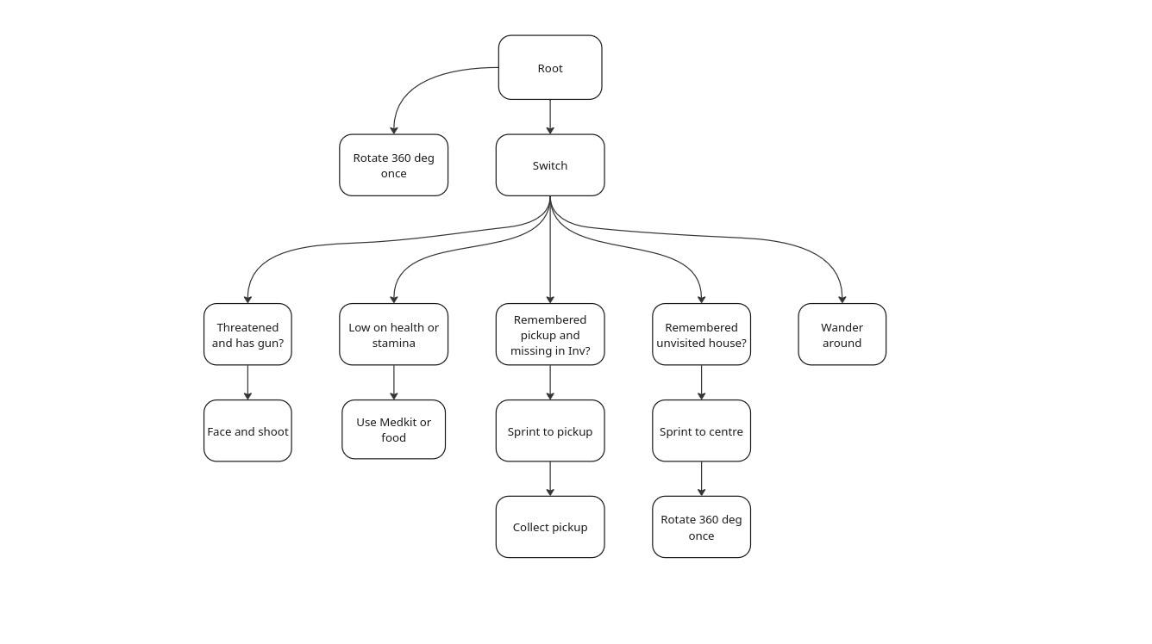
Decision Making

Slide 3
Enemy handling
Each movement tree node also has an evade blended in for each zombie
When a zombie gets too close (500 for shotgun, 800 for pistol) The survivor faces them and then shoots
USE IMAGES/GIFS

Slide 4
Inventory
Each perceived item is remembered (TArray)
Fixed inventory slots (0=medkit, 1=weapon, other=food)
Items are used when health or stamina threshold is reached based on the items value
Items are thrown away after a use when their value is 0

Slide 5
Movement - Steering
Sprint only used when using seek (only when destination is known)
Blended steering using:
Seek (optional)
Wander
Evade (one for each remembered zombie)

Slide 6
Movement - Exploration
All perceived houses are remembered
When no pickups are needed seek the closest unvisited house
When inside spin and add to visited houses
No items and no houses left? Then we just wander around
USE IMAGES/GIFS

