Slide 1
GPP Exam: Zombie AI
Benjamin Looyens

Slide 2
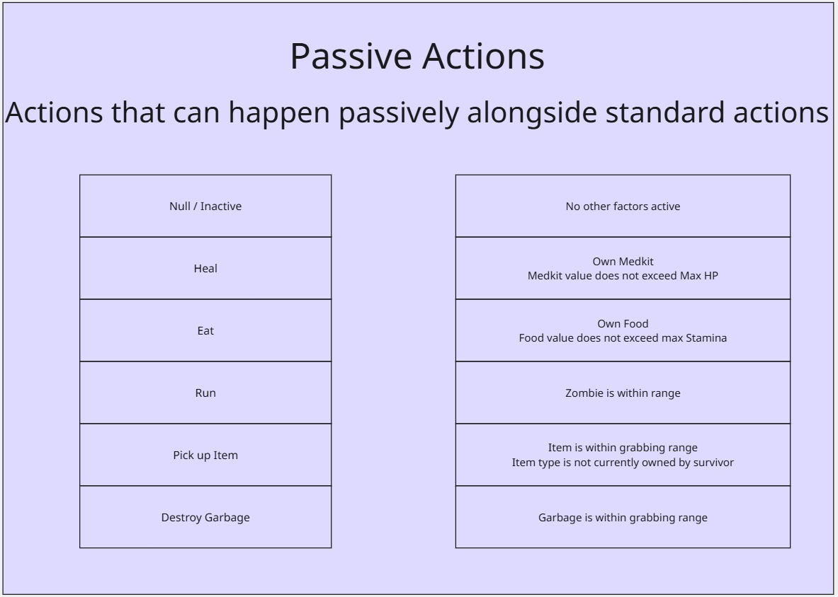
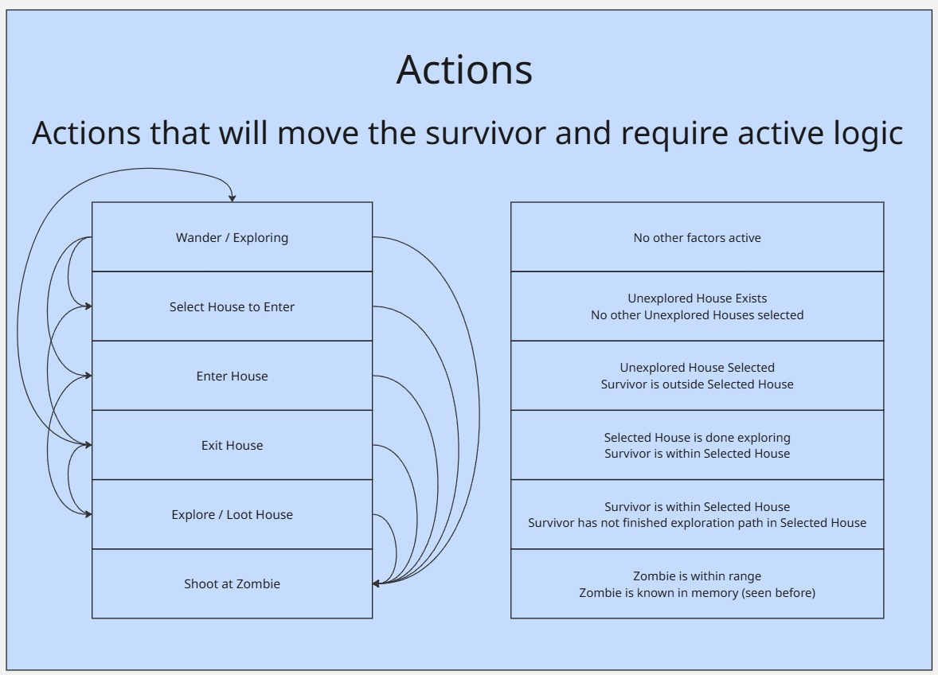
Decision Making

Slide 3
Enemy handling
Will face enemies when they are within specified range
Shoots whenever possible when facing the enemies, prioritizing shotgun when there is more than 1 enemy close
Will activate sprint until enemies are outside of specific range

Slide 4
Inventory
- Will not pick up duplicate items
Stores item in memory linked with house that contains it
If need that item type later, will go back to that house

Slide 5
Movement - Steering
Path Follow Behavior
Blended Steering (Wander + Path Follow)

Slide 6
Movement - Exploration
Randomly generate a point within a circle centered on spawn, path finds to this location
Randomly generated location is weighted to not be in similar locations repeatedly
When detecting a house, explore it and note down the items
Will return to explored house if it needs an item from it

