Slide 1
GPP Exam: Zombie AI
by Birgen Danneels

Slide 2
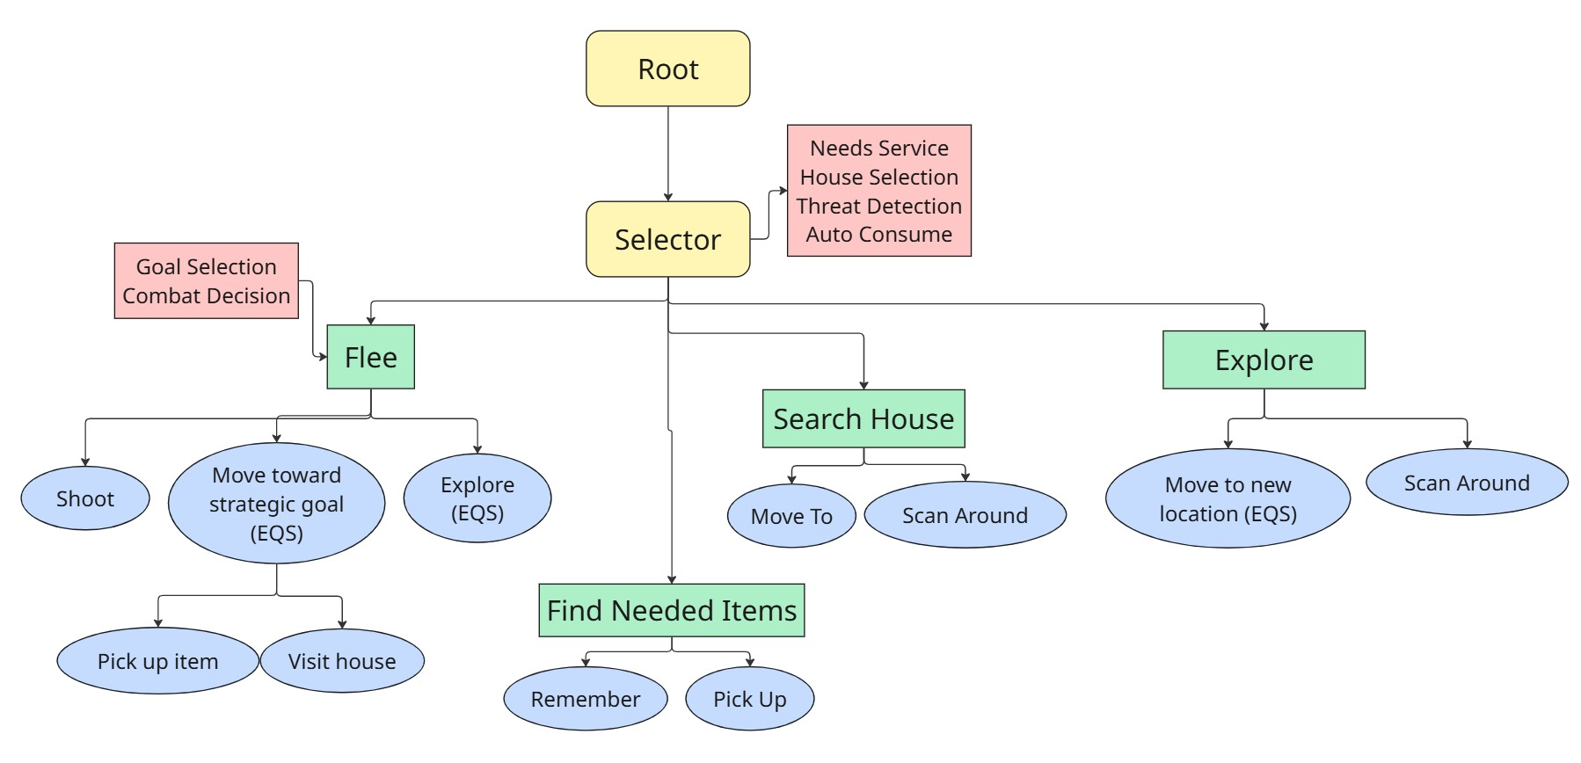
Decision Making

Slide 3
Enemy handling
Remembered for 5 seconds + checks flank
Service updates flee state
Service selects weapon and target enemy
If enemies close -> walk/sprint away and shoot
Flee location decided by EQS

Slide 4
Inventory
Remembers previously seen loot
Service evaluates needed items
Pick up closest needed item
Can discard garbage

Slide 5
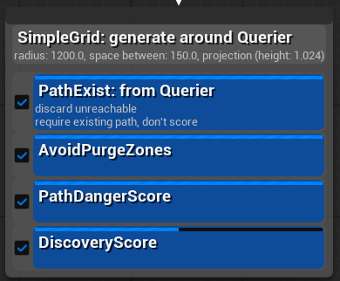
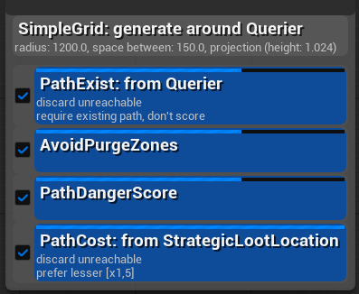
Movement - Steering
3 specialized EQS queries
Path validation
Zombie-aware path scoring
Purge zone avoidance
Goal-biased movement
Move To execution

Slide 6
Movement - Exploration
Grid-based frontier exploration
Remembers all seen houses
Visits houses when no needed item is in memory

