Slide 1
GPP Exam: Zombie AI
Cosmo Verstraeten

Slide 2
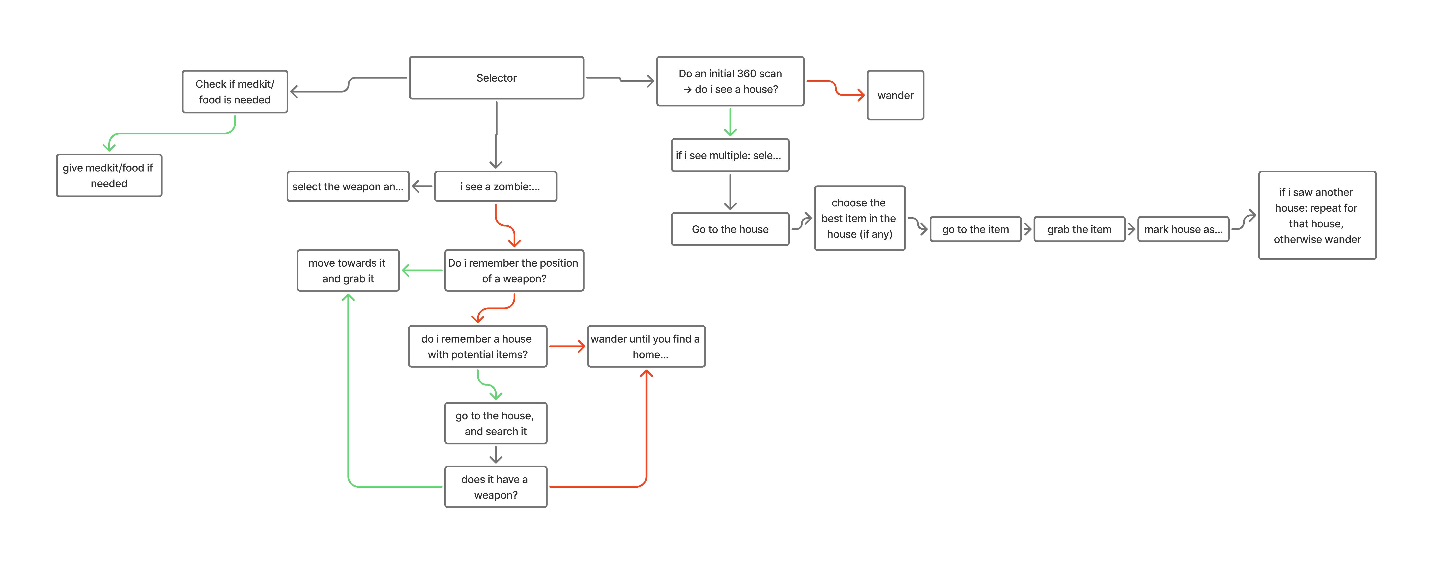
Decision Making

Slide 3
Enemy handling
In practice the enemy part is a bit brokem

Slide 4
Inventory
If there is space garbage gets taken and removed instantly
Each item gets a score, based on that is decided if it is taken
Score is calculated based on need calculations
For example if you are low health medkits get a boost in score
Or if you already have a lot of food, food loses score
If there is an item with a better score available the item with the lowest score is replaced

Slide 5
Movement - Steering
It uses the provided Calculate path primarily that uses navmesh
It manually turns the Survivor
Has Flee + Seek Blended steering

Slide 6
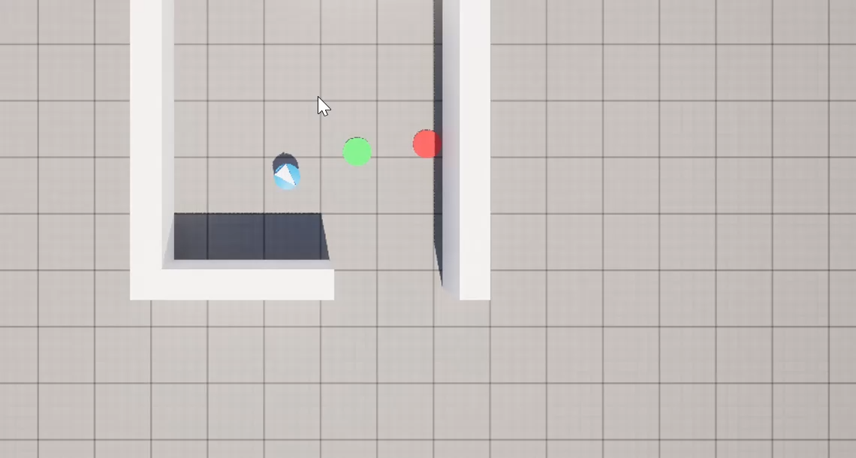
Movement - Exploration
It has a memory of already visited houses
Moves to houses and then Items
Otherwise wanders around the world

